Slide 1
Building an AI Assistant from Scratch Agents, MCP
Themistoklis Diamantopoulos, Dimitrios-Nikitas Nastos, Athanasios Michailoudis
Intelligent Systems & Software Engineering Labgroup
Electrical and Computer Engineering Dept. Aristotle University of Thessaloniki, Greece
EESTEC LC Thessaloniki
Artificial Intelligence Symposium

Slide 2
Contents
Part 1: Understanding the AI Stack
Part 2: Build Your Own Assistant
Part 3: A real use case – The ECO-READY AI Assistant

Slide 3
Part 1: Understanding the AI Stack

Slide 4
Why Are Modern LLMs Limited?
Even the most capable LLMs have hard constraints:
❌ Cannot access live systems or real-time data
❌ Cannot reliably execute workflows
❌ Forget every conversation (no memory by default)
❌ Hallucinate facts when uncertain
❌ Cannot safely operate enterprise software

Slide 5
The Evolution of AI systems
Phase 1
Prompt Engineering
Phase 2
RAG
Phase 3
Agents + MCP
LLM answers questions
LLM accesses knowledge
LLM takes actions
Phase 1: User → LLM → Response Phase 2: User → LLM + Documents → Grounded Response Phase 3: User → Agent → Plan → Tools → Iterate → Result

Slide 6
Phase 1: The Prompt Engineering Era
Characteristics:
Static training knowledge (knowledge cutoff date)
Single-shot interactions
No memory between sessions
No tools, no external actions
Mostly “extremely smart autocomplete”
Result: Great for drafting, summarizing, Q&A
Limitation: Knows nothing about your world, right now
Just ask the model
User → LLM → Response

Slide 7
Phase 2: RAG (Retrieval Augmented Generation)
The Problem: LLMs do not know your data
The Solution: Give them access to documents at runtime
RAG made LLMs:
More factual
More production-ready
Up-to-date without retraining
User question ↓ Retriever searches vector DB ↓ Relevant document chunks
injected into prompt ↓ LLM reasons over YOUR data ↓ Grounded, factual answer

Slide 8
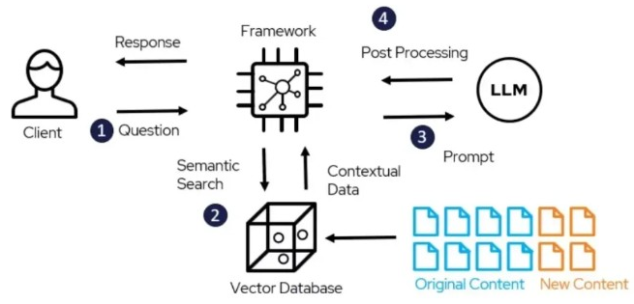
RAG Architecture
Indexing:
Documents → Chunking → Embedding model → Vector DB
Popular vector stores:
ChromaDB, Pinecone, pgvector, FAISS
User question ↓ Retriever searches vector DB ↓ Relevant document chunks
injected into prompt ↓ LLM reasons over YOUR data ↓ Grounded, factual answer
Source: https://deepchecks.com/glossary/rag-architecture/

Slide 9
But RAG is not enough
RAG helps AI KNOW but not DO
An LLM can read a Jira ticket, but it cannot:
Create one
Update its status
Trigger a CI/CD pipeline
Send a Slack notification
Coordinate across multiple systems
RAG = better librarian – Agent = actual entity who gets things done

Slide 10
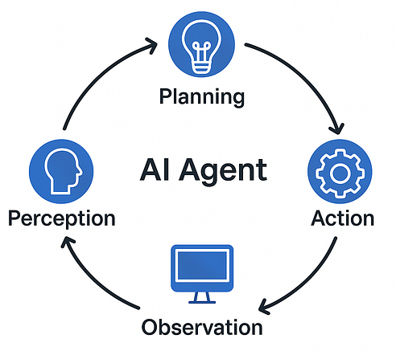
Phase 3: AI Agents
The paradigm shift:
Before:
Question → Answer
After (Agents):
Goal → Plan → Actions → Observe → Iterate → Done
An Agent is an LLM that decides what to do based on what it observes. It can call tools, check results, and even try again autonomously.
Source: AI Agents Explained (Medium)

Slide 11

What is an Agent?
An AI Agent is a system that can:
🎯 Understand and decompose goals
🧠 Reason about the next best action
🔧 Use tools to interact with the world
👁️ Observe results and adapt
🔁 Retry when something fails
✅ Coordinate complex multi-step workflows autonomously
The key word: autonomy: the LLM decides when to stop and what to do next

Slide 12

Chatbot vs Agent
Capability
Answers questions
Completes goals
Has persistent memory
Uses tools & APIs
Multi-step workflows
Autonomous decisions
Can fail and retry
Chatbot
✓
×
×
×
×
×
×
AI Agent
✓
✓
✓
✓
✓
✓
✓

Slide 13
Agent Usage Example
User says: “Prepare the weekly sales report and notify the team”
What the agent does autonomously:
🗄️ Query sales database for this week’s data
📄 Retrieve the standard report template
📊 Generate charts and figures
🤖 Write the executive summary
💬 Post “Report ready” to Slack
📧 Email PDF to the management list
So the only challenge is to integrate these services with the agent

Slide 14
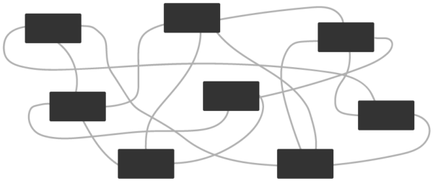
The Integration Problem (Before MCP)
Agents need tools. Before MCP, every integration was custom-built.
5 AI Apps × 10 APIs = 50 custom integrations
Each one required:
❌ Unique authentication logic per API
❌ Custom data format parsing
❌ Breaks when the API changes
❌ Cannot be reused across different LLMs or frameworks

Slide 15

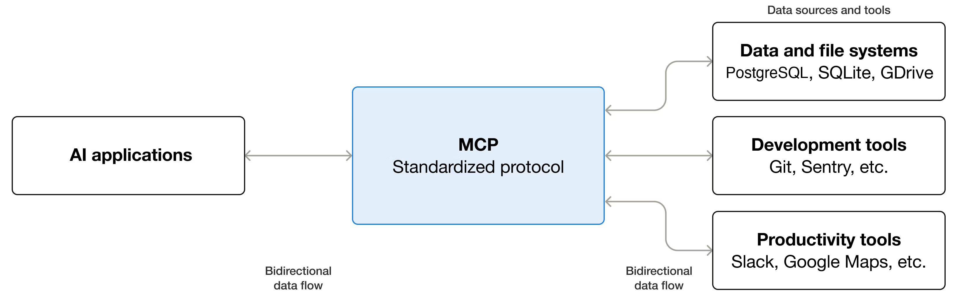
Model Context Protocol (MCP)
Created by Anthropic in 2024, now an open standard
Standardizes how AI connects to tools and systems
Like a USB-C for AI
Write an MCP server → works with any LLM, any framework
Source: modelcontextprotocol.io

Slide 16
What MCP offers
MCP is a runtime protocol, not just a spec
Capability | Description
Tool discovery | LLM learns what tools exist at runtime
Tool invocation | Standard call/response format
Context sharing | Pass structured data between agent and tools
Structured responses | Consistent, typed output
Permissions | What the agent is allowed to do
Interoperability | Any LLM + any tool + any server

Slide 17
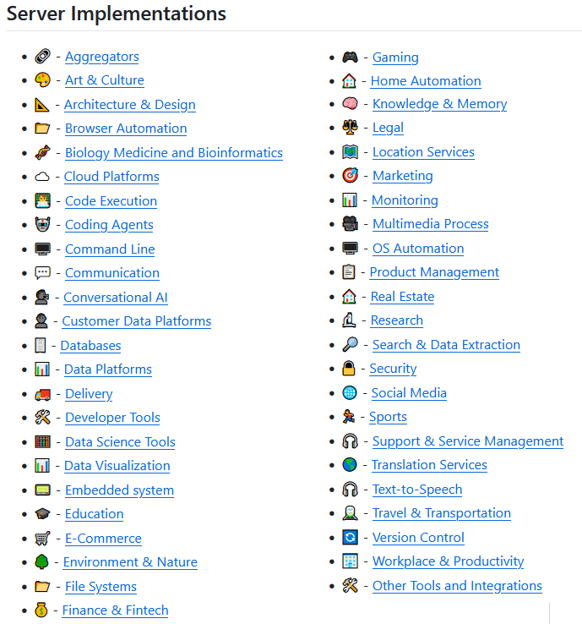
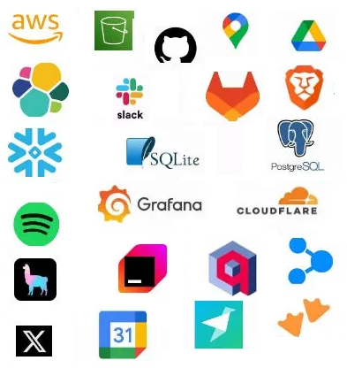
Existing MCP servers
Source: awesome-mcp-servers on GitHub

Slide 18
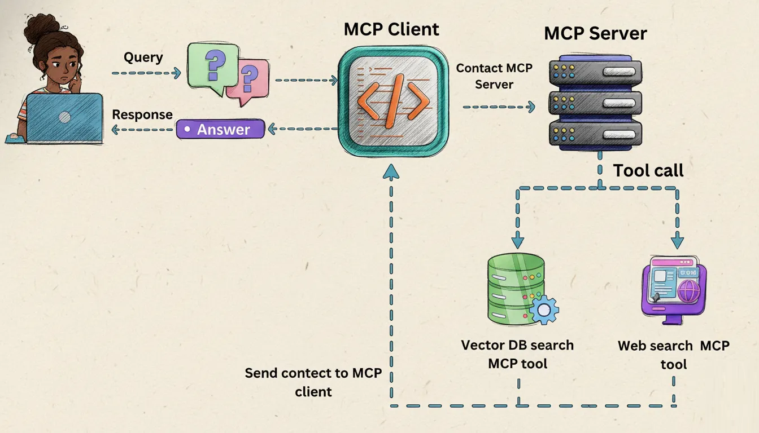
What about RAG using MCP?
Expose DBs/documents as resources
RAG as MCP Tool
Expose semantic lookup functions (e.g. search_vector_db(query))
Let LLM dynamically decide when to run searches and fetch precise text chunks
Other knowledge collection tools are possible to connect, e.g. web search!
Key Benefits
Universal Client Connectivity: Build your RAG server once; use it across AI applications
Token Efficiency: Pull only relevant semantic chunks
Flexibility: Allow the model to autonomously choose when it needs external knowledge
Source: MCP-Powered Agentic RAG (Medium)

Slide 19
Part 2: Build Your Own Assistant

Slide 20
HANDS-ON WORKSHOP
The 5-Phase Progression Map
Our Journey Roadmap: Evolving from simple API connections to full autonomous agency.
PHASE 1
Stateless Connection
Problem: Stateless APIs Solution: Compiling local message history arrays
PHASE 2
Instant Streaming
Problem: High latency pauses Solution: Yielding token chunks for immediate feedback
PHASE 3
Conversational Web UI
Problem: Dark console text Solution: Transitioning to Chainlit async session bubbles
PHASE 4
Local MCP Tools
Problem: Static AI isolation Solution: Exposing coordinates, weather, and travel logs
PHASE 5
Resilient Parallel Agent
Problem: Slow & fragile loops Solution: Concurrent execution, self-correction, & collapsible runs

Slide 21
HANDS-ON WORKSHOP
Phase 1: The CLI Chatbot (main1.py)
• The Stateless Challenge
LLM APIs are fundamentally stateless. They do not remember previous interactions. Every prompt is a brand-new, isolated request.
• Architectural Solution
We maintain conversation memory client-side using structured LangChain message arrays: • SystemMessage: Sets behavioral boundaries • HumanMessage: Represents the user input • AIMessage: Stores the model response
• Compiling History
On every turn, we append user text to the list, invoke the model (`invoke()`), print the reply, and append it back to context.
💻 main1.py (Core Loop)
messages = [SystemMessage(content=prompt)] while True: user_input = input("\nYou: ") if user_input.lower() in ["exit"]: break # Append new user interaction messages.append(HumanMessage(content=user_input)) # Blocking invoke execution response = aimodel.invoke(messages) print(f"\nAI: {response.content}") # Save response in context memory messages.append(response)

Slide 22
HANDS-ON WORKSHOP
Phase 2: CLI with Streaming (main2.py)
• The Latency UX Bottleneck
Waiting for a complete 200+ word model response creates a long, unnatural pause of 10+ seconds, causing high user drop-off.
• Generator Paradigm Shift
Instead of a single blocking API payload, the server starts yielding individual token chunks the moment they are generated.
• Implementing stream()
We swap `.invoke()` with `.stream()`, iterating over incoming chunks and flushing characters immediately to the console.
💻 main2.py (Streaming)
print("AI: ", end="", flush=True) full_response = "" # Iterate token chunks dynamically for chunk in aimodel.stream(messages): content = chunk.content # Flush immediately to console print(content, end="", flush=True) full_response += content print() # Save complete response messages.append( AIMessage(content=full_response) )

Slide 23
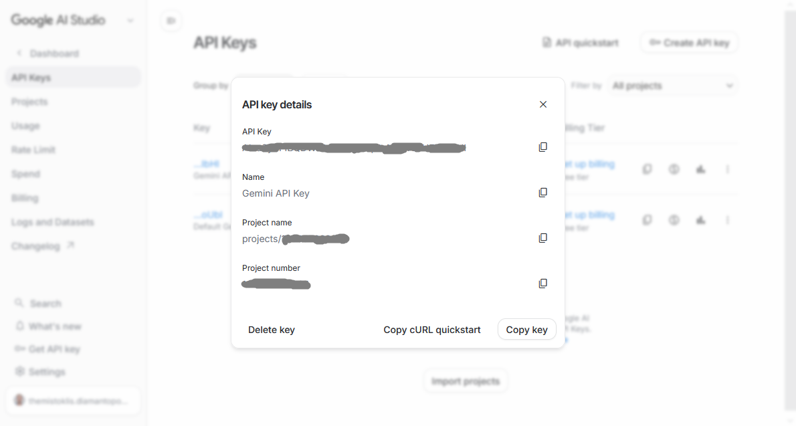
HANDS-ON WORKSHOP
Phase 3: Moving to a Web UI (main3_chainlit.py)
• Moving to the Browser
Transitioning from a text console to a beautiful browser-based UI is the key to creating production-ready consumer applications.
• Conversational Framework
We leverage Chainlit, an async web framework designed specifically for conversational UIs, avoiding generic page-reload overheads.
• Async Lifecycle Hooks
Uses event-driven callbacks for non-blocking UI updates: • `@cl.on_chat_start`: Configures session prompt state • `@cl.on_message`: Streams response bubbles asynchronously
💻 main3_chainlit.py (Web Setup)
@cl.on_message async def on_message(message: cl.Message): history = cl.user_session.get("messages") history.append(HumanMessage(content=message.content)) assistant_msg = cl.Message(content="") await assistant_msg.send() # Stream response chunks asynchronously full_response = "" async for chunk in aimodel.astream(history): content = chunk.content if isinstance(content, str): full_response += content await assistant_msg.stream_token(content) await assistant_msg.update() history.append(AIMessage(content=full_response))

Slide 24
THE ARCHITECTURE STANDARD
Model Context Protocol (MCP)
• The Integration Dilemma
Before MCP, connecting an LLM to new tools required custom, brittle integration scripts that broke whenever APIs updated.
• The Standard: 'USB-C' for AI
An open protocol standard that standardizes how LLM applications securely connect to data sources, files, and local execution tools.
• Dynamic Schema Discovery
The LLM acts as a universal client. At runtime, it dynamically queries the MCP server, learns available tools, and binds them to its engine.

Slide 25

HANDS-ON WORKSHOP
Phase 4: Exposing Local Tools via MCP
• Empowering the LLM with Tools
We build a lightweight FastMCP server (`mcpserver.py`) exposing custom python utilities that the LLM discovers at runtime.
• Baseline Tools: math & system time
Includes exactly 2 simple tools (`add_numbers` and `get_time`) to easily verify clean tool integration without external API calls.
• Modular Examples & Sandbox
Includes modular servers (Weather geocoding, journal notes, advanced developer tools) and an interactive editing sandbox inside Colab!
💻 mcpserver.py
from fastmcp import FastMCP from datetime import datetime mcp = FastMCP("MyAssistantTools") @mcp.tool() def add_numbers(a: int, b: int) -> int: """ Add two numbers together. """ return a + b @mcp.tool() def get_time() -> dict: """ Returns active system time. """ dt = datetime.now().astimezone() return {"time": dt.strftime("%H:%M:%S")} if __name__ == "__main__": mcp.run(transport="http", port=8001)

Slide 26
AGENT ORCHESTRATION
The Mechanics of the Agentic Loop
• Linear Chains vs. Agent Loops
Standard chains flow straight from input to output. Agents require a dynamic reasoning loop: LLM decides, executes tools, and reviews outcomes.
• 1. Interception Protocol
When the LLM needs facts, it returns a structured list of tool calls containing arguments, halting verbal text rendering.
• 2. Local Python Execution
The client runtime intercepts the call, halts output, runs the designated Python tools locally, and injects results as `ToolMessage` context.
• 3. Grounded Verbalization
The LLM is re-invoked with the new facts, reasons over the history, and verbalizes a correct, verified final answer to the user.

Slide 27
HANDS-ON WORKSHOP
Phase 5: Resilient Parallel Agent
• Asynchronous Concurrency
Sequential tool execution is slow. We use `asyncio.gather()` to execute all requested tool calls in parallel, dropping latencies by 60%+.
• Exception Feedback Loop
If a tool fails, we wrap the execution in a `try-except` block and feed the traceback back to the LLM. The LLM reads the error and self-corrects without crashing.
• Native Visual Traces
We integrate Chainlit's `cl.Step` to automatically render tool inputs, runtimes, and outputs dynamically under collapsible UI bubbles.
💻 main4_agent_chainlit.py
while response.tool_calls: messages.append(response) # Spawn concurrent execution tasks tasks = [ run_single_tool(tc, tool_map) for tc in response.tool_calls ] # Parallel execution speed offense! tool_results = await asyncio.gather(*tasks) for result_msg in tool_results: messages.append(result_msg) # Re-invoke LLM with grounded facts response = await bound_model.ainvoke(messages)

Slide 28
EESTEC LC THESSALONIKI | ARTIFICIAL INTELLIGENCE SYMPOSIUM
Thank You!
Themistoklis Diamantopoulos
thdiaman@issel.ee.auth.gr
Intelligent Systems & Software Engineering Lab (ISSEL) Electrical and Computer Engineering Dept., Aristotle University of Thessaloniki, Greece

