Slide 1
Computer Systems for Data Science COMS 4121, Spring 2015
Lecture 10: Pig Wrapper Up and Introduction to Spark
Instructors:
Li Erran Li
http://www.cs.columbia.edu/~lierranli/

Slide 2
Outline
Review of Previous Lecture: Pig
Official website:http://pig.apache.org/docs/r0.14.0/start.html
Spark

Slide 3
Review of Previous Lecture
What is Pig?
An open-source high-level dataflow system
Provides a simple language for queries and data manipulation, Pig Latin, that is compiled into map-reduce jobs that are run on Hadoop
Pig Latin combines the high-level data manipulation constructs of SQL with the procedural programming of map-reduce
Sweet Spot: Take the best of both SQL and Map-Reduce; combine high-level declarative querying with low-level procedural programming…Pig Latin!

Slide 4
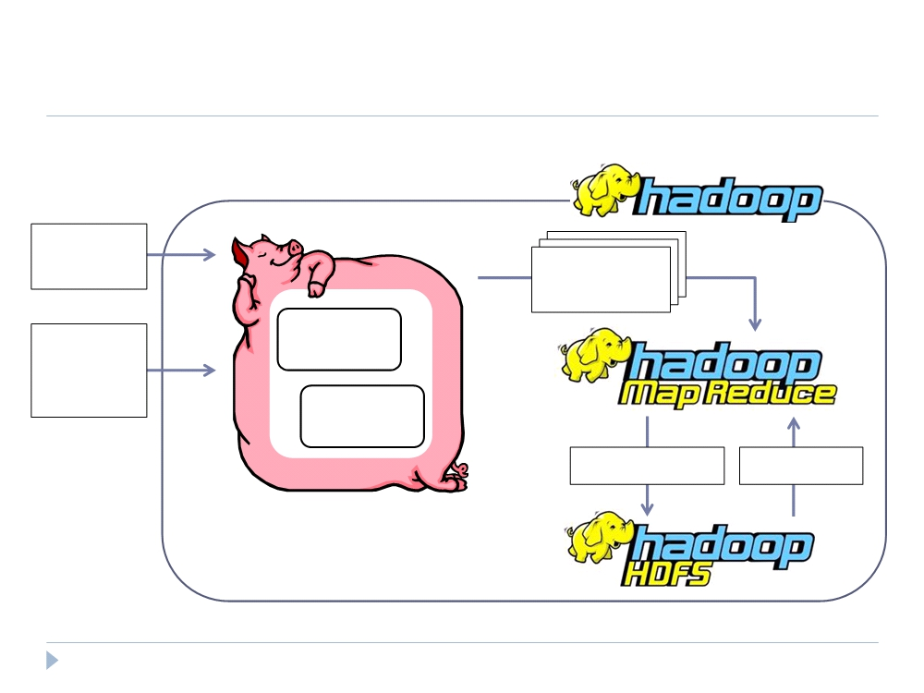
Review of Previous Lecture
What is Pig’s system architecture?
Pig
Pig Latin Script
Map-Reduce Statements
User-
Compile
Defined
Functions
Optimize
Write Results Read Data

Slide 5
Review of Previous Lecture
Command: pig –x local runs the shell locally
In-depth look of word count example
A = load '$input'; --default load function, tab-delimited file
B = foreach A generate flatten(TOKENIZE((chararray)$0)) as word;
C = group B by word;
D = foreach C generate COUNT(B), group;
store D into '$output';
Command: describe shows the schema of a relation
Command: explain shows logical plan, physical plan and map reduce plan
Command: illustrate runs script with a sample of data

Slide 6
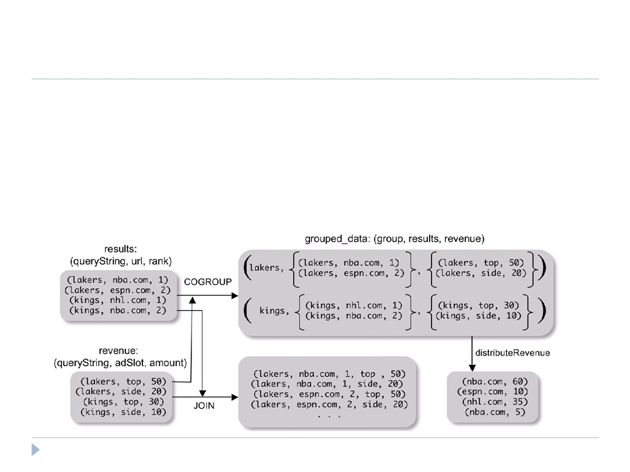
Review of Previous Lecture
COGROUP
Group two datasets together by a common attribute Groups data into nested bags
grouped_data = COGROUP results BY queryString, revenue BY queryString;

Slide 7
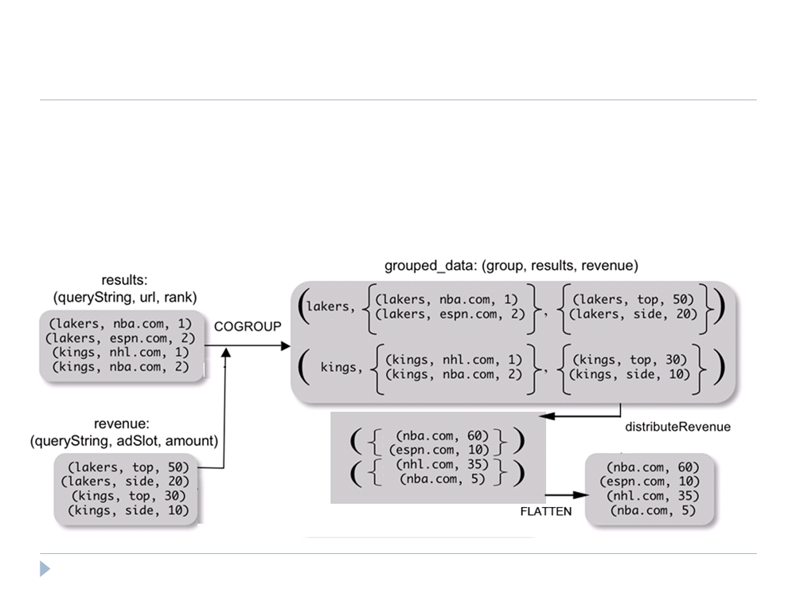
Review of Previous Lecture
Why COGROUP and not JOIN?
url_revenues =
FOREACH grouped_data GENERATE
FLATTEN(distributeRev(results, revenue));

Slide 8
Review of Previous Lecture
Why COGROUP and not JOIN?
May want to process nested bags of tuples before taking the cross product.
Keeps to the goal of a single high-level data transformation per pig-latin statement.
However, JOIN keyword is still available:
JOIN results BY queryString, revenue BY queryString;
Equivalent
temp = COGROUP results BY queryString, revenue BY queryString;
join_result = FOREACH temp GENERATE
FLATTEN(results), FLATTEN(revenue);
22

Slide 9
Review of Previous Lecture
Pig system does two tasks:
Builds a Logical Plan from a Pig Latin script
Supports execution platform independence
No processing of data performed at this stage
Compiles the Logical Plan to a Physical Plan and Executes
Convert the Logical Plan into a series of Map-Reduce statements to be executed (in this case) by Hadoop Map-Reduce

Slide 10

Review of Previous Lecture
Building a Logical Plan Example
A = LOAD ‘user.dat’ AS (name, age, city);
Load(user.dat)
B = GROUP A BY city;
C = FOREACH B GENERATE group AS city, COUNT(A);
D = FILTER C BY city IS ‘San Francisco’ OR city IS ‘NYC’;
STORE D INTO ‘local_user_count.dat’;

Slide 11
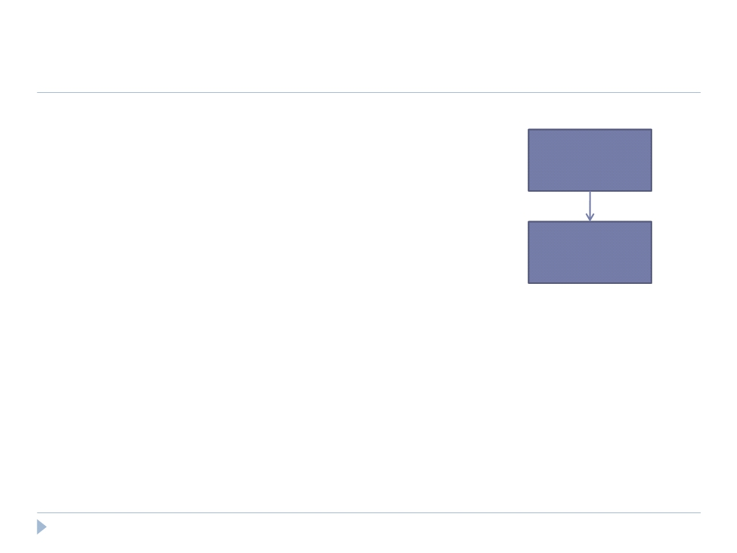
Review of Previous Lecture
Building a Logical Plan Example
A = LOAD ‘user.dat’ AS (name, age, city);
Load(user.dat)
B = GROUP A BY city;
C = FOREACH B GENERATE group AS city, COUNT(A);
D = FILTER C BY city IS ‘San Francisco’
Group
OR city IS ‘NYC’;
STORE D INTO ‘local_user_count.dat’;

Slide 12
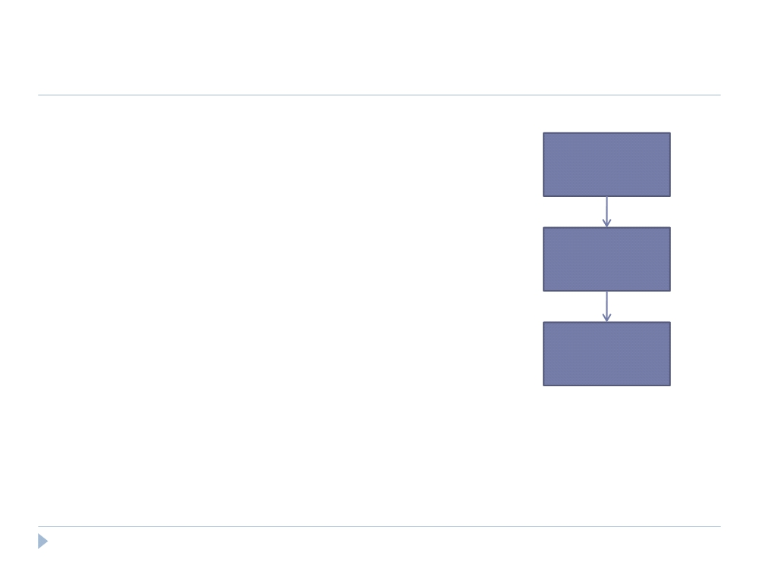
Review of Previous Lecture
Building a Logical Plan Example
A = LOAD ‘user.dat’ AS (name, age, city);
Load(user.dat)
B = GROUP A BY city;
C = FOREACH B GENERATE group AS city, COUNT(A);
D = FILTER C BY city IS ‘San Francisco’
Group
OR city IS ‘NYC’;
STORE D INTO ‘local_user_count.dat’;
Foreach

Slide 13
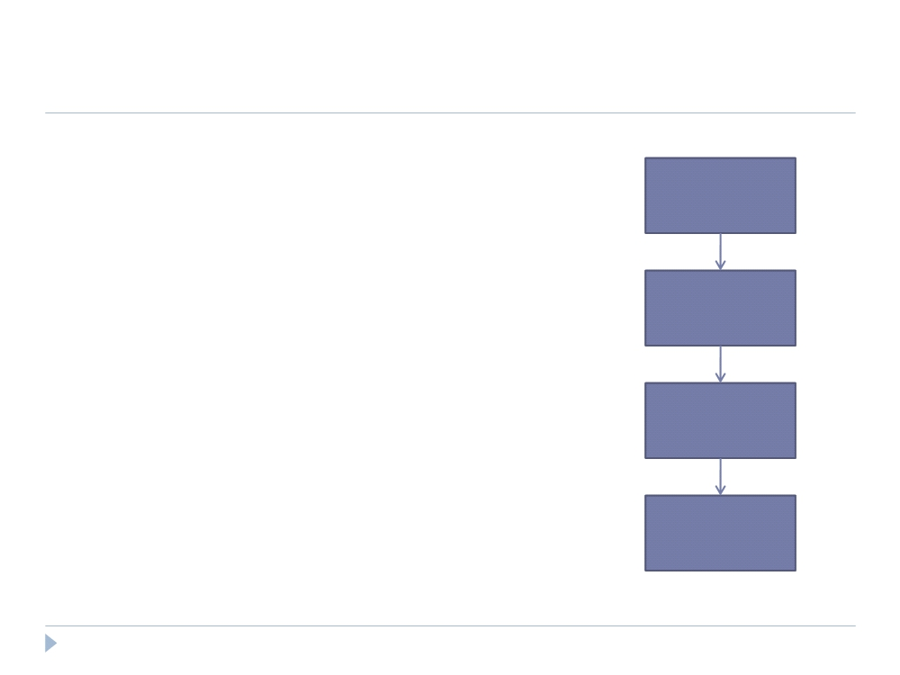
Review of Previous Lecture
Building a Logical Plan Example
A = LOAD ‘user.dat’ AS (name, age, city);
Load(user.dat)
B = GROUP A BY city;
C = FOREACH B GENERATE group AS city, COUNT(A);
D = FILTER C BY city IS ‘San Francisco’
Group
OR city IS ‘NYC’;
STORE D INTO ‘local_user_count.dat’;
Foreach
Filter

Slide 14
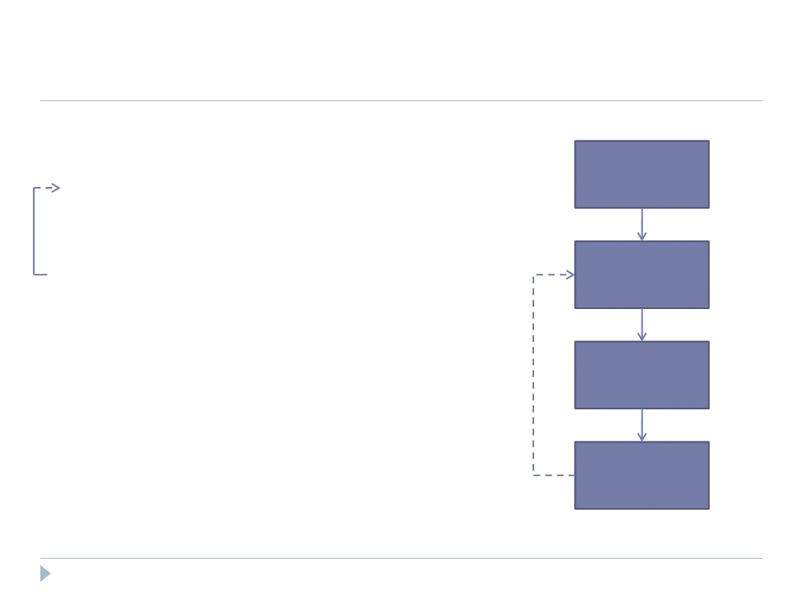
Review of Previous Lecture
Building a Logical Plan Example
A = LOAD ‘user.dat’ AS (name, age, city);
Load(user.dat)
B = GROUP A BY city;
C = FOREACH B GENERATE group AS city, COUNT(A);
D = FILTER C BY city IS ‘San Francisco’
Filter
OR city IS ‘NYC’;
STORE D INTO ‘local_user_count.dat’;
Group
Foreach

Slide 15
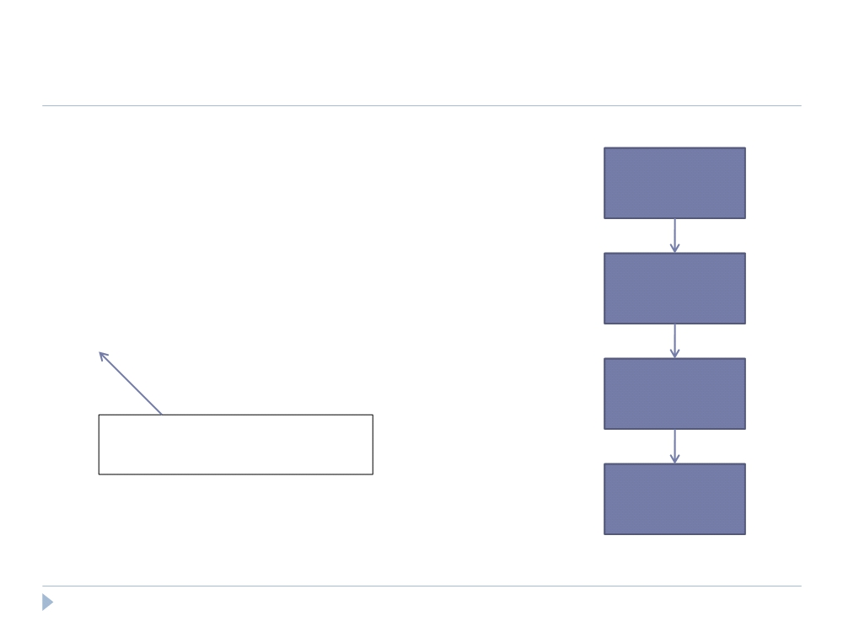
Review of Previous Lecture
Building a Physical Plan
A = LOAD ‘user.dat’ AS (name, age, city);
Load(user.dat)
B = GROUP A BY city;
C = FOREACH B GENERATE group AS city, COUNT(A);
D = FILTER C BY city IS ‘San Francisco’
Filter
OR city IS ‘NYC’;
STORE D INTO ‘local_user_count.dat’;
Group
Only happens when output is specified by STORE or DUMP
Foreach

Slide 16
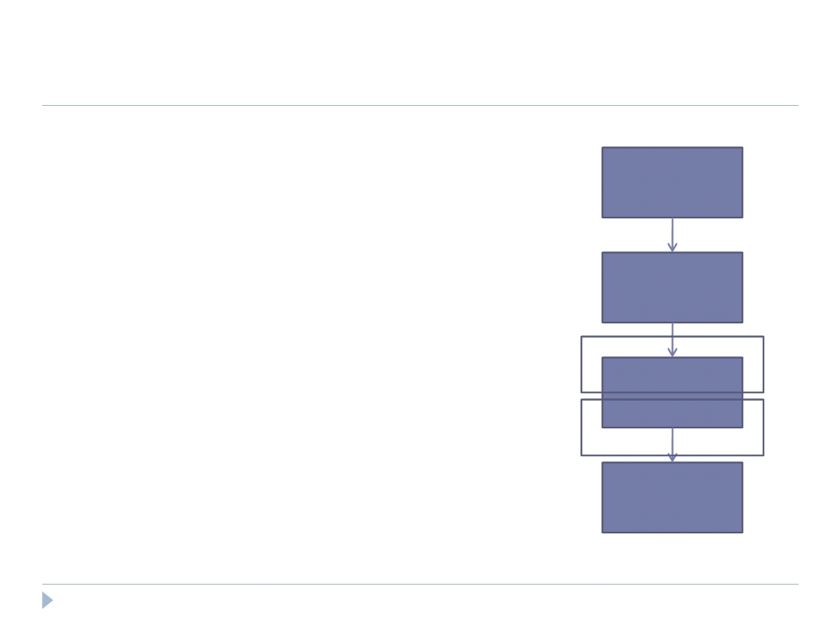
Review of Previous Lecture
Building a Physical Plan
Step 1: Create a map-reduce job for each COGROUP
Load(user.dat)
Filter
Map
Group
Reduce
Foreach

Slide 17
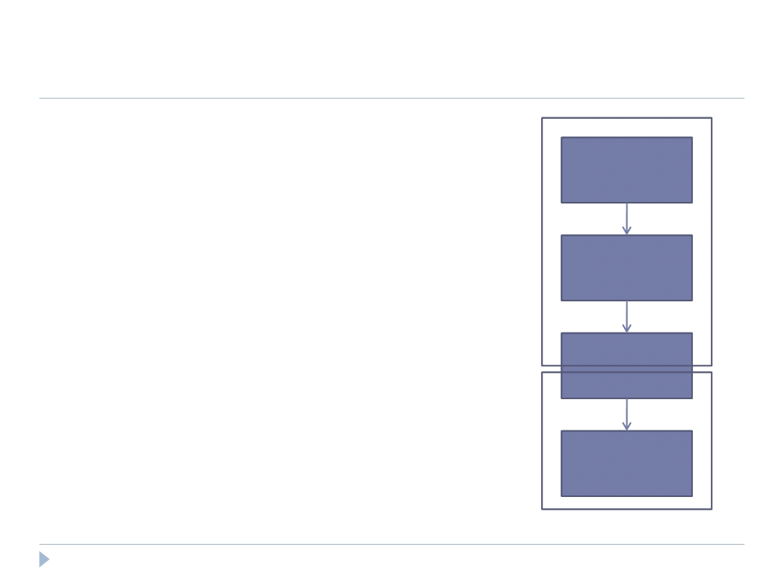
Review of Previous Lecture
Building a Physical Plan
Step 1: Create a map-reduce job for each COGROUP
Load(user.dat)
Step 2: Push other commands into the map and reduce functions where Map
Filter
possible
Certain commands
Group
require their own map-reduce
job (i.e.: ORDER needs separate map-
Reduce
reduce jobs)
Foreach

Slide 18
Review of Previous Lecture
Efficiency in Execution
Parallelism
Loading data - Files are loaded from HDFS
Statements are compiled into map-reduce jobs
Inefficiencies
Every map-reduce job requires data be written and replicated to the HDFS (although this is offset by parallelism achieved)

Slide 19
Outline
Review of Previous Lecture: Pig
Spark
Introduction to Spark
Tour of Spark operations
Job execution
Standalone programs
Deployment options

Slide 20
Big Data System Architecture
Current system modules for each software layer
Spark
Streaming
GraphX
MLbase
BlinkDB
Pig
Storm
MPI
…
Data
Processing
Shark
HIVE
Spark
Hadoop
HDFS, HBASE
Tachyon
Data
Management
Mesos, Yarn
Resource
Management
Notes:
Our instantiation of the resource management is Mesos

Slide 21
What is Spark?
Fast, expressive cluster computing system compatible with Apache Hadoop
Works with any Hadoop-supported storage system (HDFS, S3, …)
Improves efficiency through:
In-memory computing primitives
General computation graphs
Improves usability through:
Rich APIs in Java, Scala, Python
Interactive shell
Up to 100× faster
Often 2-10× less code
Notes:
Put high-level distributed collection stuff here?

Slide 22
How to Run It
Local multicore: just a library in your program
EC2: scripts for launching a Spark cluster
Private cluster: Mesos, YARN, Standalone Mode

Slide 23
Languages
APIs in Java, Scala and Python
Interactive shells in Scala and Python

Slide 24
Key Idea
Work with distributed collections as you would with local ones
Concept: resilient distributed datasets (RDDs)
Immutable collections of objects spread across a cluster
Built through parallel transformations (map, filter, etc)
Automatically rebuilt on failure
Controllable persistence (e.g. caching in RAM)

Slide 25
Operations
Transformations (e.g. map, filter, groupBy, join)
Lazy operations to build RDDs from other RDDs
Actions (e.g. count, collect, save)
Return a result or write it to storage
Notes:
You write a single program → similar to DryadLINQ
Distributed data sets with parallel operations on them are pretty standard; the new thing is that they can be reused across ops
Variables in the driver program can be used in parallel ops; accumulators useful for sending information back, cached vars are an optimization
Mention cached vars useful for some workloads that won’t be shown here
Mention it’s all designed to be easy to distribute in a fault-tolerant fashion

Slide 26

Example: Mining Console Logs
Load error messages from a log into memory, then interactively search for patterns
Base RDD
Cache 1
Transformed RDD
Worker
lines = spark.textFile(“hdfs://...”)
errors = lines.filter(lambda s: s.startswith(“ERROR”))
messages = errors.map(lambda s: s.split(‘\t’)[2])
messages.cache()
tasks
results
Block 1
Driver
Action
messages.filter(lambda s: “foo” in s).count()
Cache 2
Worker
messages.filter(lambda s: “bar” in s).count()
. . .
Cache 3
Worker
Block 2
Result: full-text search of Wikipedia in <1 sec (vs 20 sec for on-disk data)
Result: scaled to 1 TB data in 5-7 sec (vs 170 sec for on-disk data)
Block 3
Notes:
Key idea: add “variables” to the “functions” in functional programming

Slide 27
RDD Fault Tolerance
RDDs track the transformations used to build them (their lineage) to recompute lost data
E.g:
messages = textFile(...).filter(lambda s: s.contains(“ERROR”))
.map(lambda s: s.split(‘\t’)[2])
HadoopRDD
path = hdfs://…
FilteredRDD
func = contains(...)
MappedRDD
func = split(…)
Notes:
Show recomputing

Slide 28
Fault Recovery Test
Failure happens
Notes:
These are for K-means

Slide 29
Behavior with Less RAM

Slide 30
Spark in Java and Scala
Java API:
JavaRDD<String> lines = spark.textFile(…); errors = lines.filter( new Function<String, Boolean>() { public Boolean call(String s) { return s.contains(“ERROR”); } }); errors.count()
Scala API:
val lines = spark.textFile(…) errors = lines.filter(s => s.contains(“ERROR”)) // can also write filter(_.contains(“ERROR”)) errors.count

Slide 31
Which Language Should I Use?
Standalone programs can be written in any, but console is only Python & Scala
Python developers: can stay with Python for both
Java developers: consider using Scala for console (to learn the API)
Performance: Java / Scala will be faster (statically typed), but Python can do well for numerical work with NumPy

Slide 32
Scala Cheat Sheet
Variables:
var x: Int = 7 var x = 7 // type inferred
val y = “hi” // read-only
Collections and closures:
val nums = Array(1, 2, 3)
nums.map((x: Int) => x + 2) // => Array(3, 4, 5)
nums.map(x => x + 2) // => same nums.map(_ + 2) // => same
nums.reduce((x, y) => x + y) // => 6 nums.reduce(_ + _) // => 6
Functions:
def square(x: Int): Int = x*x
def square(x: Int): Int = { x*x // last line returned }
Java interop:
import java.net.URL
new URL(“http://cnn.com”).openStream()
More details:
scala-lang.org

Slide 33
Outline
Review of Previous Lecture: Pig
Spark
Introduction to Spark
Tour of Spark operations
Job execution
Standalone programs
Deployment options

Slide 34
Learning Spark
Easiest way: Spark interpreter (spark-shell or pyspark)
Special Scala and Python consoles for cluster use
Runs in local mode on 1 thread by default, but can control with MASTER environment var:
MASTER=local ./spark-shell # local, 1 thread MASTER=local[2] ./spark-shell # local, 2 threads MASTER=spark://host:port ./spark-shell # Spark standalone cluster

Slide 35
First Stop: SparkContext
Main entry point to Spark functionality
Created for you in Spark shells as variable sc
In standalone programs, you’d make your own (see later for details)

Slide 36
Creating RDDs
# Turn a local collection into an RDD
sc.parallelize([1, 2, 3])
# Load text file from local FS, HDFS, or S3
sc.textFile(“file.txt”)
sc.textFile(“directory/*.txt”)
sc.textFile(“hdfs://namenode:9000/path/file”)
# Use any existing Hadoop InputFormat
sc.hadoopFile(keyClass, valClass, inputFmt, conf)

Slide 37
Basic Transformations
nums = sc.parallelize([1, 2, 3])
# Pass each element through a function
squares = nums.map(lambda x: x*x) # => {1, 4, 9}
# Keep elements passing a predicate
even = squares.filter(lambda x: x % 2 == 0) # => {4}
# Map each element to zero or more others
nums.flatMap(lambda x: range(0, x)) # => {0, 0, 1, 0, 1, 2}
Range object (sequence of numbers 0, 1, …, x-1)
Notes:
All lazy

Slide 38
Basic Actions
nums = sc.parallelize([1, 2, 3])
# Retrieve RDD contents as a local collection nums.collect() # => [1, 2, 3]
# Return first K elements nums.take(2) # => [1, 2]
# Count number of elements nums.count() # => 3
# Merge elements with an associative function nums.reduce(lambda x, y: x + y) # => 6
# Write elements to a text file nums.saveAsTextFile(“hdfs://file.txt”)
Notes:
Launch computations

Slide 39
Working with Key-Value Pairs
Spark’s “distributed reduce” transformations act on RDDs of key-value pairs
Python: pair = (a, b)
pair[0] # => a
pair[1] # => b
Scala: val pair = (a, b)
pair._1 // => a
pair._2 // => b
Java: Tuple2 pair = new Tuple2(a, b); // class scala.Tuple2
pair._1 // => a
pair._2 // => b

Slide 40
Some Key-Value Operations
pets = sc.parallelize([(“cat”, 1), (“dog”, 1), (“cat”, 2)])
pets.reduceByKey(lambda x, y: x + y) # => {(cat, 3), (dog, 1)}
pets.groupByKey() # => {(cat, Seq(1, 2)), (dog, Seq(1)}
pets.sortByKey() # => {(cat, 1), (cat, 2), (dog, 1)}
reduceByKey also automatically implements combiners on the map side

Slide 41
Example: Word Count
lines = sc.textFile(“hamlet.txt”)
counts = lines.flatMap(lambda line: line.split(“ ”)) \ .map(lambda word: (word, 1)) \ .reduceByKey(lambda x, y: x + y)
“to” “be” “or”
(to, 1) (be, 1) (or, 1)
(be, 2) (not, 1)
“to be or”
“not” “to” “be”
(not, 1) (to, 1) (be, 1)
(or, 1)
(to, 2)
“not to be”

Slide 42
Multiple Datasets
visits = sc.parallelize([(“index.html”, “1.2.3.4”), (“about.html”, “3.4.5.6”), (“index.html”, “1.3.3.1”)])
pageNames = sc.parallelize([(“index.html”, “Home”), (“about.html”, “About”)])
visits.join(pageNames) # (“index.html”, (“1.2.3.4”, “Home”)) # (“index.html”, (“1.3.3.1”, “Home”)) # (“about.html”, (“3.4.5.6”, “About”))
visits.cogroup(pageNames) # (“index.html”, (Seq(“1.2.3.4”, “1.3.3.1”), Seq(“Home”))) # (“about.html”, (Seq(“3.4.5.6”), Seq(“About”)))

Slide 43
Controlling the Level of Parallelism
All the pair RDD operations take an optional second parameter for number of tasks
words.reduceByKey(lambda x, y: x + y, 5)
words.groupByKey(5)
visits.join(pageViews, 5)

Slide 44
Using Local Variables
External variables you use in a closure will automatically be shipped to the cluster:
query = raw_input(“Enter a query:”)
pages.filter(lambda x: x.startswith(query)).count()
Some caveats:
Each task gets a new copy (updates aren’t sent back)
Variable must be Serializable (Java/Scala) or Pickle-able (Python)
Don’t use fields of an outer object (ships all of it!)

Slide 45
Closure Mishap Example
class MyCoolRddApp { val param = 3.14 val log = new Log(...) ... def work(rdd: RDD[Int]) { rdd.map(x => x + param) .reduce(...) } }
How to get around it:
class MyCoolRddApp { ... def work(rdd: RDD[Int]) { val param_ = param rdd.map(x => x + param_) .reduce(...) } }
NotSerializableException: MyCoolRddApp (or Log)
References only local variable instead of this.param

Slide 46
More Details
Spark supports lots of other operations!
Full programming guide: spark-project.org/documentation

Slide 47
Outline
Review of Previous Lecture: Pig
Spark
Introduction to Spark
Tour of Spark operations
Job execution
Standalone programs
Deployment options

Slide 48
Software Components
Spark runs as a library in your program (one instance per app)
Runs tasks locally or on a cluster
Standalone deploy cluster, Mesos or YARN
Accesses storage via Hadoop InputFormat API
Can use HBase, HDFS, S3, …
Your application
SparkContext
Cluster manager
Local threads
Worker
Worker
Spark executor
Spark executor
HDFS or other storage

Slide 49
Task Scheduler
Supports general task graphs
Pipelines functions where possible
Cache-aware data reuse & locality
Partitioning-aware to avoid shuffles
A:
B:
F:
Stage 1
groupBy
C:
D:
E:
join
Stage 2
map
filter
Stage 3
= RDD
= cached partition
Notes:
NOT a modified version of Hadoop

Slide 50
Hadoop Compatibility
Spark can read/write to any storage system / format that has a plugin for Hadoop!
Examples: HDFS, S3, HBase, Cassandra, Avro, SequenceFile
Reuses Hadoop’s InputFormat and OutputFormat APIs
APIs like SparkContext.textFile support filesystems, while SparkContext.hadoopRDD allows passing any Hadoop JobConf to configure an input source

Slide 51
Outline
Review of Previous Lecture: Pig
Spark
Introduction to Spark
Tour of Spark operations
Job execution
Standalone programs
Deployment options

Slide 52
Add Spark to Your Project
Scala and Java: add a Maven dependency on
groupId: org.spark-project
artifactId: spark-core_2.10
version = 1.2.0
Python: run program with our pyspark script

Slide 53
Create a SparkContext
import spark.SparkContext
import spark.SparkContext._
val sc = new SparkContext(“masterUrl”,“name”,“sparkHome”,Seq(“app.jar”))
Scala
Cluster URL, or local / local[N]
App name
Spark install path on cluster
List of JARs with app code (to ship)
import spark.api.java.JavaSparkContext;
JavaSparkContext sc = new JavaSparkContext(
“masterUrl”, “name”, “sparkHome”, new String[] {“app.jar”}));
Java
from pyspark import SparkContext
sc = SparkContext(“masterUrl”, “name”, “sparkHome”, [“library.py”]))
Python
Notes:
Mention assembly JAR in Maven etc
Use the shell with your own JAR`

Slide 54
Complete App: Scala
import spark.SparkContext
import spark.SparkContext._
object WordCount { def main(args: Array[String]) {
val sc = new SparkContext(“local”, “WordCount”, args(0), Seq(args(1))) val lines = sc.textFile(args(2)) lines.flatMap(_.split(“ ”)) .map(word => (word, 1)) .reduceByKey(_ + _) .saveAsTextFile(args(3)) } }

Slide 55
Complete App: Python
import sys
from pyspark import SparkContext
if __name__ == "__main__":
sc = SparkContext( “local”, “WordCount”, sys.argv[0], None) lines = sc.textFile(sys.argv[1])
lines.flatMap(lambda s: s.split(“ ”)) \ .map(lambda word: (word, 1)) \ .reduceByKey(lambda x, y: x + y) \ .saveAsTextFile(sys.argv[2])

Slide 56
Example: PageRank

Slide 57
Why PageRank?
Good example of a more complex algorithm
Multiple stages of map & reduce
Benefits from Spark’s in-memory caching
Multiple iterations over the same data

Slide 58

Basic Idea
Give pages ranks (scores) based on links to them
Links from many pages ➔ high rank
Link from a high-rank page ➔ high rank
Image: en.wikipedia.org/wiki/File:PageRank-hi-res-2.png

Slide 59
Algorithm
Start each page at a rank of 1
On each iteration, have page p contribute rank_{p} / |neighbors_{p}| to its neighbors
Set each page’s rank to 0.15 + 0.85 × contribs
1.0
1.0
1.0
1.0

Slide 60
Algorithm
Start each page at a rank of 1
On each iteration, have page p contribute rank_{p} / |neighbors_{p}| to its neighbors
Set each page’s rank to 0.15 + 0.85 × contribs
1.0
1
0.5
1
1.0
0.5
1.0
0.5
0.5
1.0

Slide 61
Algorithm
Start each page at a rank of 1
On each iteration, have page p contribute rank_{p} / |neighbors_{p}| to its neighbors
Set each page’s rank to 0.15 + 0.85 × contribs
1.85
0.58
1.0
0.58

Slide 62
Algorithm
Start each page at a rank of 1
On each iteration, have page p contribute rank_{p} / |neighbors_{p}| to its neighbors
Set each page’s rank to 0.15 + 0.85 × contribs
1.85
0.58
0.5
1.85
0.58
0.29
1.0
0.5
0.29
0.58

Slide 63
Algorithm
Start each page at a rank of 1
On each iteration, have page p contribute rank_{p} / |neighbors_{p}| to its neighbors
Set each page’s rank to 0.15 + 0.85 × contribs
1.31
0.39
. . .
1.72
0.58

Slide 64
Algorithm
Start each page at a rank of 1
On each iteration, have page p contribute rank_{p} / |neighbors_{p}| to its neighbors
Set each page’s rank to 0.15 + 0.85 × contribs
Final state:
1.44
0.46
1.37
0.73

Slide 65
Scala Implementation
val links = // RDD of (url, neighbors) pairs
var ranks = // RDD of (url, rank) pairs
for (i <- 1 to ITERATIONS) {
val contribs = links.join(ranks).flatMap {
case (url, (links, rank)) =>
links.map(dest => (dest, rank/links.size))
} ranks = contribs.reduceByKey(_ + _) .mapValues(0.15 + 0.85 * _)
} ranks.saveAsTextFile(...)

Slide 66
Python Implementation
links = # RDD of (url, neighbors) pairs
ranks = # RDD of (url, rank) pairs
for i in range(NUM_ITERATIONS):
def compute_contribs(pair): [url, [links, rank]] = pair # split key-value pair
return [(dest, rank/len(links)) for dest in links]
contribs = links.join(ranks).flatMap(compute_contribs)
ranks = contribs.reduceByKey(lambda x, y: x + y) \ .mapValues(lambda x: 0.15 + 0.85 * x) ranks.saveAsTextFile(...)

Slide 67
PageRank Performance
Notes:
54 GB Wikipedia dataset

Slide 68
Other Iterative Algorithms
Notes:
100 GB datasets

Slide 69
Outline
Review of Previous Lecture: Pig
Spark
Introduction to Spark
Tour of Spark operations
Job execution
Standalone programs
Deployment options

Slide 70
Local Mode
Just pass local or local[k] as master URL
Still serializes tasks to catch marshaling errors
Debug using local debuggers
For Java and Scala, just run your main program in a debugger
For Python, use an attachable debugger (e.g. PyDev, winpdb)
Great for unit testing

Slide 71
Private Cluster
Can run with one of:
Standalone deploy mode (similar to Hadoop cluster scripts)
Apache Mesos: spark-project.org/docs/latest/running-on-mesos.html
Hadoop YARN: spark-project.org/docs/0.6.0/running-on-yarn.html
Basically requires configuring a list of workers, running launch scripts, and passing a special cluster URL to SparkContext

Slide 72
Amazon EC2
Easiest way to launch a Spark cluster
git clone git://github.com/mesos/spark.git
cd spark/ec2
./spark-ec2 -k keypair –i id_rsa.pem –s slaves \ [launch|stop|start|destroy] clusterName
Details: spark-project.org/docs/latest/ec2-scripts.html
New: run Spark on Elastic MapReduce – tinyurl.com/spark-emr

Slide 73
Viewing Logs
Click through the web UI at master:8080
Or, look at stdout and stdout files in the Spark or Mesos “work” directory for your app:
work/<ApplicationID>/<ExecutorID>/stdout
Application ID (Framework ID in Mesos) is printed when Spark connects

Slide 74
Community
Join the Spark Users mailing list:
groups.google.com/group/spark-users
Come to meetup:
www.meetup.com/spark-users
Notes:
Ankur’s debugger

Slide 75














Conclusion
Spark offers a rich API to make data analytics fast: both fast to write and fast to run
Achieves 100x speedups in real applications
Growing community with 14 companies contributing
Details, tutorials, videos: www.spark-project.org

Slide 76
Questions?

