Slide 1

Serendipitous Recommendation for Mobile Apps
Using Item-Item Similarity Graph
Group 25
黄宇韬 17214622
洪凯 17214615
梁伟日 17214688

Slide 2
Presentation
1
4
Background
Proposed Method
CONTENTS
2
Introduction
5
Experiments
3
Related Work
6
Conclusion

Slide 3
PART ONE
Background

Slide 4
What is Recommender System(RSs) ?
Recommender Systems (RSs) are software tools and techniques providing suggestions for items to be of use to a user. The suggestions relate to various decision-making processes, such as what items to buy, what music to listen to, or what online news to read.
RSs have proved in recent years to be a valuable means for coping with the information overload problem.

Slide 5
Recommender Systems Function
Increase the number of items sold
Sell more diverse items
Increase the user satisfaction
Increase user fidelity
Better understand what the user wants
Find Some Good Items
Find all good items
…

Slide 6
The most popular approach in recommender systems Systems Function
Collaborative Filtering (CF):
Works by recommending items to target users based on what other simi-
larusers have previously preferred.
Content-Based Filtering (CBF):
Provides recommendations by comparing representations of content
contained in an item with representations of content that the user is interested in.
Hybrid:
Based on the combination of some techniques.

Slide 7
PART TWO
Introduction

Slide 8
Mobile App Market’s explosive growth in 2013
Concurrent with the phenomenal spread of smart-devices (e.g., iPhone, iPad), the mobile application (app) market has experienced explosive growth. For instance, Apple’s iOS App Store offers more than 550,000 unique apps to users in 123 countries, along with download counts exceeding 25 billion.
The enormous scale of the app market makes it difficult for users to discover apps that are relevant to their interests.
So this paper is tempting to apply recommender systems to alleviate the problem of
information overload by suggesting items directly to users relevant to their interests.

Slide 9
Stiff hurdle for RSs to be applied in mobile app recommendations
In general, the effectiveness of RSs has been shown to be proportional to the data
sparsity of the underlying application domain.
In other words, the larger the fraction of the item corpus that has been experienced by users, the better the quality and coverage of recommendations from that corpus.
Effectively, if an item has not been experienced at all, the RSs is not able to recommend items similar to it.
The rate of introduction of mobile apps is extraordinarily high, and the fraction of apps that have been experienced (downloaded) by users is extremely low.

Slide 10
CF and CBF
Both CF and CBF, however, are mostly aimed at generating accurate recommendations that is relevant to user’s interests.
The lack of “surprise” element in these recommendations owing to the fact that there are ratings available for only a small fraction of apps creates a major hurdle in overall user satisfaction of the user.

Slide 11
Serendipitous Recommendation Systems
It is reasonable to say that a user would be happy with recommendation systems that offer less obvious choices.
The lack of “surprise” element in these recommendations owing to the fact that there are ratings available for only a small fraction of apps creates a major hurdle in overall user satisfaction of the user.
Suppose that we visit Amazon.com 2 to buy something online. To illustrate, after browsing a couple of items, Amazon.com provides us with lists such as Recommended For You or Customer Who Bought This Item Also Bought.

Slide 12
Assumption of Serendipitous Systems
User may want to be surprised with something unexpected that he did not start out looking for.
Ecommerce Web sites, however, usually just offer a long list of search results. Therefore,
users have little chance of finding out something different from their preferences. An-
other problem with existing recommendation systems is that they often recommend
items which the users have rated or downloaded before. This limits the candidate apps
to be recommended by pruning relevant but not yet rated or downloaded apps.

Slide 13
What problems of exist RSs can be solved
They first define serendipitous recommendation as the one that provides something diverse and novel, and then they propose a method for providing serendipitous recommendations by increasing item novelty and diversity.
They leverage the user’s preferences by tapping into the information about apps installed on mobile phones and recommend serendipitous apps using item-item similarity graph.

Slide 14
PART THREE
Related Work

Slide 15
Related Works on serendipitous RSs
Ziegler et al. proposed a similarity metric using a taxonomy-based classification and uses it to compute an intra-list similarity to determine the overall diversity of the recommended list.
Zhang and Hurley focused on intra-list diversity and optimized the tradeoffs between users’ preferences and the diversity of the top-N results.
Andre proposed a method for performing serendipitous searches for Web information retrieval.
Lathia found that temporal diversity is an important facet of recommender systems by showing how data of collaborative filtering changes over time.

Slide 16
Related Works on serendipitous RSs
Kawamae emphasized the surprise of each user in the recommendation focusing on the estimated search time that the users would take to find the item by themselves.
Nakatsuji et al. improved the drawback of Ziegler et al.’s approach described above.
Sugiyama and Kan proposed a method for recommending serendipitous scholarly papers.
Adamopoulos and Tuzhilin [1] proposed an approach to providing unexpected recommendations by formalizing the Greek philosopher Heraclitus’s concept, “If you do not expect it, you will not find the unexpected, for it is hard to find and difficult.”

Slide 17
Related Works on mobile apps RSs
Xu et al. [23] investigated the diverse usage behaviors of individual mobile apps using anonymized network measurements from a tier-1 cellular carrier in the United States.
Nakatsuji et al. improved the drawback of Ziegler et al.’s approach described above.
Yan and Chen and Costa-Montenegro et al. constructed recommendation system for apps by analyzing how the apps are actually used.
Davidsson and Moritz developed a prototype system of app recommendation
that achieves such context-awareness by exploiting GPS sensor information.

Slide 18
Related Works on mobile apps RSs
Yin et al. introduced the notions of actual value and tempting value and regarded recommendation for mobile apps as a result of the contest between these two values.
Lin et al. developed a novel approach to recommending mobile apps in cold-start situations.

Slide 19
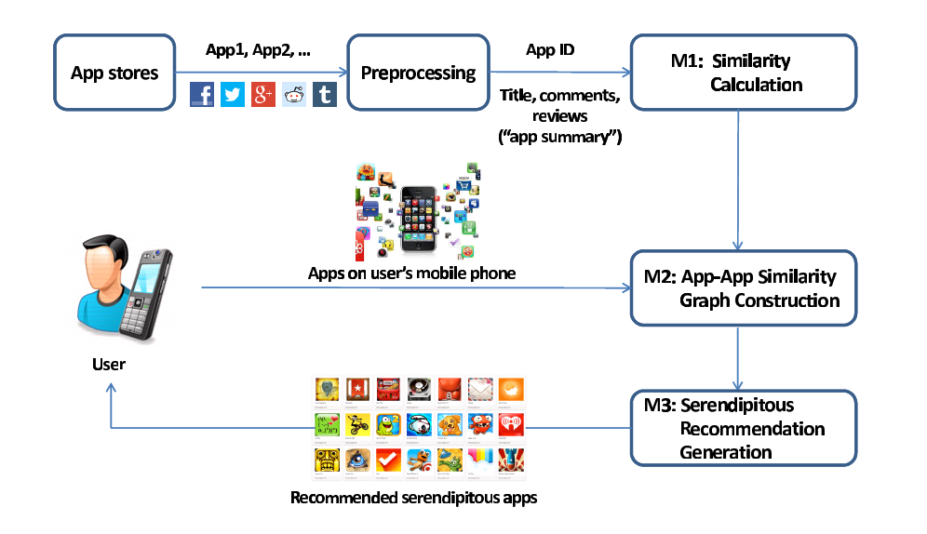

Slide 20
PART FOUR
Proposed Method

Slide 21
PART FIVE
Experiments

Slide 22
Experimental Data
Project: Mobilewalla
Apps: 66,233
Users: 22,213
Notes:
实验的数据来源于一个叫Mobilewalla的项目，数据集包含66223个app和22213个用户

Slide 23
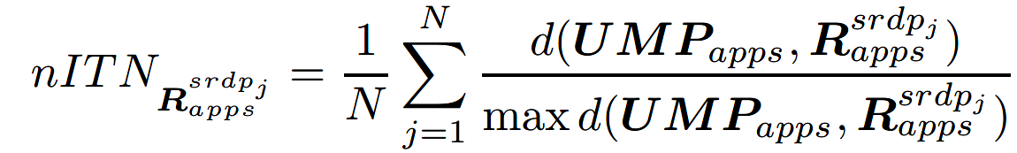
Experimental Measure
evaluate recommendations using normalized version of item novelty metric
apps in user’s mobile phone
apps recommended to user
normalized item novelty measure
larger results indicate more surprise, resulting in serendipitous recommendations
Notes:
这篇论文的目的是像用户推荐多样化和新颖的app，所以在实验中，作者定义了两个指标来评估实验中的推荐结果，分别是推荐app的新颖度和多样性，第一个是标准化项目新颖度，新颖度是根据推荐app和用户已安装app之间的距离来计算，对每个距离进行标准化。
nITN的值越大代表越多的惊喜，也就形成了偶然性的app推荐

Slide 24
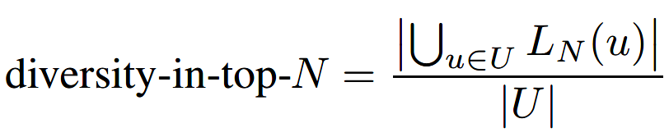
Experimental Measure
u: a user
U: all users
LN(u): the list of N items recommended for user u
Notes:
第二个衡量的指标是，前N个推荐结果的多样性，u是指单个用户，U是所有用户集合，LN(u)是推荐给用户u的N个app

Slide 25
Experimental Results
baseline system : item-based collaborative filtering
similarity threshold: 0.4
select all apps that are less than the threshold as neighbors
the number of the recommended app :5, 10, 20
Notes:
实验以协同过滤的推荐方法作为比较。协同过滤的方法是通过计算。。。。
在实验中，将相似度限制设置为0.4，选择相似度低于0.4的app作为候选推荐。
实验分别测试了推荐5个，10个，和20个app的结果

Slide 26
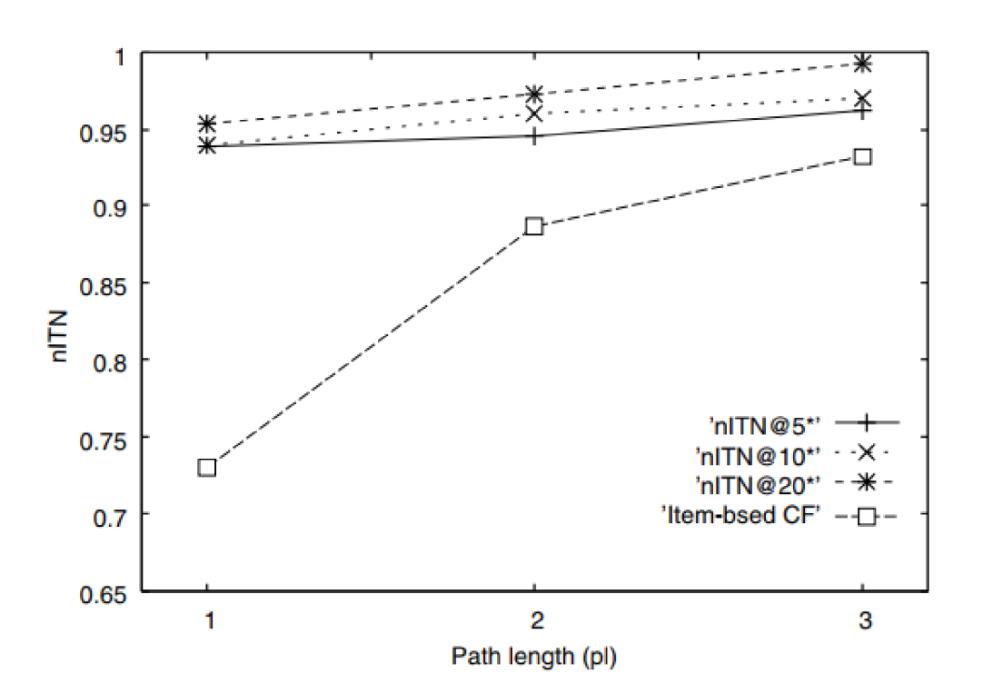
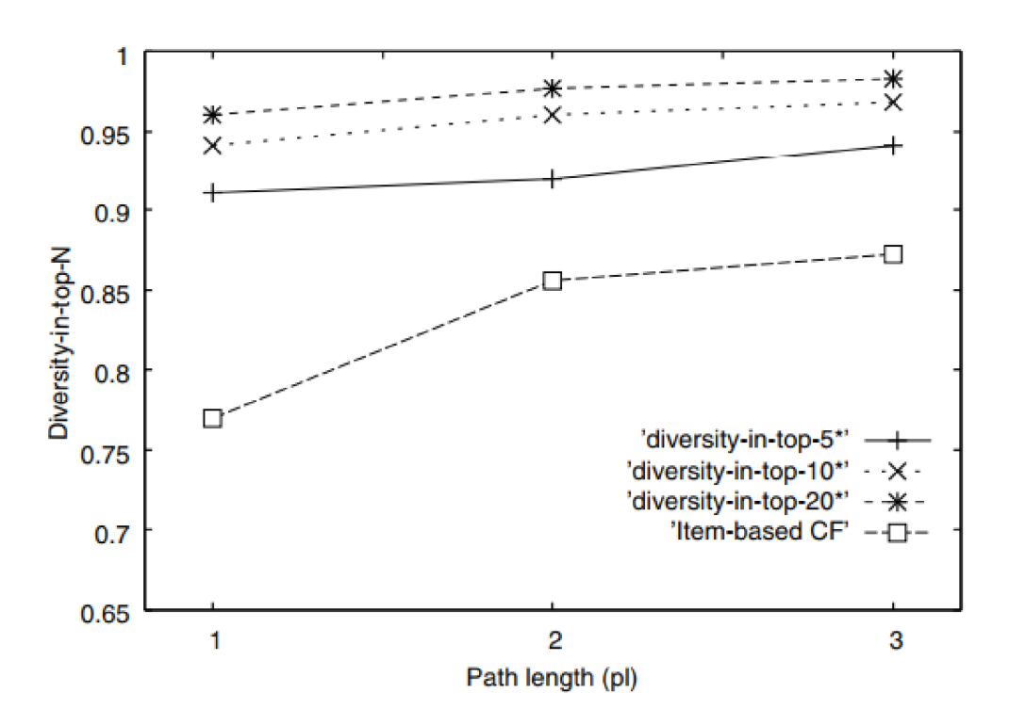
Experimental Results
nITN
diversity-in-top-N

Slide 27
Experimental Results
having established the novelty and diversity of the recommended apps, we analyze the obtained results of recommendation qualitatively
the distribution of item novelty for various number of apps installed
item novelty ranges from 0.1 to 1.0, 1.0 represents most diverse

Slide 28
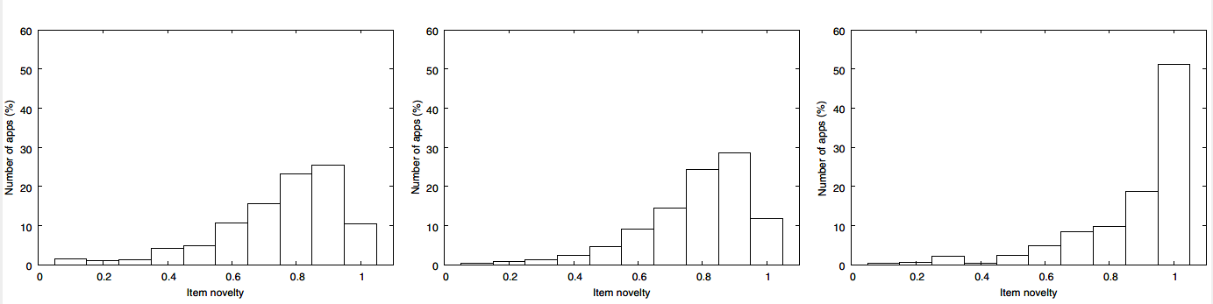
Experimental Results
15 apps installed
7 apps installed
40 apps installed

Slide 29
PART SIX
Conclusion

Slide 30
Conclusion
developed a method for providing serendipitous recommendation
for mobile apps by discovering highly diverse apps
captures user’s preferences from apps already installed on the
user’s mobile phone and provides serendipitous recommendation
by constructing app-app similarity graph
Notes:
文章提出一种偶然性的app推荐系统，

Slide 31
Conclusion
need to develop additional metrics for verifying the accuracy of these serendipitous recommendations

Slide 32
THANKS!

