Slide 1
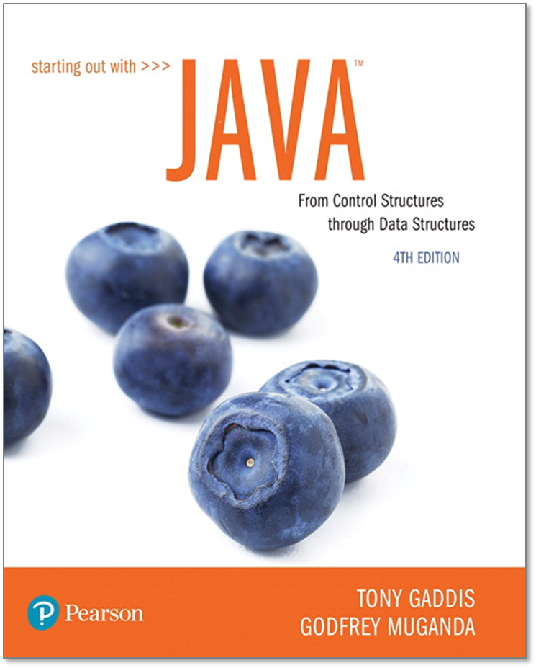
STARTING OUT WITH JAVATM
4th Edition
Chapter 10
Inheritance
Rick Cassoni, CISSP, PMP

Slide 2
Chapter Topics
Chapter 10 discusses the following main topics:
What Is Inheritance?
Calling the Superclass Constructor
Overriding Superclass Methods
Protected Members
Chains of Inheritance
The Object Class
Polymorphism
Abstract Classes and Abstract Methods
Interfaces
Anonymous Classes
Functional Interfaces and Lambda Expressions

Slide 3
What is Inheritance? Generalization vs. Specialization
Real-life objects are typically specialized versions of other more general objects.
The term “insect” describes a very general type of creature with numerous characteristics.
Grasshoppers and bumblebees are insects
They share the general characteristics of an insect.
However, they have special characteristics of their own.
grasshoppers have a jumping ability, and
bumblebees have a stinger.
Grasshoppers and bumblebees are specialized versions of an insect.

Slide 4
Inheritance
Insect
Contains those attributes and methods that are shared by all insects.
BumbleBee
Grasshopper
Contains those attributes and methods that specific to a Bumble Bee.
Contains those attributes and methods that are specific to a Grasshopper.

Slide 5
The “is a” Relationship (1 of 2)
The relationship between a superclass and an inherited class is called an “is a” relationship.
A grasshopper “is a” insect.
A poodle “is a” dog.
A car “is a” vehicle.
A specialized object has:
all the characteristics of the general object, PLUS
additional characteristics that make it special.
In object-oriented programming, inheritance creates an “is a” relationship among classes.

Slide 6
The “is a” Relationship (2 of 2)
We can extend the capabilities of a class.
Inheritance involves a superclass and a subclass.
The superclass is the general class and
the subclass is the specialized class.
The subclass is based on, or extended from, the superclass.
Superclasses are also called base classes, and
subclasses are also called derived classes.
The relationship of classes can be thought of as parent classes and child classes.

Slide 7
Inheritance
The subclass inherits public fields and methods from the superclass without any of them being rewritten.
New fields and methods may be added to the subclass.
The Java keyword, extends, is used on the class header to define the subclass.
public class FinalExam extends GradedActivity

Slide 8
The GradedActivity Example
GradedActivity
Contains those attributes and methods that are shared by all graded activities.
- score : double
+ setScore(s : double) : void
+ getScore() : double
+ getGrade() : char
Contains those attributes and methods that are specific to the FinalExam class.
Inherits all non-private attributes and methods from the GradedActivity class.
FinalExam
- numQuestions : int
- pointsEach : double
- numMissed : int
Example:
GradedActivity.java,
GradeDemo.java,
FinalExam.java,
FinalExamDemo.java
+ FinalExam(questions : int,
missed : int)
+ getPointsEach() : double
+ getNumMissed() : int

Slide 9
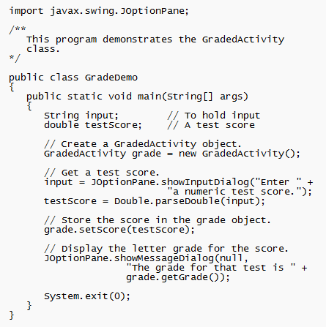
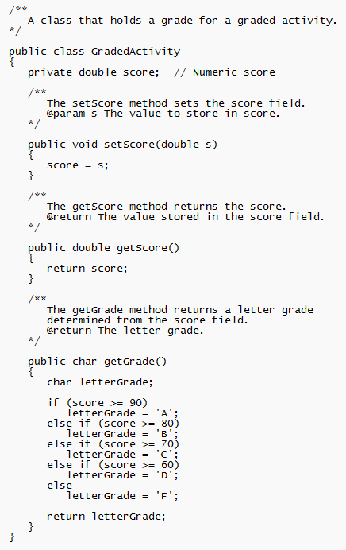
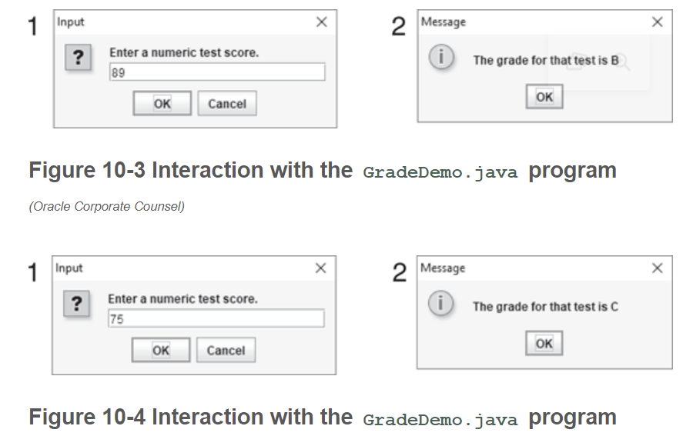
GradedActivity.java, GradeDemo.java, FinalExam.java, FinalExamDemo.java

Slide 10
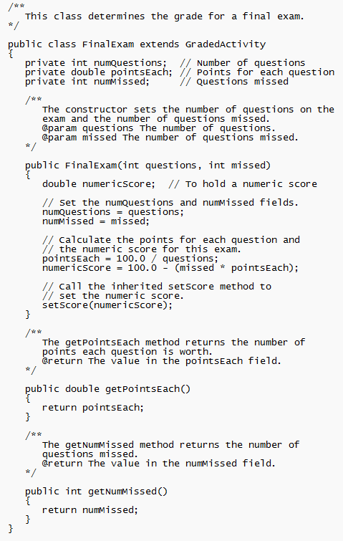
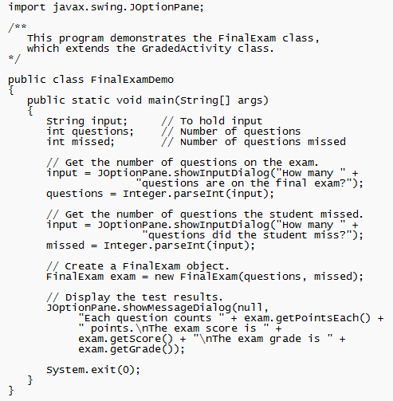
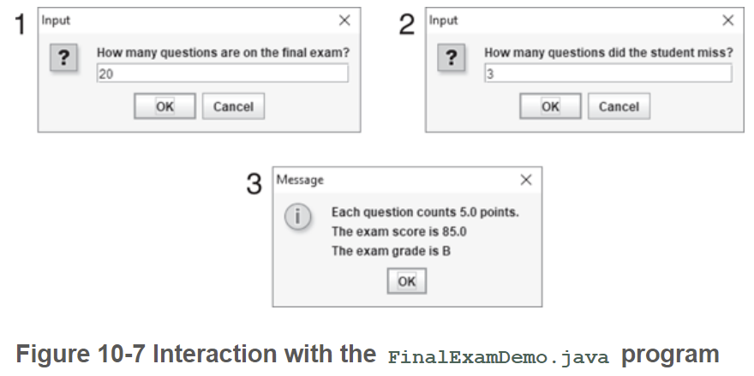
GradedActivity.java, GradeDemo.java, FinalExam.java, FinalExamDemo.java

Slide 11
Inheritance, Fields and Methods (1 of 2)
Members of the superclass that are marked private:
are not inherited by the subclass,
exist in memory when the object of the subclass is created
may only be accessed from the subclass by public methods of the superclass.
Members of the superclass that are marked public (typically methods – getters/setters):
are inherited by the subclass, and
may be directly accessed from the subclass.

Slide 12
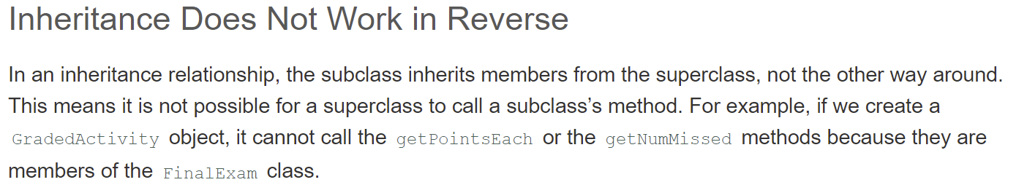
Inheritance, Fields and Methods (2 of 2)
When an instance of the subclass is created, the non-private methods of the superclass are available through the subclass object.
FinalExam exam = new FinalExam();
exam.setScore(85.0);
System.out.println("Score = " + exam.getScore());
Non-private methods and fields of the superclass are available in the subclass.
setScore(newScore);

Slide 13
Inheritance and Constructors
Constructors are not inherited.
When a subclass is instantiated, the superclass default constructor is executed first.
Example:
SuperClass1.java
SubClass1.java
ConstructorDemo1.java

Slide 14
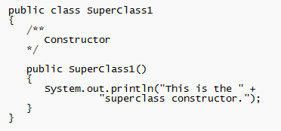
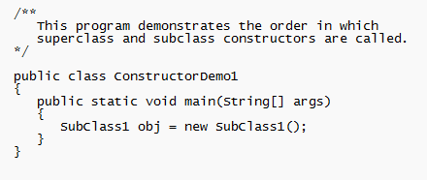
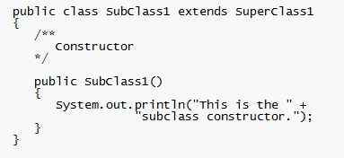
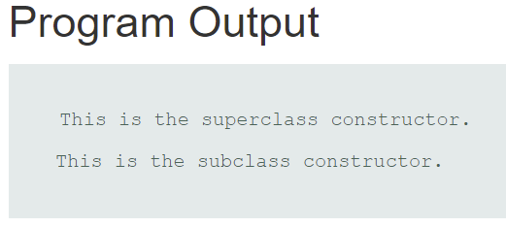
SuperClass1.java, SubClass1.java ConstructorDemo1.java

Slide 15
The Superclass’s Constructor
The super keyword refers to an object’s superclass.
The superclass constructor can be explicitly called from the subclass by using the super keyword.
Example:
SuperClass2.java, SubClass2.java, ConstructorDemo2.java
Rectangle.java, Cube.java, CubeDemo.java

Slide 16
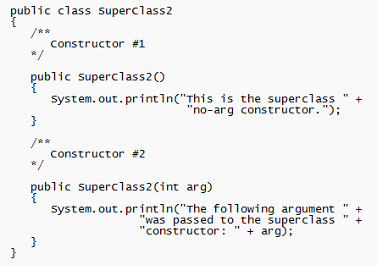
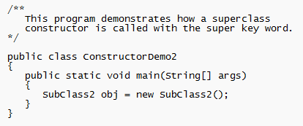
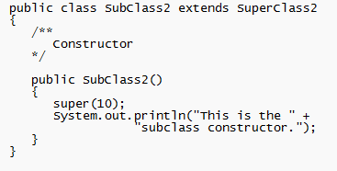
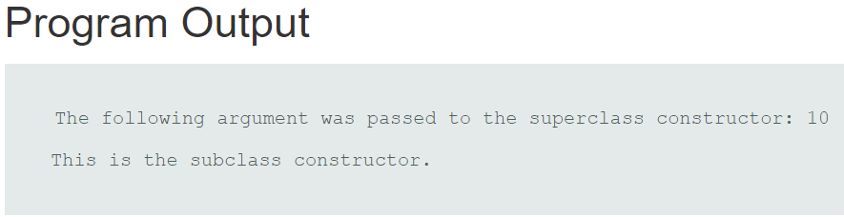
SuperClass2.java, SubClass2.java, ConstructorDemo2.java

Slide 17
Calling The Superclass Constructor
If a parameterized constructor is defined in the superclass,
the superclass must provide a no-arg constructor, or
subclasses must provide a constructor, and
subclasses must call a superclass constructor.
Calls to a superclass constructor must be the first java statement in the subclass constructors.

Slide 18
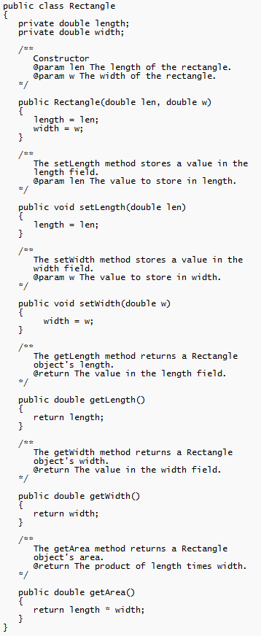
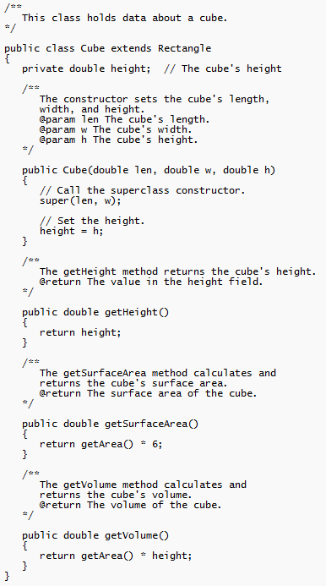
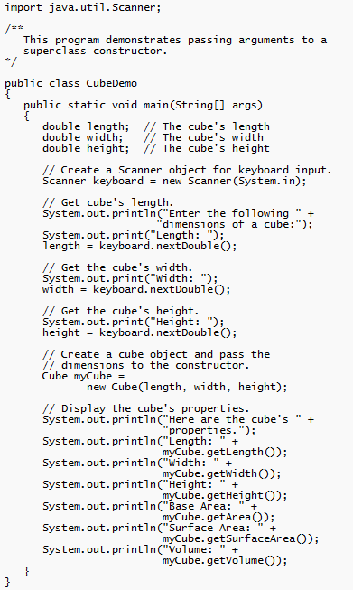
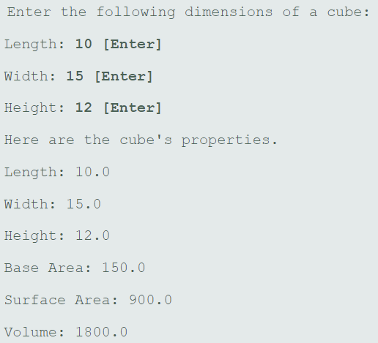
Rectangle.java, Cube.java, CubeDemo.java

Slide 19
Overriding Superclass Methods (1 of 5)
A subclass may have a method with the same signature as a superclass method.
The subclass method overrides the superclass method.
This is known as method overriding.
Example:
GradedActivity.java, CurvedActivity.java, CurvedActivityDemo.java

Slide 20
Overriding Superclass Methods (2 of 5)
GradedActivity
- score : double
+ setScore(s : double) : void
+ getScore() : double
+ getGrade() : char
This method is a more specialized version of the setScore method in the superclass, GradedActivity.
CurvedActivity
- rawScore : double
- percentage : double
+ CurvedActivity
(percent : double)
+ setScore(s : double) : void
+ getRawScore() : double
+ getPercentage() : double

Slide 21
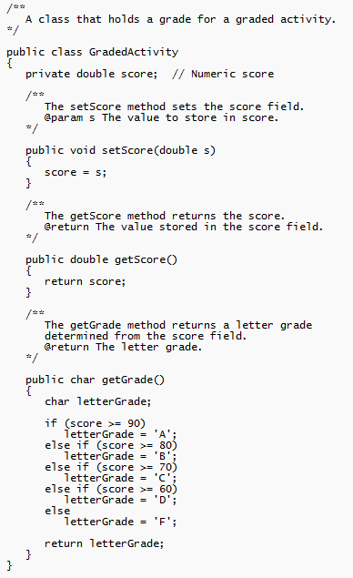
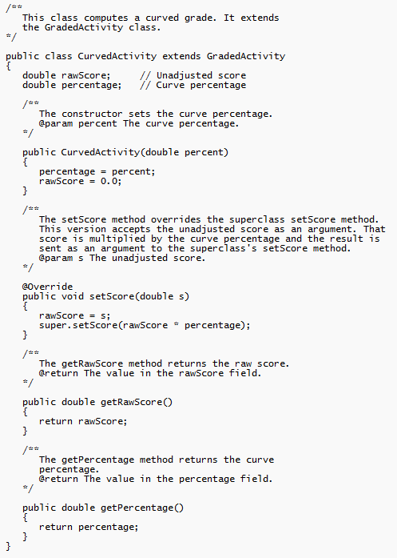
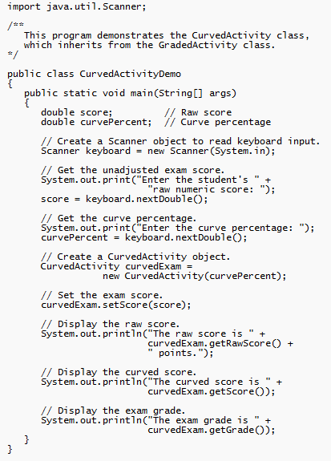
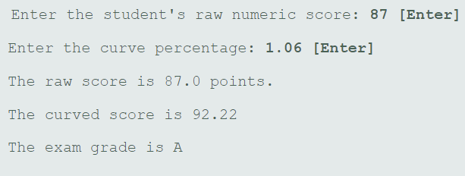
GradedActivity.java, CurvedActivity.java, CurvedActivityDemo.java

Slide 22
Overriding Superclass Methods (3 of 5)
Recall that a method’s signature consists of:
the method’s name
the data types method’s parameters in the order that they appear.
A subclass method that overrides a superclass method must have the same signature as the superclass method.
An object of the subclass invokes the subclass’s version of the method, not the superclass’s.
The @Override annotation should be used just before the subclass method declaration.
This causes the compiler to display an error message if the method fails to correctly override a method in the superclass.

Slide 23
Overriding Superclass Methods (4 of 5)
An subclass method can call the overridden superclass method via the super keyword.
super.setScore(rawScore * percentage);
There is a distinction between overloading a method and overriding a method.
Overloading is when a method has the same name as one or more other methods, but with a different signature.
When a method overrides another method, however, they both have the same signature.

Slide 24
Overriding Superclass Methods (5 of 5)
Both overloading and overriding can take place in an inheritance relationship.
Example:
SuperClass3.java,
SubClass3.java,
ShowValueDemo.java

Slide 25
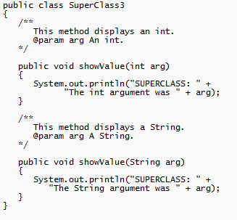
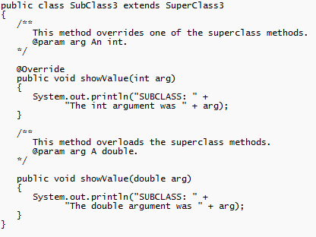
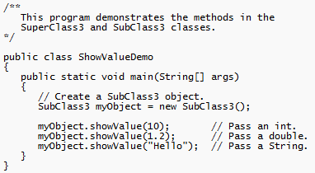
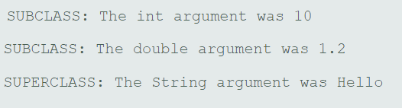
SuperClass3.java, SubClass3.java, ShowValueDemo.java

Slide 26
Preventing a Method from Being Overridden
The final modifier will prevent the overriding of a superclass method in a subclass.
public final void message()
If a subclass attempts to override a final method, the compiler generates an error.
This ensures that a particular superclass method is used by subclasses rather than a modified version of it.

Slide 27
Chains of Inheritance (1 of 2)
A superclass can also be derived from another class.
Object
Example: GradedActivity.java PassFailActivity.java PassFailExam.java PassFailExamDemo.java
GradedActivity
PassFailActivity
PassFailExam

Slide 28
Chains of Inheritance (2 of 2)
Classes often are depicted graphically in a class hierarchy.
A class hierarchy shows the inheritance relationships between classes.
GradedActivity
FinalExam
PassFailActivity
PassFailExam

Slide 29
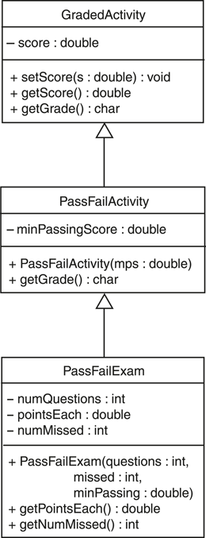

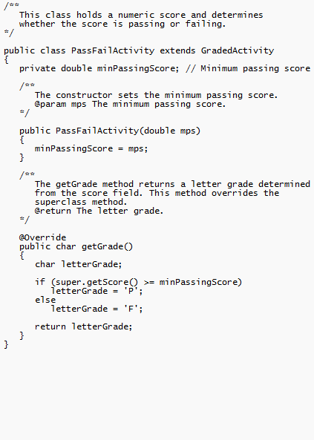
GradedActivity.java, PassFailActivity.java, PassFailExam.java, PassFailExamDemo.java

Slide 30
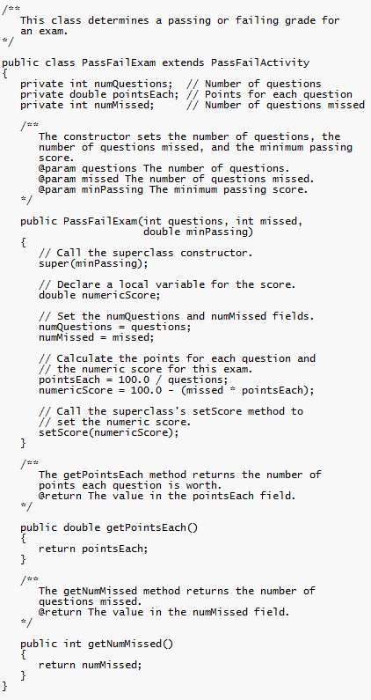
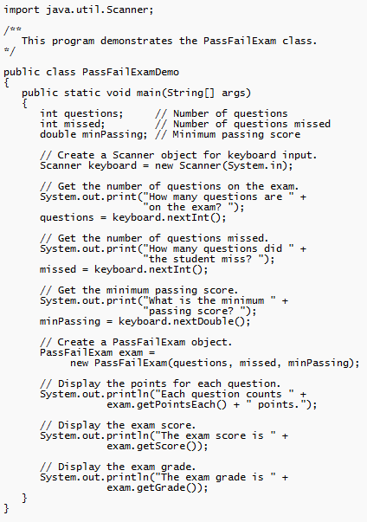
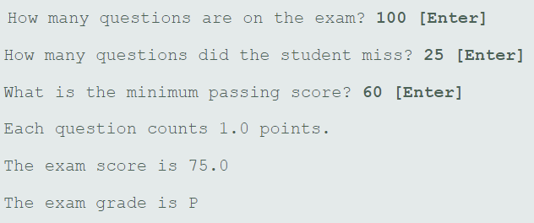
GradedActivity.java, PassFailActivity.java, PassFailExam.java, PassFailExamDemo.java

Slide 31
The Object Class (1 of 2)
All Java classes are directly or indirectly derived from a class named Object.
Object is in the java.lang package.
Any class that does not specify the extends keyword is automatically derived from the Object class.
public class MyClass
{
// This class is derived from Object.
}
Ultimately, every class is derived from the Object class.

Slide 32
The Object Class (2 of 2)
Because every class is directly or indirectly derived from the Object class:
every class inherits the Object class’s members.
example: toString and equals.
In the Object class, the toString method returns a string containing the object’s class name and a hash of its memory address.
The equals method accepts the address of an object as its argument and returns true if it is the same as the calling object’s address.
Example: ObjectMethods.java

Slide 33
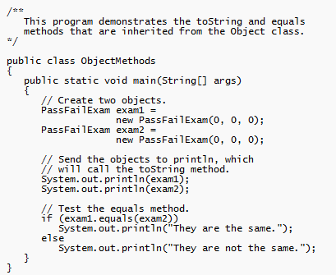
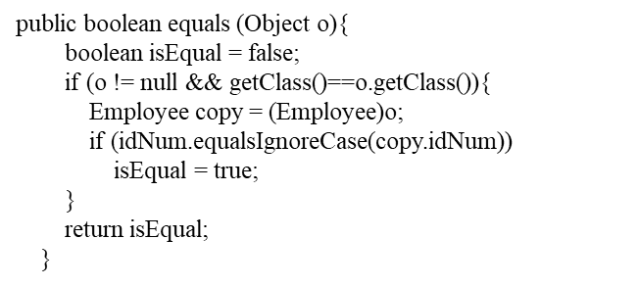
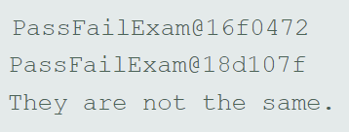
ObjectMethods.java
Steps for public boolean equals( )
Set boolean to false (assumes not equal)
Ensure param is not null and is a class of the object calling the method
If so, cast to appropriate type
Create a comparison that makes them equal
If equal, set the boolean var to true
Return the boolean var
Steps for public String toString()
Create a Sting var
Set the var to desired output
Return var
For subclasses, use super.toString to call superclass .toString and then add to this in subclass NOTE – Can chain several super and sub classes this way

Slide 34
Polymorphism (1 of 4)
A reference variable can reference objects of classes that are derived from the variable’s class.
GradedActivity exam;
We can use the exam variable to reference a GradedActivity object.
exam = new GradedActivity();
The GradedActivity class is also used as the superclass for the FinalExam class.
An object of the FinalExam class is a GradedActivity object.

Slide 35
Polymorphism (2 of 4)
A GradedActivity variable can be used to reference a FinalExam object.
GradedActivity exam = new FinalExam(50, 7);
This statement creates a FinalExam object and stores the object’s address in the exam variable.
This is an example of polymorphism.
The term polymorphism means the ability to take many forms.
In Java, a reference variable is polymorphic because it can reference objects of types different from its own, as long as those types are subclasses of its type.

Slide 36
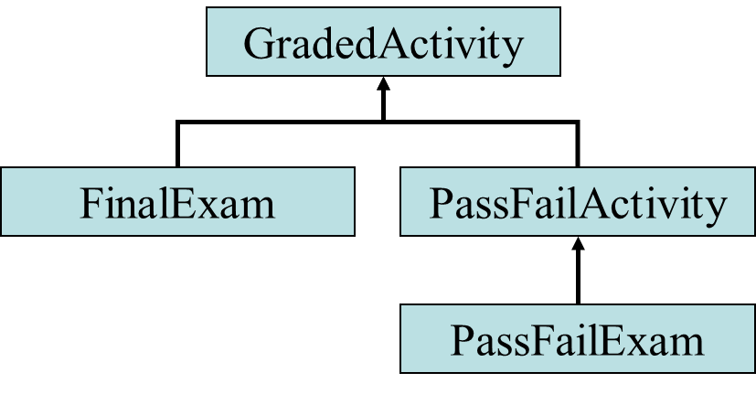
Polymorphism (3 of 4)
Other legal polymorphic references:
GradedActivity exam1 = new FinalExam(50, 7);
GradedActivity exam2 = new PassFailActivity(70);
GradedActivity exam3 = new PassFailExam(100, 10, 70);
The GradedActivity class has three methods: setScore, getScore, and getGrade.
A GradedActivity variable can be used to call only those three methods.
GradedActivity exam = new PassFailExam(100, 10, 70);
System.out.println(exam.getScore()); // This works.
System.out.println(exam.getGrade()); // This works.
System.out.println(exam.getPointsEach()); // ERROR!

Slide 37
Polymorphism and Dynamic Binding
If the object of the subclass has overridden a method in the superclass:
If the variable makes a call to that method the subclass’s version of the method will be run.
GradedActivity exam = new PassFailActivity(60);
exam.setScore(70);
System.out.println(exam.getGrade()); //In this case, getGrade()in PassFailActivity runs and returns ‘P’
Java performs dynamic binding or late binding when a variable contains a polymorphic reference.
The Java Virtual Machine determines at runtime which method to call, depending on the type of object that the variable references.
Cassoni’s tip – Ensure left and right sides are same type. Then use an array or ArrayList<> of type with most basic (highest) superclass.

Slide 38
Polymorphism (4 of 4)
It is the object’s type, rather than the reference type, that determines which method is called.
Example:
Polymorphic.java

Slide 39
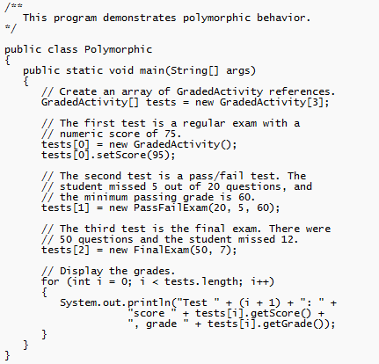
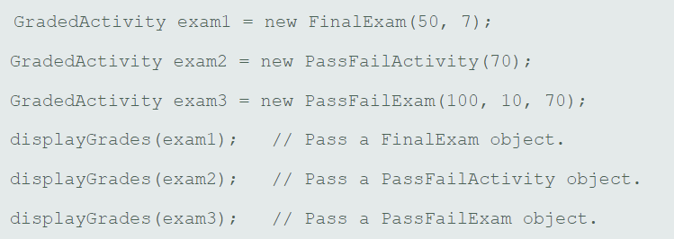
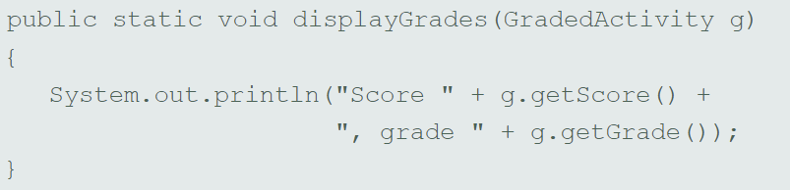
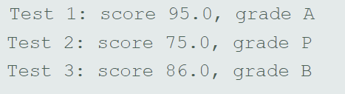
Polymorphic.java

Slide 40
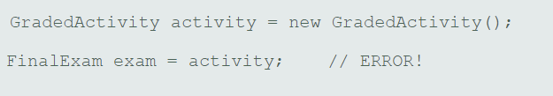
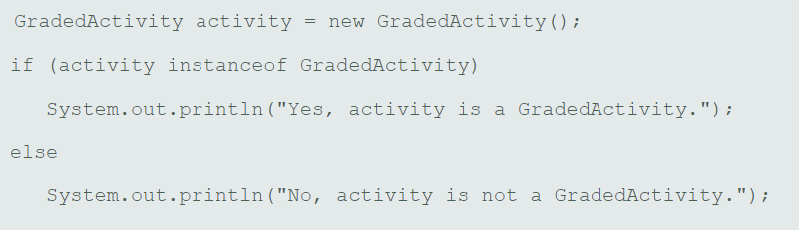
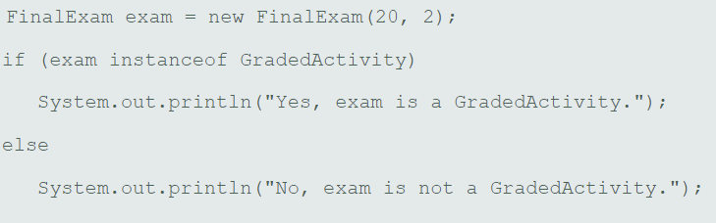
Is-a and instanceof
Is-a Relationship Does Not Work in Reverse. You cannot assign a superclass object to a subclass reference variable.
FinalExam is-a Graded Activity. However, a GradedActivity is-not a FinalExam
Prints - "Yes, activity is a GradedActivity."
Prints - "Yes, exam is a GradedActivity."

Slide 41
Abstract Classes
An abstract class cannot be instantiated, but other classes are derived from it.
An Abstract class serves as a superclass for other classes.
The abstract class represents the generic or abstract form of all the classes that are derived from it.
A class becomes abstract when you place the abstract key word in the class definition.
public abstract class ClassName

Slide 42
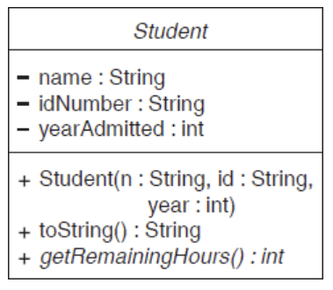
Abstract Methods (1 of 2)
An abstract method has no body and must be overridden in a subclass.
An abstract method is a method that appears in a superclass, but expects to be overridden in a subclass.
An abstract method has only a header and no body.
AccessSpecifier abstract ReturnType MethodName(ParameterList);
Example:
Student.java, CompSciStudent.java, CompSciStudentDemo.java
getRemainingHours() is abstract, therefore Student is abstract

Slide 43
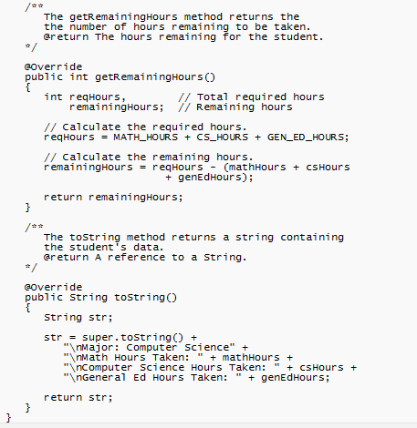
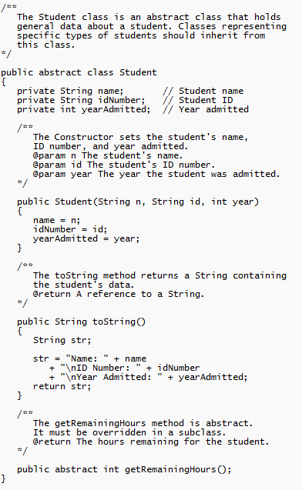
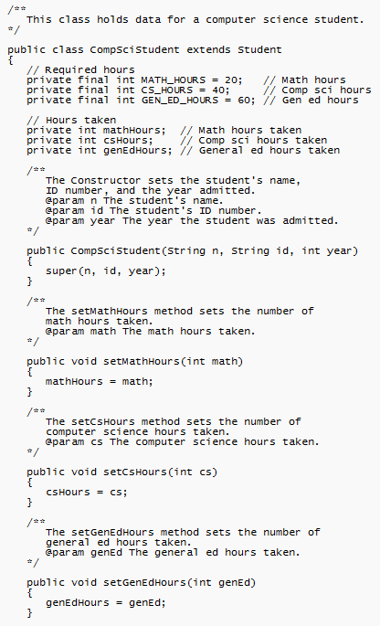
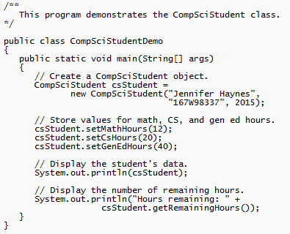
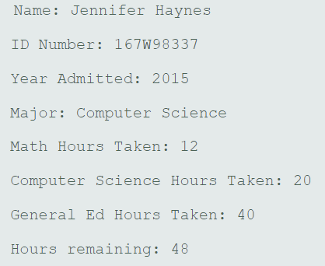
Student.java, CompSciStudent.java, CompSciStudentDemo.java

Slide 44
Abstract Methods (2 of 2)
Notice that the key word abstract appears in the header, and that the header ends with a semicolon.
public abstract int getRemainingHours( );
Any class that contains an abstract method is automatically abstract.
If a subclass fails to override an abstract method, a compiler error will result.
Abstract methods are used to ensure that a subclass implements the method.

Slide 45
Interfaces (1 of 3)
An interface is similar to an abstract class that has all abstract methods.
It cannot be instantiated, and
all the methods listed in an interface must be written elsewhere.
The purpose of an interface is to specify behavior for other classes.
It is often said that an interface is like a “contract,” and when a class implements an interface it must adhere to the contract.
An interface looks similar to a class, except:
the keyword interface is used instead of the keyword class, and
the methods that are specified in an interface have no bodies, only headers that are terminated by semicolons.

Slide 46
Interfaces (2 of 3)
The general format of an interface definition:
public interface InterfaceName
{
(Method headers...)
}
All methods specified by an interface are public by default.
A class can implement one or more interfaces (ie implements Interface1, Interface2).

Slide 47
Interfaces (3 of 3)
If a class implements an interface, it uses the implements keyword in the class header.
public class FinalExam3 extends GradedActivity implements Relatable
Example:
GradedActivity.java
Relatable.java
FinalExam3.java
InterfaceDemo.java

Slide 48

Interfaces in UML
A dashed line with an arrow indicates implementation of an interface

Slide 49





GradedActivity.java, Relatable.java FinalExam3.java, RelatableExams.java

Slide 50
Fields in Interfaces
An interface can contain field declarations:
all fields in an interface are treated as final and static.
Because they automatically become final, you must provide an initialization value.
public interface Doable
{
int FIELD1 = 1, FIELD2 = 2;
(Method headers...)
}
In this interface, FIELD1 and FIELD2 are final static int variables.
Any class that implements this interface has access to these variables. Extended subclasses also have access.

Slide 51
Implementing Multiple Interfaces
A class can be derived from only one superclass.
Java allows a class to implement multiple interfaces.
When a class implements multiple interfaces, it must provide the methods specified by all of them.
To specify multiple interfaces in a class definition, simply list the names of the interfaces, separated by commas, after the implements key word.
public class MyClass implements Interface1,
Interface2,
Interface3

Slide 52
Polymorphism with Interfaces (1 of 3)
Java allows you to create reference variables of an interface type.
An interface reference variable can reference any object that implements that interface, regardless of its class type.
This is another example of polymorphism.
Example:
RetailItem.java
CompactDisc.java
DvdMovie.java
PolymorphicInterfaceDemo.java

Slide 53





RetailItem.java, CompactDisc.java, DvdMovie.java, PolymorphicInterfaceDemo.java

Slide 54
Polymorphism with Interfaces (2 of 3)
In the example code, two RetailItem reference variables, item1 and item2, are declared.
The item1 variable references a CompactDisc object and the item2 variable references a DvdMovie object.
When a class implements an interface, an inheritance relationship known as interface inheritance is established.
a CompactDisc object is a RetailItem, and
a DvdMovie object is a RetailItem.

Slide 55
Polymorphism with Interfaces (3 of 3)
A reference to an interface can point to any class that implements that interface.
You cannot create an instance of an interface.
RetailItem item = new RetailItem(); // ERROR!
When an interface variable references an object:
only the methods declared in the interface are available,
explicit type casting is required to access the other methods of an object referenced by an interface reference.

Slide 56

Copyright
This work is protected by United States copyright laws and is provided solely for the use of instructions in teaching their courses and assessing student learning. dissemination or sale of any part of this work (including on the World Wide Web) will destroy the integrity of the work and is not permit- ted. The work and materials from it should never be made available to
students except by instructors using the accompanying text in their classes. All recipients of this work are expected to abide by these
restrictions and to honor the intended pedagogical purposes and the needs of
other instructors who rely on these materials.

Slide 57
Backup Slides

Slide 58
Protected Members (1 of 2)
Protected members of class:
may be accessed by methods in a subclass, and
by methods in the same package as the class.
Java provides a third access specification, protected.
A protected member’s access is somewhere between private and public.
Example:
GradedActivity2.java
FinalExam2.java
ProtectedDemo.java

Slide 59
Protected Members (2 of 2)
Using protected instead of private makes some tasks easier.
However, any class that is derived from the class, or is in the same package, has unrestricted access to the protected member.
It is always better to make all fields private and then provide public methods for accessing those fields.
If no access specifier for a class member is provided, the class member is given package access by default.
Any method in the same package may access the member.

Slide 60
Access Specifiers
Access Modifier | Accessible to a subclass inside the same package? | Accessible to all other classes inside the same package?
default (no modifier) | Yes | Yes
Public | Yes | Yes
Protected | Yes | Yes
Private | No | No
Access Modifier | Accessible to a subclass outside the package? | Accessible to all other classes outside the package?
default (no modifier) | No | No
Public | Yes | Yes
Protected | Yes | No
Private | No | No

Slide 61
Default Methods
Beginning in Java 8, interfaces may have default methods.
A default method is an interface method that has a body.
You can add new methods to an existing interface without causing errors in the classes that already implement the interface.
Example:
Displayable.java
Person.java
InterfaceDemoDefaultMethod.java

Slide 62
Anonymous Inner Classes
An inner class is a class that is defined inside another class.
An anonymous inner class is an inner class that has no name.
An anonymous inner class must implement an interface, or extend another class.
Useful when you need a class that is simple, and to be instantiated only once in your code.
Example:
IntCalculator.java
AnonymousClassDemo.java

Slide 63
Functional Interfaces and Lambda Expressions
A functional interface is an interface that has one abstract method.
A lambda expression can be used to create an object that implements the interface, and overrides its abstract method.
In Java 8, these features work together to simplify code, particularly in situations where you might use anonymous inner classes.
Example:
LambdaDemo.java
LambdaDemo2.java

