Slide 1
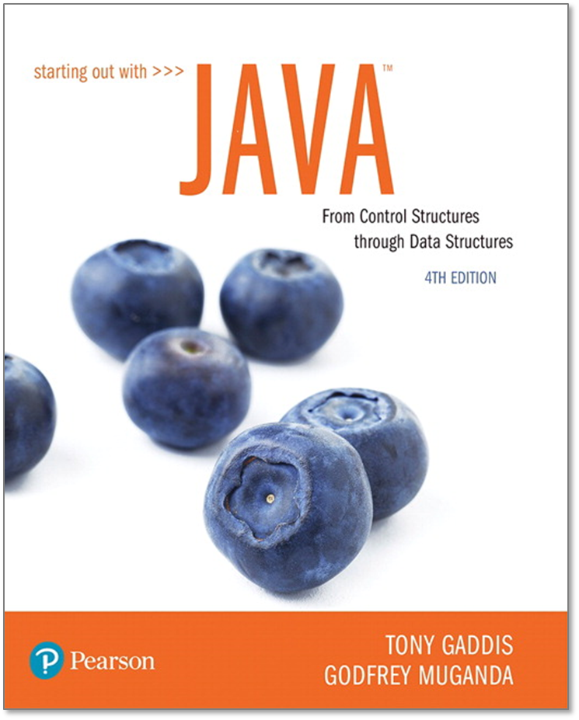
STARTING OUT WITH JAVATM
4th Edition
Chapter 11
Exceptions and
Advanced File I/O
Rico Cassoni, CISSP, PMP

Slide 2
Chapter Topics
Chapter 11 discusses the following main topics:
  Handling Exceptions
  Throwing Exceptions
  More about Input/Output Streams
  Advanced Topics:
    Binary Files,
    Random Access Files, and
    Object Serialization

Slide 3
Handling Exceptions (1 of 2)
An exception is an object that is generated as the result of an error or an unexpected event.
Exception are said to have been “thrown.”
It is the programmer’s responsibility to write code that detects and handles exceptions.
Unhandled exceptions will crash a program.
Example: BadArray.java
Java allows you to create exception handlers.

Slide 4
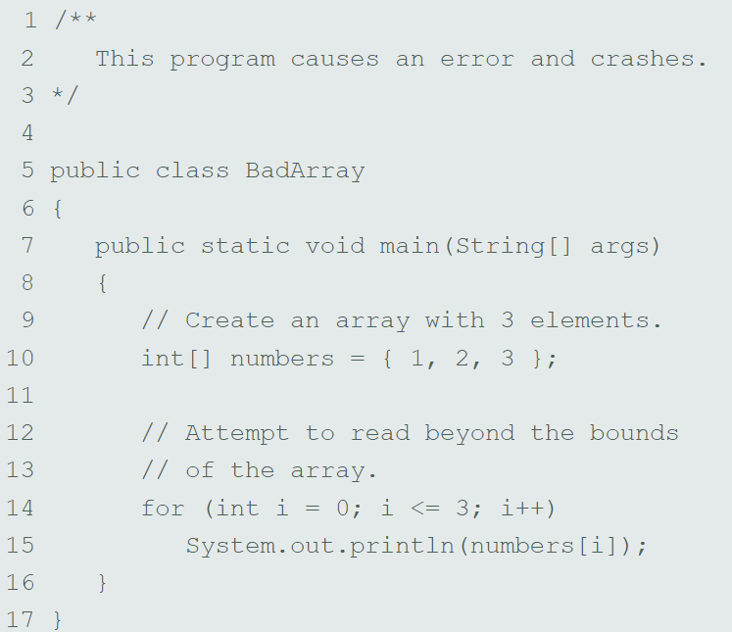
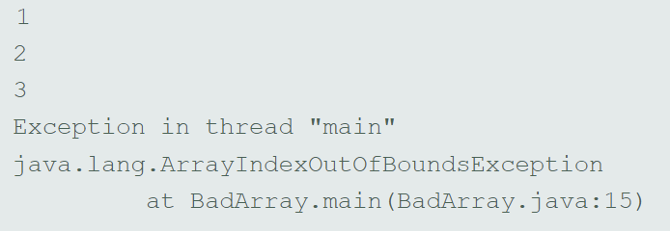
BadArray

Slide 5
Handling Exceptions (2 of 2)
An exception handler is a section of code that gracefully responds to exceptions.
The process of intercepting and responding to exceptions is called exception handling.
The default exception handler deals with unhandled exceptions.
The default exception handler prints an error message and crashes the program.

Slide 6
Exception Classes (1 of 3)
An exception is an object.
Exception objects are created from classes in the Java API hierarchy of exception classes.
All the exception classes in the hierarchy are derived from the Throwable class.
Error and Exception are derived from the Throwable class.

Slide 7
Exception Classes (2 of 3)
Classes that are derived from Error:
  are for exceptions that are thrown when critical errors occur. (i.e.)
    an internal error in the Java Virtual Machine, or
    running out of memory.
Applications should not try to handle these errors because they are the result of a serious condition.
Programmers should handle the exceptions that are instances of classes that are derived from the Exception class.

Slide 8
Exception Classes (3 of 3)
NOTE-The inheritance throughout
Object
Major issues. We don’t handle these as coders
Throwable
These are the ones that we handle as coders. Can create our own.
Error
Exception
…
…
IOException
RuntimeException
…
EOFException
FileNotFoundException
…

Slide 9
Handling Exceptions (1 of 6)
To handle an exception, you use a try statement.
  try
  {
  (try block statements...)
  }
  catch (ExceptionType ParameterName)
  {
  (catch block statements...)
  }
First the keyword try indicates a block of code will be attempted (the curly braces are required).
This block of code is known as a try block.

Slide 10
Handling Exceptions (2 of 6)
A try block is:
  one or more statements that are executed, and
  can potentially throw an exception.
The application will not halt if the try block throws an exception.
After the try block, a catch clause appears.

Slide 11
Handling Exceptions (3 of 6)
A catch clause begins with the key word catch:
  catch (ExceptionType ParameterName)
  ExceptionType is the name of an exception class and
  ParameterName is a variable name which will reference the exception object if the code in the try block throws an exception.
The code that immediately follows the catch clause is known as a catch block (the curly braces are required).
The code in the catch block is executed if the try block throws an exception.

Slide 12
Handling Exceptions (4 of 6)
This code is designed to handle a FileNotFoundException if it is thrown.
  try
  {
  File file = new File ("MyFile.txt");
  Scanner inputFile = new Scanner(file);
  }
  catch (FileNotFoundException e)
  {
  System.out.println("File not found.");
  }
The Java Virtual Machine searches for a catch clause that can deal with the exception.
Example: OpenFile.java

Slide 13
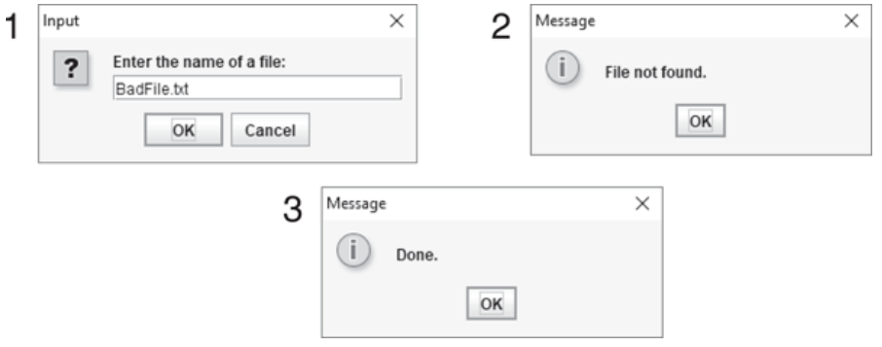
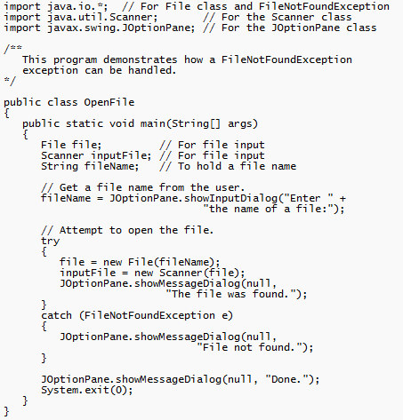
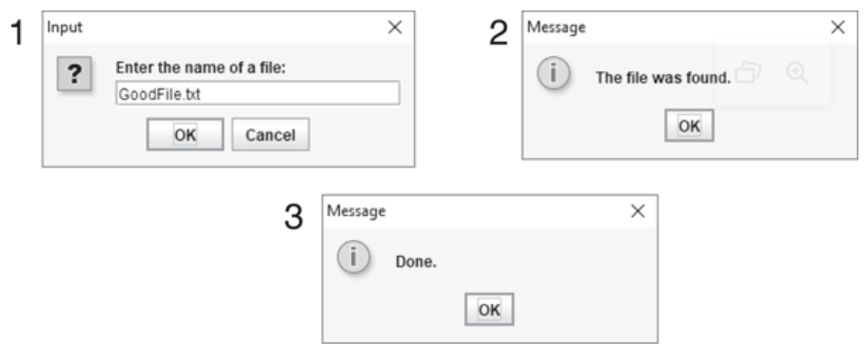
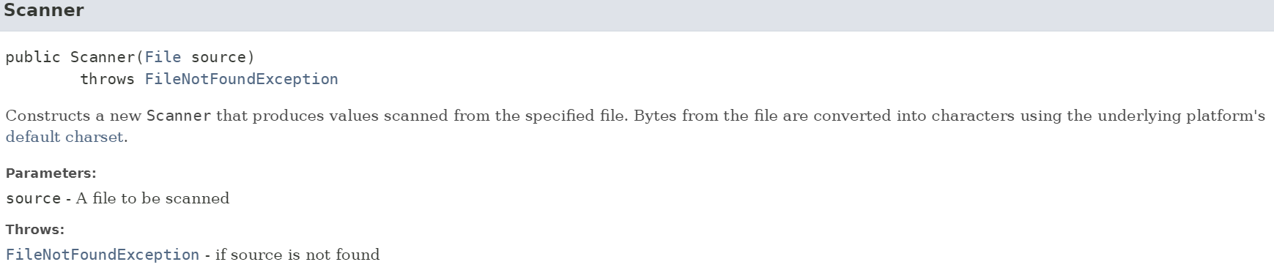
OpenFile
Once an exception is thrown, it tries to find an applicable catch
https://docs.oracle.com/en/java/javase/17/docs/api/java.base/module-summary.html
Go to java.util, select Scanner, and then look at the constructor, Scanner (File source)

Slide 14
Handling Exceptions (5 of 6)
The parameter must be of a type that is compatible with the thrown exception’s type.
  In the case of the OpenFile example
  (FileNotFoundException e). NOTE - It is customary to use e as the param name
After an exception, the program will continue execution at the point just past the catch block.

Slide 15
Handling Exceptions (6 of 6)
Each exception object has a method named getMessage that can be used to retrieve the default error message for the exception.
Example:
  ExceptionMessage.java
  ParseIntError.java

Slide 16
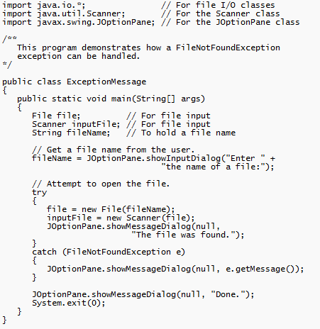
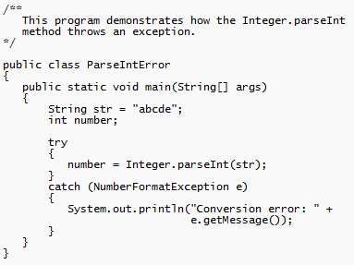
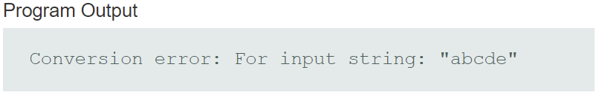
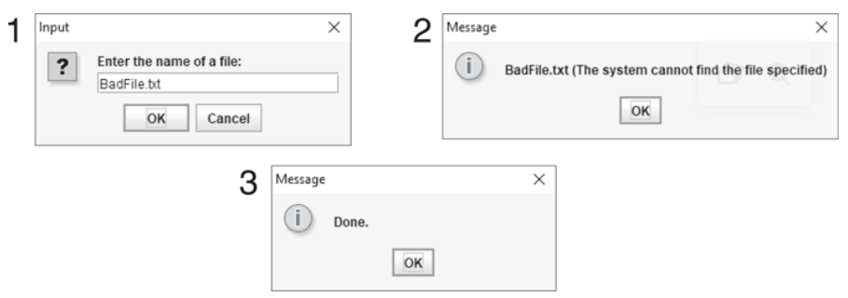
ExceptionMessage.java, ParseIntError.java

Slide 17
Polymorphic References To Exceptions
(1 of 2)
When handling exceptions, you can use a polymorphic reference as a parameter in the catch clause.
Most exceptions are derived from the Exception class.
A catch clause that uses a parameter variable of the Exception type is capable of catching any exception that is derived from the Exception class.

Slide 18
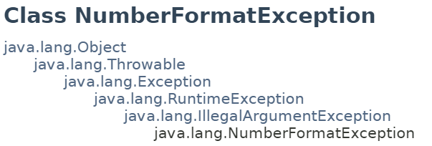
Polymorphic References To Exceptions
(2 of 2)
  try
  {
  number = Integer.parseInt(str);
  }
  catch (Exception e)
  {
  System.out.println("The following error occurred: "
  + e.getMessage());
  }
The Integer class’s parseInt method throws a NumberFormatException object.
The NumberFormatException class is derived from the Exception class.

Slide 19
Handling Multiple Exceptions
The code in the try block may be capable of throwing more than one type of exception.
A catch clause needs to be written for each type of exception that could potentially be thrown.
The JVM will run the first compatible catch clause found.
The catch clauses must be listed from most specific to most general.
Example: SalesReport.java, SalesReport2.java

Slide 20
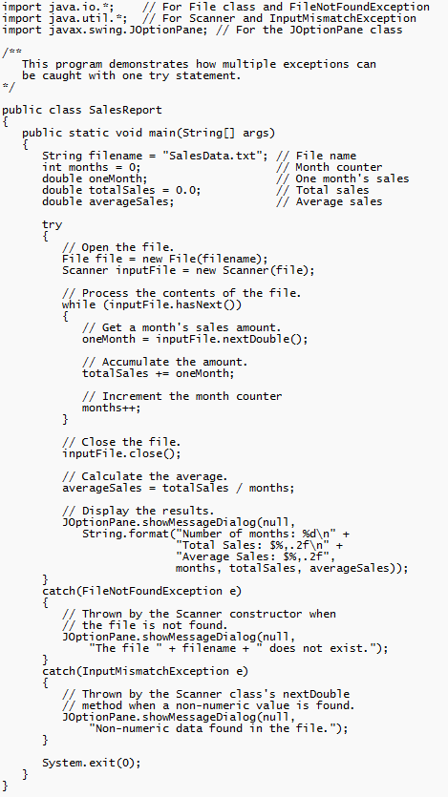
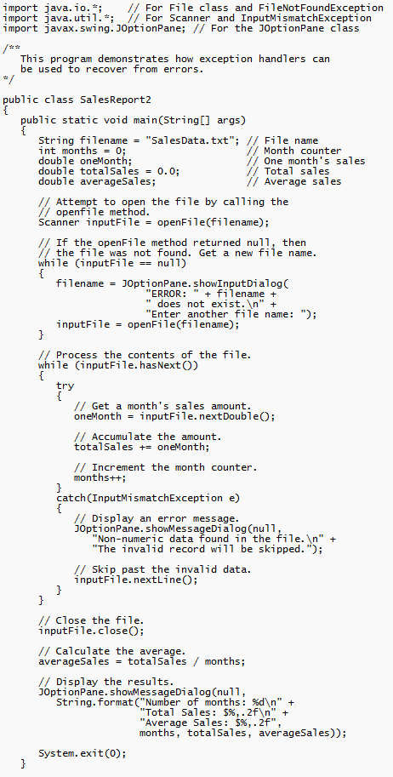
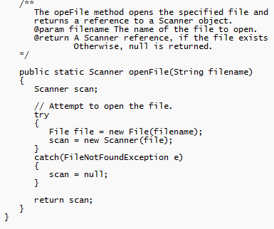
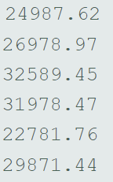
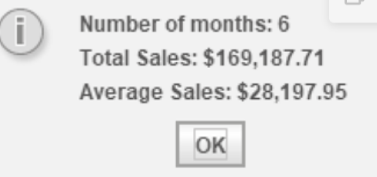
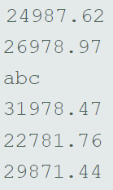
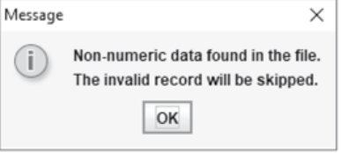
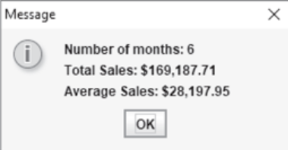
SalesReport.java, SalesReport2.java

Slide 21
Exception Handlers (1 of 3)
There can be many polymorphic catch clauses.
A try statement may have only one catch clause for each specific type of exception.
  try
  {
  number = Integer.parseInt(str);
  }
  catch (NumberFormatException e)
  {
  System.out.println("Bad number format.");
  }
  catch (NumberFormatException e) // ERROR!!!
  {
  System.out.println(str + " is not a number.");
  }

Slide 22
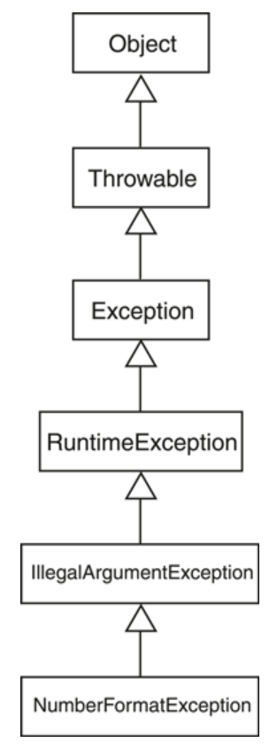
Exception Handlers (2 of 3)
The NumberFormatException class is derived from the IllegalArgumentException class.
  try
  {
  number = Integer.parseInt(str);
  }
  catch (IllegalArgumentException e)
  {
  System.out.println("Bad number format.");
  }
  catch (NumberFormatException e) // ERROR!!!
  {
  System.out.println(str + " is not a number.");
  }

Slide 23
Exception Handlers (3 of 3)
The previous code could be rewritten to work, as follows, with no errors:
  try
  {
  number = Integer.parseInt(str);
  }
  catch (NumberFormatException e)
  {
  System.out.println(str + " is not a number.");
  }
  catch (IllegalArgumentException e) //OK
  {
  System.out.println("Bad number format.");
  }

Slide 24
The finally Clause (1 of 2)
The try statement may have an optional finally clause.
If present, the finally clause must appear after all the catch clauses.
  try
  {
  (try block statements...)
  }
  catch (ExceptionType ParameterName)
  {
  (catch block statements...)
  }
  finally
  {
  (finally block statements...)
  }

Slide 25
The finally Clause (2 of 2)
The finally block is one or more statements,
  that are always executed after the try block has executed and
  after any catch blocks have executed if an exception was thrown.
The statements in the finally block execute whether an exception occurs or not.

Slide 26
The Stack Trace
The call stack is an internal list of all the methods that are currently executing.
A stack trace is a list of all the methods in the call stack.
It indicates:
  the method that was executing when an exception occurred and
  all the methods that were called in order to execute that method.
Example: StackTrace.java

Slide 27
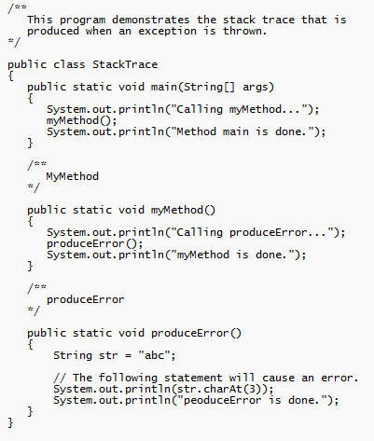
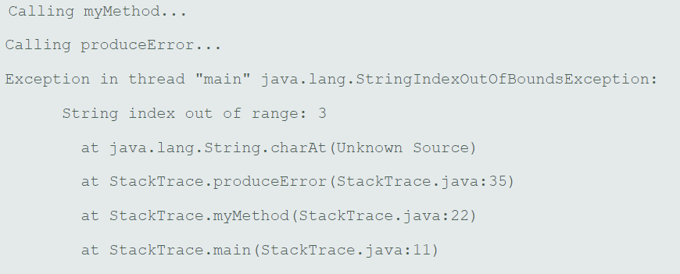
StackTrace.java

Slide 28
Multi-Catch (Java 7)
Beginning in Java 7, you can specify more than one exception in a catch clause:
try
{
}
catch(NumberFormatException | InputMismatchException ex)
{
}
Separate the exceptions with
the | character.
I’m old school and like separate catches. Seems cleaner

Slide 29
Uncaught Exceptions (1 of 2)
When an exception is thrown, it cannot be ignored.
It must be handled by the program (graceful with try/catch), or by the default exception handler (harsh program shutdown).
When the code in a method throws an exception:
  normal execution of that method stops, and
  the JVM searches for a compatible exception handler inside the method.

Slide 30
Uncaught Exceptions (2 of 2)
If there is no exception handler inside the method:
  control of the program is passed to the previous method in the call stack.
  If that method has no exception handler, then control is passed again, up the call stack, to the previous method.
If control reaches the main method:
  the main method must either handle the exception, or
  the program is halted and the default exception handler handles the exception.

Slide 31
Checked and Unchecked Exceptions (1 of 4)
There are two categories of exceptions:
  unchecked
  checked.
Unchecked exceptions are those that are derived from the Error class or the RuntimeException class.
Exceptions derived from Error are thrown when a critical error occurs, and should not be handled.
RuntimeException serves as a superclass for exceptions that result from programming errors.
  These exceptions can be avoided with properly written code.
All exceptions that are not derived from Error or RuntimeException are checked exceptions.

Slide 32
Checked and Unchecked Exceptions (2 of 4)
If the code in a method can throw a checked exception, the method:
  must handle the exception, or
  it must have a throws clause listed in the method header.
The throws clause informs the compiler what exceptions can be thrown from a method.

Slide 33
Checked and Unchecked Exceptions (3 of 4)
  // This method will not compile!
  public void displayFile(String name)
  {
  // Open the file.
  File file = new File(name);
  Scanner inputFile = new Scanner(file);
  // Read and display the file's contents.
  while (inputFile.hasNext())
  {
  System.out.println(inputFile.nextLine());
  }
  // Close the file.
  inputFile.close();
  }

Slide 34
Checked and Unchecked Exceptions (4 of 4)
The code in this method is capable of throwing checked exceptions.
The keyword throws can be written at the end of the method header, followed by a list of the types of exceptions that the method can throw.
The slang for this is “Passing the Buck”
  public void displayFile(String name)
  throws FileNotFoundException

Slide 35
Throwing Exceptions (1 of 2)
You can write code that:
  throws one of the standard Java exceptions, or
  an instance of a custom exception class that you have designed.
The throw statement is used to manually throw an exception.
  throw new ExceptionType(MessageString);
The throw statement causes an exception object to be created and thrown.

Slide 36
Throwing Exceptions (2 of 2)
The MessageString argument contains a custom error message that can be retrieved from the exception object’s getMessage method.
If you do not pass a message to the constructor, the exception will have a null message.
  throw new Exception("Out of fuel");
  Note: Don’t confuse the throw statement with the throws clause.
Example: DieExceptionDemo.java

Slide 37
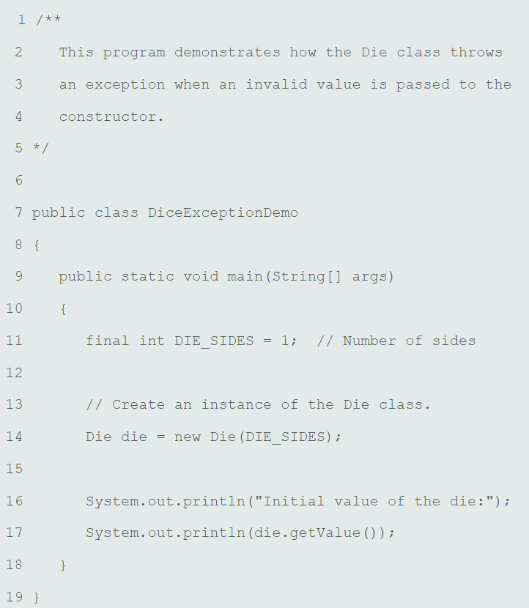
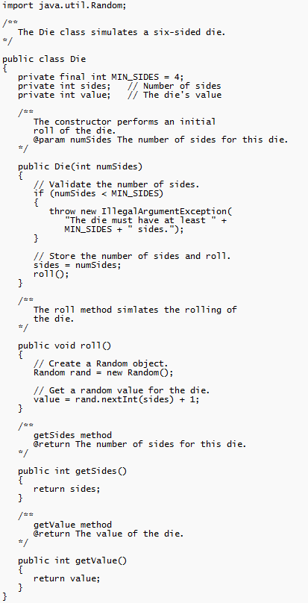
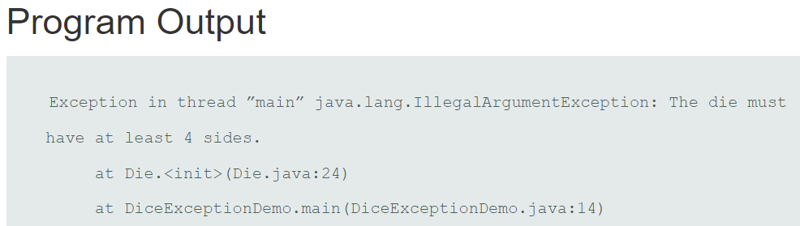
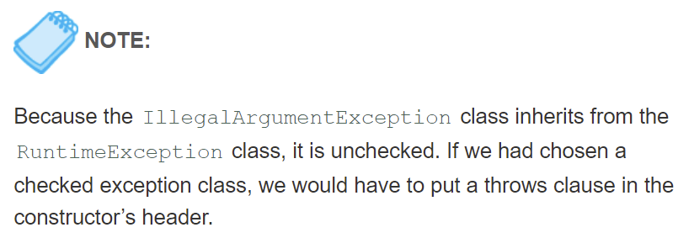
DieExceptionDemo.java

Slide 38
Creating Exception Classes (1 of 2)
You can create your own exception classes by deriving them from the Exception class or one of its derived classes.
Example:
  BankAccount.java
  NegativeStartingBalance.java
  AccountTest.java

Slide 39
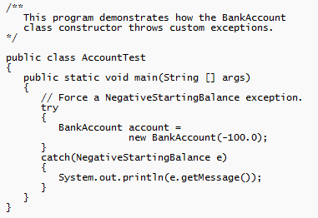
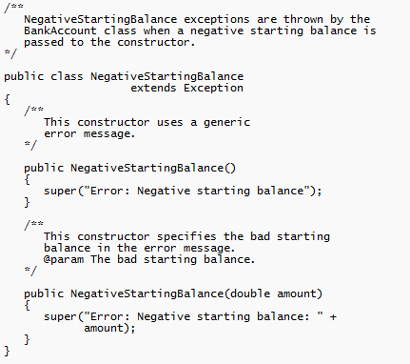
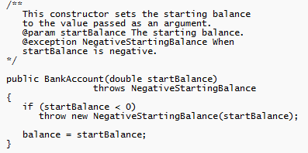
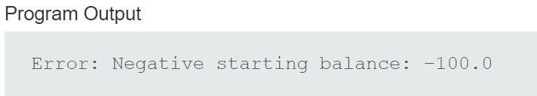
BankAccount.java, NegativeStartingBalance.java,
AccountTest.java
This is HUGE for helping out
with Lab 11

Slide 40
Creating Exception Classes (2 of 2)
Some examples of exceptions that can affect a bank account:
  A negative starting balance is passed to the constructor.
  A negative interest rate is passed to the constructor.
  A negative number is passed to the deposit method.
  A negative number is passed to the withdraw method.
  The amount passed to the withdraw method exceeds the account’s balance.
We can create exceptions that represent each of these error conditions.

Slide 41
@exception Tag in Documentation Comments
General format
  @exception ExceptionName Description
The following rules apply
  The @exception tag in a method’s documentation comment must appear after the general description of the method.
  The description can span several lines. It ends at the end of the documentation comment (the */ symbol) or at the beginning of another tag.

Slide 42
Binary Files, Random Access Files, and Object Serialization
Binary Files and Object Serialization will be required for the Final Project.

Slide 43
Binary Files (1 of 6)
The way data is stored in memory is sometimes called the raw binary format.
Data can be stored in a file in its raw binary format.
A file that contains binary data is often called a binary file.
Storing data in its binary format is more efficient than storing it as text. For example, “1234” is 8B (each char in a string is 2B) vs 4B for an int.
PrintWriter print() and println()s store everything as text

Slide 44
Binary Files (2 of 6)
Binary files cannot be opened in a text editor such as Notepad.
To write data to a binary file you must create objects from the following classes:
  FileOutputStream - allows you to open a file for writing binary data. It provides only basic functionality for writing bytes to the file.
  DataOutputStream - allows you to write data of any primitive type or String objects to a binary file. Cannot directly access a file. It is used in conjunction with a FileOutputStream object that has a connection to a file.

Slide 45
Binary Files (3 of 6)
A DataOutputStream object is wrapped around a FileOutputStream object to write data to a binary file.
  FileOutputStream fstream = new
  FileOutputStream("MyInfo.dat");
  DataOutputStream outputFile = new
  DataOutputStream(fstream);
If the file that you are opening with the FileOutputStream object already exists, it will be erased and an empty file by the same name will be created.
Another constructor allows for a 2nd argument boolean in the FileOutputStream constructor call. true appends, false erases
FileOutputStream fstream = new
FileOutputStream("MyInfo.dat“, true);

Slide 46
Binary Files (4 of 6)
These statements can combined into one.
  DataOutputStream outputFile = new DataOutputStream(new
  FileOutputStream("MyInfo.dat"));
Once the DataOutputStream object has been created, you can use it to write binary data to the file.
Example: WriteBinaryFile.java

Slide 47
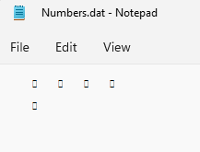
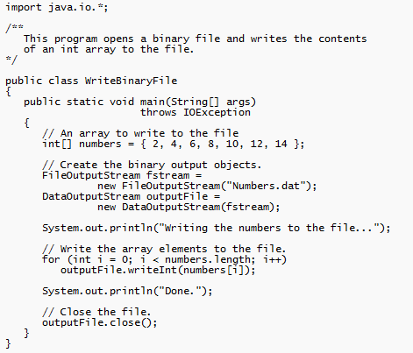
WriteBinaryFile.java
See page 734 for
popular methods.
write<type>( )’s for each
primitive type. For
example, writeInt(3).
Use writeUTF (“profC”)
for Strings

Slide 48
Binary Files (5 of 6)
To open a binary file for input, you wrap a DataInputStream object around a FileInputStream object.
  FileInputStream fstream = new FileInputStream("MyInfo.dat");
  DataInputStream inputFile = new DataInputStream(fstream);
These two statements can be combined into one.
  DataInputStream inputFile = new DataInputStream(new
  FileInputStream("MyInfo.dat"));

Slide 49
Binary Files (6 of 6)
The FileInputStream constructor will throw a FileNotFoundException if the file named by the string argument cannot be found.
Once the DataInputStream object has been created, you can use it to read binary data from the file.
Example:
  ReadBinaryFile.java

Slide 50
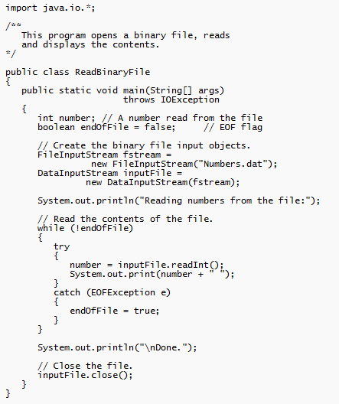

ReadBinaryFile.java
See page 736 for
popular methods.
read<type>( )’s for each
primitive type. For
example, readInt( )
and readUTF ( )
for Strings.

Slide 51
Writing and Reading Strings (1 of 2)
To write a string to a binary file, use the DataOutputStream class’s writeUTF method.
This method writes its String argument in a format known as UTF-8 encoding.
  Just before writing the string, this method writes a two-byte integer indicating the number of bytes that the string occupies.
  Then, it writes the string’s characters in Unicode. (UTF stands for Unicode Text Format.)
  Two byte interger code not necessary for primitive types since size is fixed depending on type (ie int are 4B)
The DataInputStream class’s readUTF method reads from the file and uses two-byte integer to know how big String is and therefore far to read.

Slide 52
Writing and Reading Strings (2 of 2)
To write a string to a file:
  String name = "Chloe";
  outputFile.writeUTF(name);
To read a string from a file:
  String name = inputFile.readUTF();
The readUTF method will correctly read a string only when the string was written with the writeUTF method.
Example:
  WriteUTF.java
  ReadUTF.java
vs. print(name) or println(name) for PrintWriter (text file)

Slide 53
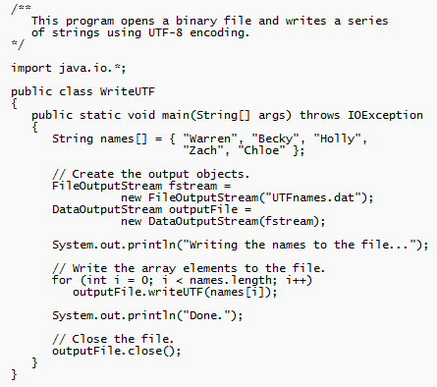
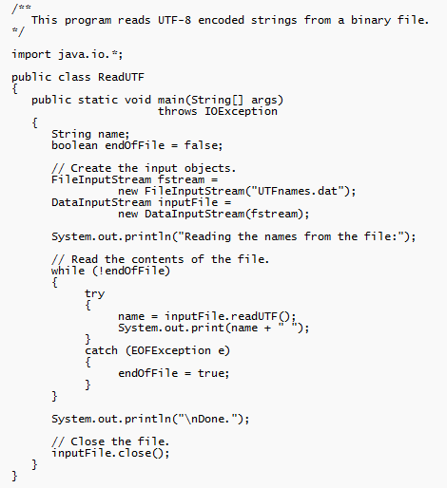
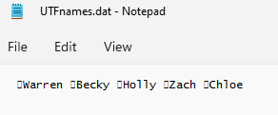
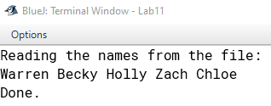
WriteUTF.java, ReadUTF.java

Slide 54
Appending Data to Binary Files
The FileOutputStream constructor takes an optional second argument which must be a boolean value.
If the argument is true, the file will not be erased if it exists; new data will be written to the end of the file.
If the argument is false, the file will be erased if it already exists.
  FileOutputStream fstream = new FileOutputStream("MyInfo.dat", true);
  DataOutputStream outputFile = new DataOutputStream(fstream);

Slide 55
Random Access Files (1 of 5)
Text files and the binary files previously shown use sequential file access.
With sequential access:
  The first time data is read from the file, the data will be read from its beginning.
  As the reading continues, the file’s read position advances sequentially through the file’s contents.
Sequential file access is useful in many circumstances.
If the file is very large, locating data buried deep inside it can take a long time.

Slide 56
Random Access Files (2 of 5)
Java allows a program to perform random file access.
In random file access, a program may immediately jump to any location in the file.
To create and work with random access files in Java, you use the RandomAccessFile class.
  RandomAccessFile(String filename, String mode)
  filename: the name of the file.
  mode: a string indicating the mode in which you wish to use the file.
    "r" = reading
    "rw" = for reading and writing.

Slide 57
Random Access Files (3 of 5)
  // Open a file for random reading.
  RandomAccessFile randomFile = new RandomAccessFile("MyData.dat", "r");
  // Open a file for random reading and writing.
  RandomAccessFile randomFile = new RandomAccessFile("MyData.dat", "rw");
When opening a file in "r" mode where the file does not exist, a FileNotFoundException will be thrown.
Opening a file in "r" mode and trying to write to it will throw an IOException.
If you open an existing file in "rw" mode, it will not be deleted and the file’s existing content will be preserved.

Slide 58
Random Access Files (4 of 5)
Items in a sequential access file are accessed one after the other.
Items in a random access file are accessed in any order.
If you open a file in "rw" mode and the file does not exist, it will be created.
A file that is opened or created with the RandomAccessFile class is treated as a binary file.

Slide 59
Random Access Files (5 of 5)
The RandomAccessFile class has:
  the same methods as the DataOutputStream class for writing data, and
  the same methods as the DataInputStream class for reading data.
The RandomAccessFile class can be used to sequentially process a binary file.
Example: WriteLetters.java

Slide 60
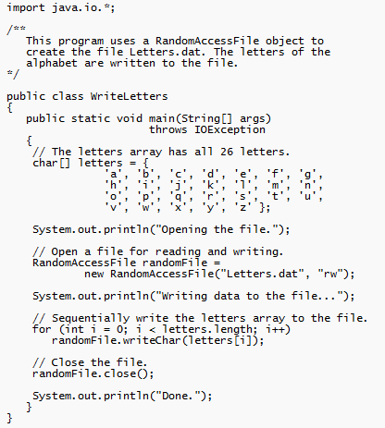
WriteLetters.java
NOTE1 – Did not have to
create FileOutputStream.
Just pass file name into
RandomAccessFile object.
NOTE2 – Since no try/catch,
have to throws in method
header writeChar( ) throws
IOException (a checked
exception).

Slide 61
The File Pointer (1 of 4)
The RandomAccessFile class treats a file as a stream of bytes.
The bytes are numbered:
  the first byte is byte 0.
  The last byte’s number is one less than the number of bytes in the file.
These byte numbers are similar to an array’s subscripts, and are used to identify locations in the file.
Internally, the RandomAccessFile class keeps a long integer value known as the file pointer.

Slide 62
The File Pointer (2 of 4)
The file pointer holds the byte number of a location in the file.
When a file is first opened, the file pointer is set to 0.
When an item is read from the file, it is read from the byte that the file pointer points to.
Reading also causes the file pointer to advance to the byte just beyond the item that was read.
If another item is immediately read, the reading will begin at that point in the file.

Slide 63
The File Pointer (3 of 4)
An EOFException is thrown when a read causes the file pointer to go beyond the size of the file.
Writing also takes place at the location pointed to by the file pointer.
If the file pointer points to the end of the file, data will be written to the end of the file.
If the file pointer holds the number of a byte within the file, at a location where data is already stored, a write will overwrite the data at that point.

Slide 64
The File Pointer (4 of 4)
The RandomAccessFile class lets you move the file pointer.
This allows data to be read and written at any byte location in the file.
The seek method is used to move the file pointer.
  rndFile.seek(long position);
The argument is the number of the byte that you want to move the file pointer to.

Slide 65
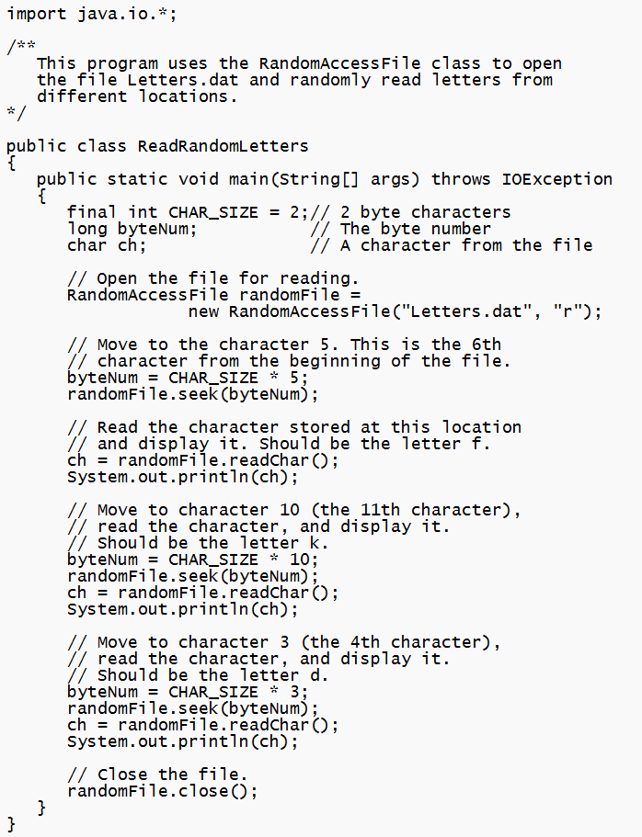
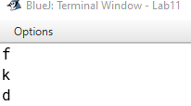
ReadRandLetters.java

Slide 66
Object Serialization (1 of 6)
If an object contains other types of objects as fields, saving its contents can be complicated.
Java allows you to serialize objects, which is a simpler way of saving objects to a file.
When an object is serialized, it is converted into a series of bytes that contain the object’s data.
If the object is set up properly, even the other objects that it might contain as fields are automatically serialized.
The resulting set of bytes can be saved to a file for later retrieval.

Slide 67
Object Serialization (2 of 6)
For an object to be serialized, its class must implement the Serializable interface.
The Serializable interface has no methods or fields.
It is used only to let the Java compiler know that objects of the class might be serialized.
If a class contains objects of other classes as fields, those classes must also implement the Serializable interface, in order to be serialized.
Example: BankAccount2.java

Slide 68
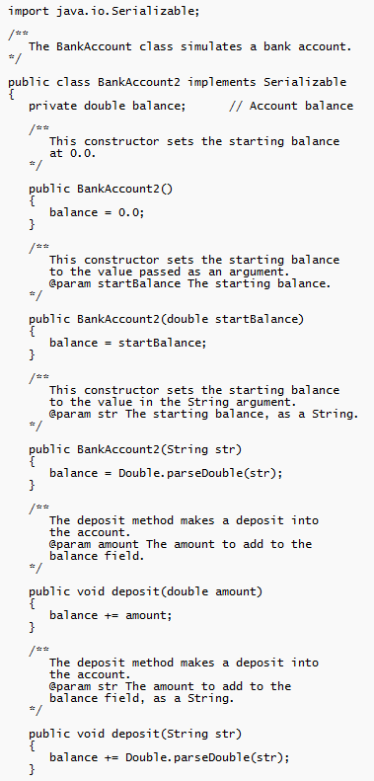
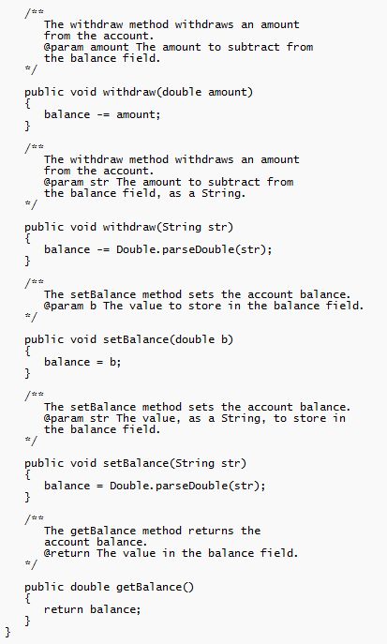
BankAccount2.java

Slide 69
Object Serialization (3 of 6)
The String class, as many others in the Java API, implements the Serializable interface.
To write a serialized object to a file, you use an ObjectOutputStream object.
The ObjectOutputStream class is designed to perform the serialization process.
To write the bytes to a file, an output stream object is needed.
  FileOutputStream outStream = new FileOutputStream("Objects.dat");
  ObjectOutputStream objectOutputFile = new ObjectOutputStream(outStream);

Slide 70
Object Serialization (4 of 6)
To serialize an object and write it to the file, the ObjectOutputStream class’s writeObject method is used.
  BankAccount2 account = new
  BankAccount(25000.0);
  objectOutputFile.writeObject(account);
The writeObject method throws an IOException if an error occurs.
The process of reading a serialized object’s bytes and constructing an object from them is known as deserialization.

Slide 71
Object Serialization (5 of 6)
To deserialize an object an ObjectInputStream object is used in conjunction with a FileInputStream object.
  FileInputStream inStream = new FileInputStream("Objects.dat");
  ObjectInputStream objectInputFile = new ObjectInputStream(inStream);
To read a serialized object from the file, the ObjectInputStream class’s readObject method is used.
  BankAccount2 account;
  account = (BankAccount2) objectInputFile.readObject();

Slide 72
Object Serialization (6 of 6)
The readObject method returns the deserialized object.
  Notice that you must cast the return value to the desired class type.
The readObject method throws a number of different exceptions if an error occurs.
Examples:
  SerializeObjects.java
  DeserializeObjects.java

Slide 73
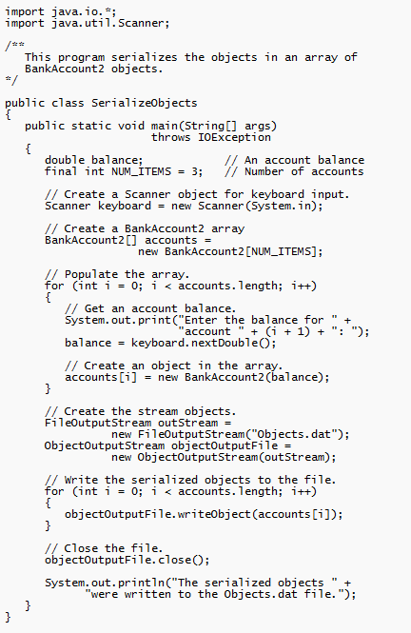
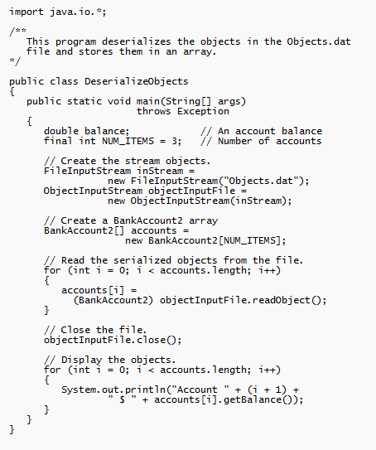
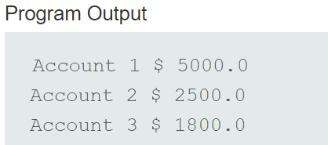
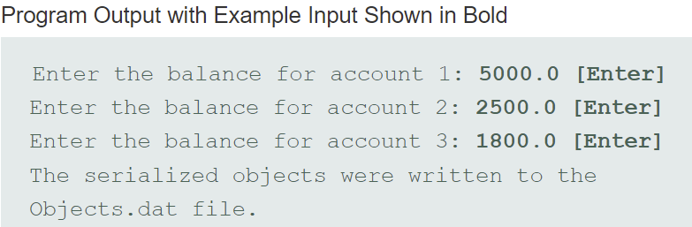
SerializeObjects.java, DeserializeObjects.java
Helpful for
Final Project

Slide 74
Streaming Away - Input
Keyboard:
Scanner keyboard = new Scanner (System.in)
Text File:
File inFile = new File (String var or “path to file”);
Scanner inStream = new Scanner(inFile);
Binary File (primitive and Strings only):
FileInputStream inFile = new FileInputStream (String var or “path to file);
DataInputStream inStream = new DataInputStream (inFile);
Binary File (Anything including Objects): Must implement Serializable
FileInputStream inFile = new FileInputStream (String var or “path to file);
ObjectInputStream inStream = new ObjectInputStream (inFile);
KEY for reading in objects. MUST cast!!! See below example
SomeClass item;
item = (SomeClass) inStream.readObject();

Slide 75
Streaming Away - Output
Screen:
System.out.print(“String to print) or System.out.print(“String to print)
System.out.printf(“Rounded to 2 places: $%,.2f”, 1234.567);
String output = String.format("Your annual pay is $%,.2f", annualPay);
Text File:
File outFile = new File (String var or “path to file”); //no append
FileWriter outFile = new FileWriter (String var or “path to file”, true); //append
PrintWriter outStream = new Scanner(outFile);
Binary File (primitive and Strings only):
FileOutputStream outFile = new FileOutputStream (String var or “path to file);
FileOutputStream outFile = new FileOutputStream (String var or “path to file, true); //append
DataOutputStream outStream = new DataOutputStream (outFile);
Binary File (Anything including Objects): Must implement Serializable
FileOutputStream outFile = new FileOutputStream (String var or “path to file);
FileOutputStream outFile = new FileOutputStream (String var or “path to file, true); //append
ObjectOutputStream inStream = new ObjectOutputStream (inFile);

Slide 76
Streaming Away – Random Access File
Read Only:
RandomAccessFile randomFile = new RandomAccessFile("MyData.dat", "r");
Read and Write:
RandomAccessFile randomFile = new RandomAccessFile("MyData.dat", "rw");
File Pointer:
randomFile.seek(integer number of which byte to jump to);

Slide 77
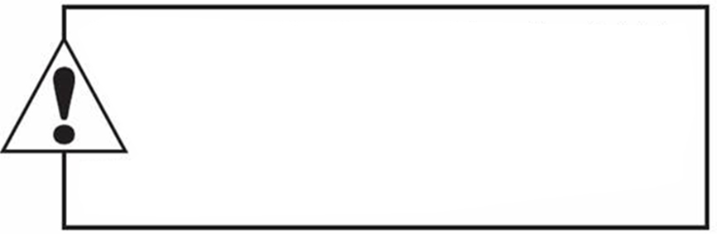
Copyright
This work is protected by United States copyright laws and is provided solely
for the use of instructions in teaching their courses and assessing student
learning. dissemination or sale of any part of this work (including on the
World Wide Web) will destroy the integrity of the work and is not permit-
ted. The work and materials from it should never be made available to
students except by instructors using the accompanying text in their
classes. All recipients of this work are expected to abide by these
restrictions and to honor the intended pedagogical purposes and the needs of
other instructors who rely on these materials.

