Slide 1
PROBLEM STATEMENT:-
TO SYNCHRONISE 2 DIFFERENT DATABASE SERVERS(SIFMS & GoSPED)
According to the need of government of Sikkim

Slide 2
Diagrammatic Representation :
MVC with custom made 3-tier Architecture
Primary Database
Secondary Database
SIFMS
GoSPED

Slide 3
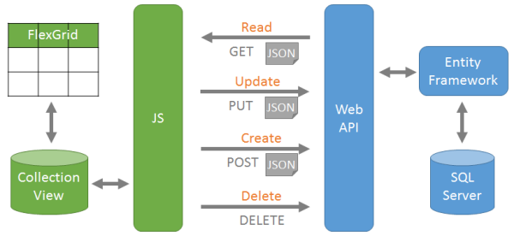
Data Flow Diagram
3-tier
Architecture
Application servers

Slide 4
IMPLEMENTATION
STEPS:-

Slide 5
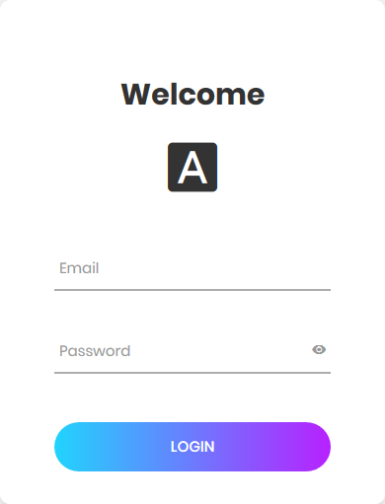
Step1-
VERIFICATION Of USER CREDENTIALS
In this step only authorised users have the privilege to insert the data into primary database records.

Slide 6
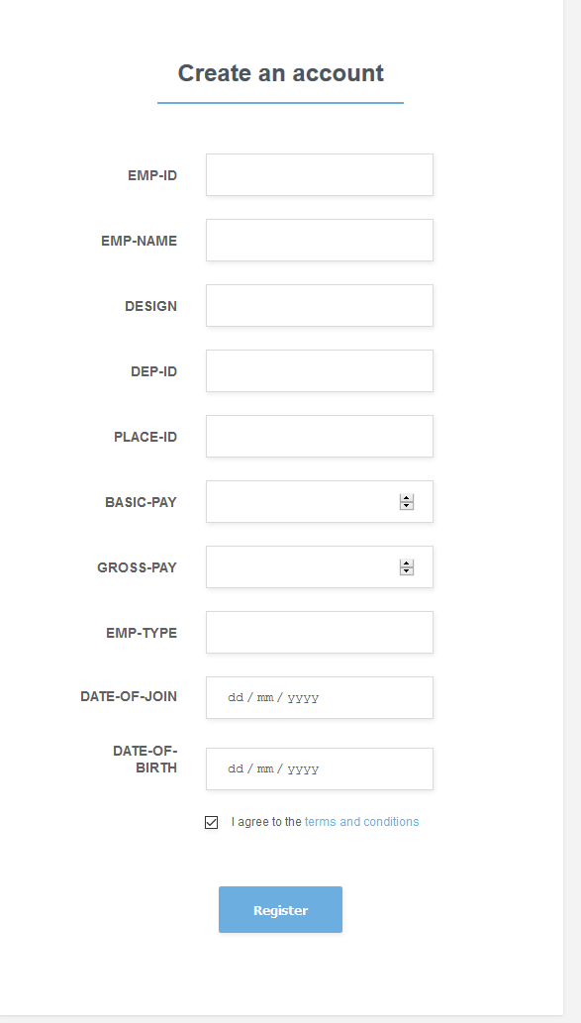
STEP 2:-
FORMATION OF PRIMARY DATABASE (SIFMS)
In this step only the authorised person has the permission to enter the data into the primary servers.

Slide 7
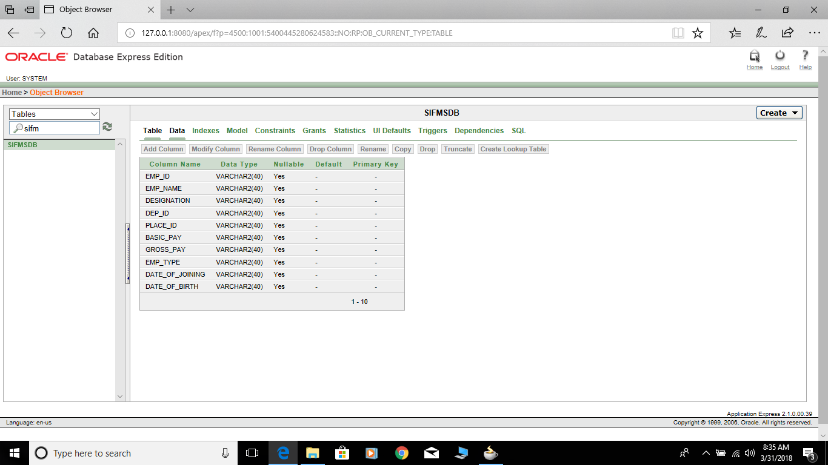
Step-3
AUTOMATIC SYNCHRONIZATION OF THE PRIMARY DATABASE TO SECONDARY DATABASE (GoSPED)
Primary Schema

Slide 8
Secondary Schema

Slide 9
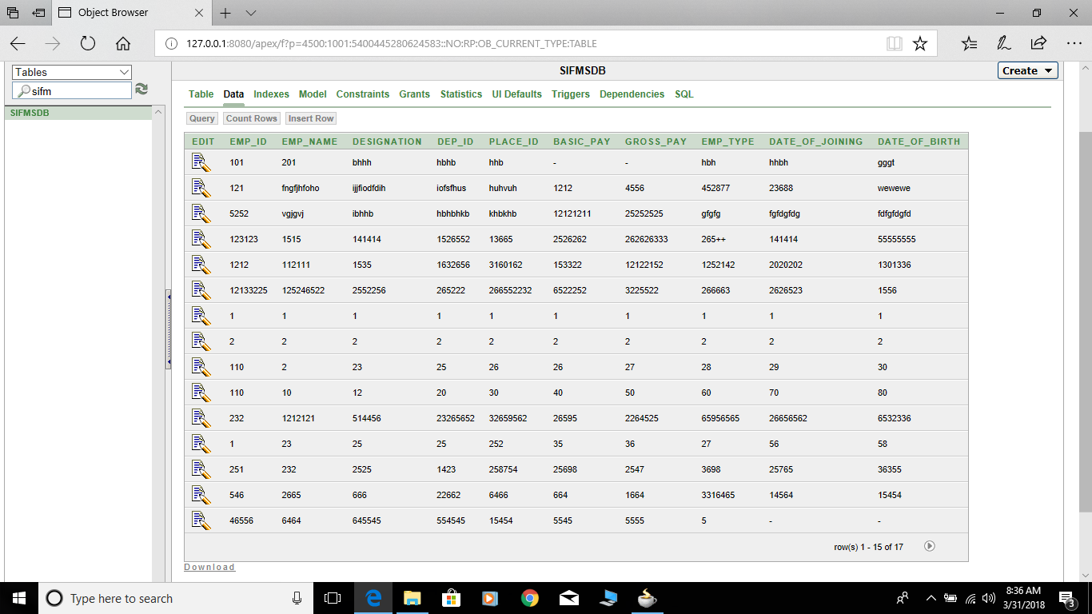
PRIMARY DATA

Slide 10

SECONDARY DATA

Slide 11
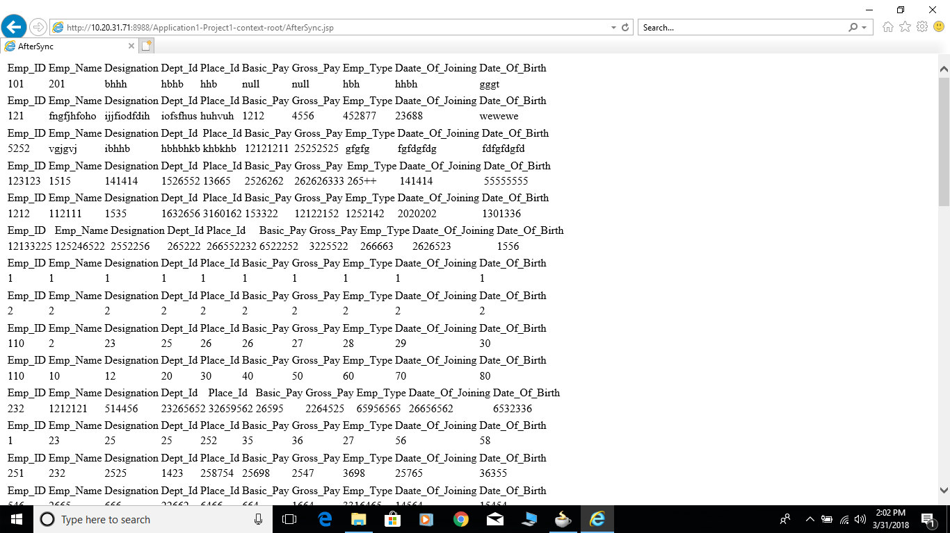
THE FINAL OUTPUT OF SYNCRONIZATION

Slide 12
Thank-you

