Slide 1
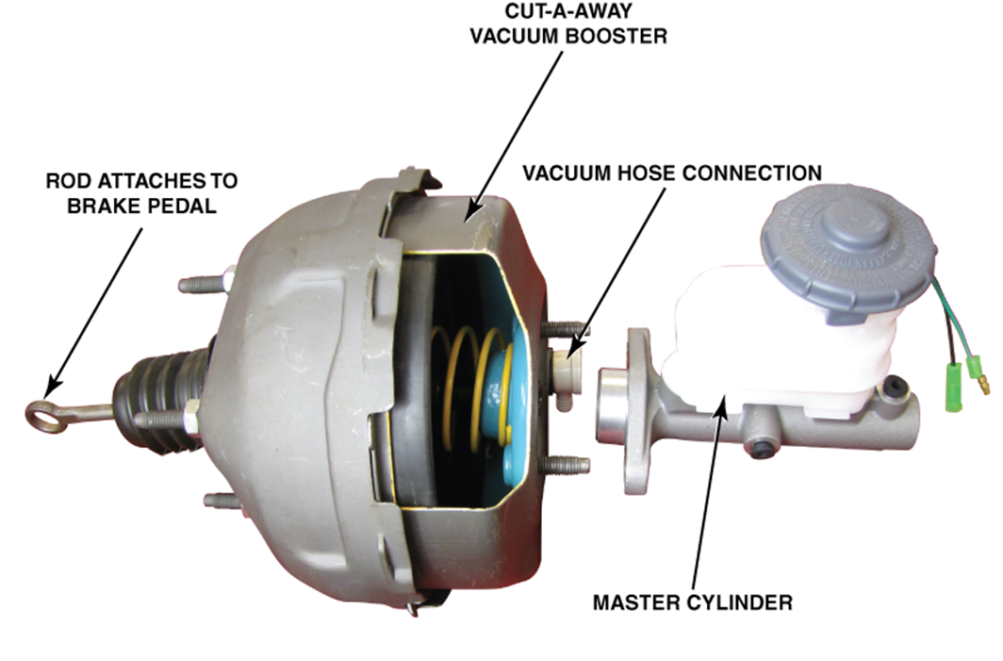
AUTOA 123 · BRAKES
Brake Booster
Systems
Vacuum Boosters · Hydro-Boost · Electronic Boosters
Shoreline Community College · Professional Automotive Training Center

Slide 2
FUNDAMENTALS
What Is a Brake Booster?
Multiplies the force applied to the brake pedal — typically 2:1 to 4:1
Located between the brake pedal and the master cylinder
Most common type uses engine intake manifold vacuum
If it fails, braking still works — pedal effort increases significantly
Reserve vacuum allows 2–3 assisted stops after engine shuts off
Key Specs
Boost ratio: 2:1 to 4:1
Min vacuum: 15 in. Hg
Reserve: 2–3 stops
Diameter: 7–11 inches
Key Takeaway
The booster amplifies driver pedal force. It does not generate braking power on its own.

Slide 3
FUNDAMENTALS
Brake Boosters — Key Facts
Reduces Driver Effort
Still Works When Failed
The booster allows drivers to generate sufficient hydraulic pressure without high pedal loads — essential for modern vehicle stopping distances.
If the booster fails completely, the brake hydraulic system remains functional. Pedal effort increases dramatically — vehicle can still stop.
Vacuum Reserve
Booster Size = More Force
A healthy booster stores enough vacuum for at least 2–3 full power-assisted stops after the engine stops running.
Larger diameter diaphragm = greater assist force. Tandem (dual) diaphragm boosters provide higher boost in a smaller physical package.

Slide 4
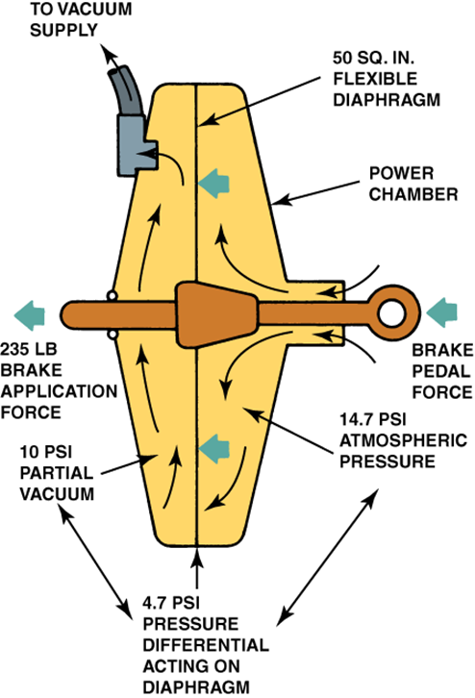
HOW IT WORKS
Understanding Vacuum
Vacuum measured in inches of mercury (in. Hg). Perfect vacuum ≈ 30 in. Hg.
Engine pistons moving down on the intake stroke create low pressure (vacuum).
Idle intake manifold vacuum: typically 15–22 in. Hg.
Vacuum is routed to the front chamber of the booster via a hose.
When pedal pressed, atmospheric air (14.7 PSI) enters the rear chamber.
Pressure difference deflects the diaphragm — creating the assist force.
Minimum Required
15 in. Hg minimum. Healthy: 18–22 in. Hg at idle.

Slide 5
HOW IT WORKS
Where Does the Vacuum Come From?
Gasoline Engine
Diesel Engine
Vacuum pulled from intake manifold. A hose routes to the booster check valve. Requires engine running for fresh vacuum.
Minimal intake vacuum — uses compression ignition. Requires a dedicated belt-driven or electric vacuum pump to supply the booster.
Turbocharged Engine
Electric / Hybrid
Turbo pressurizes the intake manifold — positive pressure, not vacuum. Requires a separate electric vacuum pump.
No combustion engine running = no vacuum. Uses electric vacuum pump or fully electronic booster. Covered in Section 4.

Slide 6
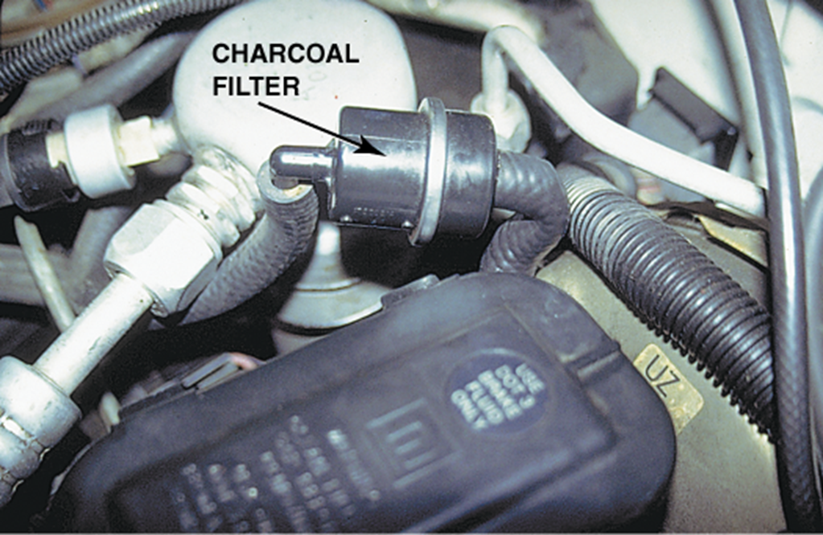
COMPONENTS
Booster Air Filter (Charcoal Filter)
Purpose
Filters atmospheric air entering the booster rear chamber when the pedal is pressed. Protects the diaphragm from dirt and debris.
Service
Replace if visibly clogged or if hissing is heard near booster when pedal is applied. Located in the vacuum hose near the booster inlet.
Symptom When Clogged
Restricted airflow = sluggish or reduced pedal assist. Replace during brake inspection.

Slide 7
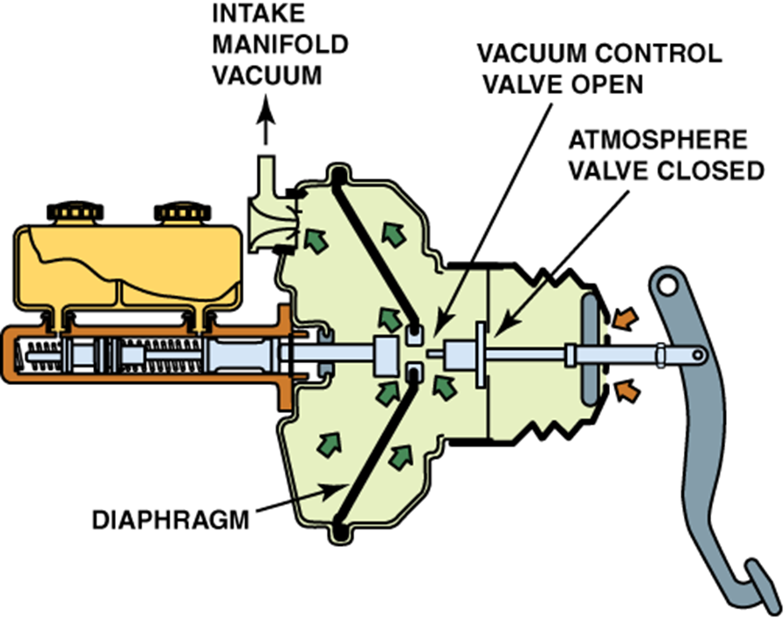
HOW IT WORKS
Booster Operation — Brake Released
Vacuum applied to BOTH sides of the diaphragm.
Vacuum control valve is OPEN — both chambers equalized.
Atmosphere valve is CLOSED — no atmospheric air entering.
No pressure differential = zero boost force applied.
Output pushrod is not acting on the master cylinder piston.
Remember
The booster is passively holding vacuum at all times while the engine runs. The check valve maintains this reserve.
System State: At Rest
Both chambers at equal vacuum. Diaphragm centered. No pedal force, no boost force.

Slide 8
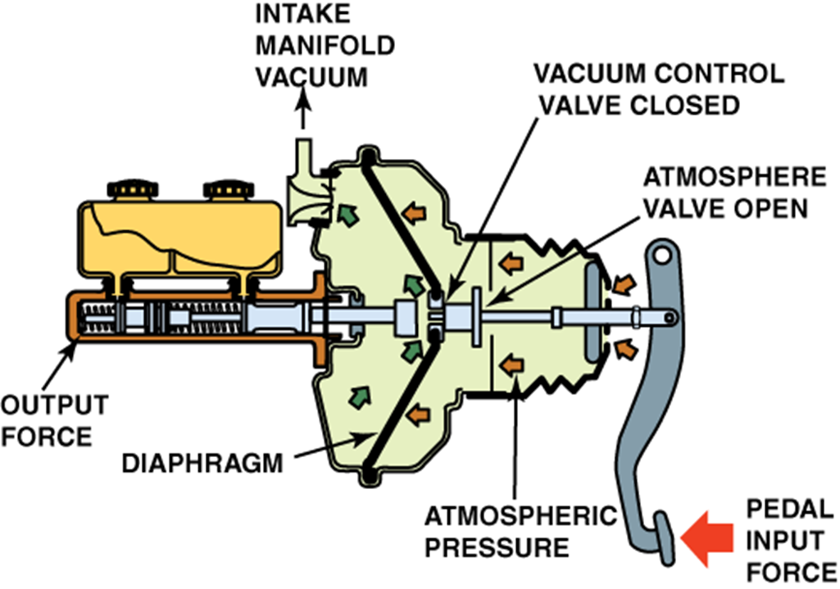
HOW IT WORKS
Booster Operation — Brake Applied
Pedal input shifts the control valve spool rearward.
Vacuum control valve CLOSES — front chamber sealed.
Atmosphere valve OPENS — 14.7 PSI air enters rear chamber.
Pressure differential deflects diaphragm toward the front.
Diaphragm force adds to pedal force on the output pushrod.
Master cylinder piston pushed — hydraulic pressure builds.
Result
Pedal + diaphragm force combined — 2x to 4x amplification of driver input.

Slide 9
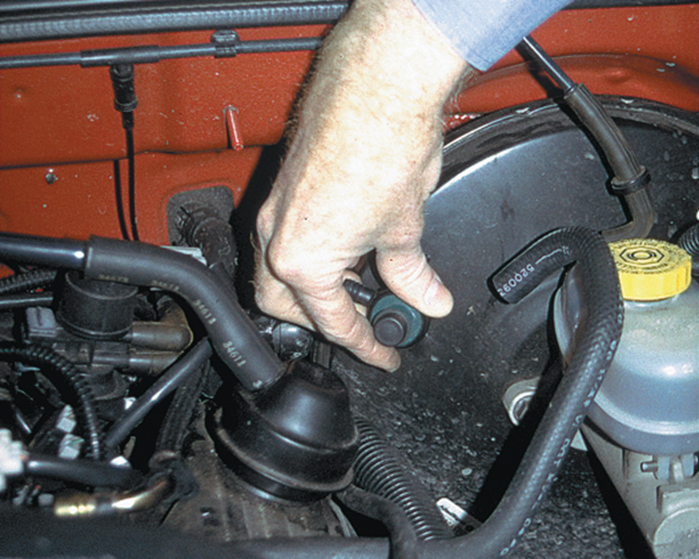
COMPONENTS
Identifying the Booster on the Vehicle
Location
Driver's side firewall, directly behind the master cylinder. Connected to intake manifold via vacuum hose and check valve.
Identification
Large round canister, 7–11 inch diameter. Vacuum hose on front side. Pedal pushrod connects to rear.
ShopKey First
Always look up booster size, mounting specs, and vacuum routing for the specific year/make/model.

Slide 10
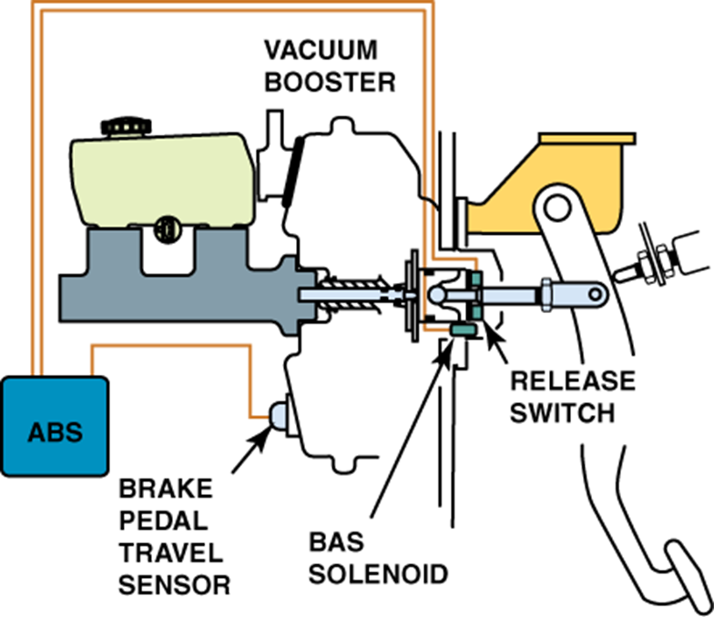
ADVANCED SYSTEMS
Brake Assist System (BAS)
BAS detects a panic stop via the brake pedal travel sensor input.
When panic stop detected, ABS module energizes the BAS solenoid.
Solenoid opens an air valve — atmospheric pressure floods the rear chamber at full force.
Applies maximum booster assist regardless of driver pedal effort.
Result: full braking force even if pedal is applied gently in an emergency.
Works together with ABS during emergency stops.
Key Point
BAS intervenes automatically — no additional driver input required.

Slide 11
SECTION 2
Booster Testing
Vacuum supply · Depletion · Operation check · Check valve

Slide 12
BOOSTER TESTING
Quick Booster Operation Test
Confirms the booster is functioning. Engine must be warm and running.
1
Start Engine
2
Pump to Deplete
Run engine for at least 30 seconds to build vacuum. Engine must be at operating temperature for an accurate test.
Engine OFF — pump brake pedal 5–7 times until the pedal feels hard and resistance is firm. Vacuum is now depleted.
3
Hold Steady Pressure
4
Start Engine — Observe Pedal
Apply firm, steady foot pressure to the brake pedal. Maintain constant pressure — do not release.
Start engine while holding pedal pressure. A working booster will cause the pedal to noticeably drop/sink as vacuum builds.

Slide 13
BOOSTER TESTING
Vacuum Booster Leak Test
Tests the integrity of the booster diaphragm and check valve. Engine OFF.
1
Operate the Engine — Shut Off
Run engine for 30+ seconds to fully charge the booster with vacuum. Then shut the engine off.
2
Wait One Minute
Do not touch the pedal. Let the booster sit with stored vacuum for one full minute. The check valve should hold the vacuum during this time.
3
Depress Pedal — Count Assisted Applications
Press brake pedal fully and release several times. You should get at least 2 full power-assisted applications. If not: check valve or booster is leaking.

Slide 14
BOOSTER TESTING
Hydraulic System Leak Test
Distinguishes a hydraulic leak from a booster problem. Engine running.
01
02
03
Depress and Release
Depress and Hold
Observe — Should Not Sink
Press and release the brakes several times with engine running to deplete any residual vacuum assist.
Press pedal with medium force (20–35 lbs). Hold pedal position without pumping. Hold for 30 seconds.
Pedal should NOT sink toward the floor. If it slowly sinks while held: suspect a hydraulic leak — master cylinder, caliper, line, or wheel cylinder.

Slide 15
VACUUM TESTING — TEST 1
Vacuum Supply Test
Confirms the engine is producing enough vacuum to operate the booster. Engine must be running and warm.
1
Connect Gauge
2
Warm Engine
Attach vacuum gauge to the vacuum supply hose at the booster check valve port or booster inlet.
Run engine to operating temperature. Let idle stabilize before recording any readings.
3
Record at Idle
4
Record at 2,000 RPM
Read gauge at idle. Record in lab sheet. Minimum 15 in. Hg to operate. Healthy: 18–22 in. Hg.
Rev engine to 2,000 RPM and hold steady. Vacuum should equal or increase vs. idle reading.
READING
RESULT
ACTION
18–22 in. Hg
Healthy
Proceed with testing
15–17 in. Hg
Marginal
Inspect hoses and engine vacuum — do not pass without follow-up

Slide 16
VACUUM TESTING — TEST 2
Vacuum Depletion Test
Tests stored vacuum reserve and check valve integrity. Engine OFF. Connect gauge between check valve and booster.
Engine OFF
APPLICATION
READING
IN. HG
1
Turn off engine. Check valve should hold residual vacuum inside the booster.
Pedal Application 1
Record reading
in. Hg
Pedal Application 2
Record reading
in. Hg
2
Connect Gauge
Pedal Application 3
Record reading
in. Hg
Attach vacuum gauge downstream of the check valve — between valve and booster inlet.
Expected Result
3
Press 3 Times
At least 2 full power-assisted applications. Rapid depletion = check valve or booster failure.
Push brake pedal fully three times. Record gauge reading after each press in the table.
INTERPRETING DEPLETION RESULTS
3 assisted apps
2 assisted apps
1 or fewer apps
0 apps / no reserve
Excellent reserve — check valve holding well
Acceptable — meets minimum specification
Inspect check valve — test both components
Booster or check valve failed — must repair

Slide 17
VACUUM TESTING — TEST 3
Check Valve Inspection and Blow-Through Test
The one-way check valve stores vacuum in the booster. Remove and test before replacing the booster.
1
Remove and Inspect
2
Blow Toward Booster Side
Twist or pull valve from the booster grommet. Check for cracks, soft rubber, distortion, or debris in the seat.
Blow through the valve toward the booster (the booster-side end). Air should NOT pass. This is the one-way seal.
3
Blow Toward Engine Side
4
Reinstall or Replace
Flip the valve. Blow toward the engine/hose side. Air SHOULD pass freely. This is the open direction.
If air passes in BOTH directions: valve failed — replace. Reinstall with booster side toward booster.
PASS: Booster side — no flow · Engine side — flows freely FAIL: Booster side — flows freely · Engine side — blocked

Slide 18
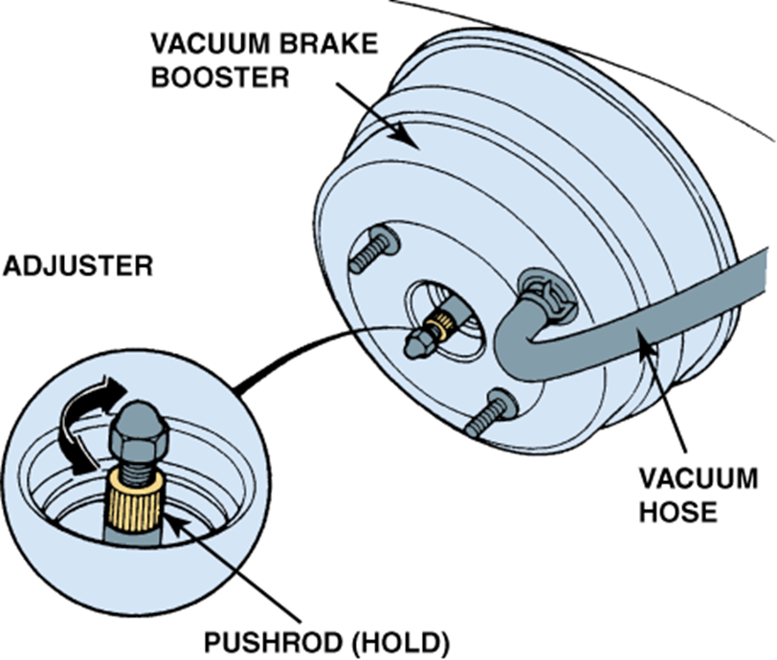
SERVICE & ADJUSTMENT
Master Cylinder Pushrod Clearance
Purpose of Pushrod Adjustment
The pushrod must contact the master cylinder piston correctly — not too short, not too long. Always verify with ShopKey for vehicle-specific specs.
Too Short — Effect
Gap between pushrod and piston. Excessive pedal travel before hydraulic pressure builds. Brakes feel 'lazy' — long pedal before engagement.
Too Long — Effect
Pushrod pre-loads the master cylinder piston. Brakes drag, overheat, or apply without pedal input. Can cause premature pad/rotor wear.
Measurement Method
Use ShopKey to find spec. Measure protrusion with a pushrod gauge or digital caliper. Adjust by turning the pushrod adjuster — clockwise to lengthen, counter-clockwise to shorten.

Slide 19
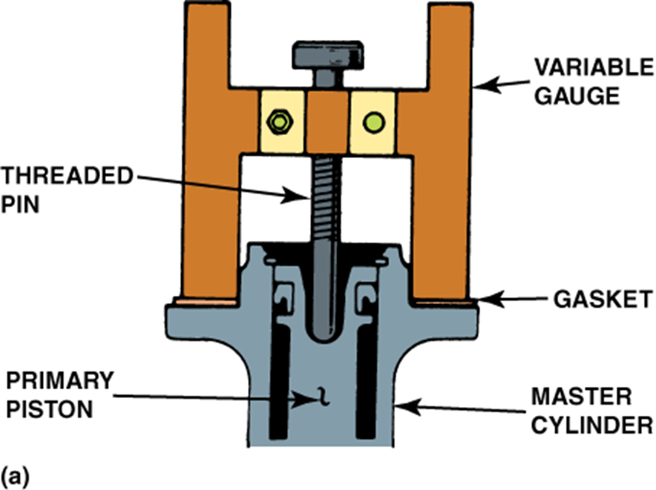
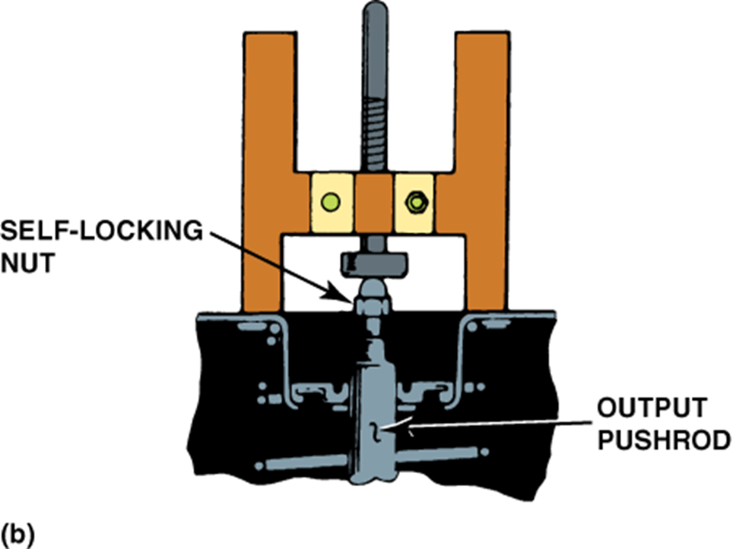
SERVICE & ADJUSTMENT
Pushrod Measurement Tool
How the Gauge Works
The tool is placed on the booster output pushrod. The adjustable pin contacts the master cylinder piston bore. Measurement is read from the gauge to determine protrusion. Compare to ShopKey spec.

Slide 20
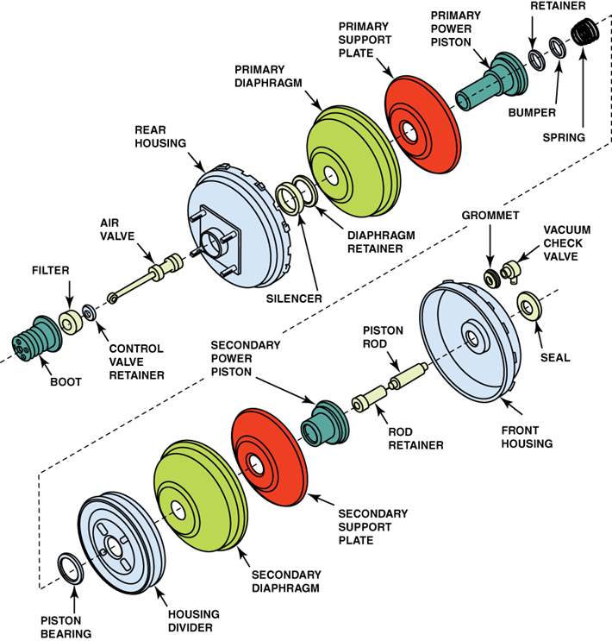
COMPONENTS
Booster Component Exploded View
Key components: front/rear shell, primary/secondary diaphragm, control valve, reaction disk, input & output pushrods, check valve, silencer (charcoal filter).

Slide 21
SECTION 3
Hydro-Boost
Hydraulic power steering fluid instead of vacuum

Slide 22
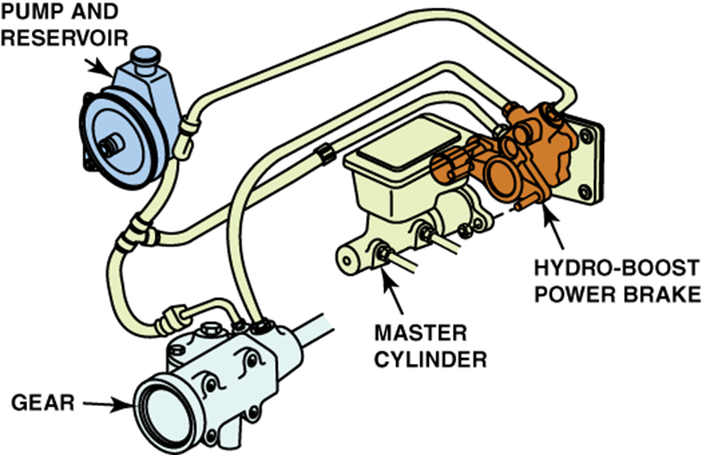
HYDRO-BOOST
Hydro-Boost Brake Booster
Uses pressurized power steering fluid instead of engine vacuum.
Originally developed by Bendix — common on diesel and turbocharged vehicles.
Fluid enters via a spool valve. At rest: fluid flows through unrestricted.
When pedal pressed: spool valve closes, pressure builds in boost chamber.
Boost chamber force added to pedal input via the output pushrod.
Accumulator (spring or gas charged) provides reserve for 2–3 stops when engine off.
Common Applications
Diesel trucks, turbocharged vehicles, and any platform where engine vacuum is insufficient or unavailable.

Slide 23
HYDRO-BOOST
Diagnosing Hydro-Boost
Check Power Steering Level
Check for Leaks
Check Power Steering Belt
Fluid low is the most common cause of reduced boost. Use correct fluid type. Check for leaks at hoses and accumulator.
Inspect all hose connections, the booster body, and the accumulator for seepage. Even small leaks cause pressure loss.
A loose or slipping belt reduces pump output pressure. Verify belt condition and tension before further diagnosis.
Check Fluid Volume
Check Pump Pressure/Volume
Confirm Brake System Normal
Recommended: 2 gallons with max 150 PSI available. Verify pump output pressure with a gauge if boost is still insufficient.
Compare pump output to spec. Low pressure = worn pump. Low volume = restriction in lines or filter.
After hydro-boost checks pass, verify brake system operates normally. Rule out master cylinder or caliper issues.

Slide 24
SECTION 4
Electronic Boosters
EVs · Full hybrids · GDI engines · Turbocharged platforms

Slide 25
ELECTRONIC BOOSTERS
Why Electronic? No Engine Vacuum Available
Traditional vacuum boosters require 15–18 in. Hg. These platforms cannot reliably supply it:
Electric Vehicles (BEV)
Full Hybrid (at High SOC)
No combustion engine = zero intake manifold vacuum. A fully electric booster or electric vacuum pump is the only option.
Engine runs only when needed. When the engine is off, there is no vacuum — the booster must generate or store its own reserve.
GDI Engines
Turbocharged Engines
Gasoline Direct Injection engines have low intake restriction at many operating conditions. Vacuum can be marginal or inconsistent.
Turbocharger pressurizes the intake manifold above atmospheric. No vacuum — positive pressure. Requires a dedicated vacuum pump.

Slide 26
ELECTRONIC BOOSTERS
Types of Electronic Brake Boosters
Electric Vacuum Pump
Bosch iBooster
Electrohydraulic (EHBS)
HOW IT WORKS
HOW IT WORKS
HOW IT WORKS
A small electric motor drives a vane or diaphragm pump to generate vacuum. The booster itself is still vacuum-operated — same diagnosis approach.
An electric motor directly drives the master cylinder pushrod via gear reduction. No vacuum required. Force applied electromechanically. Extremely fast response — enables AEB.
Electric motor drives a hydraulic pump, building pressure in an accumulator. Accumulator releases pressure on demand to assist braking. Tightly integrated with regenerative braking.
FOUND ON
FOUND ON
FOUND ON
Many hybrids, some GDI and diesel vehicles. Simplest solution — familiar testing.
Tesla Model S (early), Volvo XC90, Audi/BMW hybrids and EVs.
Toyota/Lexus hybrids and EVs (Prius, RAV4, Mirai). Regen coordination built in.
All three types: scan tool diagnosis required. No vacuum gauge. No vacuum hose to check.

Slide 27
ELECTRONIC BOOSTERS
Diagnosing Electronic Brake Boosters
Shift from vacuum gauge to scan tool. Approach is fundamentally different.
1
Scan Tool First
2
Check Power and Ground
Connect scan tool before anything else. Check DTCs in the brake booster module, ABS/ESC module, and hybrid/EV control system. Module communication errors are the most common first clue.
Electric boosters draw high current. Verify battery voltage, fuse condition, and ground integrity at the booster module. Voltage drop testing applies here exactly as in electrical diagnosis.
3
Live Data: Pedal vs. Pressure
4
No Vacuum — Adjust Your Approach
Use scan tool live data to compare pedal position sensor input against hydraulic pressure output. Lag, no response, or disproportionate pressure = actuator or control module issue.
There is no vacuum hose to test. No depletion test. Reserve is electrical (capacitor or battery backup) — check system warnings and charge state, not in. Hg.
Regen braking note: On EVs and hybrids, pedal feel is simulated while the motor generates electricity. This is normal — do not diagnose it as a booster fault.

