Slide 1
AUTOMOTIVE TECHNOLOGY
AUTOA 123 · BRAKES UNIT
Disc Brakes
Components, configurations, service, and diagnosis
Lecture 3 of 4 · Brakes Unit
Shoreline Community College · Amber Avery-Graff

Slide 2
AUTOMOTIVE TECHNOLOGY · AUTOA 123
SAFETY
Safety First
Before any disc brake work
PPE
DUST
FLUID
Safety glasses or goggles
Nitrile gloves (brake fluid eats skin)
Particulate mask if dust is visible
Closed-toe boots, hair tied back
Treat all brake dust as hazardous
Never blow it off with compressed air
Wet method or HEPA vacuum only
Wash hands before eating or smoking
Brake fluid strips paint and finishes
Cap reservoir when leaving the bay
Catch fluid when opening bleeders
Never reuse fluid drained from the system
AUTOA 123 · Brakes · Lecture 3 of 4 · Shoreline Community College
2 / 24
Amber Avery-Graff · aavery@shoreline.edu

Slide 3
AUTOMOTIVE TECHNOLOGY · AUTOA 123
OUTCOMES
What You'll Be Able to Do
By the end of this lecture
Identify disc brake components and explain how each contributes to stopping
Compare floating, sliding, and fixed caliper designs and where each is used
Explain how the square-cut piston seal returns the piston and self-adjusts pads
Describe pad construction, friction materials, and wear indicator systems
Identify rotor designs, ventilation, and the purpose of slots and cross-drilling
Diagnose the most common disc brake concerns: pulsation, noise, drag, pulling
Describe correct caliper service including slide pin lubrication and pad burnishing
Service an integrated parking brake using the correct retraction method
AUTOA 123 · Brakes · Lecture 3 of 4 · Shoreline Community College
3 / 24
Amber Avery-Graff · aavery@shoreline.edu

Slide 4
AUTOMOTIVE TECHNOLOGY · AUTOA 123
ASE TASKS
ASE A5 - Section D Disc Brakes
Tasks covered in this lecture and the lab that follows
D.1 Remove and clean caliper assembly; inspect for leaks, damage, wear
D.2 Inspect caliper mounting and slides/pins for proper operation
D.3 Remove, inspect, replace brake pads and retaining hardware
D.4 Lubricate and reinstall caliper, pads, and hardware; seat pads
D.5 Clean and inspect rotor; measure thickness, variation, runout
D.6 Remove and reinstall or replace rotor
D.7 Refinish rotor on vehicle; measure final thickness
D.8 Refinish rotor off vehicle; measure final thickness
D.9 Retract and re-adjust caliper piston on integrated parking brake
D.10 Describe importance of burnishing replacement pads
D.11 Diagnose poor stopping, noise, vibration, pulling, dragging, pulsation
AUTOA 123 · Brakes · Lecture 3 of 4 · Shoreline Community College
4 / 24
Amber Avery-Graff · aavery@shoreline.edu

Slide 5
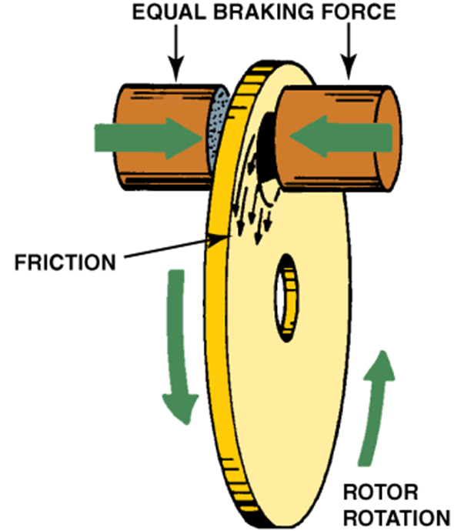
AUTOMOTIVE TECHNOLOGY · AUTOA 123
OPERATION
How Disc Brakes Work
Equal clamping force on both sides of a spinning rotor
The rotor spins with the wheel and hub assembly
Hydraulic pressure pushes the caliper piston outward
Inboard pad clamps the rotor face from the piston side
On a floating caliper, reaction force pulls the outboard pad in
Friction between pads and rotor converts kinetic energy to heat
Equal force on both sides means no rotor distortion
AUTOA 123 · Brakes · Lecture 3 of 4 · Shoreline Community College
5 / 24
Amber Avery-Graff · aavery@shoreline.edu

Slide 6
AUTOMOTIVE TECHNOLOGY · AUTOA 123
WHY DISCS
Advantages of Disc Brakes
Heat dissipation
No mechanical fade
Friction surface is exposed to airflow, so swept area cools quickly between stops
Heat expands the rotor toward the pads, not away, so pedal travel stays consistent
Reduced lining fade
Less gas fade
Pad compounds work better hot than cold; runaway heat can still cause a hard pedal
Open design lets gas and dust escape instead of building between pad and friction surface
No water fade
Self adjusting
The rotating rotor flings water off the friction surface in fractions of a second
Square cut piston seal pulls the piston back just enough to maintain pad clearance
AUTOA 123 · Brakes · Lecture 3 of 4 · Shoreline Community College
6 / 24
Amber Avery-Graff · aavery@shoreline.edu

Slide 7
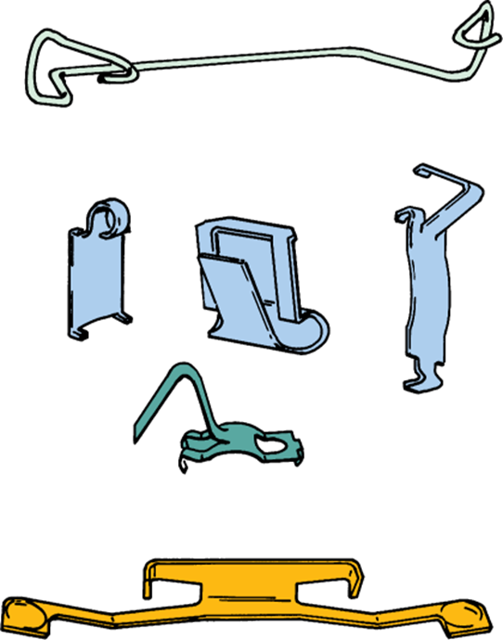
AUTOMOTIVE TECHNOLOGY · AUTOA 123
TRADE-OFFS
Disadvantages of Disc Brakes
Higher pedal effort
No self-energizing servo action like drum brakes; needs a power booster
Brake noise
High-frequency pad vibration causes squeal; shims, clips, and lubricant suppress it
Brake dust
Open friction surface throws dust onto wheels and rotors
Less holding power for given size
No self-energizing means a larger rotor is needed for the same stopping force
AUTOA 123 · Brakes · Lecture 3 of 4 · Shoreline Community College
7 / 24
Amber Avery-Graff · aavery@shoreline.edu

Slide 8
AUTOMOTIVE TECHNOLOGY · AUTOA 123
ROTORS
Brake Rotor Designs
Solid, vented, slotted, drilled, and composite
Solid
One-piece disc; light vehicles, rear axles, cost driven
Vented
Internal vanes pump air through cooling channels; standard on most front axles
Slotted
Surface slots vent gas and dust, sweep pad face clean; mild noise increase
Cross-drilled
Holes through the friction surface; aggressive cooling, can crack under hard use
Composite
Hub and friction ring of different materials; saves weight and unsprung mass
OPERATING TEMPS
Normal driving: 300 to 500 F
Hard street braking: 600 to 800 F
Track or heavy tow: over 1000 F
Pad and fluid choice must match the use.
WHY THIS MATTERS
Heat is the enemy. Rotor design is one half of the cooling story; pad compound and airflow are the other half.
AUTOA 123 · Brakes · Lecture 3 of 4 · Shoreline Community College
8 / 24
Amber Avery-Graff · aavery@shoreline.edu

Slide 9
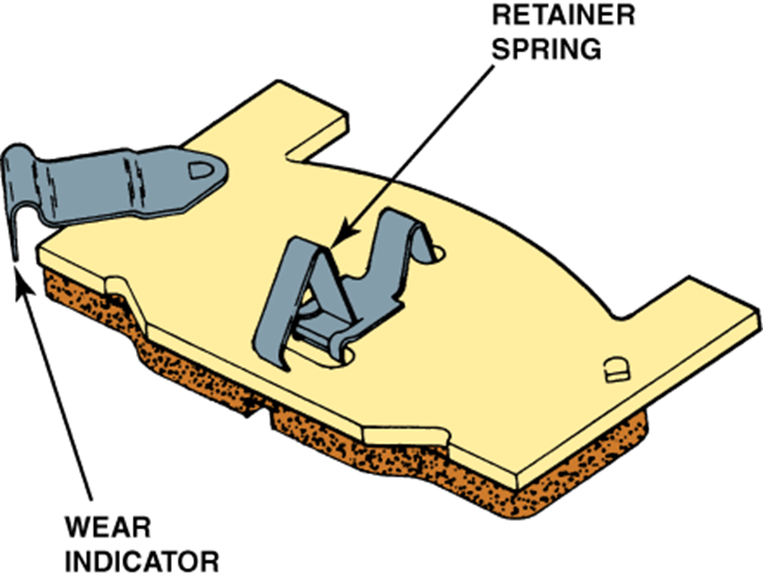
AUTOMOTIVE TECHNOLOGY · AUTOA 123
PADS
Brake Pad Hardware
How pads are held, oriented, and quieted
Tabs
Hold the pad against the rotor to control rattle
Retaining pins
Pass through holes in the backing plate to capture the pad
Retaining springs
Spring-loaded clips that pre-load the pad
Tapered or chamfered edges
Reduce vibration that causes squeal
Anti-rattle clips and shims
Hardware kit replaces with every pad change
AUTOA 123 · Brakes · Lecture 3 of 4 · Shoreline Community College
9 / 24
Amber Avery-Graff · aavery@shoreline.edu

Slide 10
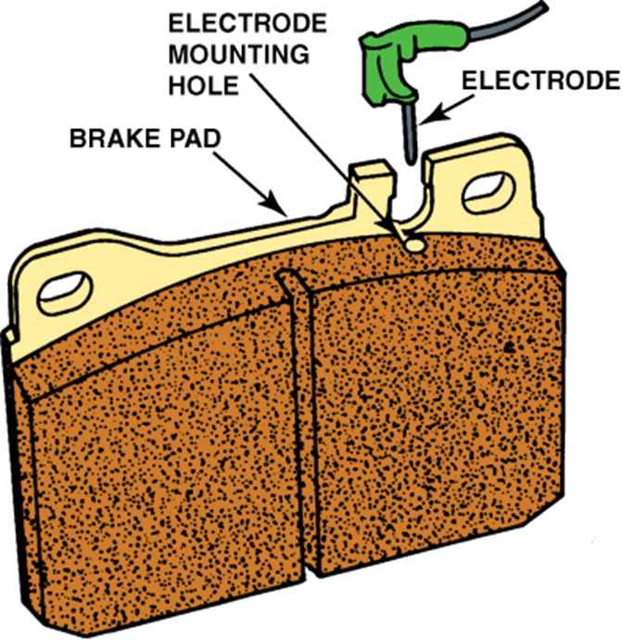
AUTOMOTIVE TECHNOLOGY · AUTOA 123
PADS
Pad Wear Indicators
How the pad tells you it is done
MECHANICAL
Spring-steel tab rides against the rotor when pads thin
Produces a high-frequency chirp or squeal under braking
Will keep squealing until pads are replaced
ELECTRICAL
Sensor wire is embedded in the pad backing or face
When pad wears down, the wire grounds to the rotor
Triggers a brake pad warning light at the cluster
AUTOA 123 · Brakes · Lecture 3 of 4 · Shoreline Community College
10 / 24
Amber Avery-Graff · aavery@shoreline.edu

Slide 11
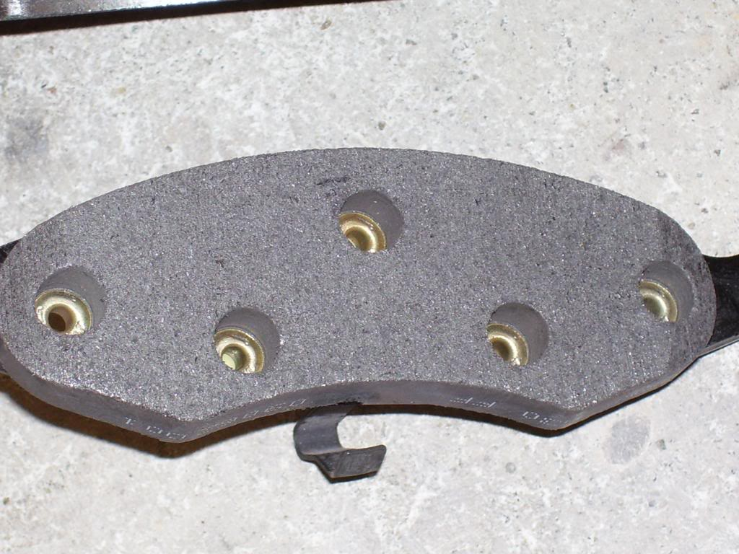
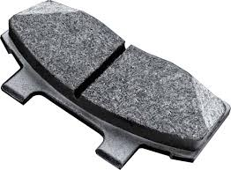
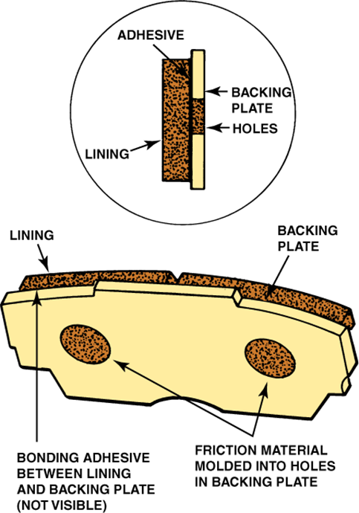
AUTOMOTIVE TECHNOLOGY · AUTOA 123
PADS
Pad Attachment Methods
How friction material is bonded to the backing plate
Riveted
Bonded
Mold Bonded
PLUS
PLUS
PLUS
Allows slight flex, dampens vibration
Longer service life, less likely to crack
Strongest attachment; high performance use
MINUS
MINUS
MINUS
Cracks form around rivet holes; older method
Bonding can fail in extreme heat; can be noisier
More expensive; combination of holes and adhesive
AUTOA 123 · Brakes · Lecture 3 of 4 · Shoreline Community College
11 / 24
Amber Avery-Graff · aavery@shoreline.edu

Slide 12
AUTOMOTIVE TECHNOLOGY · AUTOA 123
PADS
Pad Friction Material
Match the compound to the use
Semi-metallic
NAO (Non-asbestos organic)
Made of: Steel fibers, copper, brass, with resin and binders
Use: Most stock daily drivers; good cold and hot performance
Watch out: Higher rotor wear; heavier dust
Made of: Glass, rubber, fibers, resin; no metal
Use: Quiet, gentle on rotors; low dust
Watch out: Fades faster under heavy or repeated heat
Ceramic
Carbon and carbon-metallic
Made of: Ceramic fibers with bonding agents and small amounts of metal
Use: Premium daily drivers; quiet, light dust, long life
Watch out: Higher cost; can require warm-up before peak bite
Made of: Carbon fibers in a binder; sometimes with metal
Use: Racing, jets, heavy-duty applications
Watch out: Need significant heat to work; not for street use
AUTOA 123 · Brakes · Lecture 3 of 4 · Shoreline Community College
12 / 24
Amber Avery-Graff · aavery@shoreline.edu

Slide 13
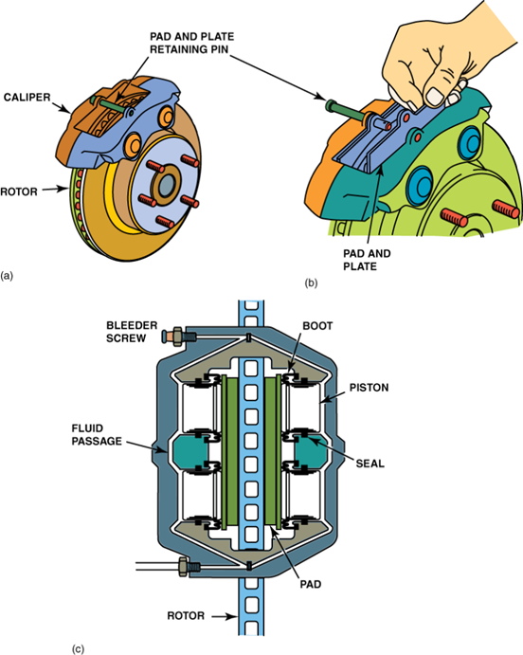
AUTOMOTIVE TECHNOLOGY · AUTOA 123
CALIPERS
Fixed Caliper
Pistons on both sides of the rotor
Earliest disc design Used since the 1950s on European sports cars
Two-piece body Cast in two halves bolted together with a fluid passage
Two, four, or six pistons Pistons sit on both sides; rotor is squeezed equally without movement of the caliper
Rigidly mounted Body bolts directly to the steering knuckle or hub carrier
Strengths Excellent heat absorption; resists hard repeated stops
Common on Performance cars, heavy trucks, motorcycles
AUTOA 123 · Brakes · Lecture 3 of 4 · Shoreline Community College
13 / 24
Amber Avery-Graff · aavery@shoreline.edu

Slide 14
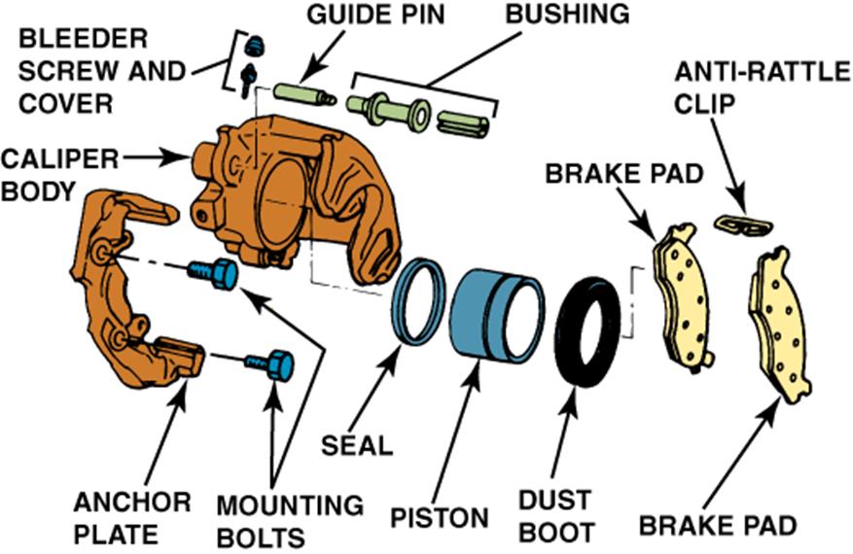
AUTOMOTIVE TECHNOLOGY · AUTOA 123
CALIPERS
Floating and Sliding Caliper
One piston, caliper body moves on slide pins
Most common design Standard on the vast majority of passenger vehicles
Body floats on slide pins Anchor bracket is bolted to the knuckle; caliper body slides
Single piston, both pads work Piston pushes inboard pad; reaction draws caliper body and outboard pad against the rotor
Strengths Lower cost, compact, simple construction, easy service
Watch outs Sticking slide pins cause uneven pad wear; cooling spreads to suspension
AUTOA 123 · Brakes · Lecture 3 of 4 · Shoreline Community College
14 / 24
Amber Avery-Graff · aavery@shoreline.edu

Slide 15
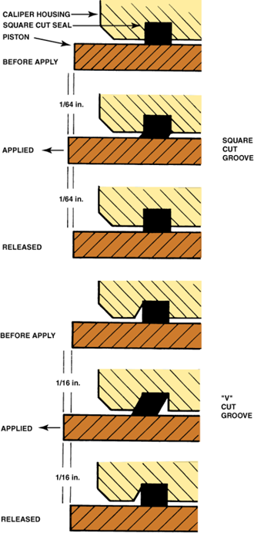
AUTOMOTIVE TECHNOLOGY · AUTOA 123
CALIPERS
Square-Cut Piston Seal
How calipers self-adjust without a return spring
Apply: hydraulic pressure pushes the piston outward
The square cut seal twists slightly, deforming with the piston
Release: stored energy in the seal pulls the piston back about 1/64 inch
Rotor knockback during cornering creates the small running clearance
As pads wear, the piston repositions through the seal and stays there
Result: no return spring needed, and pads self-adjust
SERVICE RULE
Always open the bleeder before pushing a piston back. Otherwise you push contaminated fluid back through the ABS unit and master cylinder.
AUTOA 123 · Brakes · Lecture 3 of 4 · Shoreline Community College
15 / 24
Amber Avery-Graff · aavery@shoreline.edu

Slide 16
AUTOMOTIVE TECHNOLOGY · AUTOA 123
ROTOR SERVICE
Rotor Inspection and Measurement
ASE A5 D.5 Determine serviceability
Thickness
Use an outside micrometer; compare to manufacturer minimum machine-to and discard specs
Thickness variation (parallelism)
Measure at 6 to 8 points around the rotor; difference must be within spec, often under 0.001 inch
Lateral runout
Mounted on hub, dial indicator on friction surface; usually under 0.002 inch
Surface condition
Look for hot spots, scoring, glazing, hard spots, heat checks
SPECS YOU MUST FIND
Every rotor has two thickness specs cast or stamped on it:
MIN. THK = minimum thickness, the legal limit for use
MACHINE-TO = the lowest you can refinish to and still leave wear material
Below MIN. THK = replace, not refinish.
AUTOA 123 · Brakes · Lecture 3 of 4 · Shoreline Community College
16 / 24
Amber Avery-Graff · aavery@shoreline.edu

Slide 17
AUTOMOTIVE TECHNOLOGY · AUTOA 123
ROTOR SERVICE
Rotor Refinishing
On vehicle vs off vehicle
ON THE VEHICLE
OFF THE VEHICLE
On-Car Brake Lathe
Bench Lathe
Cuts the rotor in place against its own hub
Eliminates runout caused by hub or stud face buildup
No risk of damaging hub during R and R
Required by many manufacturers from the factory
Rotor is removed and chucked on the lathe arbor
Faster for shops without on-car equipment
Hub face must be cleaned before reinstalling
Index-mark rotor to one stud for repeatable seating
AUTOA 123 · Brakes · Lecture 3 of 4 · Shoreline Community College
17 / 24
Amber Avery-Graff · aavery@shoreline.edu

Slide 18
AUTOMOTIVE TECHNOLOGY · AUTOA 123
CALIPER SERVICE
Caliper Service Points
ASE A5 D.1, D.2, D.4 Inspection and lubrication
Slide pins and bushings
Pull, clean, inspect for corrosion and wear; lube with high-temp silicone synthetic only. The wrong grease swells the bushing and locks the pin.
Dust boots
Inspect every boot for tears, cuts, or fluid weeping. A torn boot lets water in and the piston rusts in place.
Pad abutments
Replace anti-rattle clips; clean abutment surfaces; apply a thin film of brake lubricant where the pad ear contacts the bracket.
Piston retraction
Standard caliper: open bleeder, push piston back with a C-clamp or piston tool. Never force fluid backwards through the system.
Where NOT to grease
Never lube the pad face, rotor face, or the wear sensor. Never use moly or chassis grease anywhere on a brake.
AUTOA 123 · Brakes · Lecture 3 of 4 · Shoreline Community College
18 / 24
Amber Avery-Graff · aavery@shoreline.edu

Slide 19
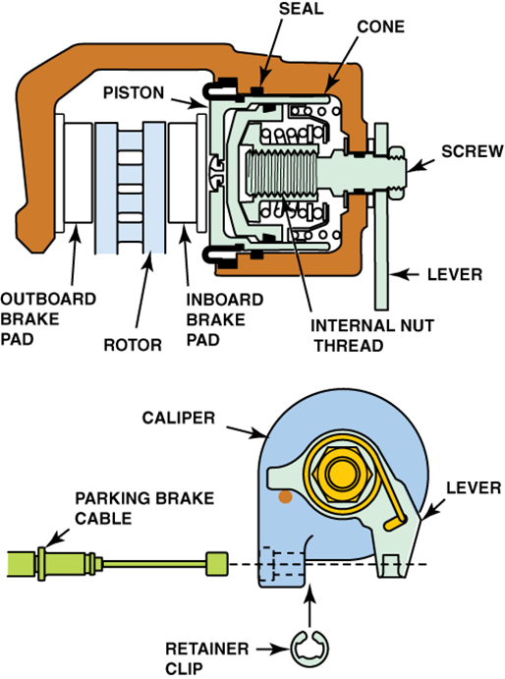
AUTOMOTIVE TECHNOLOGY · AUTOA 123
PARKING BRAKE
Integrated Parking Brake
Cable-actuated screw mechanism inside the caliper
A lever on the caliper turns a screw inside the piston
The screw walks the piston outward to clamp the rotor mechanically
When parking brake releases, the screw retracts but the piston stays adjusted
Square-cut seal still controls running clearance during normal braking
HOW TO RETRACT THE PISTON
These calipers do not push back. The piston must be twisted clockwise as it is pressed in. Use the correct cube tool that matches the piston pattern. Forcing it with a C-clamp shears the internal mechanism.
AUTOA 123 · Brakes · Lecture 3 of 4 · Shoreline Community College
19 / 24
Amber Avery-Graff · aavery@shoreline.edu

Slide 20
AUTOMOTIVE TECHNOLOGY · AUTOA 123
PARKING BRAKE
Electric Parking Brake (EPB)
On most vehicles built since 2015
A small electric motor on the caliper drives a gearbox and screw
Module receives a request from the EPB switch or system logic
Replaces traditional cable, lever, and integrated screw mechanism
Often supports auto-hold, hill-hold, and emergency dynamic apply
SERVICE MODE IS REQUIRED
Before pad replacement, the EPB must be commanded into Service Mode using a scan tool that supports it.
Trying to retract the piston by hand will strip the actuator gears.
After the new pads are installed, command the EPB to recalibrate; some vehicles require an apply and release cycle plus a clutch or pedal sequence.
AUTOA 123 · Brakes · Lecture 3 of 4 · Shoreline Community College
20 / 24
Amber Avery-Graff · aavery@shoreline.edu

Slide 21
AUTOMOTIVE TECHNOLOGY · AUTOA 123
BREAK-IN
Burnishing and Pad Break-In
ASE A5 D.10 Why the first 200 miles matter
New pads start with a fresh surface and no transfer layer
Burnishing deposits a thin, even film of pad material on the rotor
An even transfer layer is what gives smooth, quiet stops
Skipping the procedure causes uneven deposits, judder, and pulsation
TYPICAL PROCEDURE
1. 30 mph to 5 mph, moderate stop, ten times
2. 50 mph to 5 mph, firm stop, three times
3. Drive without dragging the brakes for several minutes to cool
Always follow the pad manufacturer specification.
TELL THE CUSTOMER
Give the customer the burnish-in instructions when you hand back the keys. If they hard-brake from highway speed on the way home, they will be back with a pulsation complaint.
AUTOA 123 · Brakes · Lecture 3 of 4 · Shoreline Community College
21 / 24
Amber Avery-Graff · aavery@shoreline.edu

Slide 22
AUTOMOTIVE TECHNOLOGY · AUTOA 123
DIAGNOSIS
Diagnosing Disc Brake Concerns
ASE A5 D.11 Match the symptom to the likely cause
SYMPTOM
LIKELY CAUSE
Pedal pulsation
Rotor thickness variation; lateral runout out of spec
Pulling to one side
Sticking caliper or seized slide pin on the opposite side
Drag or running hot
Stuck piston, sticking pin, or restricted hose acting as one-way valve
Squeal
Glazed pads, missing shim, or worn anti-rattle hardware
Grinding
Pads worn through; metal-on-metal contact with rotor
Grabbing
Contaminated pad face or scored rotor surface
Soft or sinking pedal
Air in system, internal master cylinder leak, or hose ballooning
AUTOA 123 · Brakes · Lecture 3 of 4 · Shoreline Community College
22 / 24
Amber Avery-Graff · aavery@shoreline.edu

Slide 23
AUTOMOTIVE TECHNOLOGY · AUTOA 123
MODERN
Hybrids, EVs, and Brake-by-Wire
What changes when the friction brake is the backup
Regenerative braking does most of the work
Most light braking is electric; friction brakes only finish the stop
Less use means more rust
Rear pads can stick to rotors; surface rust forms on rotor friction face
Pads can glaze early
Without enough heat cycles, pad transfer layer never properly forms
Service mode is mandatory
Most regen-capable vehicles require a scan tool routine before pad service
Brake-by-wire pedal feel
Pedal feeds a sensor; there is no direct hydraulic feel until backup mode engages
AUTOA 123 · Brakes · Lecture 3 of 4 · Shoreline Community College
23 / 24
Amber Avery-Graff · aavery@shoreline.edu

Slide 24
AUTOMOTIVE TECHNOLOGY · AUTOA 123
WRAP UP
Wrap Up
Quick recap and what comes next
KEY TAKEAWAYS
COMING UP IN LAB
Equal clamping force on both rotor faces
Square-cut seal handles return and self-adjust
Match pad compound to the use case
Always measure: thickness, variation, runout
Service the slide pins, not just the pads
Burnish in or you will see them again
Disc brake System Basics on the assigned vehicle. You will measure rotor thickness, variation, and runout, and inspect caliper hardware. Pull both calipers, inspect, lube, and reinstall.
STUDY RESOURCES
Lecture slides PDF in Canvas
Disc brake micro lessons
Theoretical Diagnosis quiz unlocks after lecture
ShopKey: pull torque specs and rotor min thickness for your vehicle before lab
AUTOA 123 · Brakes · Lecture 3 of 4 · Shoreline Community College
24 / 24
Amber Avery-Graff · aavery@shoreline.edu

