Slide 1
AUTOMOTIVE TECHNOLOGY
AUTOA 123
Intro to Brakes
Brake system components and operation • Road testing • Braking concerns
Shoreline Community College | Amber Avery-Graff
1 / 16

Slide 2
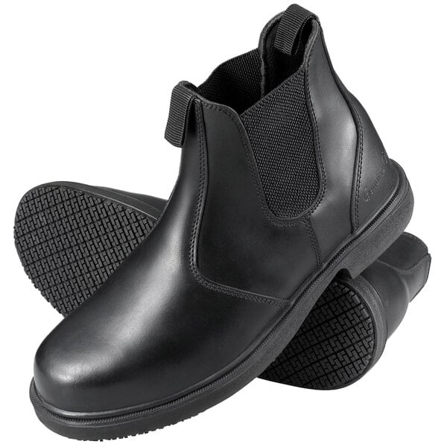
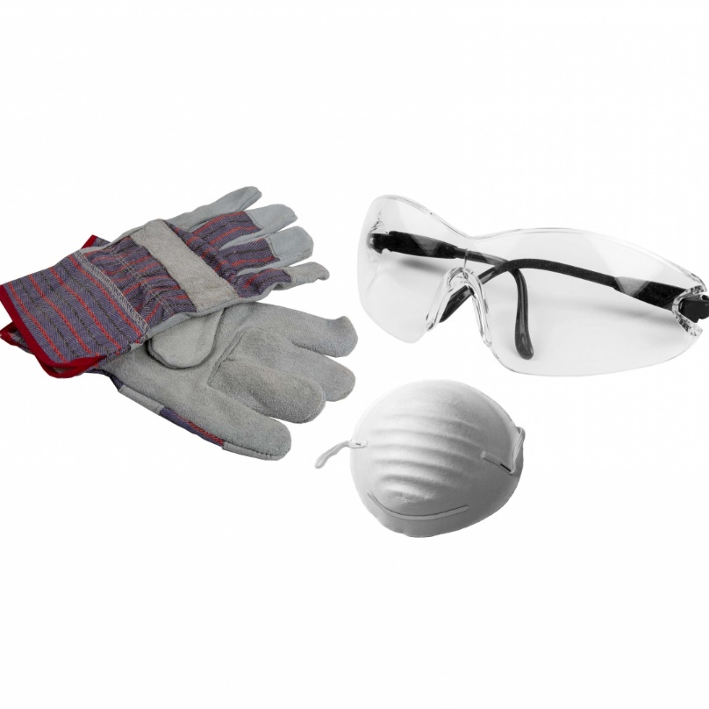

SAFETY
Personal Protective Equipment
Safety-toed boots
Required at all times
Safety glasses, gloves
& dust mask
Shop uniform
Required -- part of grade
2 / 16

Slide 3
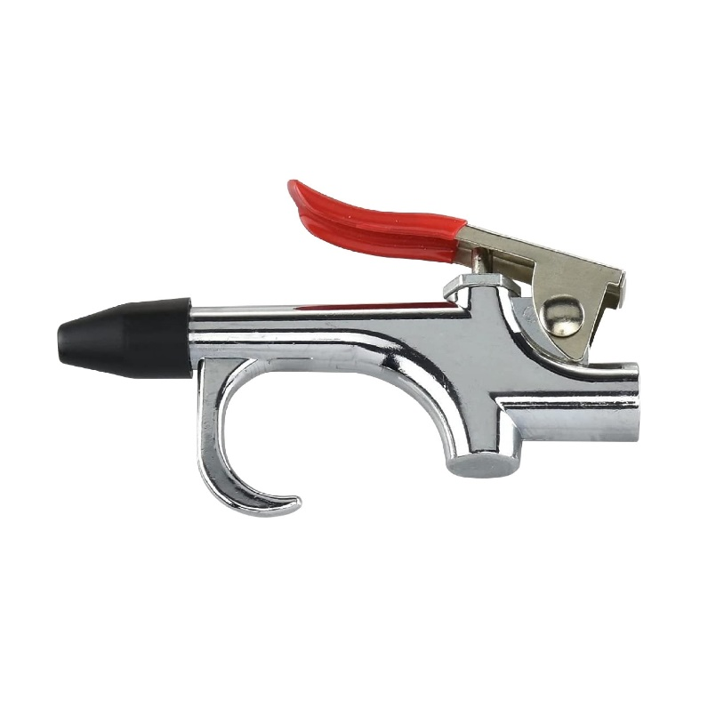
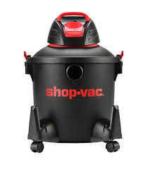

SAFETY
Cleaning Brake Dust Safely
Do NOT blow with air gun
Use HEPA shop vac instead
Or wipe with damp rags
NEVER use compressed air to blow brake dust -- older vehicles may contain asbestos. Use a HEPA shop vac or brake cleaner spray.
3 / 16

Slide 4
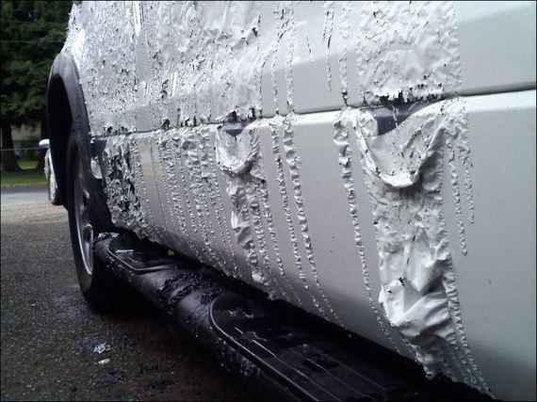
SAFETY
Chemical Safety -- Brake Fluid Is Toxic
Brake fluid is TOXIC -- treat it as a hazardous chemical
Eye contact: flush immediately with water, seek medical attention
Skin contact: wash thoroughly with soap and water
Always use the fluid specified for the vehicle
Never set an open container on a painted surface
Know where the SDS sheets are in the shop
Brake fluid destroys automotive paint on contact. One spill can cause thousands in damage.
4 / 16

Slide 5
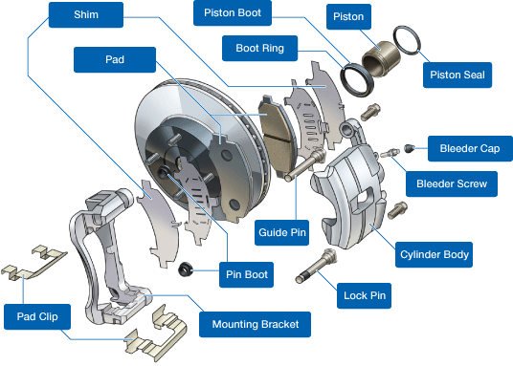
DISC BRAKE SYSTEM
Disc Brake Components
Rotor -- rotating friction surface
Caliper body -- houses pistons
Piston & piston seal -- applies force, retracts
Brake pad -- friction material on steel backing
Shim -- reduces noise and vibration
Guide pins -- allow caliper to float and center
Bleeder screw -- purge air from system
Mounting bracket -- bolts to knuckle
5 / 16

Slide 6
SYSTEM OPERATION
How the Brake System Works
Driver presses pedal
Pistons clamp pads to rotor
1
4
Mechanical force applied
Friction material contacts rotor/drum
Master cylinder pressurizes fluid
Friction slows the vehicle
2
5
Force converts to hydraulic pressure
Kinetic energy converts to heat
Pressure flows to calipers
Pedal released
3
6
Lines deliver pressure to each corner
Pressure drops, system returns to rest
The chain: Mechanical Force → Hydraulic Pressure → Friction → Deceleration
6 / 16

Slide 7
SYSTEM REQUIREMENTS
What the Brake System Must Do
Apply equal force to both sides of the vehicle to prevent pulling
Use hydraulic control valves to maximize stopping force without wheel lockup
Use hydraulic fluid that will not evaporate, freeze, or boil under normal conditions
Friction material must not contain asbestos -- exercise caution with older vehicles
Asbestos warning: Some pre-1980s brake pads may still contain asbestos. Always use a HEPA vacuum and avoid blowing dust.
7 / 16

Slide 8
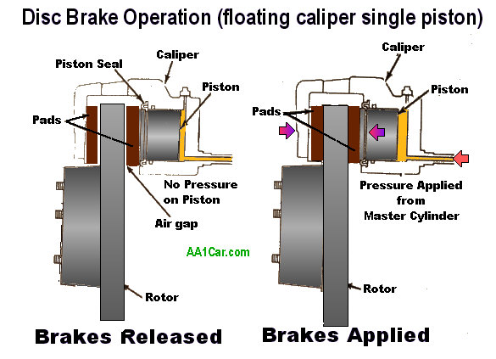
CALIPER TYPES
Floating Caliper
Moves freely on an anchor plate using guide pins
Pressure pushes the inboard pad to the rotor
Reaction force slides caliper body, applying outboard pad
Typically 1 to 2 pistons
PRO
CON
Lower cost, compact design
More flex, potential spongy pedal, uneven pad wear
8 / 16

Slide 9
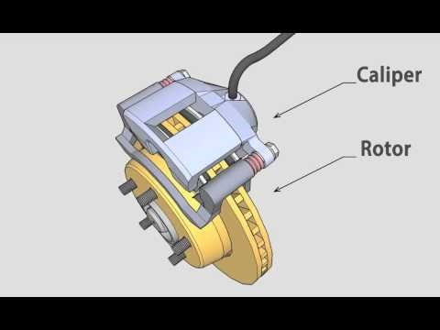
CALIPER TYPES
Floating Caliper -- In Motion
Video Reference
Watch how the piston pushes the inboard pad and the caliper body reacts to apply the outboard pad.
youtube.com/watch?v=Au_SRabG_64
Key takeaway:
The caliper MOVES -- that movement is what applies the outer pad. Sticky guide pins = uneven pad wear.
9 / 16

Slide 10
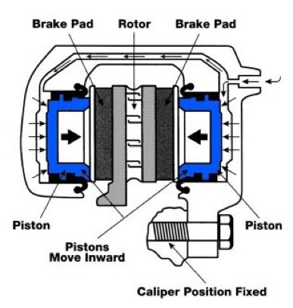
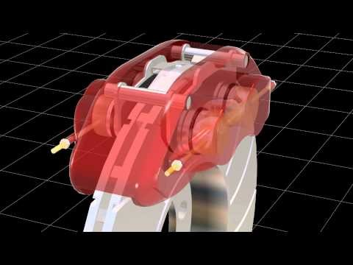
CALIPER TYPES
Fixed Caliper
Does NOT move -- bolted rigidly to knuckle or trailing arm
2, 4, or 6 pistons -- equal numbers on each side of rotor
Pistons apply equal clamping force on both sides simultaneously
PRO
CON
Better heat dissipation, heavy-duty use
Heavier, harder to service, higher leak potential
 | Floating | Fixed
Pistons | 1-2 (one side) | 2-4-6 (both sides)
Moves? | Yes -- slides on pins | No -- rigid mount
Typical Use | Everyday vehicles | Performance / trucks
10 / 16

Slide 11
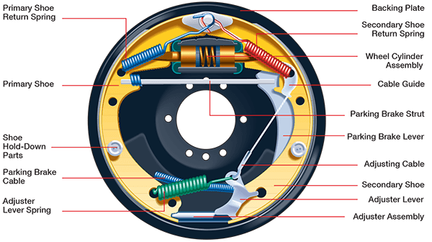
DRUM BRAKE SYSTEM
Drum Brake Components
Brake shoes (primary + secondary)
Wheel cylinder
Return springs
Star adjuster (self-adjusting)
Drum
Backing plate
Parking brake lever and cable
Drum brakes are a PREREQUISITE SKILL in this program. We do not run drum brake labs. If this is new content to you -- study it independently. A micro lesson is available in the Study Hub.
11 / 16

Slide 12
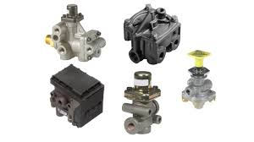
HYDRAULIC CONTROL
Brake Balancing Control Systems
Metering valve -- delays front disc until rear drums engage (RWD)
Proportioning valve -- limits rear pressure during hard stops
Height sensing proportioning valve -- adjusts for vehicle load
Combination valve -- metering + proportioning + pressure differential in one (RWD)
ABS -- electronically prevents wheel lockup at each corner
Covered in depth in the next lecture: Valves, Switches & Brake Fluid
12 / 16

Slide 13

DIAGNOSIS
Identifying the Customer Concern
What is the Customer Concern?
Can it be...
Felt -- vibration, pulsation, pulling, hard/spongy pedal
Heard -- squealing, grinding, clicking, scraping
Smelled -- burning odor (overheating, seized caliper)
When does it occur?
Cold mornings only
After driving a long time (heat-related)
Hard braking only vs. light braking
13 / 16

Slide 14
DIAGNOSIS REFERENCE
Common Braking Concerns and Likely Causes
Concern | Likely Cause(s)
Noise (squeal, grind, scrape) | Low pads, shifted shims, rust on rotor, seized component
Pedal vibration | Rotor lateral runout or thickness variation
Steering vibration during braking | Front rotor runout
Soft or spongy pedal | Air in lines, leak, failed master cylinder or caliper
Burning odor | Overheating -- usually a seized caliper preventing retraction
BRAKE / ABS / TRAC warning light | Many causes -- requires scan tool diagnosis
Pulling to one side when braking | Seized caliper, contaminated pad, collapsed hose
14 / 16

Slide 15
ROAD TESTING
Verifying Brake System Operation
Once you understand the concern, attempt to DUPLICATE it on the road test
Pay attention to driving parameters -- speed, braking force, temperature
Once duplicated, confirm it is a braking issue and not tires, suspension, or wheel bearing
A thorough road test must be performed AFTER all repairs before returning the vehicle
ABS must be verified as part of every brake road test. ABS should activate during a controlled hard stop on a safe surface.
15 / 16

Slide 16
ROAD TESTING
Standardized Brake Test Procedures (FMVSS)
Test | What It Verifies
Burnishing | 200 stops from 50 mph -- seats new pads and rotors
Cold effectiveness | Adequate stopping power when linings are cold
High speed effectiveness | Adequate stopping under load at speed
Engine off stops | Stops in 230 ft from 62 mph with no power assist
ABS functional failure | Warning light illuminates with simulated failure
Parking brake | Holds vehicle on 20% grade for 5 minutes
Brake heat test | Brakes function correctly after heat soak
16 / 16

