Slide 1
AUTOMOTIVE TECHNOLOGY
AUTOA 123
Pascal's Law and Master Cylinders
Brake pedal height, travel, and free-play | Master cylinder diagnosing, servicing, and R&R
Brakes | Day 2
AUTOA 123 | Brakes | Pascal's Law and Master Cylinders | Shoreline Community College
1 / 24

Slide 2
Pascal's Law
Hydraulic Principles
Blaise Pascal | 1632 -- 1662
"When force is applied to a liquid confined in a container or enclosure, the pressure is transmitted equally and undiminished in every direction."
What this means for brakes:
Pressure created at the master cylinder travels equally to every wheel cylinder and caliper.
Different piston sizes allow us to multiply or reduce force as needed.
Example: 10 lbs on a 1 sq.in. piston = 10 psi. That 10 psi is present at every wheel.
AUTOA 123 | Brakes | Pascal's Law and Master Cylinders | Shoreline Community College
2 / 24

Slide 3
Pascal's Law -- The Formulas
Hydraulic Principles
F = P x A
F = Force (lbs)
Force = Pressure x Area
P = F / A
P = Pressure (PSI)
Pressure = Force / Area
A = F / P
A = Area (sq. in.)
Area = Force / Pressure
AUTOA 123 | Brakes | Pascal's Law and Master Cylinders | Shoreline Community College
3 / 24

Slide 4
Pascal's Law -- Force
Hydraulic Principles
Because of Pascal's law, we can use different piston sizes to change braking force -- higher force in the front, smaller force in the rear.
The amount of force starts at the brake pedal, then transfers to the fluid which pushes the piston in the brake.
If the input force is 150 lbs at the pedal and the piston is 2 sq. in., then the output force to the brake pads is 300 lbs of force.
AUTOA 123 | Brakes | Pascal's Law and Master Cylinders | Shoreline Community College
4 / 24

Slide 5
Pascal's Law -- Pressure
Hydraulic Principles
P = F / A
100 lbs / 1 sq. in. = 100 psi
100 lbs / 2 sq. in. = 50 psi
Pressure stays constant throughout a sealed system -- but force changes with piston size.
AUTOA 123 | Brakes | Pascal's Law and Master Cylinders | Shoreline Community College
5 / 24

Slide 6
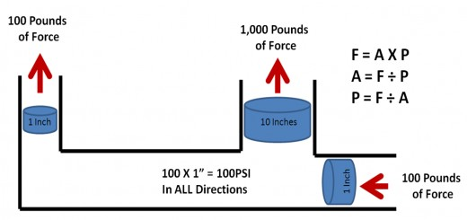
Pascal's Law -- Applied to Brakes
Hydraulic Principles
The piston surface area affects force -- not diameter.
The first area that converts force into pressure is the Master Cylinder.
If the driver inputs 100 PSI to a 1/2" piston in the MC, the pressure in the closed system is 200 psi at each wheel.
Class exercise: Using ShopKey, find the MC bore and one caliper piston bore. Calculate the force ratio.
AUTOA 123 | Brakes | Pascal's Law and Master Cylinders | Shoreline Community College
6 / 24

Slide 7
Pascal's Work as Class
Use ShopKey to find your vehicle's MC bore and caliper piston bore.
Calculate the force ratio and explain what it means.
AUTOA 123 | Brakes | Pascal's Law and Master Cylinders | Shoreline Community College
7 / 24

Slide 8
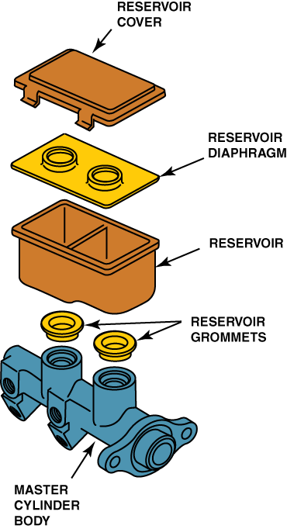
Master Cylinders
Hydraulic System Components
Master cylinders have 2 reservoirs -- one primary and one secondary.
Reservoir Cover
Reservoir Diaphragm
Reservoir
Reservoir Grommets
Master Cylinder Body
AUTOA 123 | Brakes | Pascal's Law and Master Cylinders | Shoreline Community College
8 / 24

Slide 9
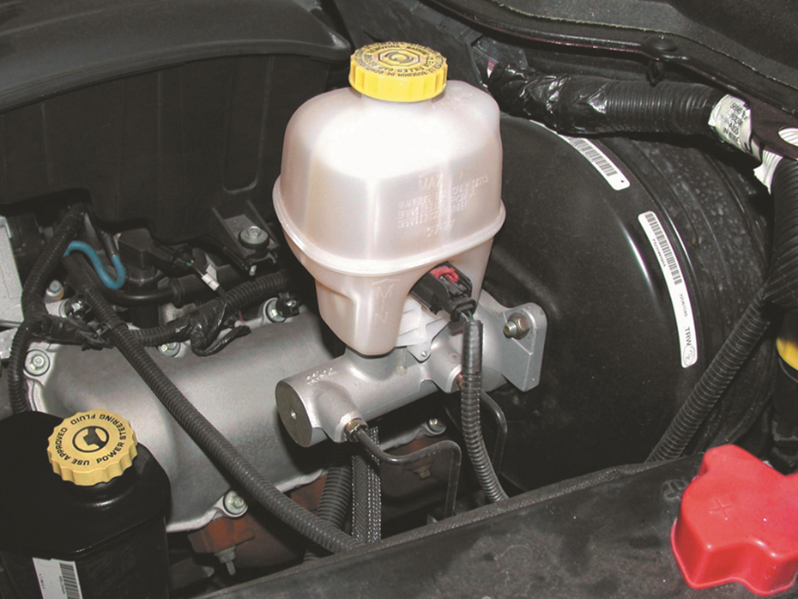
Reservoir Fluid Level
Hydraulic System Components
Full / MAX
Normal when system is new. All pads near full thickness.
At or near MIN
Normal as pads wear. Fluid moves into calipers to compensate.
Below MIN -- new pads installed
Suspect a fluid leak -- internal or external. Inspect before filling.
AUTOA 123 | Brakes | Pascal's Law and Master Cylinders | Shoreline Community College
9 / 24

Slide 10

Vent and Replenishing Ports -- Different Names
Master Cylinder Operation
Vent Port (also called):
Compensating port | Bypass port
Replenishing Port (also called):
Inlet port | Bypass port | Filler port | Breather port
AUTOA 123 | Brakes | Pascal's Law and Master Cylinders | Shoreline Community College
10 / 24

Slide 11
Vent Ports Must Remain Open
Master Cylinder Operation
The vent ports must remain open to allow brake fluid to expand when heated by the friction material and transferred to the caliper and/or wheel cylinder.
If blocked:
Brakes drag and overheat
Residual pressure trapped in lines
Fluid cannot return to reservoir
AUTOA 123 | Brakes | Pascal's Law and Master Cylinders | Shoreline Community College
11 / 24

Slide 12
Pedal Depressed -- Vent Port Closes
Master Cylinder Operation
As the brake pedal is depressed, the pushrod moves the primary piston forward, closing off the vent port.
This is the moment the hydraulic circuit is sealed and force transmits to the calipers.
AUTOA 123 | Brakes | Pascal's Law and Master Cylinders | Shoreline Community College
12 / 24

Slide 13
Replenishing Port -- Purpose
Master Cylinder Operation
The purpose of the replenishing port is to keep the volume behind the primary piston filled with brake fluid from the reservoir as the piston moves forward during a brake application.
AUTOA 123 | Brakes | Pascal's Law and Master Cylinders | Shoreline Community College
13 / 24

Slide 14
Brake Pedal Released
Master Cylinder Operation
When the brake pedal is released, the master cylinder piston moves rearward.
Vent port reopens -- pressure bleeds back to reservoir
Calipers release -- pads retract
System ready for next application
AUTOA 123 | Brakes | Pascal's Law and Master Cylinders | Shoreline Community College
14 / 24

Slide 15
Dual Split Master Cylinder
Master Cylinder Types
Dual split master cylinder
Used on most rear-wheel-drive vehicles
Front circuit: both front wheels
Rear circuit: both rear wheels
If one circuit fails, the other continues to provide braking.
AUTOA 123 | Brakes | Pascal's Law and Master Cylinders | Shoreline Community College
15 / 24

Slide 16
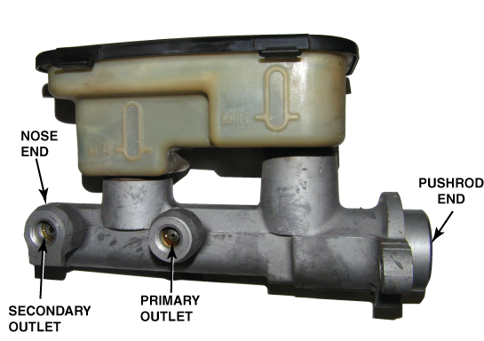
Primary and Secondary Pistons
Master Cylinder Types
Primary piston
Closest to the pushrod (brake pedal side)
Secondary piston
Closest to the nose (front of the MC body)
Memory tip: Pushrod end = Primary. Nose end = Secondary.
AUTOA 123 | Brakes | Pascal's Law and Master Cylinders | Shoreline Community College
16 / 24

Slide 17
Primary Circuit Failure
Master Cylinder Types
In the event of a primary system failure, no hydraulic pressure is available to push the secondary piston forward.
What happens:
Primary circuit loses pressure
Secondary piston is not actuated -- rear brakes may have reduced or no effect
Pedal may travel further before resistance is felt
Warning light illuminates via pressure differential switch
AUTOA 123 | Brakes | Pascal's Law and Master Cylinders | Shoreline Community College
17 / 24

Slide 18
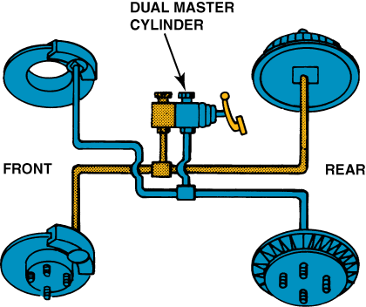
Diagonal Split Master Cylinder
Master Cylinder Types
Front-wheel-drive vehicles use a diagonal split master cylinder.
Circuit 1: Right front + Left rear
Circuit 2: Left front + Right rear
Guarantees at least one front wheel has braking if a circuit fails
FWD vehicles do most braking at the front -- diagonal split ensures at least one front wheel always has pressure.
AUTOA 123 | Brakes | Pascal's Law and Master Cylinders | Shoreline Community College
18 / 24

Slide 19
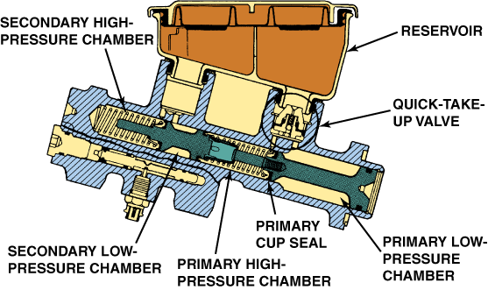
Quick Take-Up Master Cylinder
Master Cylinder Types
Used in new vehicles for fuel economy.
Can be identified by the large primary chamber (low pressure side)
Has a large primary piston in the low pressure chamber
Check ball valve holds pressure
Allows low drag caliper pistons to retract further -- reduces pad drag and fuel waste
AUTOA 123 | Brakes | Pascal's Law and Master Cylinders | Shoreline Community College
19 / 24

Slide 20
Bench Bleeding
Master Cylinder Service
Bench bleeding
Install bench bleed tubes into outlet ports, loop back into reservoir
Slowly stroke the piston until no bubbles appear in tubes
Keep reservoir filled -- never let it run dry
Plug outlets before removing tubes
Connect brake lines immediately after installing to prevent draining
AUTOA 123 | Brakes | Pascal's Law and Master Cylinders | Shoreline Community College
20 / 24

Slide 21
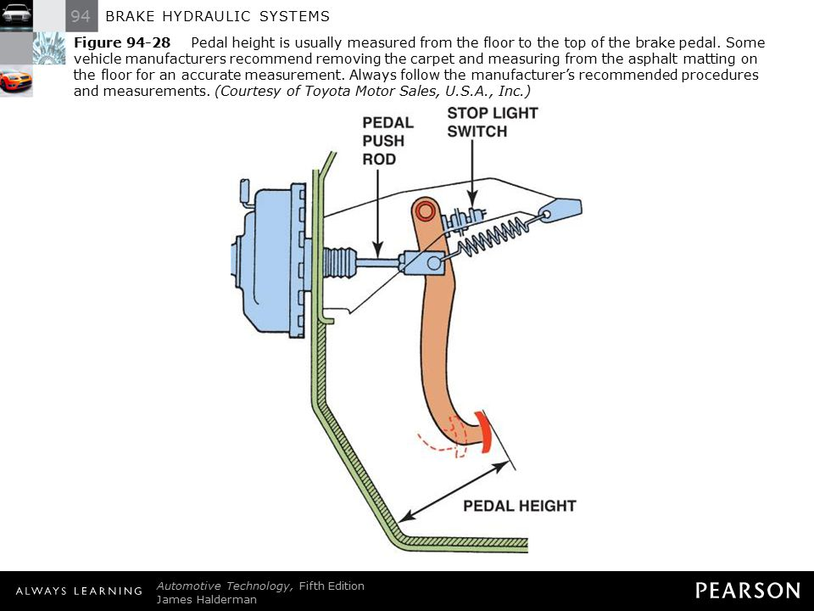
Brake Pedal Height
Pedal Measurements
Brake pedal height
This is important for the operation of the stop light switch
If too far forward -- can cause the vent ports not to open
If too low -- it can cause the free play to be excessive
Always look up the vehicle-specific specification in ShopKey before measuring.
AUTOA 123 | Brakes | Pascal's Law and Master Cylinders | Shoreline Community College
21 / 24

Slide 22
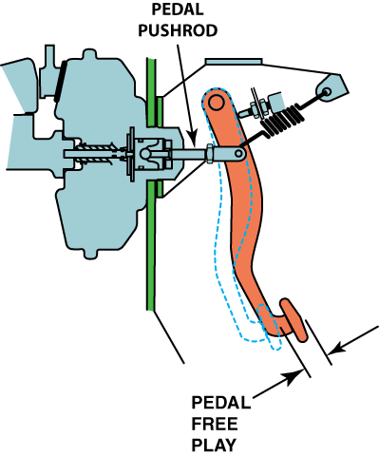
Brake Pedal Free Play
Pedal Measurements
Brake pedal free play
Free play is the amount of 'slack' the system has before the pushrod engages with the master cylinder
First measure from the top of the pedal to the floor
Second measure from the point that the pedal begins to have resistance
Subtract these two numbers -- this is the freeplay
AUTOA 123 | Brakes | Pascal's Law and Master Cylinders | Shoreline Community College
22 / 24

Slide 23
Free Play
Pedal Measurements
It is a measurable distance of the travel before the primary piston in the master cylinder moves.
Too much or too little free play can cause:
A spongy pedal
Lower than normal pedal
Sinking brake pedal -- can sink even when car is not moving; internal leak also known as bypassing
AUTOA 123 | Brakes | Pascal's Law and Master Cylinders | Shoreline Community College
23 / 24

Slide 24
Brake Pedal Reserve
Pedal Measurements
With the brake pedal fully depressed, measure from the floor to the top of the pedal -- specification is usually between 2-3 inches.
If the travel is out of specification -- possible causes:
Check the brake booster push rod clearance
Check for fluid leaks
Check for damaged components
Check for air in the system
AUTOA 123 | Brakes | Pascal's Law and Master Cylinders | Shoreline Community College
24 / 24

