Slide 1
AFTERNOON · 13:00
What changed in autoATES v3.0
Two scenarios, what the validation supports, and how a cell gets its class.
Then we run that model on Connaught Creek.
Two scenarios
Validation
Classifier
Typical and infrequent, in parallel
Nine regions. One held out.
Floors first. Then an average.
Notes:
BFW has introduced autoATES. This block is the v3.0 change, then notebook 03. About 15 minutes. Do not re-teach the whole pipeline.

Slide 2
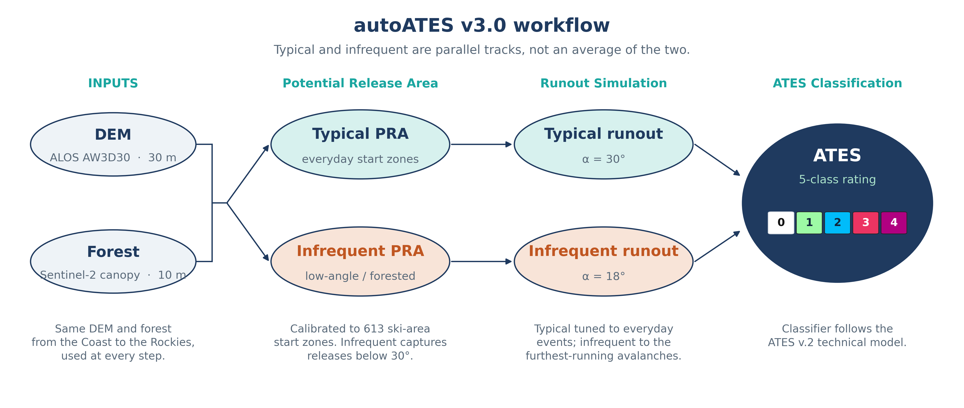
THE CHANGE
Two tracks. They meet in the classifier.
ISSW 2026 · autoATES v3.0 · afternoon
2 / 10
Notes:
Read the figure. Typical PRA into alpha 30. Infrequent PRA into alpha 18. PRA calibrated to 613 ski-area start zones. The live notebook uses the bundled Connaught forest layer in that same role. Runout detail belongs to the BFW block. The sentence under the title on the figure is the point: the two tracks are not averaged together.

Slide 3
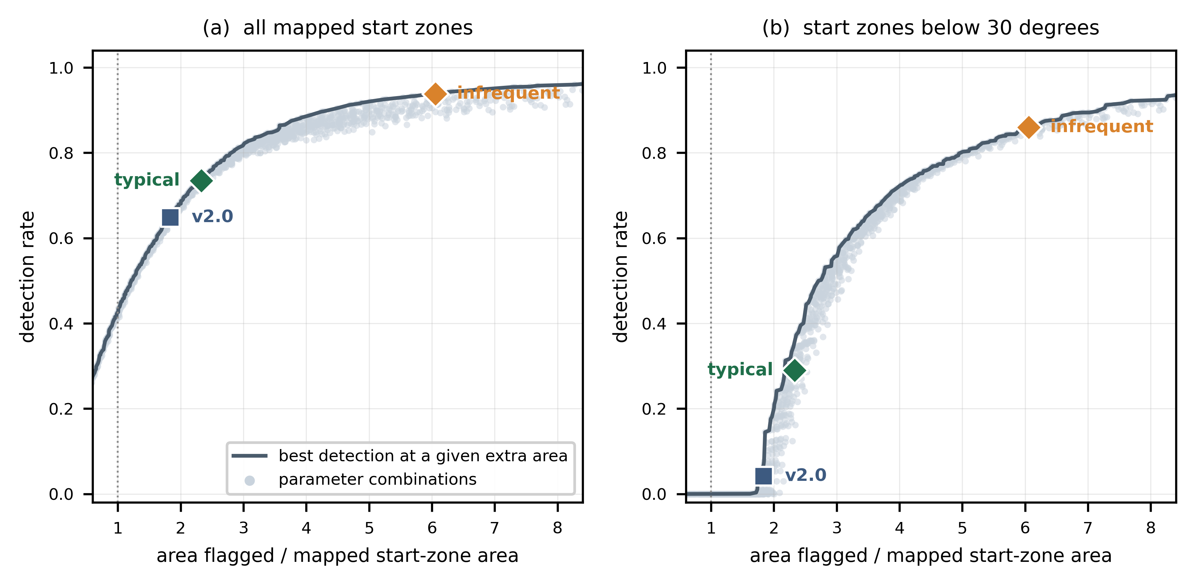
WHY TWO SCENARIOS
Infrequent is the layer that sees start zones below 30°.
ISSW 2026 · autoATES v3.0 · afternoon
3 / 10
Notes:
Each dot is a parameter combination. The line is the best detection at a given extra area. v2.0 is one point on that envelope. Typical sits a little further along. On the right-hand panel, start zones below 30°, infrequent is the setting that climbs the curve. Keep the ISSW thresholds in the room. Do not retune them live to look more like an expert map. Do not quote a detection rate unless you are reading it off this figure.

Slide 4
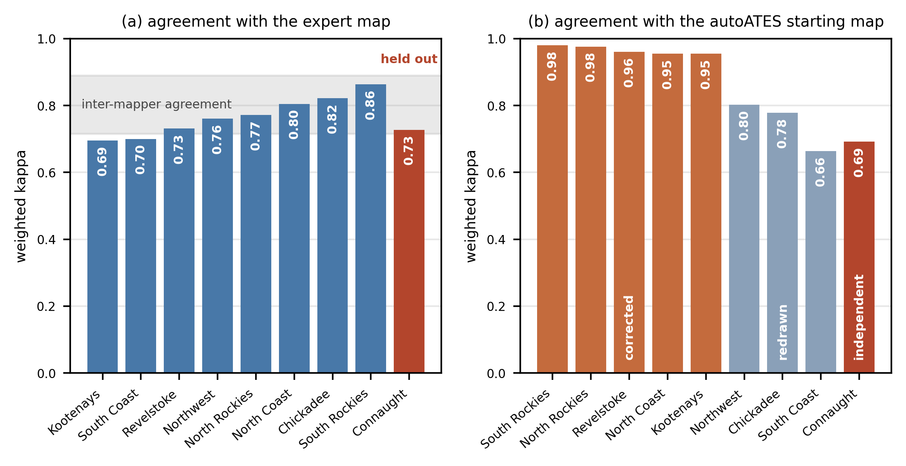
VALIDATION
Connaught was held out.
ISSW 2026 · autoATES v3.0 · afternoon
4 / 10
Notes:
Panel (a): weighted kappa against the expert map. Connaught is the red bar, marked held out, 0.73. The grey band is inter-mapper agreement, so 1.0 is not the target. Panel (b): agreement with the autoATES starting map. Use the figure’s own words for the groups: corrected, redrawn, independent. Connaught is independent. This is context. It is not a scoreboard for the overlay we open at 15:05.

Slide 5
HOW WE WILL USE THAT
Three rules for the Connaught overlay.
1
2
3
A reference
Tune the scenarios
Leave the thresholds
The expert map is there for discussion. Agreement between mappers is the ceiling on this comparison.
Regional calibration belongs in the typical and infrequent runs. The class thresholds stay as published.
Editing them in the room so Connaught looks closer to the overlay undoes the v3.0 design.
ISSW 2026 · autoATES v3.0 · afternoon
5 / 10
Notes:
Say these out loud before anyone opens the expert layer. If the room wants a number, go back one slide. Do not invent a second statistic.

Slide 6
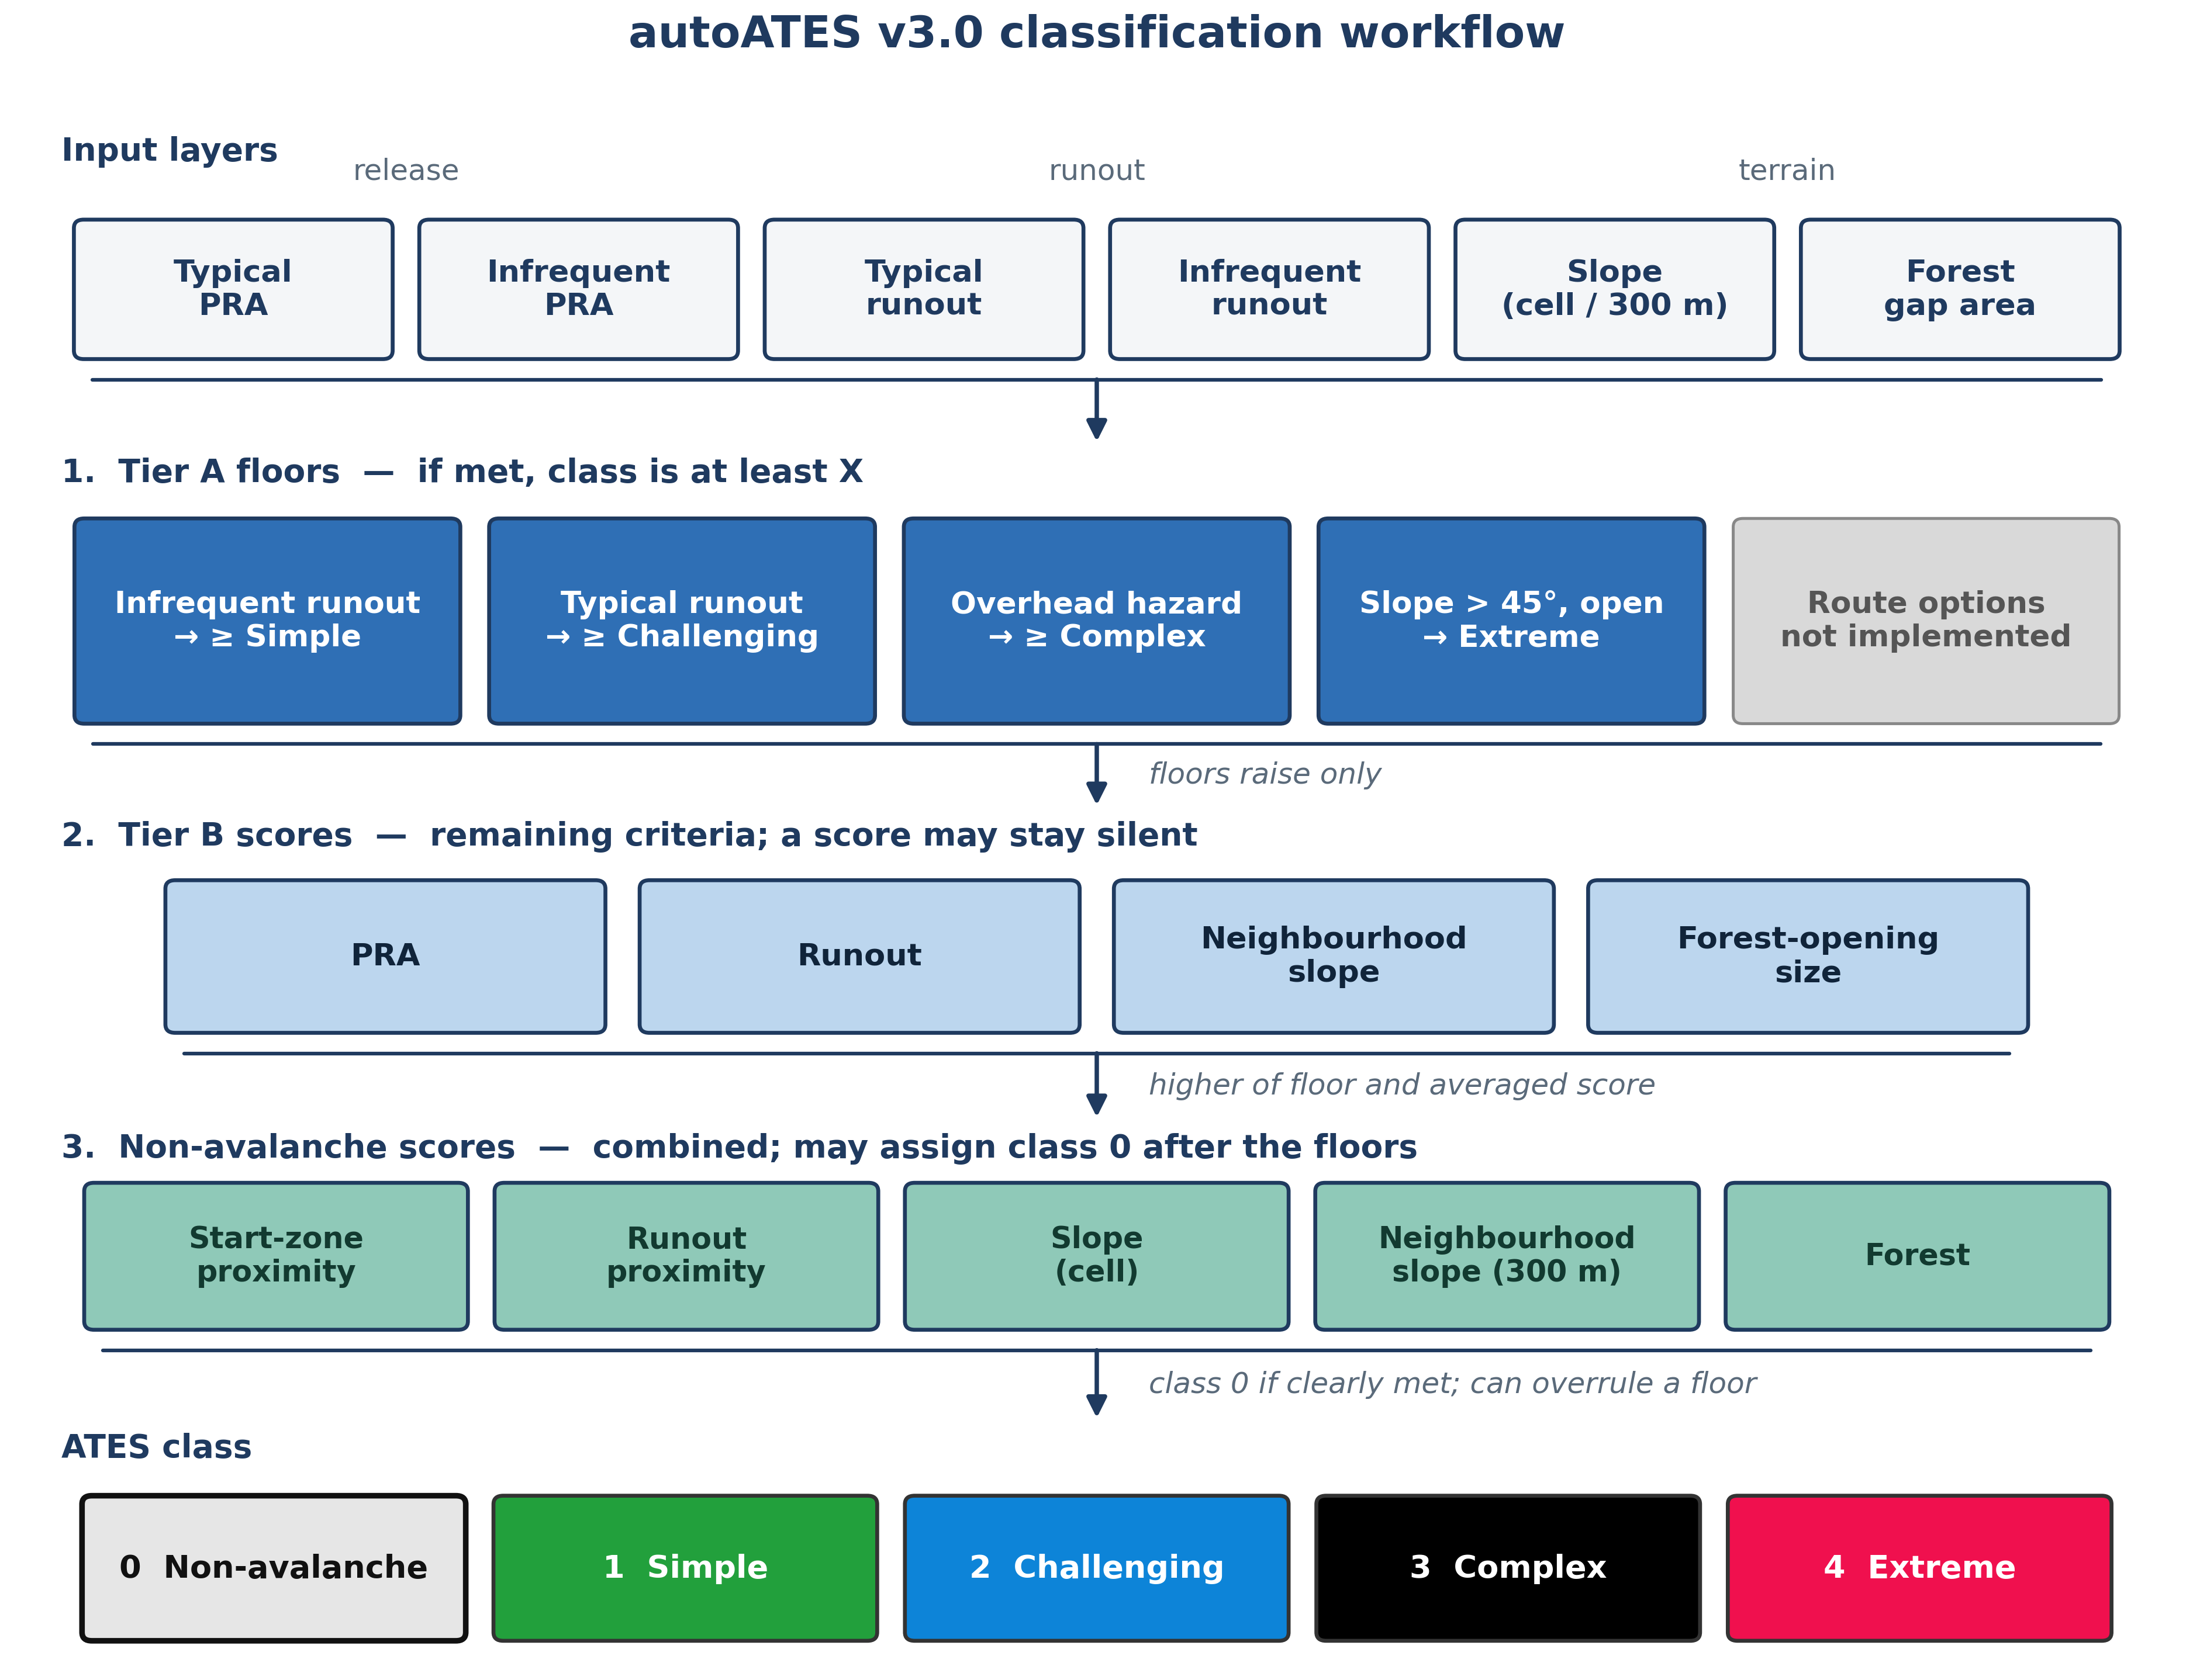
THE CLASSIFIER
Floors raise the class. The average cannot lower it.
ISSW 2026 · autoATES v3.0 · afternoon
6 / 10
Notes:
Walk top to bottom. Inputs, then Tier A floors (raise only; route options are greyed as not implemented), then Tier B scores that may stay silent, then the higher of the floor and the averaged score, then class 0 if it is clearly met. Class 0 can overrule a floor. The next slide is the same rules in the colours the map will use. The flowchart palette is the poster palette.

Slide 7
WHAT SETS THE CLASS
Five decisions. The map uses these colours.
0 Non-avalanche
Clear non-avalanche tests. This step can overrule a floor.
1 Simple
Floor: inside the infrequent runout.
2 Challenging
Floor: inside the typical runout.
3 Complex
Floor: overhead hazard.
4 Extreme
Floor: slope steeper than 45°, and open.
Tier B is averaged with the floor, and the higher value is kept. Route options are unimplemented.
ISSW 2026 · autoATES v3.0 · afternoon
7 / 10
Notes:
Colours match the QGIS style and the Connaught map, not the poster flowchart. Tier B (PRA, runout, neighbourhood slope, opening size) is averaged, and the higher of that average and the floor is kept. A Tier B score may stay silent. Route options are not implemented. Class 0 is a safety decision: calling avalanche terrain non-avalanche is the error that hurts someone.

Slide 8
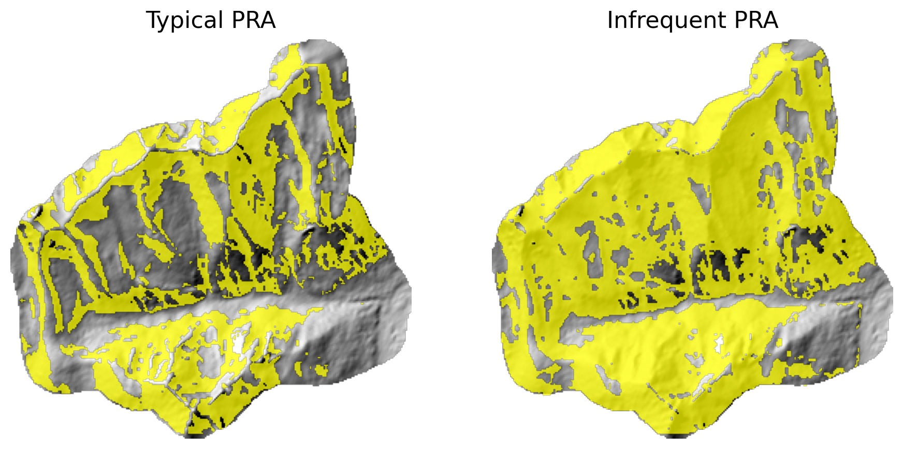
13:00 · CONNAUGHT CREEK
Next notebook: these two start-zone layers.
ISSW 2026 · autoATES v3.0 · afternoon
8 / 10
Notes:
13 km², ALOS about 21 m on this clip. Typical is the tighter layer. Infrequent fills in lower-angle and forested start zones. If a laptop stalls, copy data/03_pra/outputs_reference/ and continue. Do not switch to the 5 m lidar stack.

Slide 9
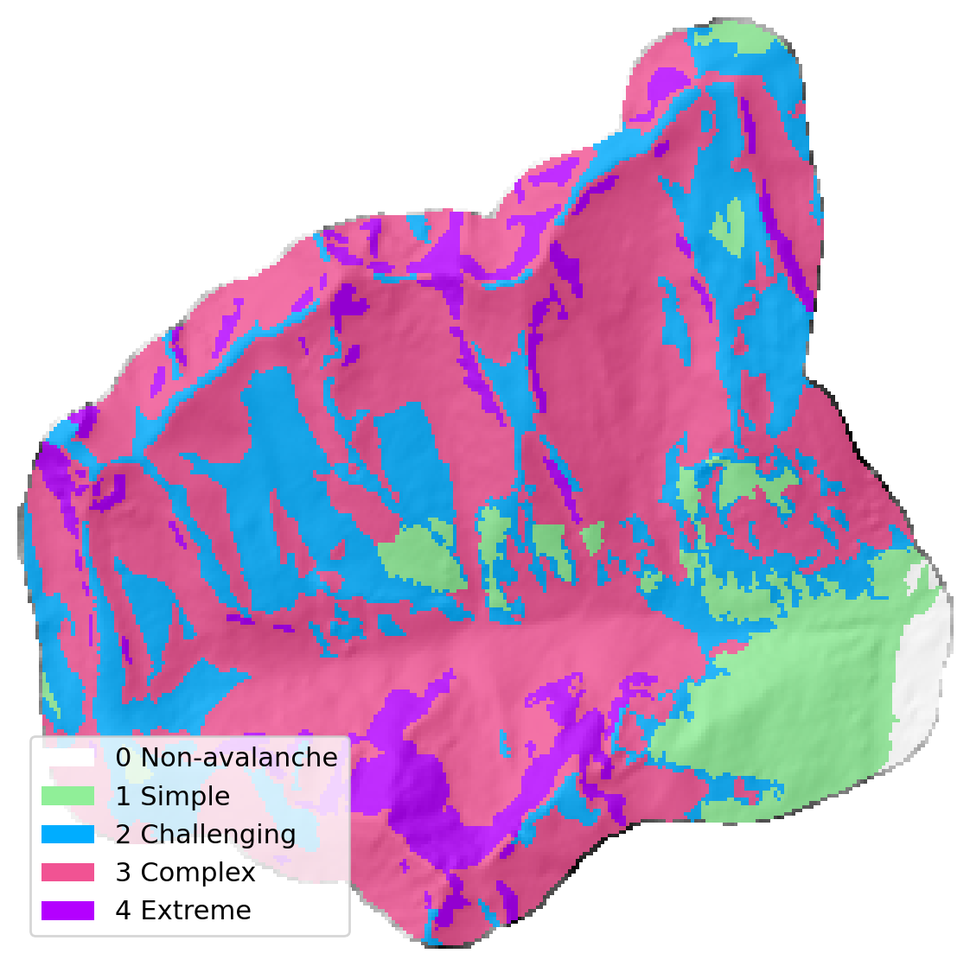
15:05 · SAME DRAINAGE
The classifier turns those layers into this map.
Open the overlay
Put this next to the expert consensus map. Talk about where they differ.
Hold the three rules
Reference, scenarios, published thresholds. The kappa slide is the comparison.
Watch class 0
A white cell is a claim that the tests for non-avalanche were clearly met.
ISSW 2026 · autoATES v3.0 · afternoon
9 / 10
Notes:
Square map, legend is on the figure. Pink is Complex and purple is Extreme, matching the QGIS style. South Coast is optional and QGIS-only at the end. Do not start a second live AOI.

Slide 10
THE NEXT THREE HOURS
13:00
Potential release area
Both scenarios. Notebook 03. You are here.
13:50
Runout, with BFW
com4FlowPy. Alpha 30° and alpha 18°. Notebook 04.
15:05
Classifier
Floors, then the Connaught map beside the expert overlay. Notebook 05.
If a laptop is still running, copy that folder’s outputs_reference and stay with the room.
Notes:
Break is 14:50–15:05. Flow-Py is the step most likely to stall; reference rasters are expected there. Total on this clip was about 5 seconds on the desktop with numba. Laptops will be slower. We do not start a second AOI after 15:45.

