Slide 1
ISSW 2026 · Saturday 3 October · 09:00–16:00 · Peak Room
autoATES v3.0
Mapping Connaught Creek with open-source tools
You can run the notebooks on a laptop, or follow the same maps on the projector.
Notes:
Welcome. Two tracks. Connaught 13 km2, production stack not 5 m lidar.

Slide 2
HOW THE ROOM WORKS
Two tracks, one timetable
On a laptop
Watching
If a step stalls
Run the notebook for the current module (Python 3.11 + QGIS). If a step stalls, copy that folder’s outputs_reference and continue with the group.
The same maps are on this screen. A laptop is optional. You leave with the method, the design choices, and where to get the code.
data/<step>/outputs_reference/ lets you stay with the room. Helpers will keep the day moving so the afternoon still fits.
Helpers from 08:15, with USB copies. Please download the folders before Saturday if you can — conference wifi is often slow.
ISSW 2026 · autoATES v3.0 workshop · Connaught Creek
2 / 12

Slide 3
THE CHAIN
Five steps. Typical and infrequent stay split.
1
2
3
4
5
Elevation
Forest
PRA
Runout
ATES
ALOS 30 m surface
Sentinel-2 canopy + gap
Typical / infrequent
Flow-Py α 30° / 18°
Floors, then average
One parameterization cannot stand in for everyday events and the larger, less frequent avalanches that still belong on an ATES map.
ISSW 2026 · autoATES v3.0 workshop · Connaught Creek
3 / 12
Notes:
Typical vs infrequent is the v3.0 design. Keep the ISSW thresholds for this session.

Slide 4
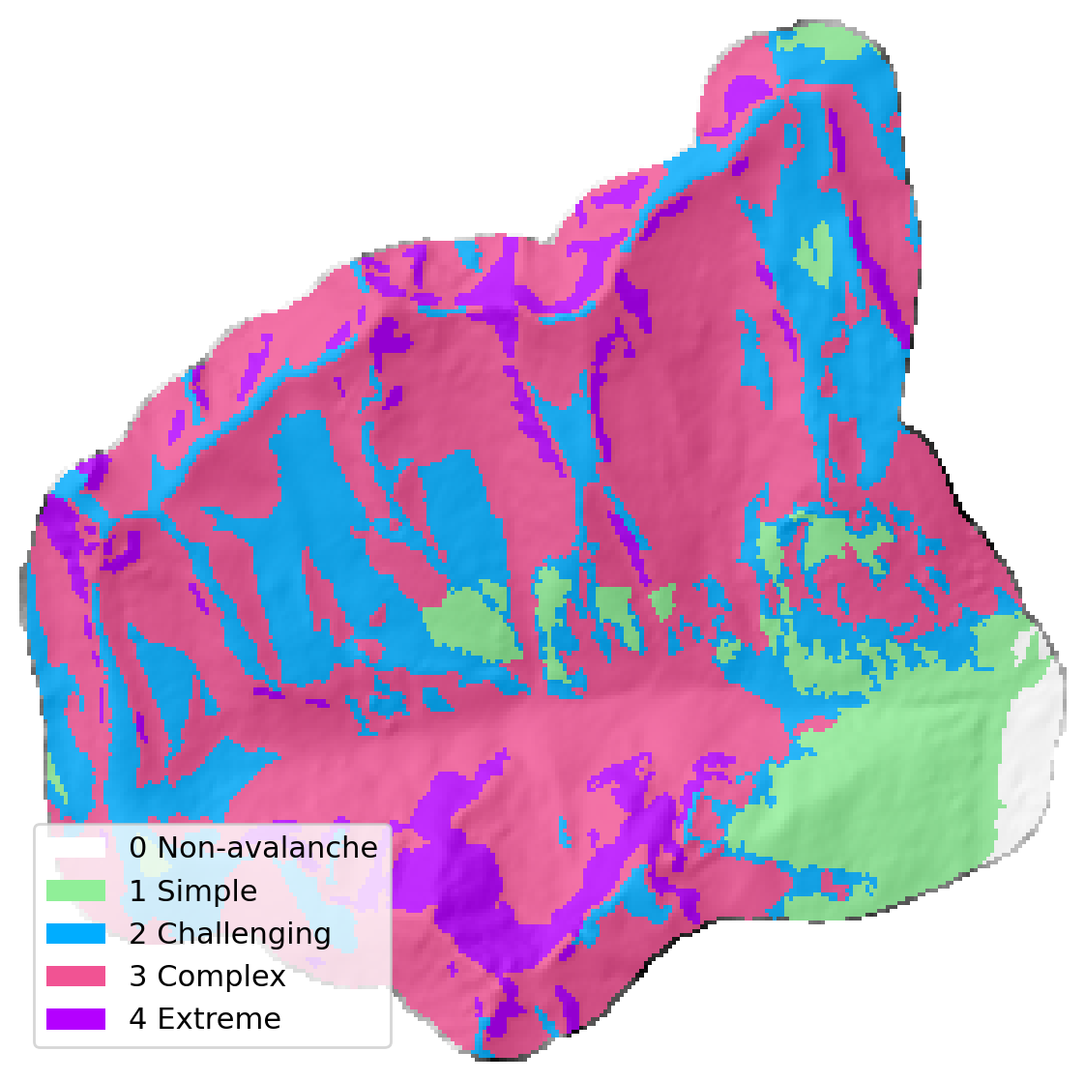
09:00 · THE MAP WE WILL REBUILD
Connaught Creek, Rogers Pass — 13 km²
ISSW 2026 · autoATES v3.0 workshop · Connaught Creek
4 / 12
Notes:
Held-out comparison drainage. Production stack, not 5 m lidar. Expert overlay is a reference, not ground truth.

Slide 5
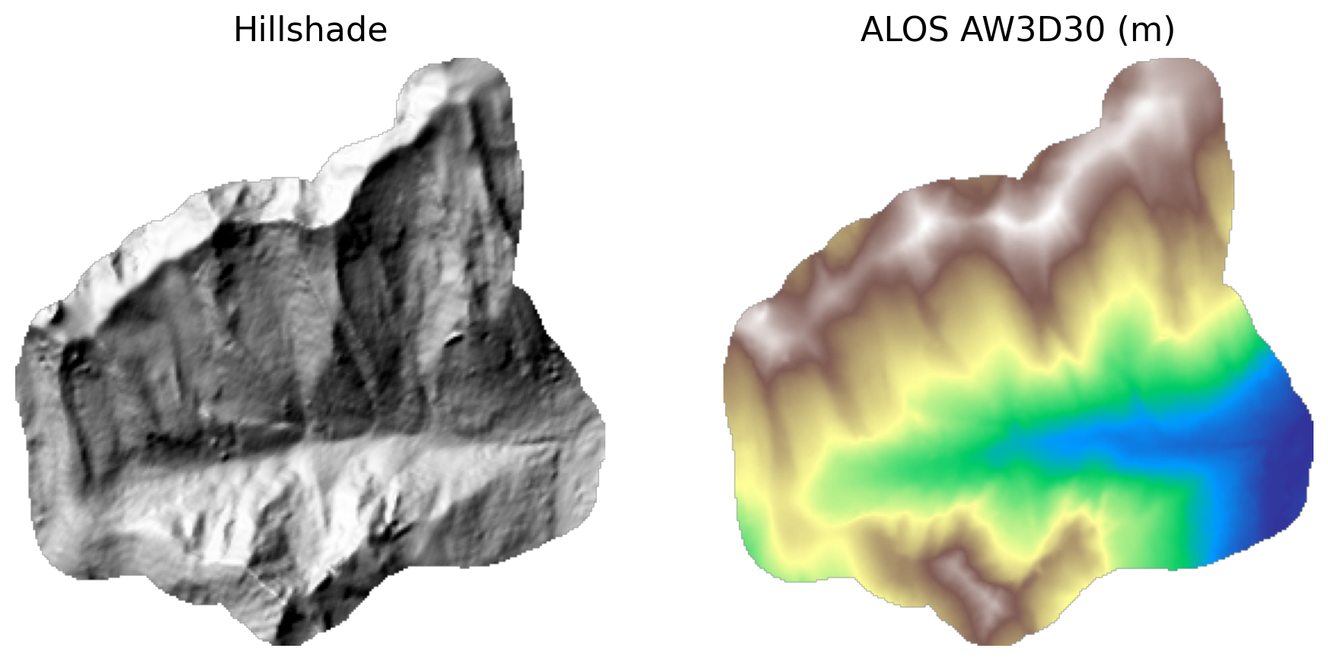
09:25 · ELEVATION
30 m surface. Canopy-top in forest. Slope is smoothed.
ISSW 2026 · autoATES v3.0 workshop · Connaught Creek
5 / 12
Notes:
Why not a lidar patchwork. Extreme cliffs and isolated low-angle start zones are both harder to pick out.

Slide 6
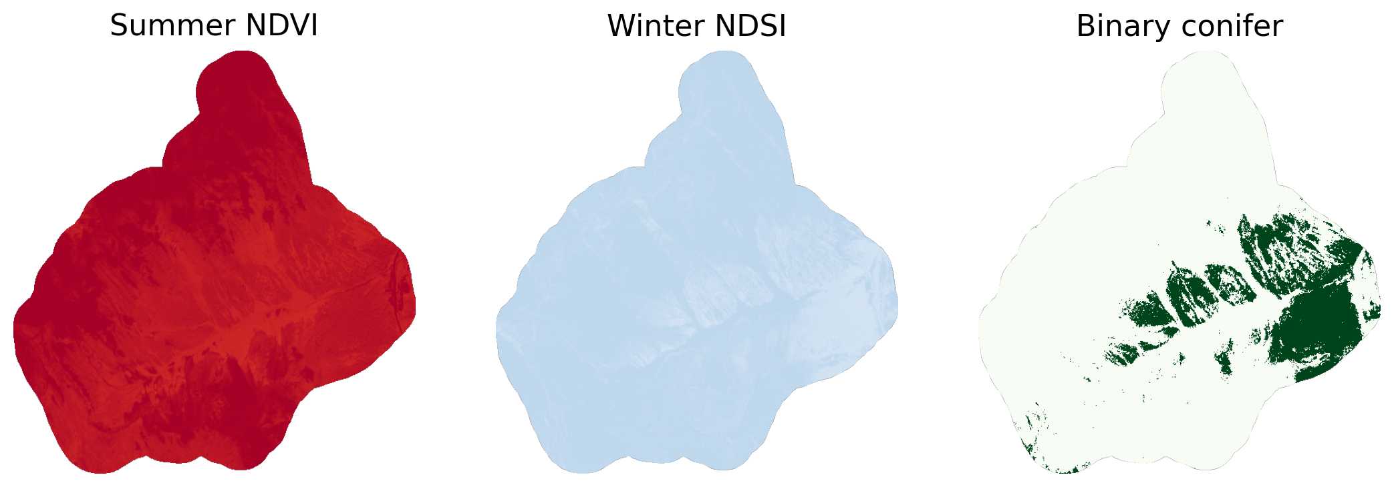
10:35 · FOREST
Summer greenness. Winter conifer, deciduous, and gully paths.
ISSW 2026 · autoATES v3.0 workshop · Connaught Creek
6 / 12
Notes:
We do not train a model in the room. Operational binary is bundled. Then 3x3 canopy and gap area.

Slide 7
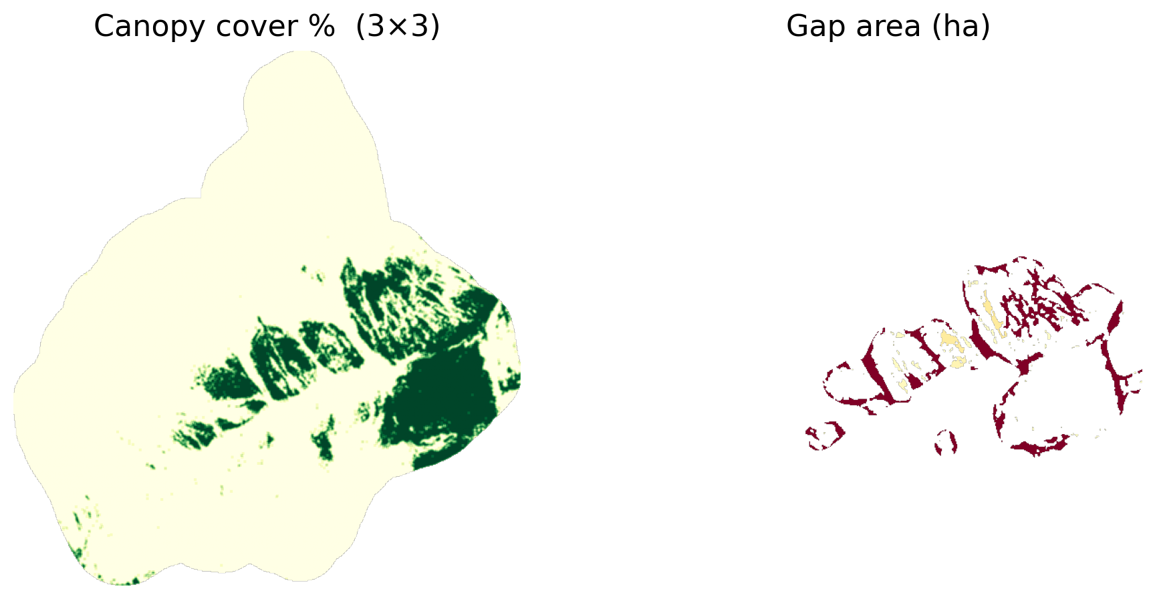
10:35 · FOREST
PRA uses canopy cover. The classifier uses opening size.
ISSW 2026 · autoATES v3.0 workshop · Connaught Creek
7 / 12
Notes:
Gap is only read where the neighbourhood is forested, so alpine is not one unbounded opening. Treeline segments large PRAs; it is not an ATES input.

Slide 8
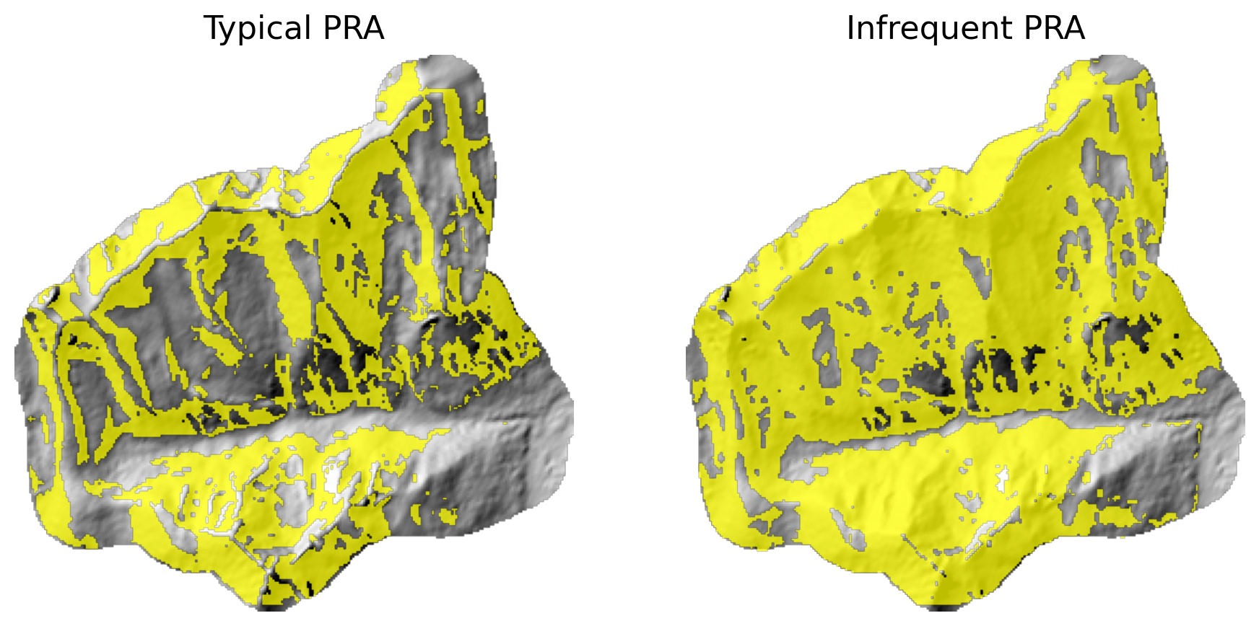
13:00 · POTENTIAL RELEASE AREA
Typical is tighter. Infrequent picks up start zones below 30°.
ISSW 2026 · autoATES v3.0 workshop · Connaught Creek
8 / 12
Notes:
Published v2 sits on the calibration envelope. Keep the ISSW thresholds for this session.

Slide 9
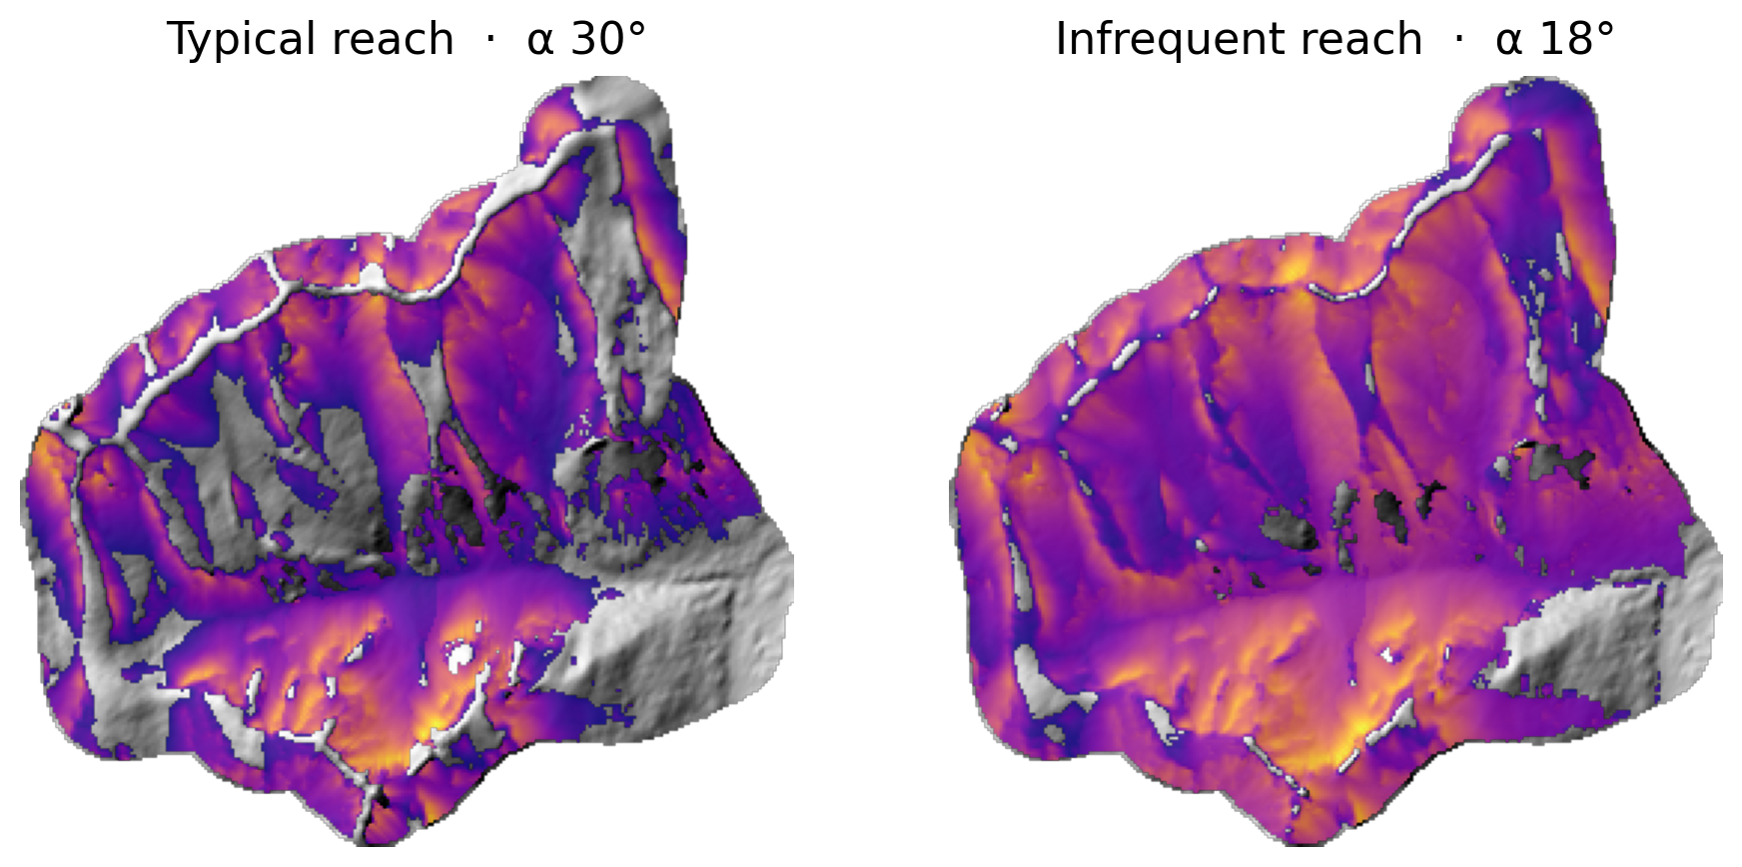
13:50 · RUNOUT
com4FlowPy — typical α 30°, infrequent α 18°. Not RAMMS.
ISSW 2026 · autoATES v3.0 workshop · Connaught Creek
9 / 12
Notes:
Desktop numba: 3.4 s for both scenarios. If a laptop is still going at 14:35, load reference outputs. BFW owns this block.

Slide 10
15:05 · ATES CLASSIFIER
Infrequent sets the envelope. A floor cannot be averaged down.
ISSW 2026 · autoATES v3.0 workshop · Connaught Creek
10 / 12
Notes:
This raster is dev8: split votes, then reach floors. Class 0 is a safety decision. Discuss next to the expert overlay; do not score as an exam.

Slide 11
15:05 · WHAT SETS THE CLASS
Floors first. Then the rest is averaged.
Simple
Infrequent runout reach
Challenging
Typical runout reach
Complex
Typical overhead / contributing area
Extreme
Slope > 45° and open canopy
ISSW 2026 · autoATES v3.0 workshop · Connaught Creek
11 / 12
Notes:
Regional calibration lives in the PRA and runout scenarios, not in retuned class thresholds.

Slide 12
TAKE-HOME
Point this at a home range with an AOI, a 30 m surface, and a canopy raster.
Keep typical / infrequent parameters unless you have a reason and a validation set.
A map from this tutorial is not an operational ATES product.
Repo, pins, and papers: SETUP.md and CITING.md in the workshop repository.
Best-practices document is in development.
Notes:
We will not start a second live AOI. South Coast is QGIS-only if that extra is present.

