Slide 1
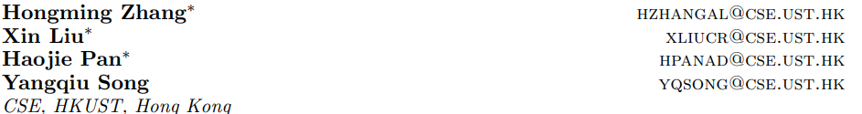
ASER: A Large-scale Eventuality Knowledge Graph
一个数量巨大、质量很高、事件为中心、常识知识覆盖率高、内容明确、从多个领域文本corpus抽取 的知识库
动机: 现有KG都是关于 实体中心,缺乏activity、state、event
ASER(activities, states, events, and their relations) 15种 relation types 5个大类 194-million unique eventualities, 64-million unique edges among them
1.ASER的构建 1.1 定义ASER: 事件、关系、ASER组织形式 1.2. 事件抽取 1.3 事件关系抽取 2.ASER的统计等: 2.1 自身数量统计，比较 现有知识库; 3. ASER知识库 进行推理(事件、关系-one-hop、multi-hop inference) 4. ASER的使用、评价 4.1 内部评价: 4.1.1 事件抽取的人工评价→ 事件抽取与原句子 语义未发生变化. 4.1.2 关系抽取2种版本(core-full(关系扩展))的分别人工评价→ 关系的准确性高 4.1.3 与现有知识库 进行质量比较 → 与 conceptNet中四种和事件相关的关系重合度高→质量高 4.2 外部评价: 4.2.1 WSC+ASER(external knowledge)实验对比评价 4.2.2 dialog generation +ASER (external knowledge)实验对比评价
https://github.com/HKUST-KnowComp/ASER.

Slide 2
语义定义: semantic meaning as ‘a finite set of mental primitives and a finite set of principles of mental combination (Jackendoff, 1990)’. The primitive units of semantic meanings include Thing (or Object), Activity , State, Event, Place, Path, Property, Amount, etc
Activate|Event定义: While both activity and event are occurrences (actions) described by active verbs, a state is usually described by a stative verb(静态动词) and cannot be qualified as actions
ASER is essentially an eventuality centric knowledge graph
举例说明:ASER
activities
I sleep
states
I am hungry
events
I make a call
their relations
I am hungry’ may result in ‘I have lunch
ASER vs. 现有事件知识库
FrameNet
define complex structures of events by enumerating triggers with senses and arguments with roles
ACE
use patterns to extract eventuality-centric knowledge based on dependency grammar
ASER
do not distinguish between semantic senses or categories of particular triggers or arguments in eventualities but treat all extracted words with their dependency relations as hyperedge in a graph to define an eventuality as a primitive semantic unit in our knowledge graph.

Slide 3
贡献:
Definition of ASER 1. 语义单元为 eventuality，每个eventually 使用超边 和依存分析(DP)解析的结果连接在一起 2. Relations between 2 eventualities → 14种 PDTB中定义的 + co-occurrence relation
Scalable Extraction of ASER 1. designed several high-quality patterns based on dependency parsing results and extract all eventualities that match these patterns 2. use unambiguous connectives obtained from PDTB to find seed relations among eventualities . → bootstrapping
Inference over ASER provide several ways of inference over ASER. We show that both eventuality and relation retrieval over one-hop or multi-hop relations can be modeled as conditional probability inference problems
Evaluation and Applications of ASER 1. intrinsic evaluation,在扩展关系过程中采样人工评价 关系的质量; 2) 和 ConceptNet 进行对比评价 2. extrinsic evaluation, 1): WSC测试评价 2) : 对话生成任务评价

Slide 4
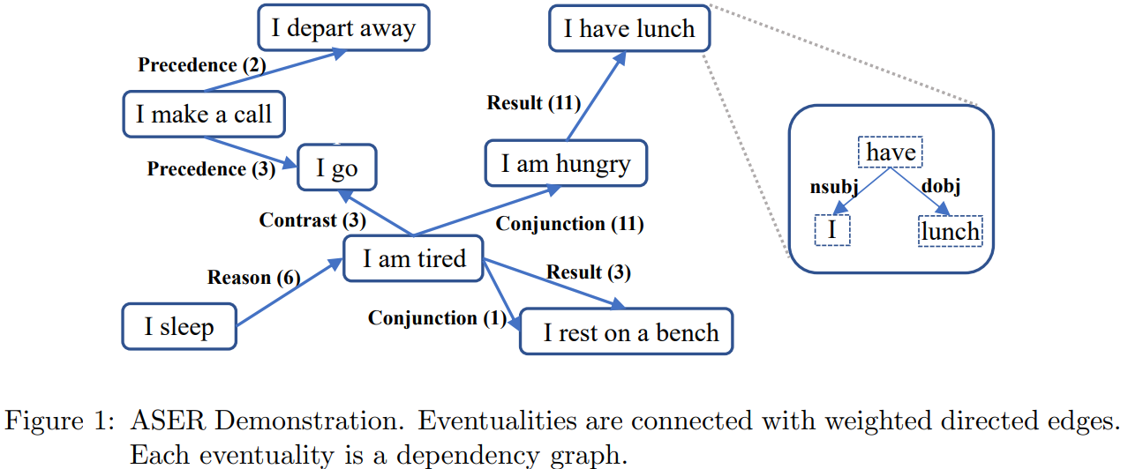
ASER: 主要是 两部分: 1) eventualities的定义与抽取 2) eventuality 之间的关系的定义与抽取: 预定义是用PDTB
1. use less ambiguous connectives as seed connectives to find initial relations 2. then bootstrap the eventuality relation extraction using large corpora. 关系可以进一步按照 ConceptNet 中预定义种类进行分类
ASER中的一个例子

Slide 5
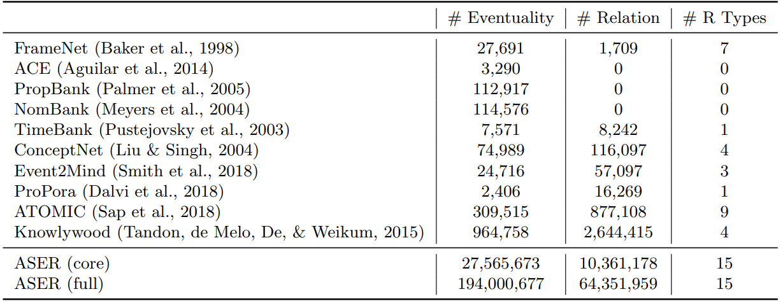
ASER 知识库 与 现有的事件相关的知识库之间的数量比较
syntactic parse trees , V - N
syntactic parse trees , V - N
仅仅是动词之间的时序关系
ASER (core) filters out eventualities that appear only once and thus has better accuracy while ASER (full) can cover more knowledge

Slide 6
2. Overview of ASER
Definition 1 ASER KG: ASER KG H = {V, E, R, T }
E:代表事件,V和E之间是通过超边连接
E1=(I, am, hungry) and E2=(I, eat, anything)
R1,2=Result
V: I am hungry … 定义为词表的结合
R:代表事件之间的关系 T: 关系的类型集合
2.1 Eventuality： 原则是: 事件定义简单、明确无歧义、语义完整
一般动词短语就可以代表一个事件，但是ASER使用相对明确的模式去过滤，保证事件抽取质量
构建ASER中eventuality的两个语言学假设: 1) 英语的句法模式是相对固定统一的; 2) 事件的语义是由它包含的词语所决定的
Definition 2 Evventuality的定义形式: An eventuality Ei is a hyperedge linking multiple words {vi,1, . . . , vi,Ni }, where Ni is the number of words in eventuality Ei. Here, vi,1, . . . , vi,Ni ∈ V are all in the vocabulary. A pair of words in Ei (vi,j , vi,k) may follow a syntactic relation ei,j,k

Slide 7
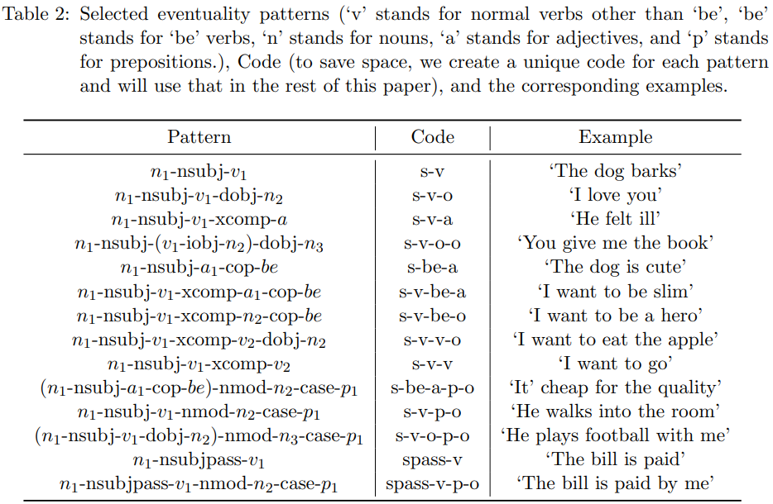
大型文本语料库(large-scale corpora)
召回率低，P高的事件，由于语料库巨大，所以事件数量也足够
ASER中事件的抽取模式: 相对简单、明确、类型相对固定

Slide 8
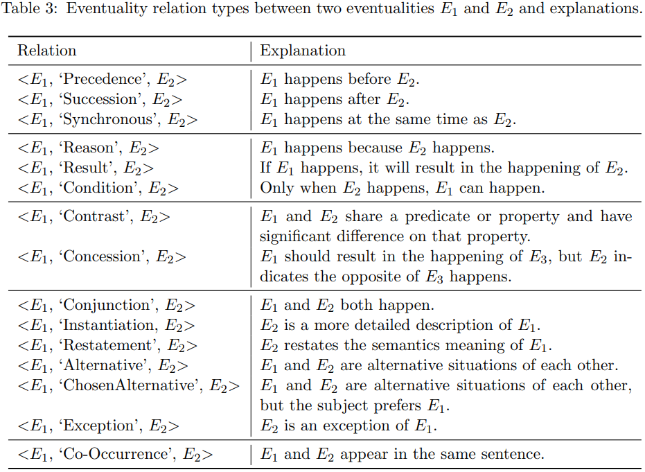
2.2 Eventuality Relation
follow PDTB’s definition of relations between sentences or clauses but simplify them to eventualities
又称作: seed relation
Temporal 关系
Contingency 关系
原先从PDTB中follow 14种关系，然后进一步分为5种类型，最后使用 自扩展的方式扩展这5种关系
Comparison关系
Expansion关系
Co-Occurrence关系
ASER中事件关系类型的定义: 15种，5大类

Slide 9
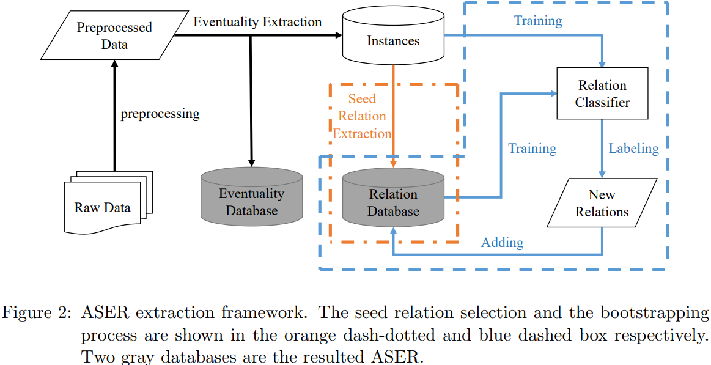
2.3 KG Storage
1. eventuality table, we record information about event ids, all the words, dependencies edges between words, and frequencies.
2. relation table, we record ids of head and tail eventualities and relations between them
3. Knowledge Extraction
Pattern Matching 1. 一个句子，parsing之后可能包含多个event,然后使用预定于 pattern matching → 组成 group→ instance
Seed Relation Extraction less ambiguous connectives obtained from PDTB预定义14种关系,进一步划分为5种关系类型
Dependency parser
15种关系进一步bootstrapping 使用bootstrapping process 进行学习-训练得到更多的关系

Slide 10
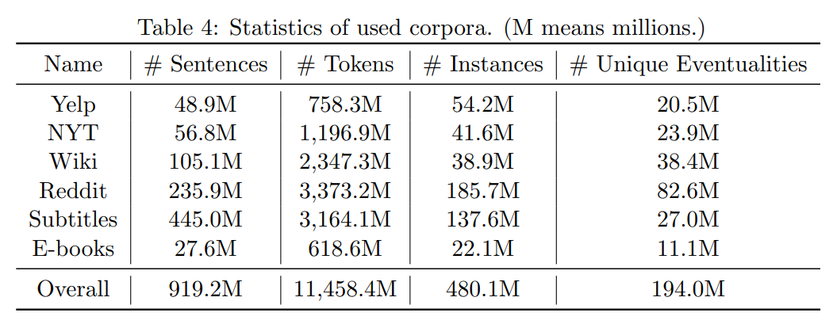
3.2 Corpora： → parsing → Eventuality → Relation
评论
新闻
百科
论坛
字幕
电子书

Slide 11
3.3 Preprocessing and Eventuality Extraction(事件抽取具体处理过程)
1.Parse with Stanford Dependency Parser
2. filter out all the sentences that contain clauses
3.一个句子可能有多个事件和多个动词都进行保留
4. 为了保证语义完整性而且不复杂，使用14种模式去模式匹配抽取事件 每种模式包含: 3种类型的依存边(dependency edges: positive(前面展示)-optional-negative)
Optional： Six more dependency relations (advmod, amod, nummod, aux, compound, and neg) are optional dependency edges that can associate with any of the selected patterns
Negative： All other dependency edges are considered are negative dependency edges, which are designed to make sure all the extracted eventualities are semantically complete and all the patterns are exclusive with each other
模式匹配具体做法: For each verb v and each pattern, we first put it in the position of v1 and then try to find all the positive dependency edges. If we can find all the positive dependency edges around the center verb we consider it as one potential valid eventuality and then add all the words connected via those optional dependency edges. In the end, we will check if any negative dependency edge can be found in the dependency graph. If not, we will keep it as one valid eventuality. Otherwise, we will disqualify it

Slide 12
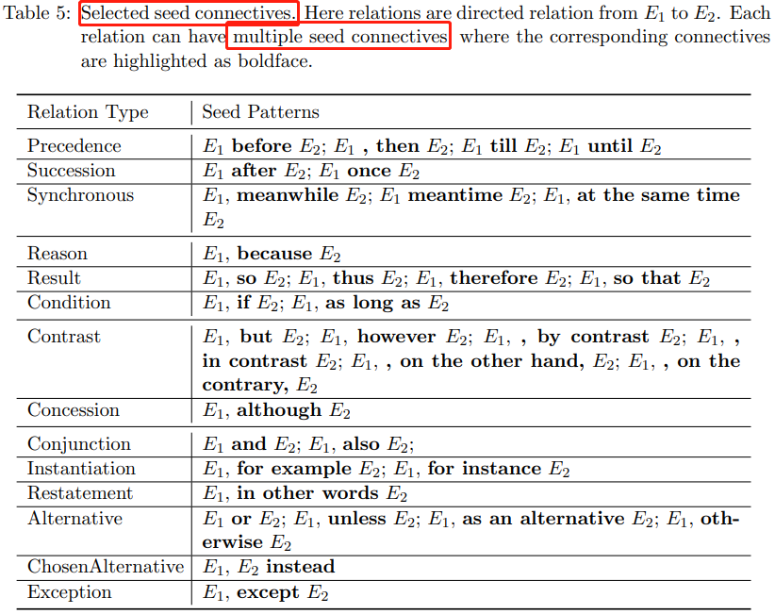
3.4 Eventuality Relation Extraction(事件关系 抽取具体处理过程)
PDTB基础之上去除一些模糊的关系表达: 原则: 90%以上都表达同一种关系的保留 so that 被注释31次,都是 result关系 while 被注释 连接词39次，转折词11次→ 舍弃
first extract seed relations from the corpora by using the unambiguous connectives obtained from PDTB
Bootstrapping Process:
Step 1: Use the extracted seed training instances as the initial labeled training instances
时序
因果
Step 2: Train a classifier based on labeled training instances
比较
Step 3: Use the classifier to predict relations of each training instance. 自训练→结果>预定于阈值→ 加入训练→ 重复step2
扩充 说明
共现

Slide 13
4. Inference over ASER
4.1 Eventuality Retrieval
4.1.1 One-hop Inference
4.1.2 Two-hop Inference
4.2 Relation Retrieval
4.2.1 One-hop Inference
4.2.2 Two-hop Inference

Slide 14
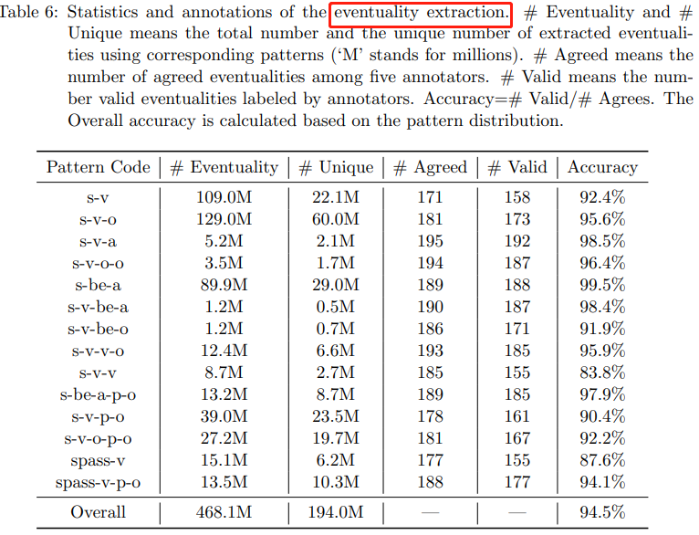
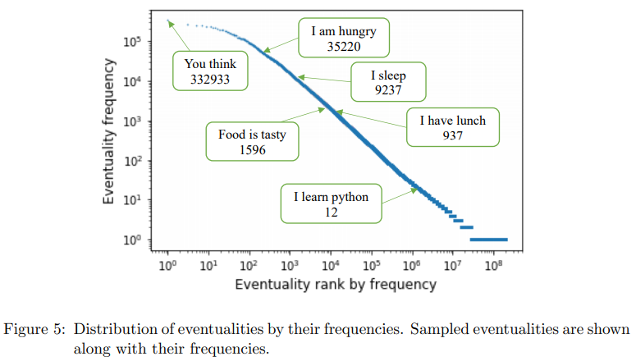
5. Intrinsic Evaluation
5.1 Eventualities Extraction
抽取的200eventuality 与原始的句子之间语义一致性人工进行评价
Zipf’s law
抽取事件的频率分布 常见事件频率较高 服从Zipf定律
92.8%

Slide 15
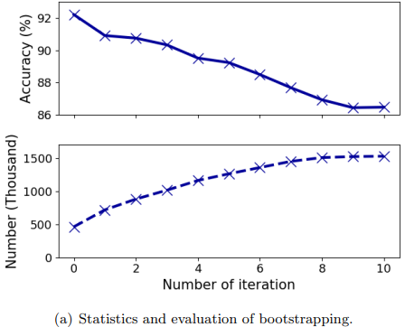
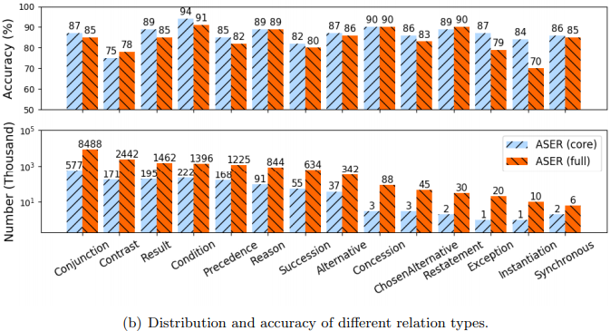
5.2 Relations Extraction 评价
1. 首先过滤 eventuality and eventuality pairs: 出现一次或者用来训练bootstrapping模型的instance.
core ASER: 未使用 bootstrapping扩展之前,且过滤出现一次
full ASER: 使用bootstrapping扩展关系之后的版本
事件关系扩展迭代过程中的评价: 迭代10 轮人工评价 准确率从 92→ 86 数量从500→ 1500
2.测试评价:
2.1 评价 bootstrapping过程 每次迭代之后抽样使用人工评价,关系是不是合理
select 100 edges for each relation type→ Valid vs. Not
2.2 评价两种版本的relation：抽样进行人工评价
关系扩展之后按照关系类型进行评价

Slide 16
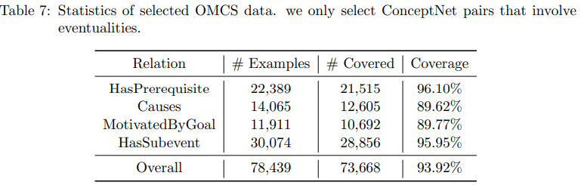
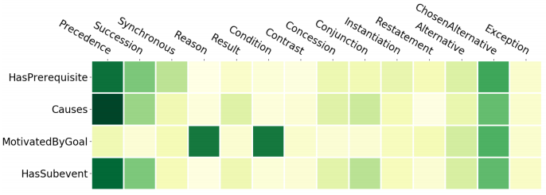
5.3 Comparison with Commonsense Knowledge
ASER vs. ConceptNet
Concept: 600K crowdsourced commonsense triplets and 75K among them involve eventualities
选择 conceptNet中的4种关系进行测试评价: for a given ConceptNet pair (Eo1, Eo2), we can find an edge x = (Ea1, Ea2, c) in ASER such that Eo1 = Ea1, Eo1 = Ea1
ConceptNet与ASER覆盖率统计
ConceptNet与ASER关系类型重叠率可视化

Slide 17
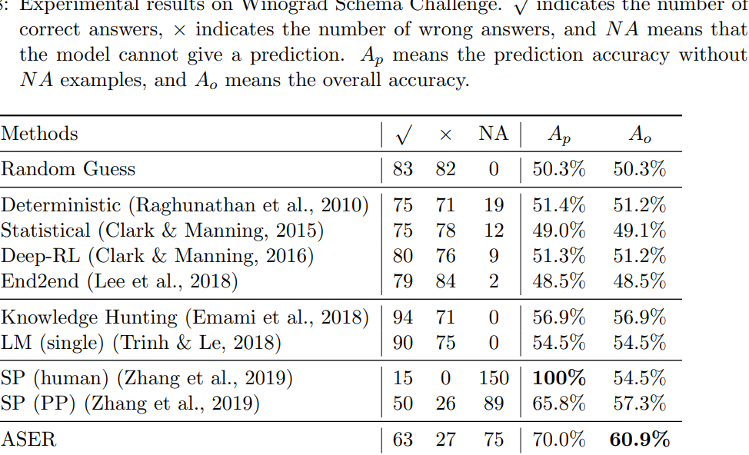
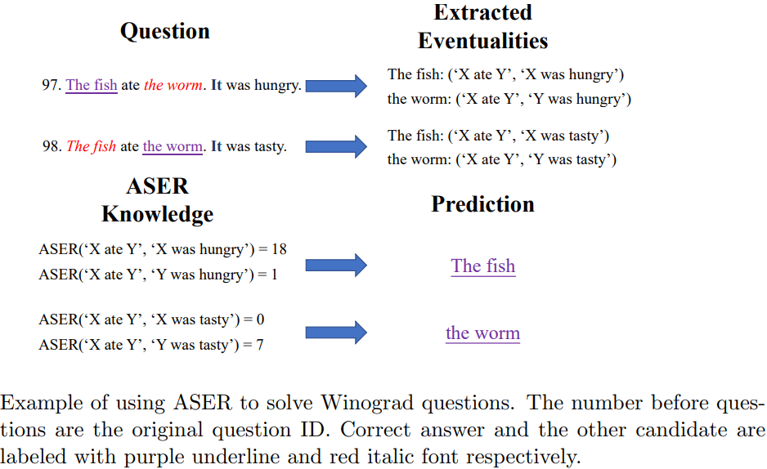
6. Extrinsic Evaluations
6.1 Winograd Schema Challeng
任务定义: 给定两个句子,然后每个句子中都含有two candidate noun phrases,一个 target_pronoun ，然后选择一个 (1) The fish ate the worm. It was hungry. Which was hungry? Answer: the fish. (2) The fish ate the worm. It was tasty. Which was tasty? Answer: the worm
WSC使用ASER作为外部知识的例子说明
实验结果对比

Slide 18
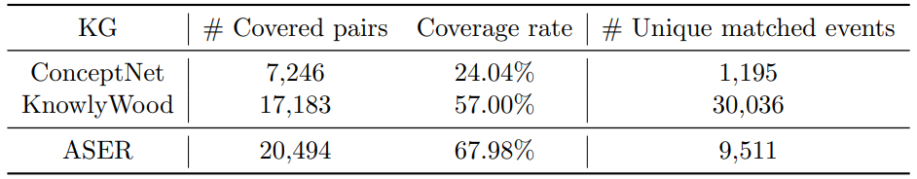
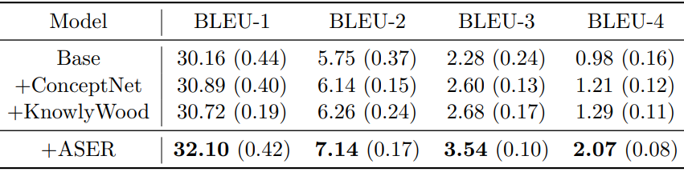
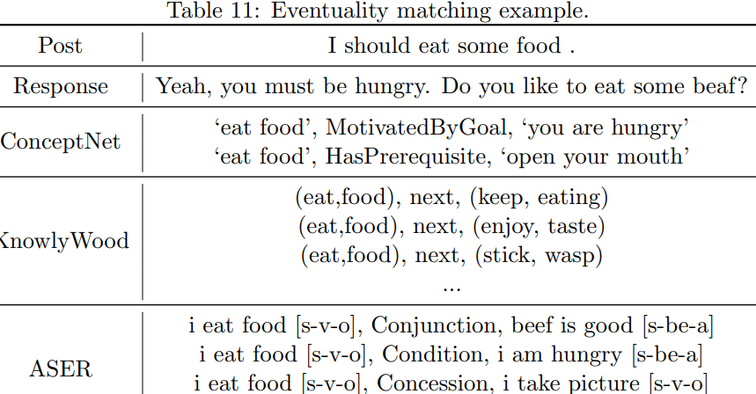
6.2 Eventuality knowledge enhanced dialogue system
Daily dialog 2017 根据特定规则进行知识三元组抽取
几种知识库对话任务覆盖率统计
几种实验的结果
几种知识库的使用举例对比：→ ASER质量高

Slide 19
总结: 1. ASER: 超级大的事件相关的知识库。 2. ASER中事件的抽取相对 明确、简单、覆盖率高、带了parsing 解析结果 3. ASER的事件之间的关系 15种5大类，基本包含Concept中四种关系，然后关系进一步扩展，5大类下面关系类型多种多样，总结的关系的边也是巨大。 关系类型和事件密切相关。 4. 使用角度: 4.1.文章提供了几种 linking-使用的方法，并进一步证明有效果; 4.2. 可以考虑和其他几种数据库同时进行使用。 4.3 怎样使用这种知识库？ 微调之类-----

Slide 21
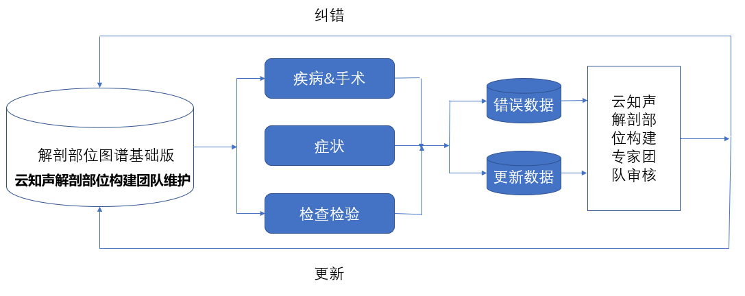
图谱纠错: 属性、概念、关系、同义词纠错
概念更新
举例：
外耳道\n
上鼓室\n
关系更新
下位解剖概念\t上位解剖概念\t关系类型\n
举例：
左上尖牙\t恒牙\tis_a\n
食指甲盖\t食指\tpart_of\n
同义词更新
举例：
内耳\t迷路\n
耳廓\t耳郭\n
属性更新：
概念\t属性值\t属性类型\n

Slide 22
1. 体系问题纠错: 错误或者应该添加注释、解释 393,肝的结缔组织、皮下组织和其他软组织,bodypart 403,脑膜前动脉和脑膜后动脉颞支,bodypart 265,"会阴, NOS",bodypart 180,下叶，支气管,bodypart 445,小指对掌肌（手）,bodypart 697,* 趾近端趾骨 *足母,bodypart 1039,L5水平,bodypart 1338,"(拉)终丝(脊髓),终丝(脊髓),尾丝(昆虫)",bodypart
1540,"(复choanae)漏头,鼻后孔,内鼻孔",bodypart 1748,腹腔内部位，没有进一步说明,bodypart 1931,"腕骨(解)Ossa carpi{拉},Ossa carpalia{拉}",bodypart 2369,"拉特克囊,神经颊囊,颅颊囊",bodypart

Slide 23
2. 体系方面: 2.1 体系按照局部解剖和系统解剖的角度进行划分，没有问题，我们之前不这样把 部位-全身性-全身性表达 按照层次进行组织，最主要还是因为，很难穷举，以及层次过深，泛化性较差。 如果按照云之声这样组织也没有问题，但是首先要做的应该是9000+症状按照这个体系进行对应、分类(这个应该是 医生专家完成,确保基础图谱质量，可以才考之前的 部位体系),统计回标的数量，看看这种体系是不是可以足够完备，足够合理. 2.2 发现体系中很多schema 都是医学专业表达，从链接角度，不管学习方法-规则方法都要再商量，理解意思等。 2.3 概念、属性、关系、同义词更新的来源在于哪里？ 以及体系中并没有体现这些 挂靠在哪里。 迭代的过程中是怎么迭代？ 加上体系上去吗？ 这些和算法有什么关系？ 2.3 明确接下来往这个体系上面挂靠什么？ 比如: 输入输出，有了输入输出，剩下的就是模型选择、模型调优的工作，这些才是我们所想做的算法的东西，而不是一直在搞体系。 挂靠就是 识别和抽取:NER-关系抽取-同义词发现—上下位词训练等等都是可以使用的算法，先定义好 输入、输出，调算法或者尝试各种算法可能效率更高一些。 2.4 算法角度看新添加的 概念-属性-关系-同义词: 通过算法或者基础规则进行测试，case_study 查看 bad_case然后进一步对应现有的体系。 不清楚云之声那边定义的添加和纠错是什么意思。

Slide 28
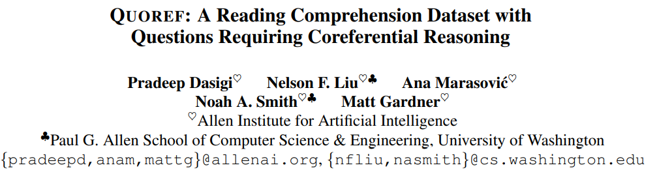
EMNLP2019 | AI2 | 共指推理 | 常识10% 答案类型： span-selection→ 可能是 多 span
MRC需要具有共指能力,目前数据集中没有明确测试 focus understanding local predicate argument structure, with very few questions requiring long-distance entity tracking
提出QuoRef数据集: 24K span-selection questions over 4.7K Wikipedia paragraph
Strong baseline model 对抗预测确保数据出现short coming: lexical cues

Slide 29
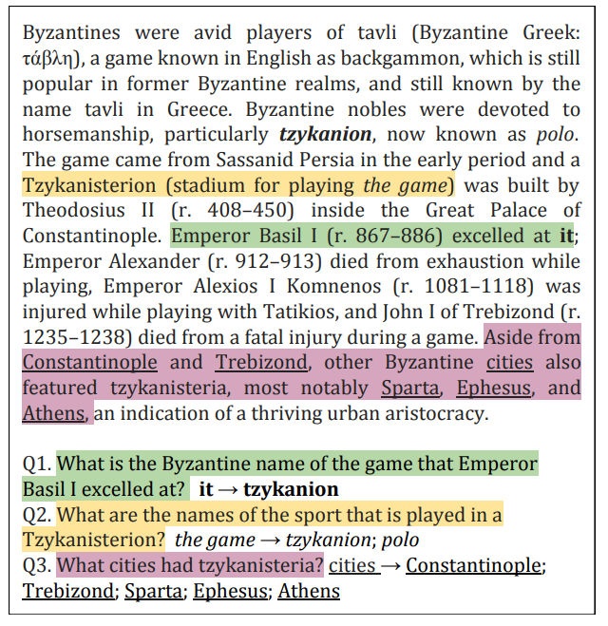
文章大意: B这个国家的人爱玩游戏→ 骑马这个游戏 → 骑马厂 → 几个爱玩这个游戏皇帝的结局 → 骑马厂在各大城市中的地位 Q1: Basil 擅长→ 原文中 it → tzy… Q2: palted in Tz… → 原文 the game → 多个名字 Q3: city has …→ city featured… →aside from … also …
总之算是很难了 1. 根据question匹配回原文 2. 从原文找与其相关的 共指或者其他说明实体

Slide 30
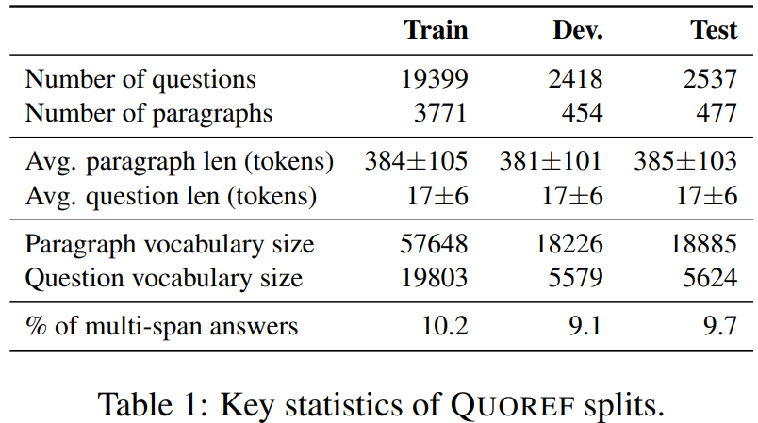
数据集的构建过程:
难点:
1) 共指很难统一定义，更难标注者统一标注 2) 即使标注共指，可能模型使用捷径，并不需要共指推理能力 解决: 1) 要求众包者 识别 回指短语以及指代词，要求问题与文章中两个mention有关系。 → 一定程度规范约束 共指 2) 将1中收集的问题使用Bert去预测，去除做对的 → 去除简单捷径
Collecting paragraphs
scraped paragraphs from Wikipedia pages about English movies, art and architecture, geography, history, and music. Movie涉及大量角色→ 所以占比 40% 样本
1. 标注着 发现 >=2 共指span在 paragraph → 未标注 2. 写问题: 需要标注的span coreference 才可以回答 3. 写答案
Crowdsourcing setup
78%问题必须依赖于 共指→ 解决 22%: 有共指现象但是解决问题可以不用

Slide 31
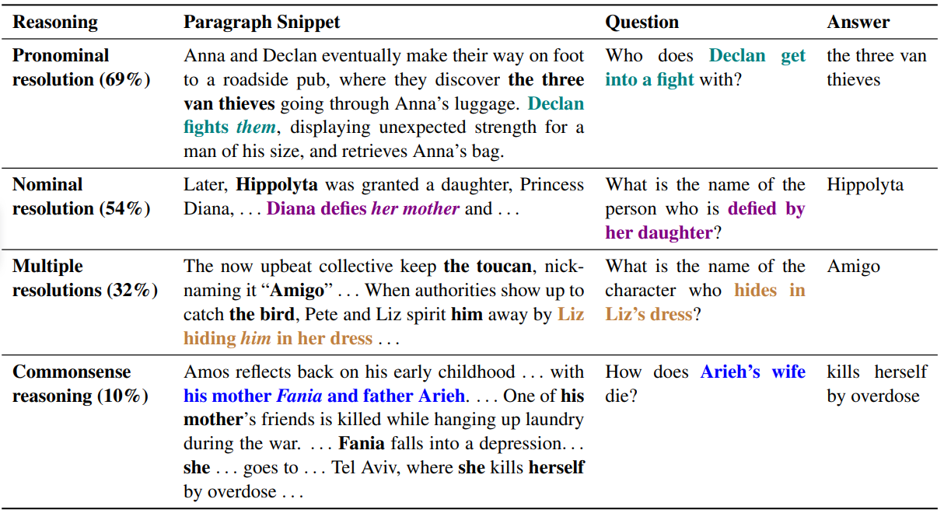
Types of coreferential reasoning
Name → naming
Aries –father – mother –she

Slide 32
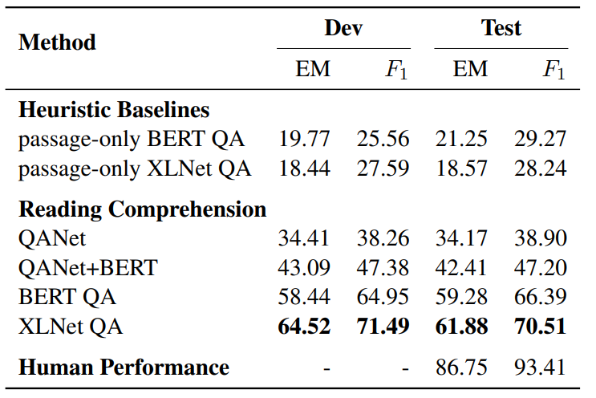
Semantic Phenomena in QUOREF
1. Requirement of coreference resolution
78%: 人工分析 不使用共指不能回答 22%: 涉及某种形式的共指，但是不需要解决这个问题才可以作答 * 文章中只提到了一个城市，问题说 哪个城市被轰炸了?
2. Types of coreferential reasoning 上页图片
baseline
与现有 共指任务区别: 感觉基本没有，形式上是qa的任务了。没有明确说 检测共指

Slide 33
“title”: “Journey to Jamaa”, “url”: “https://en.wikipedia.org/wiki/Journey_to_Jamaa”, “paragraphs”: [ { “context”: “After their HIV positive mother‘s death, Derick and Margaret collect wood and construct a human-length box with wheels. Then, they journey with it from Kampala to Kasangombe in a heartbreaking bid to overcome poverty and experience hope. The journey throws them dangerous experiences on unpredictable Ugandan roads. Their mother’s dying wish had set them off on a seemingly impossible journey to find a relative they do not even know.\nBefore her death, she leaves them an envelope addressed to her sister (their auntie) who is married to a hard-working man living in a distant village called Kasangombe with their kids. Ingeniously, Derick creates a coffin using wood he collected from a rubbish dump and adds luggage bag rollers brought by Margaret. On their journey from Kampala City to their aunt‘s place, they are offered a lift by a seemingly kind man (played by Joel Okuyo Atiku) in a truck who is amazed by their \”box\“. He introduces them to a kid he had taken under his wings relaxing at the back and shows them a photo of a house they can possess if they work for him. At night though, Margaret sees a scary dream where their helper is not exactly as kind as he seemed so she runs out of the truck. Derick follows and the boy throws out their coffin before waving. They walk the rest of the distance.\nInitially, their uncle (played by Isaac Muwawu) did not want them in his house because he thought they were HIV-infected. Derick overheard him quarrel with his aunt at night and shook Margaret in themorning from another dream (this time beautiful, where both siblings were smiling and enjoying a picnic in a glorious garden with their aunt, uncle, cousins, dead parents and some whites). Derick convinced her to walk away from the home with him but without a reason. ", "qas": [ "question": "What's another word for the human-length box with wheels that the siblings construct?", answers": ["text": "coffin","answer_start": 650 "question": "Where are Derick and Margaret going to find their aunt?", "answers": ["text": "Kasangombe","answer_start": 592 "question": "In what state was Derick's sister when he shakes her awake?", "answers": ["text": "dream","answer_start": 1531 "question": "How do the pair of siblings finish the last leg of their journey?", "answers": "text": "They walk", "answer_start": 1274 "question": "Why did Derick's and Margaret's uncle argue about them living in their house?", "answers": "text": "he thought they were HIV-infected","answer_start": 1397 "question": "In what country are the two children traveling?", "answers": "text": "Uganda", "answer_start": 301
1. 常识可以解决，不需要文章，或者不需要共指 2. 文章中多处给出答案，不知道最后评价时候按照字符串还是开始位置
1.Aunt的家→ 住的地方
数据标注错误: Ugandan → Uganda

Slide 34
难点: 1. 将问题中表达的内容对应到文章中 2. 在文章中发现、识别 共指相关的表达或者span
3. 模型怎样学会去 文章中识别共指的span，并作答
For pronouns, we consider two types of them following Ng (2005), i.e., third personal pronoun (she, her, he, him, them, they, it) and possessive pronoun (his, hers, its, their, theirs). 实验1: 统计 上述名词性代词在quoref中出现的频率，以及人工抽样，出现之后和答案相关的比例

Slide 35
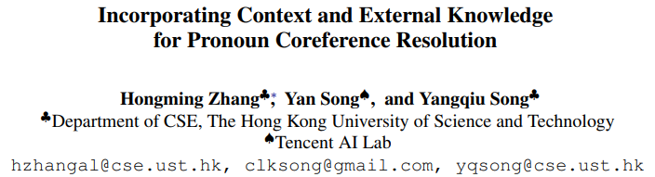
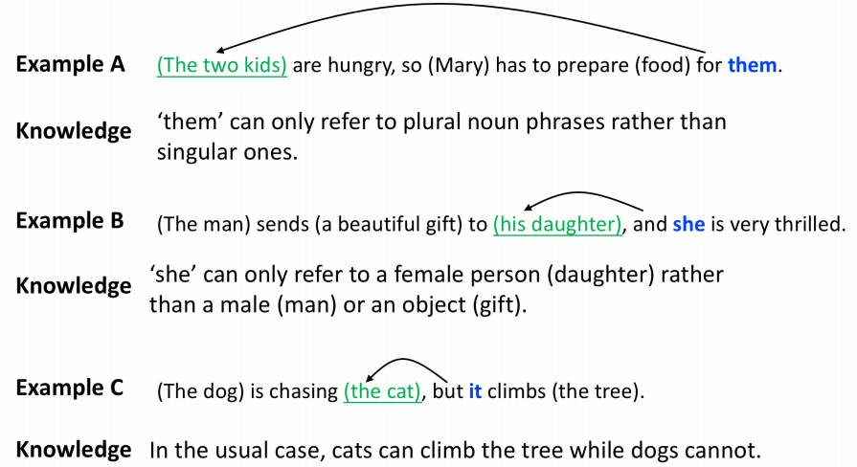
动机: 共指过程中需要知识，结合上下文 和 外部知识 可以指导共指过程 代词共指消解定义:pronoun coreference resolution is to find the correct reference for a given pronominal anaphor in the context
三个通过结合 外部知识 和 上下文 可以促进共指消解任务的例子
Task: 给定 target代词(需要进行消解) 以及 可能的候选 noun parse ，选择合适的候选，为 target代词在上下文中找到相应的解析消解表达。 本文为3句上下文中

Slide 36
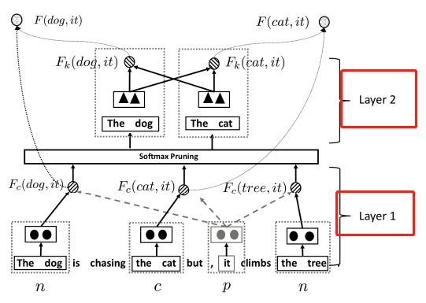
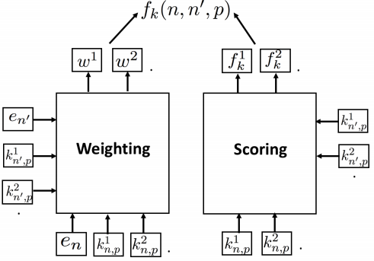
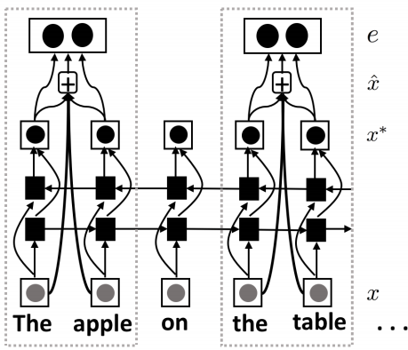
知识融入的难点:
1) 知识的特殊性: 针对训练中每个例子需要的知识可能不相同 → 需要 融入 知识具有灵活性 2) 知识有限性、知识噪声 → 增强鲁棒性
Processing External Knowledge 1. 知识选择: 都是从wikipedia文本中选择出来 1) 复数特征(plurality) → 候选的复数性质 与 target相同 → 1 2) AG(生命性/性别) → 候选 matching target → 1 3) SP(语义优选特征) → 通过 parsing Wikipedia 以及 train_sentence 进行按照数量排序选择。 如: 狗想要吃毛，但是它爬树上去了 ，选择知识: 狗-爬树 猫-爬树，其中猫爬树在知识库中出现次数比较多，所以认为 爬树的 它指的是猫，而不是狗 2. 知识融合: 针对 选择上述三种不同的知识特征使用 knowledge-attention 机制使得模型自己选择那种类型的知识比较有用。 (具体没仔细看)
Fc:上下文计算 Fk: 知识相关计算函数
上下文span编码: gold_span已经是给出,只需要判断代词指代 的 候选span的正确性就可以，使用lstm_attention 进行span编码为一个 向量表示

Slide 37
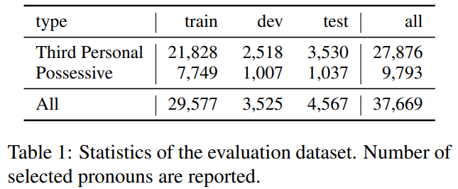
代词指代实验代词选择: third personal pronoun (she, her, he, him, them, they, it) and possessive pronoun (his, hers, its, their, theirs)
代词实验数据分布:

Slide 38
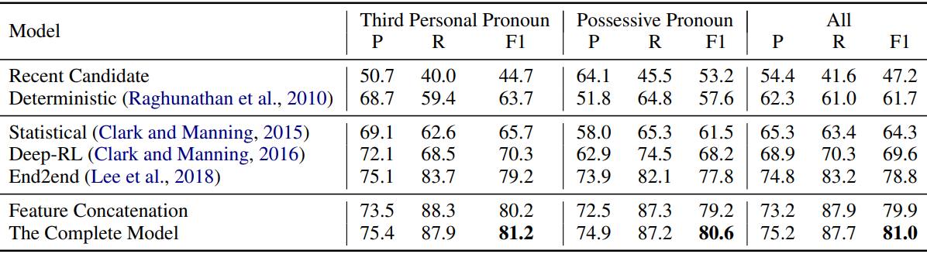
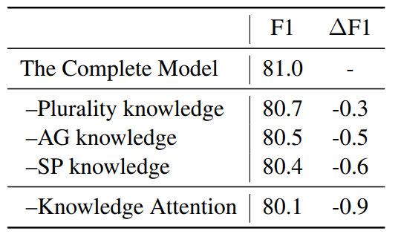
实验结果
消融实验:
借鉴之处: 1. 对于代词的识别: 2. 代词中知识类型的选择、knowledge的选择 3. 融合的方法 4. Knowledge attention 机制 5. softmax purning机制

Slide 39
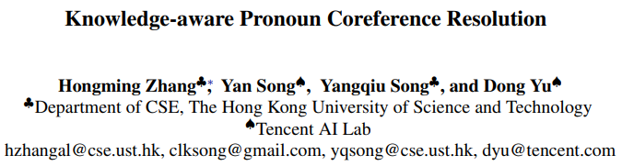
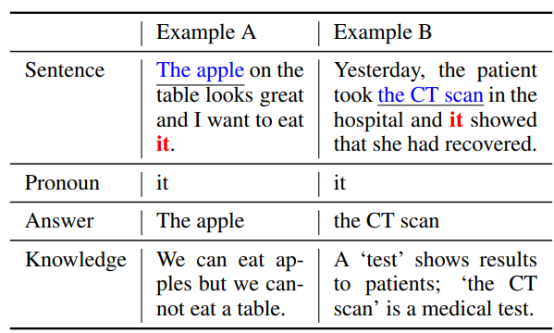
动机: explore how to leverage different types of knowledge to better resolve pronoun coreference with a neural model。 贡献: 1) span任意而不是预先给定进行判断 2) 选择不同知识库的来源，而不是简单的从文本中进行parsing 3) 知识选择时候的 knowledge attention 机制
两个代词共指解析知识增强的例子

Slide 40
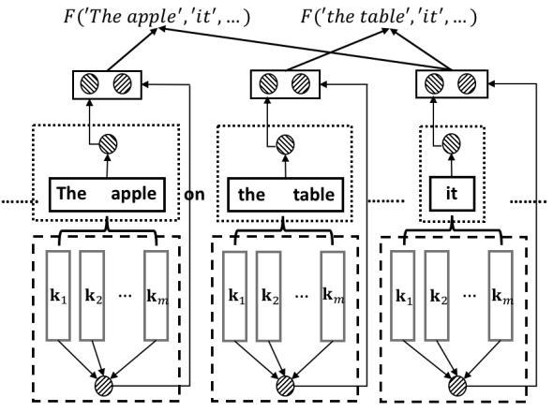
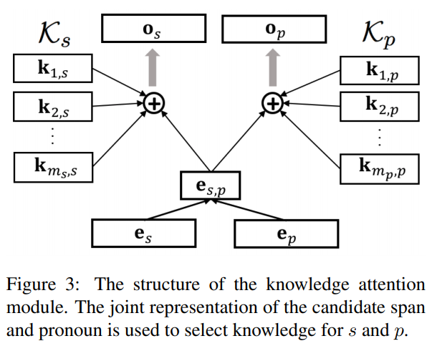
Span进行编码
检索到的知识

Slide 41
1 Knowledge Resources
1.1. Commonsense knowledge graph (OMCS) 常识相关
600K crowdsourced commonsense triplets
选择高置信度: form the OMCS KG 62,730 triplets
1.2. Medical concepts (Medical-KG) 医疗领域
The annotated triplets are used as the medical concept KG, which contains 22,234 triplets
1.3. Linguist features (Ling) 语言特性知识 1. Plurality 2. Animacy 3. Gender
40,149 and 40,462 triplets for plurality and AG
1.4. Selectional Preference (SP) 语义优选知识 Wikipedia 使用 斯坦福 parsing 进行parsing extract all dependency edges (predicate, argument, relation, number)
select two SP relations, nsubj and dobj, to form the SP knowledge graph, including 17,074 and 4,536 frequent predicate-argument pairs for nsubj and dobj
2. Knowledge Representation
string match for knowledge extraction
匹配头实体→ 尾实体有多个就求平均embedding

Slide 42
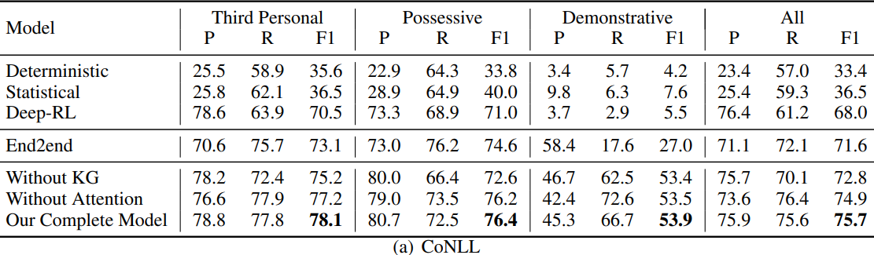
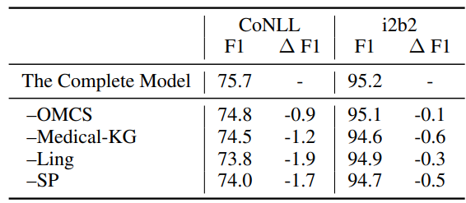
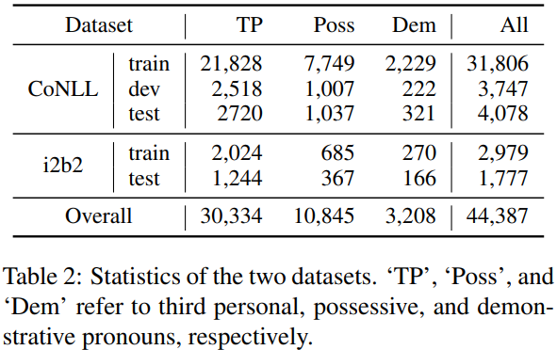
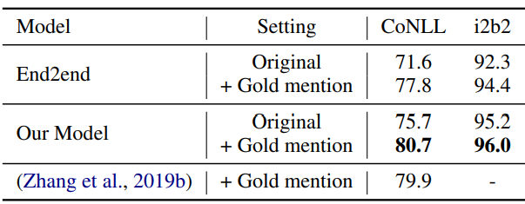
实验结果
数据集中 共指统计
知识源消融
Gold mention 比较

Slide 43
总结： 1. 多知识来源进行三元组整合 2. 考虑文本和知识库异构信心怎样融合 3. knowledge attention 融合机制

Slide 48
1. 从预先定义好的 MRC所需要的能力出发，然后去对应现在已有的数据集，以及认知学角度、自然语言理解的角度对标 现在的数据集

