Slide 1
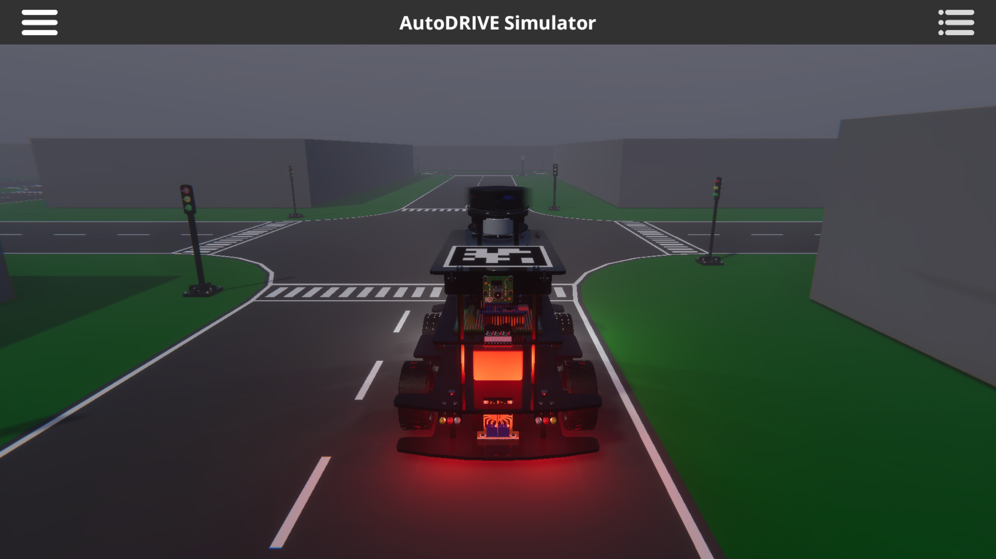


X

Slide 2
X

