Slide 1
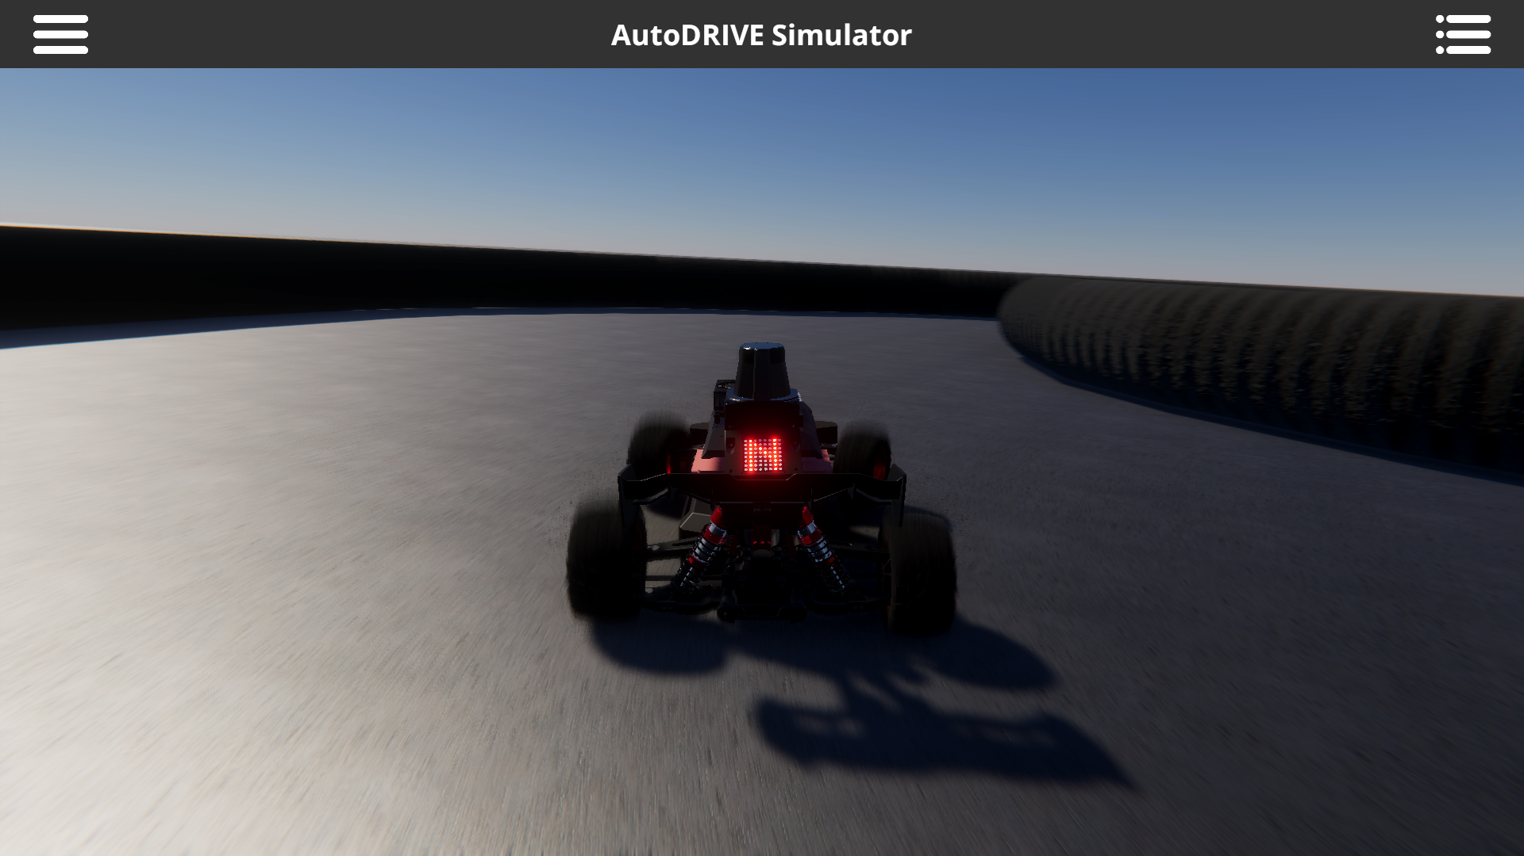



X

Slide 2

X

