Slide 1


Automated Teacher Workflow
From one teacher input to a structured, editable lesson package powered by n8n and AI.
Prepared by Project team

Slide 2




Project Idea
The Problem
The Solution
Unique Value Proposition
Repetitive lesson-preparation tasks consume teachers’ time
Lesson plans, activities, assessments and answer keys are often prepared separately
Inconsistent quality and format
One automated n8n workflow
Teacher enters instructional information once
AI generates multiple connected teaching materials for review
One input → multiple teaching outputs
Structured and reusable workflow
Supports differentiation
Teacher review remains the final control step

Slide 3














End Users + Key Features
Primary End User
Key Features
How It Helps
Teachers
Lesson outline generation
Saves preparation time
Student activities
Keeps outputs aligned to the same lesson context
Key Needs
Assessment generation
Answer key
Supports different learner needs
Faster preparation
Clear and relevant outputs
Differentiated material
Provides review ready materials
Control over lesson inputs
Input validation
Gives clear feedback when input is incomplete
Easy review before classroom use
Organized final lesson package

Slide 4
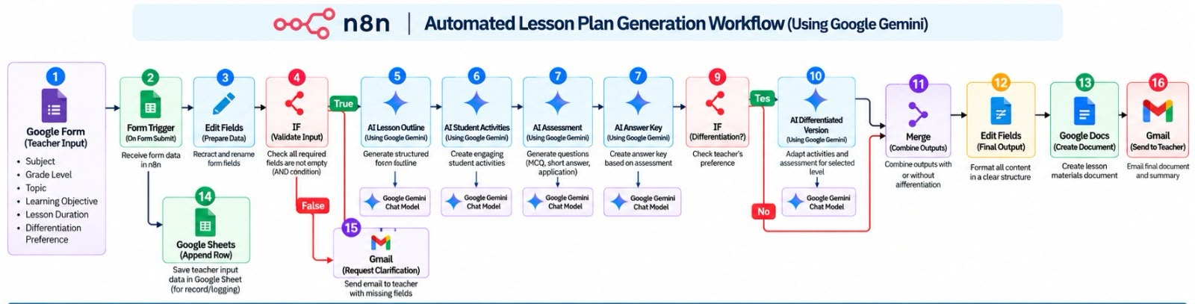
DEPI | PROJECT
Project Wireframe | Automated Teacher Workflow
A teacher-facing request form connected to an automated AI content-generation journey.
USER JOURNEY
WORKFLOW OVERVIEW
01
Submit lesson request
Teacher enters grade, topic, objectives, duration and differentiation preference.
02
Validate required fields
n8n checks completeness; missing details trigger a clarification email.
03
Generate learning assets
Gemini creates the outline, activities, assessment and answer key.
04
Review & personalize
Optional differentiation adapts materials to the selected learner level.
05
Deliver resources
Outputs are combined, formatted in Google Docs and emailed to the teacher.
UX focus: one clear input form • validation before generation • optional differentiation • familiar Google Docs/Gmail delivery
AUTOMATED TEACHER WORKFLOW | DEPI
3

Slide 5
DEPI | PROJECT
Data Structure | Inputs, Processing & Outputs
A lightweight, workflow-based data architecture using Google Forms, Google Sheets, Gemini and Google Workspace.
ARCHITECTURE
No standalone database: structured form data is logged in Google Sheets; n8n orchestrates processing; generated documents are stored in Google Docs.
1 INPUT ENTITY
2 PROCESSING & LOG
3 OUTPUT ENTITIES
Source: Google Form → n8n trigger
n8n passes validated fields to Google Gemini
Merge combines generated content; optional differentiated version
Fields: subject, grade, topic, objectives, duration, differentiation preference
Google Sheets stores one row per request for tracking / logging
Edit Fields formats the final output
Validation: required-field IF condition
Separate AI outputs: outline, activities, assessment, answer key
Google Docs stores lesson materials; Gmail sends the teacher a link / summary
DATA FLOW
Collect
→
Validate
→
Generate
→
Combine
→
Deliver
Teacher form
Required fields
Gemini assets
Merge + format
Docs + Gmail
DATA NOTES
Shape: one Google Sheets row per teacher request; columns represent input fields and tracking values. Data is structured/tabular (not a training CSV), so class balance and ML preprocessing are not applicable. Generated lesson content is saved as a document rather than stored as a model dataset.
AUTOMATED TEACHER WORKFLOW | DEPI
4

Slide 6
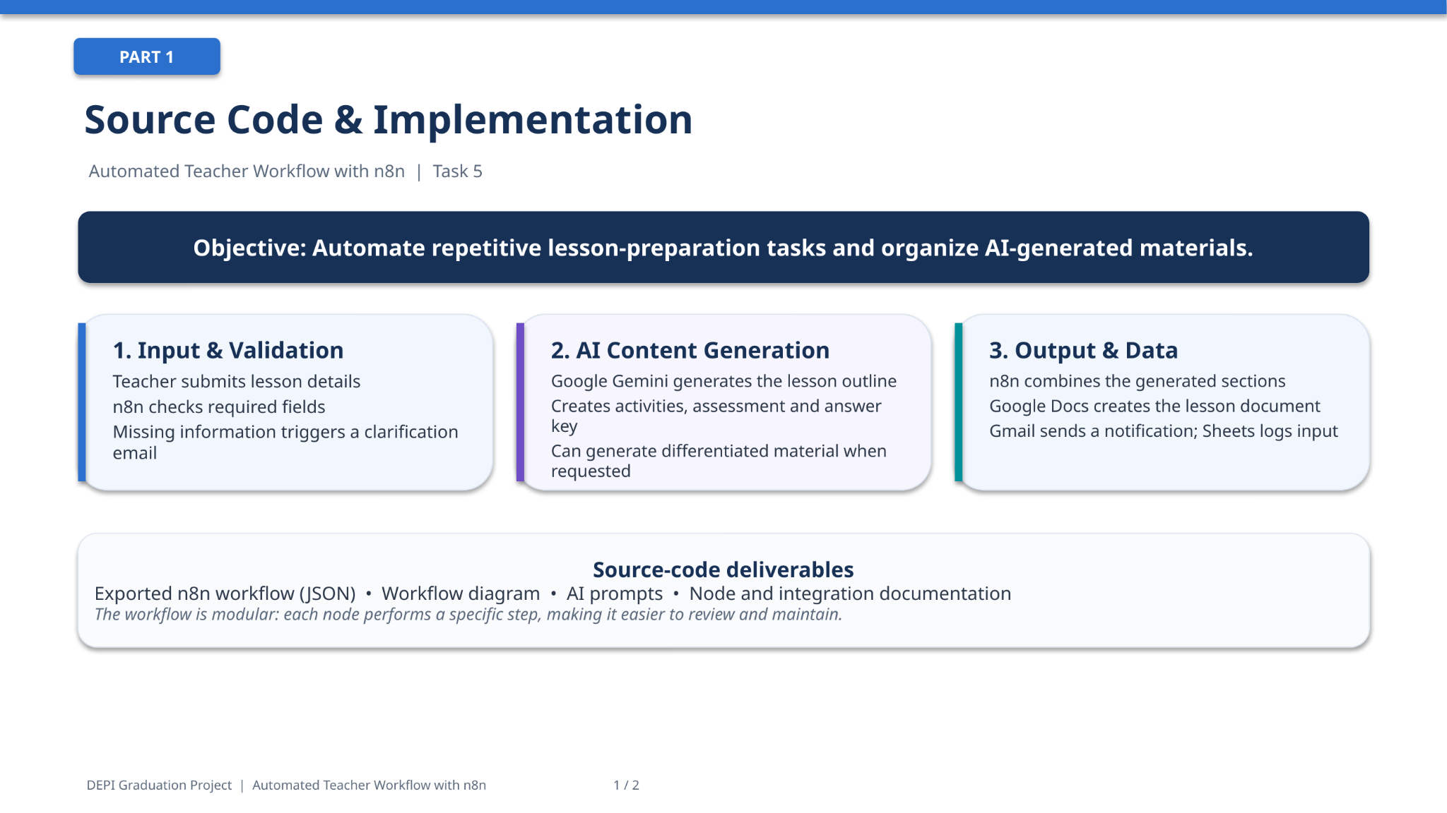
Implementation(Source&Excution)

Slide 7
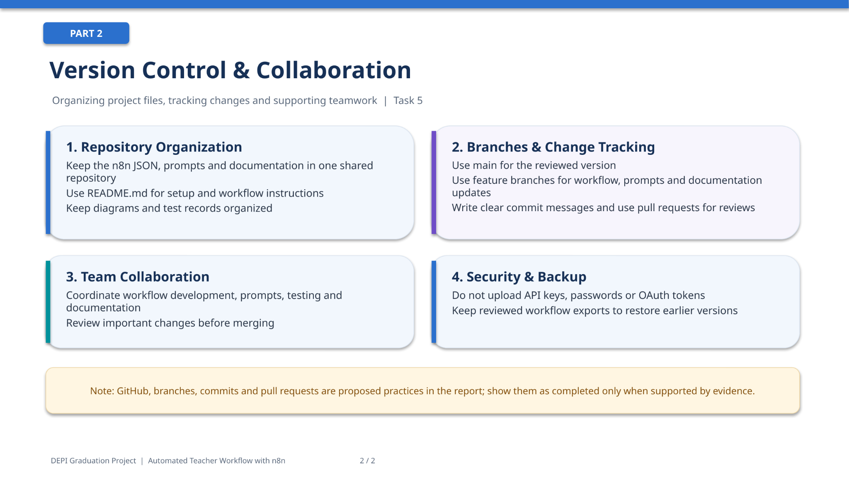

Slide 8
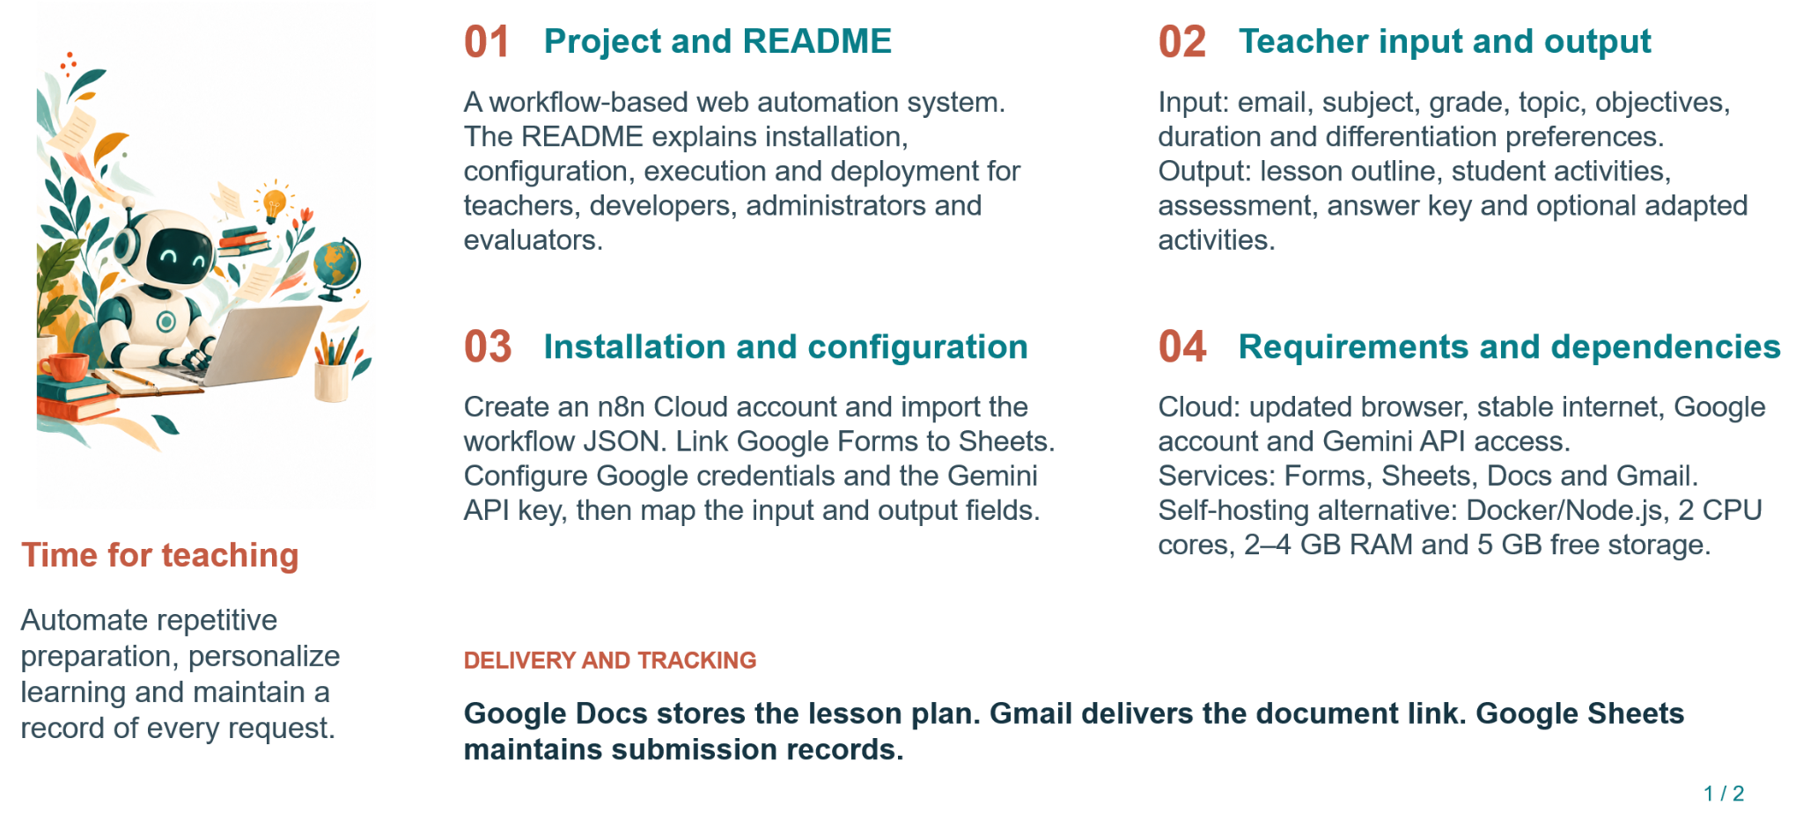
Frameworks & Live Application

Slide 9
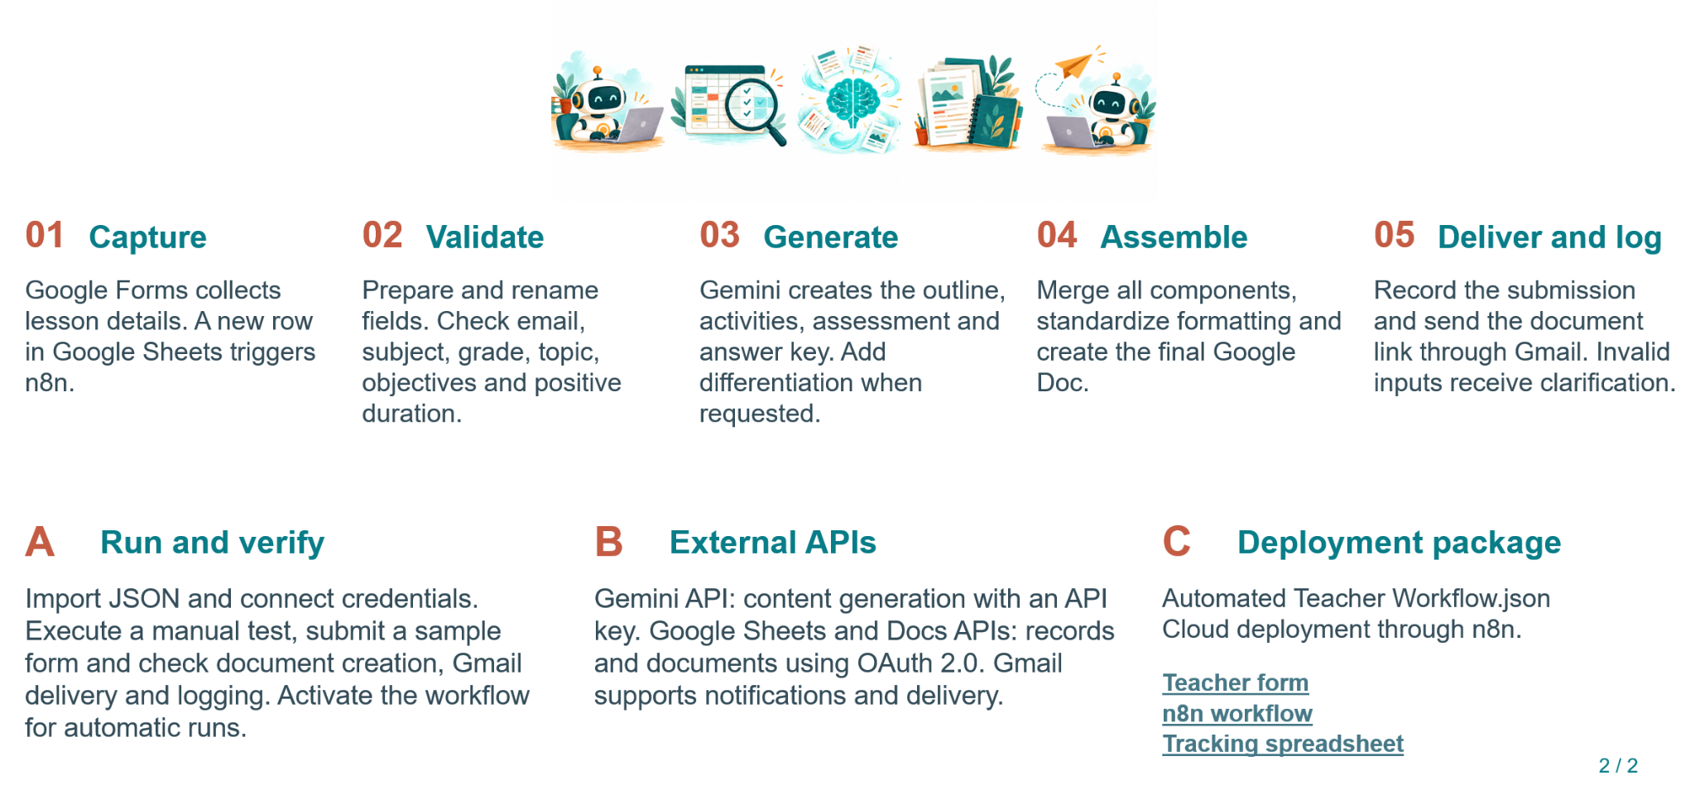

Slide 10
Testing Overview
28
Test cases executed
27
Passed (1 confirmed by tester)
1
Open content issue (TC-7)
6
Documented limitations
Testing approach
• Existing workflow reviewed and manually tested node by node
• Covered data mapping, conditional routing, AI-generated lesson content, document creation and email delivery
• Test-data end-to-end execution also performed
• Append Row node tested separately on a QA sheet
Main issue found & fixed
• Original Google Docs route showed Markdown syntax as plain text
• New path: Markdown-to-HTML conversion, JavaScript multipart body and Google Drive HTTP upload
• Resulting document displays formatted content; Gmail now uses the new link
• Append Row disabled in the client handoff template to avoid duplicate records

Slide 11
Test Results (1/2)
Test case / Component | Status | Observed result / Note
TC-1 Google Sheets Trigger (Fetch Test Event) | PASS | 34 sample records; live new-row activation not proven
TC-2 Edit Fields | PASS | Six required fields mapped for one input item
TC-3 If - valid route | PASS | Complete input routed to true branch
TC-4 AI-Lesson outline | PASS | 45-minute lesson outline generated; scope concerns noted
TC-5 Students Activities | PASS | Five activities generated; some advanced / out of scope
TC-6 Merge1 | PASS | Activities and outline retained in distinct fields
TC-7 AI Assessment + retests | OPEN CONTENT ISSUE | Answer key removed; multiple-choice quality variable across runs
TC-8 Merge2 | PASS | Assessment, activities, lesson outline preserved
TC-9 Assessment Answer key | PASS | Numbered answers generated; upstream item ambiguities persist
TC-10 Edit Fields2 | PASS | Answer key mapped to separate answer_key field
TC-11 Merge3 | PASS | Four content fields retained in merged item
TC-12 AI Differentiated material | PASS | Advanced material generated; some incorrect debugging instructions
TC-13 Edit Fields1 | PASS | Five sections assembled in Final_content
TC-14 Create a document (legacy route) | PASS | Test Google Doc created; route later disconnected
PASS by tester = user-confirmed behavior, not an independently captured output.

Slide 12
Test Results (2/2)
Test case / Component | Status | Observed result / Note
TC-15 Update a document (legacy route) | PASS | Update accepted; document body verified separately
TC-16 Gmail Send (legacy route) | PASS | SENT message ID returned
TC-17 Email link access (legacy route) | PASS by tester | Email received and link opened for test account
TC-18 If - missing Topic | PASS | Blank Topic routed to false branch
TC-19 Markdown to HTML | PASS | HTML field generated; five sections preserved (shared JSON)
TC-20 Full main-path integration | PASS | User screenshot showed green nodes through Gmail
TC-21 Code - HTML multipart prep | PASS | uploadBody and contentType returned (shared JSON)
TC-22 HTTP Request - HTML conversion | PASS | Google Docs file id, MIME type and URL returned (shared JSON)
TC-23 Formatted Google Doc | PASS | Rendered headings, bold, lists; latest link reconfirmed
TC-24 Gmail link preview | PASS | Expression resolved latest HTTP Request webViewLink
TC-25 Formatted-route wiring | PASS | HTTP Request connected to Gmail; legacy path detached
TC-26 New Gmail route | PASS | Tester confirmed new path operates; no dedicated JSON screenshot
TC-27 Missing-information Gmail | PASS | SENT label and message ID returned on invalid-input path
TC-28 Append row (separate test sheet) | PASS | Mapped response added; tester confirmed row in test sheet
Statuses reflect observed manual testing, tester confirmations and configuration review.

Slide 13
Issues & Limitations
1 Append-row duplication risk
The append stage was safely tested on a separate QA sheet. The client template keeps the node disabled to avoid unintended writes.
2 MCQ ambiguities / Python correctness
Retests removed the duplicated answer key, but some items had valid alternatives in several options and used uppercase AND. A regression risk.
3 Differentiation beyond lesson scope
Advanced output sometimes added loops, functions and exceptions beyond a 45-minute Python basics objective. Human review is required.
4 Google Docs raw Markdown
The legacy update inserted ### and ** markers. Fixed by Markdown-to-HTML conversion and Drive multipart upload; formatting was verified.
5 Fixed test resources and recipient
The export held the tester Gmail, source sheet, pinned row and test folder. The client template removes them and needs client-specific setup.
6 Live trigger and recipient access
Manual Fetch Test Event and pinned-input runs do not prove unattended new-row triggering. Link access for others depends on Drive sharing.

Slide 14
Client Setup Required
Connect client-owned credentials
Google Sheets Trigger, Sheets, Google Drive, Gmail and the Gemini / AI model.
Keep append node disabled
The separate append test passed, but appending is unnecessary for the main flow.
1
5
Select spreadsheet and response tab
Replace the placeholder spreadsheet ID and tab ID; preserve column names and spaces.
Verify document sharing
Check access as the actual recipient, not only as the connected Google account.
2
6
Set output folder
Replace REPLACE_WITH_DESTINATION_FOLDER_ID in the Code in JavaScript node.
Run genuine end-to-end validation
Submit a new Form response with the trigger active and check the document and email.
3
7
Set email recipients
Change the placeholder recipient on both Gmail nodes; consider adding a teacher-email field.
Inspect educational material
Review questions, answer key and differentiated content for accuracy and age appropriateness.
4
8
Additional checks: keep the workflow inactive until the real trigger, Google Drive sharing permissions, valid inputs, missing-field handling and educational correctness are confirmed in the client environment.

Slide 15
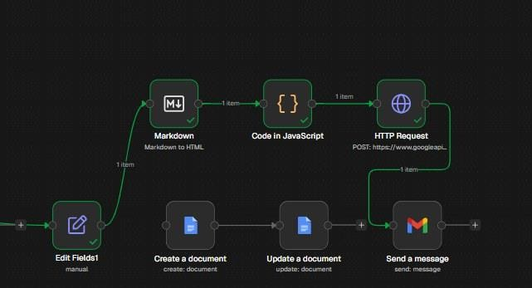
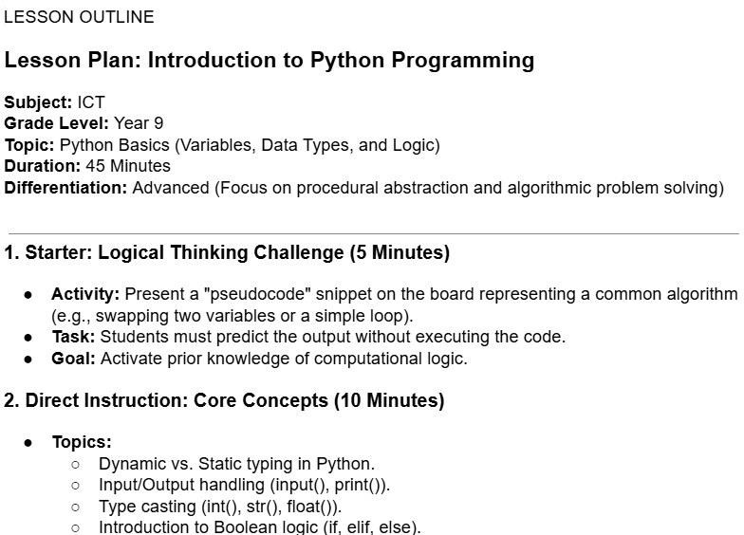
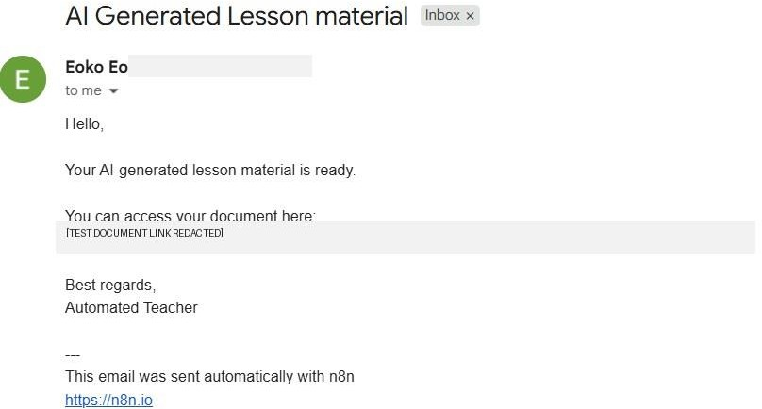
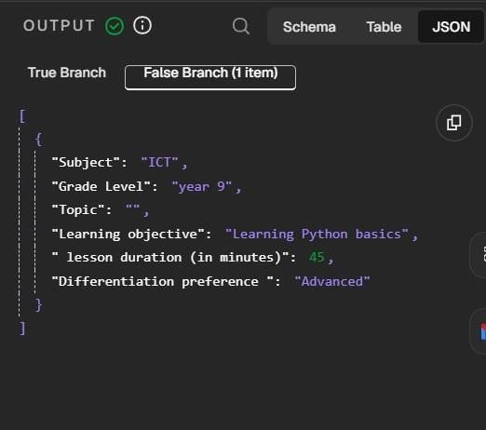
Screenshot Evidence
New route: Markdown to HTML, Drive upload, Gmail
Generated lesson document rendered with headings, bold and lists
Email received with the link to the generated document
Missing Topic routed to the false branch (TC-18)

Slide 16
Deliverables
Core Workflow Deliverables
• Lesson outline, student activities, assessment and answer key
• Optional differentiated learning materials
• Combined, editable lesson package in Google Docs
Automation & Delivery
• Teacher input form and required-field validation
• Google Sheets request log for tracking
• Gmail delivery and clarification email for missing inputs
Project Documentation
• User manual and technical documentation
• Presentation and video demonstration script
Review & Handover
• Teacher reviews AI-generated content before classroom use
• Workflow setup notes and test evidence, where available

Slide 17





Project Team + Roles
Hend Ahmed
Eman Mahmoud
Fatma Mohamed
Ahmed Ismail
Marwa Ahmed
Heba Abdelhameed
Tasks 1, 2 & 3
Task 4 & 5
Task 4
Task 5
Task 5
Task 6
Project Planning
Literature Review
Requirements Gathering
System Analysis
System Design
Implementation
System Analysis
Implementation
Implementation
Testing

Slide 18

Thank You
Questions & Feedback

