Slide 1
ROS
Robot Operating System

Slide 2

ROS
- software framework for robot applications (initial release 2007, first version Box Turtle 2010)
- programming languages:
- mainly C++, Python, LISP
- experimental Java, C#, Ruby, R, Lua, Go etc.
- package management (over 3000 packages available)
- powerful build system on top of CMake
- message passing:
- easy de-/serialization
- Publisher/Subscriber or Service invocation concept
- big community, developed and documented by thousands of contributors

Slide 3
ROS
- many libraries and tools, for example:
- motion planning
- object recognition
- hardware interfaces
- plotting
- 3D visualization
- https://youtu.be/0CsSok3QgZk?t=53s

Slide 4
ROS - Installation
- OS: Ubuntu 14.04 Trusty Tahr
- ROS: Indigo version
$ sudo apt-get install ros-indigo-desktop-full
- add this line to your ~/.bashrc file:
source /opt/ros/indigo/setup.bash
- for Ubuntu 16.04 you could use a docker container (untested!)
https://github.com/jbohren/rosdocked

Slide 5
ROS - System Architecture
- modular node concept
- node runs a specific computation and share data with the network
- nodes can be added, removed while ROS is running
- can run on different machines too (distributed system)
zzZ
Node A
Node B
Node C

Slide 6
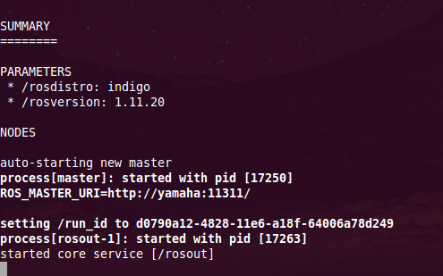
ROS - System Architecture
rosout
roscore
roscore:
- one master node:
- tracks publishers / subscribers
- enables peer-to-peer connectections between nodes
- parameter server
- logging node rosout
- run it by:
$ roscore
Parameter Server
Master A
Node B
Node C

Slide 7
ROS - Message passing
- default by TCP, but UDP possible too
- Publish/Subscribe model:
- data is sent by defined message type (Topic)
- receiver gets only messages of subscribed topics
- anonymous, receiver and sender doesn’t know of each other
- Service model:
- service type definitions (contains request and response topics)
- server/client semantic:
server waits for client calls on specific service name and then sends response
Node A
Message /topic-name
Node B

Slide 8
ROS - Hello World Example
- install build tool:
$ sudo apt-get install python-catkin-tools
- look at: https://github.com/neumann89/ros_hello_world
- don’t forget to source catkin workspace (add this line in ~/.bashrc):
source /path/to/your/catkin-workspace/

