Slide 1
Logo
Easy PIPO
How to Use?
What is Pipo Painting?
My Color Setting
Painting easier what you want
Browse Files
Choose a file or drag it here.
GO

Slide 2


Origin Image
You can set the number of colors
Reduce Color
Color matching with my color
16
24
32

Slide 3




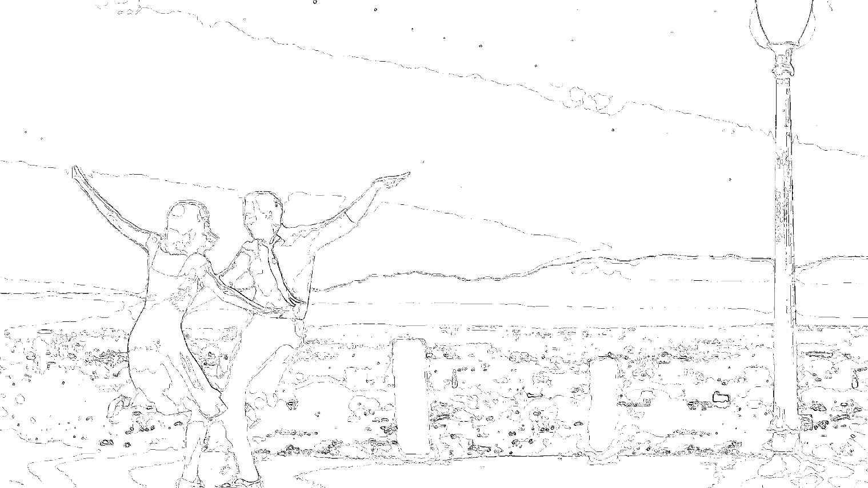
You can set the number of colors
Reduce Color
Color matching with my color
16
24
32
16 Color
24 Color
32 Color
Painting Image
Draw Line
Line Image

Slide 4
You can set the number of colors
Reduce Color
Color matching with my color
16 Color
X
16 Color
24 Color
32 Color
Painting Image
>
Draw Line
Line Image

Slide 5
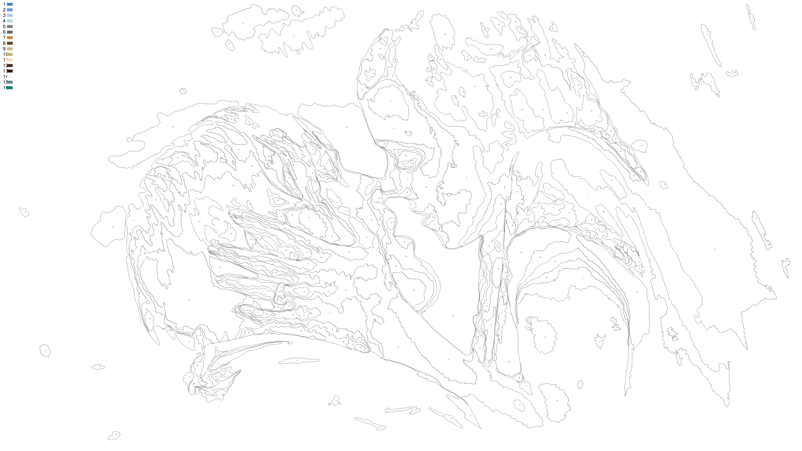
Line Image
Numbering

Slide 6
Pipo Painting
Input Color Label

