Slide 1


Slide 2
----------------------------------------------------------------------------------------------------------------------------
Automotive Electronics: Beginner to intermediate (Duration:1hr) ----------------------------------------------------------------------------------------------------------------------------- 1. Evolution of automotive (5 min ) – To be discussed - Amarnath
Vehicle at beginning- first vehicle (world Automotive day)
Control unit (Embedded system) introduction
Latest cars –with max features
why electronics in Automotive is so important ??
2. Domains in Automotive (10 min) – (Amarnath.K /Joined discussion is needed)
Animation to classify different domains - Power train - 2 slide ( Engine, To discuss about Diesel, Petrol, EV) - Chassis – 2 slide ( Transmission, Torque vectoring Differential, 4X4, Steering) - Vehicle dynamics – 2 Slide ( what is vehicle dynamics, Antilock braking, EPS, wheel alignment) - Comfort and safety – 2 Slide ( Airbag, suspension control, HVAC, remote control Keys, Steering lock Add-ons) - Infotainment - 3 Slide ( Infotainment ecu( Not only media support - it also control the vehicle on certain aspects like routines , Over the air updates, Head up display, rear seat entertainment).

Slide 3
3. Deep dive into Automotive electronics (15 min) – Amarnath
- Sensor – ( Basic sensors Fluid sensors, engine sensors, crash sensors, vehicle speed & wheel speed sensors, Parking sensors RADAR, LIDAR, Camera) – 3 slide
- Actuators – All motors – ABS, EPS, Steering lock, Airbag – 3 slides
- ECU – Architectures based on domains – ( car classification into domin and controllers) – 2 slides
(CAN1 & CAN2) –Interior, Exterior
- Harness (wiring) – Why harness important, fuses, power distribution, connectors, main branch and sub branch, additional plugging’s – 2 slides

Slide 4
4. Communication protocols (20 min) – Guna
How ECU’s communicate - Why communication is needed. – 1 slides
Traditional wiring vs CAN – Difference and benefits – 1 slide CAN - 5 slide
Introduction,
how messages are sent in terms of electric signals,
how it is understood by the ECU’s,
what is the need for this mechanics
A message and Signal - Pictorial view, CAN message format
Merits and Demerits
- Diagnostics ( glimpse on OBD , UDS ) - Praveen
Why OBD is introduced
On board diagnostics & off board diagnostics – Placement of OBD in cars
UDS- what it is – How it is beneficial for service line , tuning (Programming)
Over the air updates

Slide 5
5. Future Trends(10 min) – Praveen
EV
Difference between diesel and EV
what is needed for the conversion
Power distribution
Risks and challenges
ADAS
Futures & Sensor
SAE Level – What is needed for each levels
Connected Car ( V2V, V2X, associated ecu’s, OTA)
Constrains and Complications

Slide 6
Milestone: 1. Topic finalization(31.01.22) - Completed 2. Account creation Udemy , YouTube , website(on hold) - (06.02.22) 3. Content and slide preparation(20.02.22) 4. Animation and video preparation for identified topics (27.02.22) 5. Final presentation and review (06.03.22) 6 . Uploading to YouTube and Udemy (13.03.22)

Slide 7
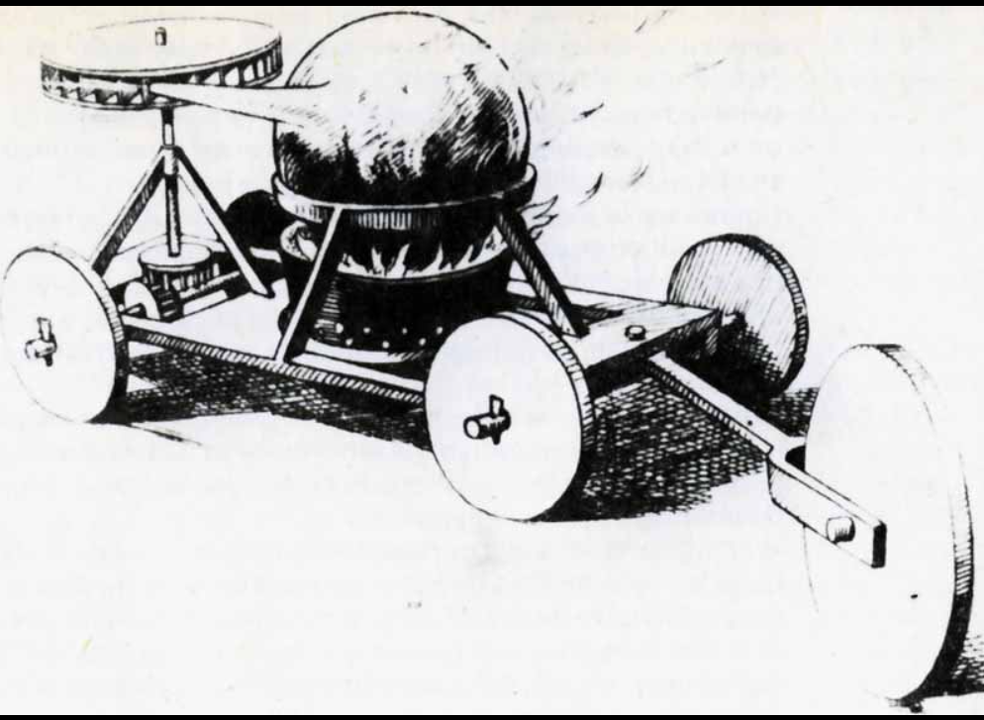
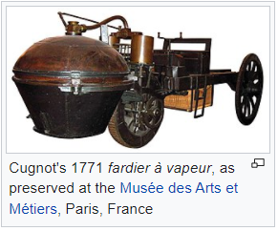
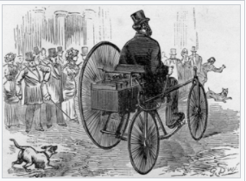
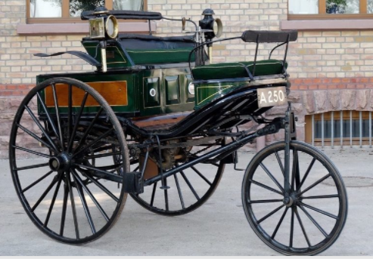
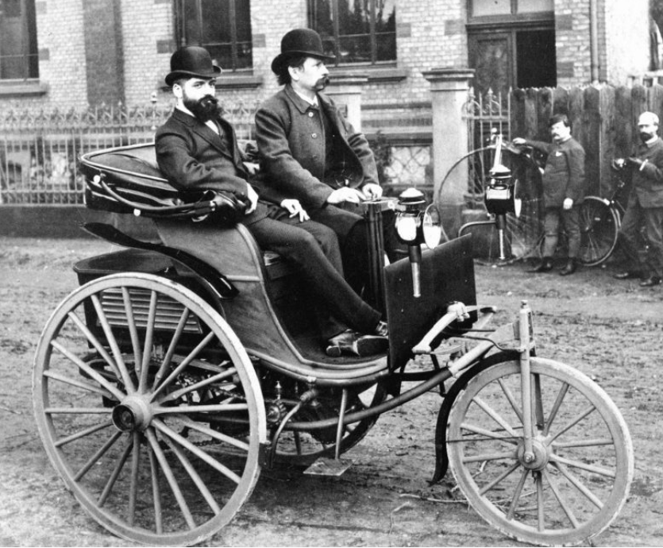
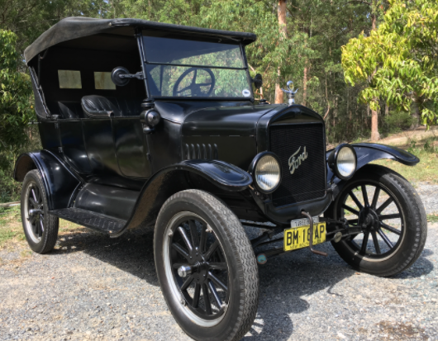
Evolution of automotive:
Steam Machine Of Verbiest, In 1678. (Ferdinand Verbiest)
Cugnot's 1771 fardier à vapeur, as preserved at the Musée des Arts et Métiers, Paris, France
Gustave Trouvé's tricycle, the first ever electric automobile to be shown in public
The original Benz Patent-Motorwagen, first built in 1885 and awarded the patent for the concept
In 1885, Karl Benz invented a car that is credited as the first car in the world to be powered by fuel. The complete structure of the car was created in accordance with the dimensions of the internal machinery. Benz’s car became the model for the cars made after it.
Cars became widely available in the early
20th century. One of the first cars accessible
to the masses was the 1908 Model T,
an American car manufactured by the
Ford Motor Company.
1908 Model T

Slide 8
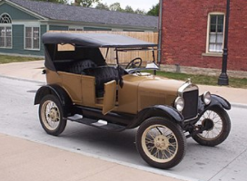
1927 Ford Model T
Control unit (Embedded system) introduction
Latest cars –with max features
why electronics in Automotive is so important ??

