Slide 1


Slide 2
----------------------------------------------------------------------------------------------------------------------------
Automotive Electronics: Beginner to intermediate (Duration:1hr) ----------------------------------------------------------------------------------------------------------------------------- 1. Evolution of automotive (5 min ) – To be discussed - Amarnath
Vehicle at beginning- first vehicle (world Automotive day)
Control unit (Embedded system) introduction
Latest cars –with max features
why electronics in Automotive is so important ??
2. Domains in Automotive (10 min) – (Amarnath.K /Joined discussion is needed)
Animation to classify different domains - Power train - 2 slide ( Engine, To discuss about Diesel, Petrol, EV) - Chassis – 2 slide ( Transmission, Torque vectoring Differential, 4X4, Steering) - Vehicle dynamics – 2 Slide ( what is vehicle dynamics, Antilock braking, EPS, wheel alignment) - Comfort and safety – 2 Slide ( Airbag, suspension control, HVAC, remote control Keys, Steering lock Add-ons) - Infotainment - 3 Slide ( Infotainment ecu( Not only media support - it also control the vehicle on certain aspects like routines , Over the air updates, Head up display, rear seat entertainment).

Slide 3
3. Deep dive into Automotive electronics (15 min) – Amarnath
- Sensor – ( Basic sensors Fluid sensors, engine sensors, crash sensors, vehicle speed & wheel speed sensors, Parking sensors RADAR, LIDAR, Camera) – 3 slide
- Actuators – All motors – ABS, EPS, Steering lock, Airbag – 3 slides
- ECU – Architectures based on domains – ( car classification into domin and controllers) – 2 slides
(CAN1 & CAN2) –Interior, Exterior
- Harness (wiring) – Why harness important, fuses, power distribution, connectors, main branch and sub branch, additional plugging’s – 2 slides

Slide 4
4. Communication protocols (20 min) – Guna
How ECU’s communicate - Why communication is needed. – 1 slides
Traditional wiring vs CAN – Difference and benefits – 1 slide CAN - 5 slide
Introduction,
how messages are sent in terms of electric signals,
how it is understood by the ECU’s,
what is the need for this mechanics
A message and Signal - Pictorial view, CAN message format
Merits and Demerits
- Diagnostics ( glimpse on OBD , UDS ) - Praveen
Why OBD is introduced
On board diagnostics & off board diagnostics – Placement of OBD in cars
UDS- what it is – How it is beneficial for service line , tuning (Programming)
Over the air updates

Slide 5
5. Future Trends(10 min) – Praveen
EV
Difference between diesel and EV
what is needed for the conversion
Power distribution
Risks and challenges
ADAS
Futures & Sensor
SAE Level – What is needed for each levels
Connected Car ( V2V, V2X, associated ecu’s, OTA)
Constrains and Complications

Slide 6
Milestone: 1. Topic finalization(31.01.22) - Completed 2. Account creation Udemy , YouTube , website(on hold) - (06.02.22) 3. Content and slide preparation(20.02.22) 4. Animation and video preparation for identified topics (27.02.22) 5. Final presentation and review (06.03.22) 6 . Uploading to YouTube and Udemy (13.03.22)

Slide 7
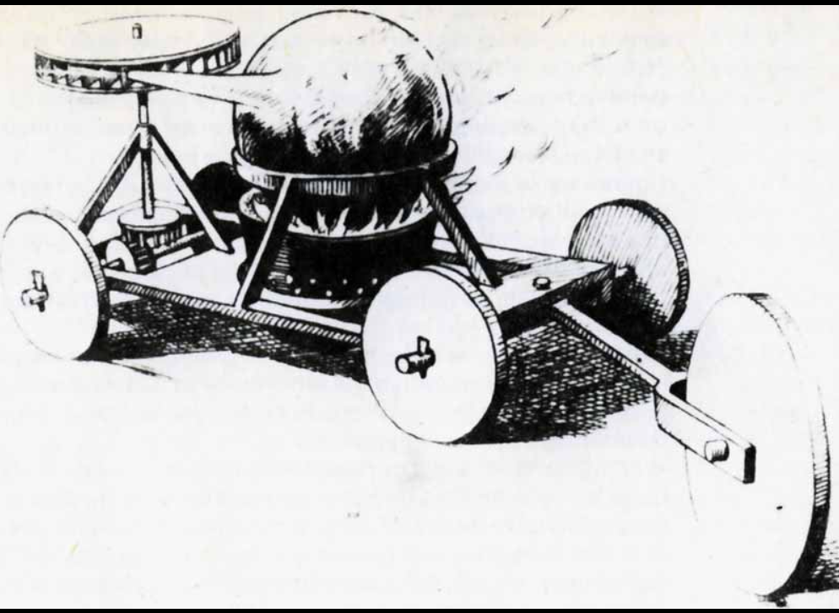
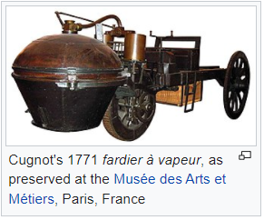
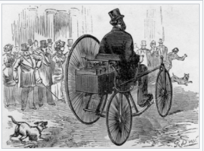
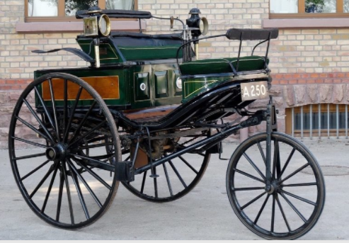
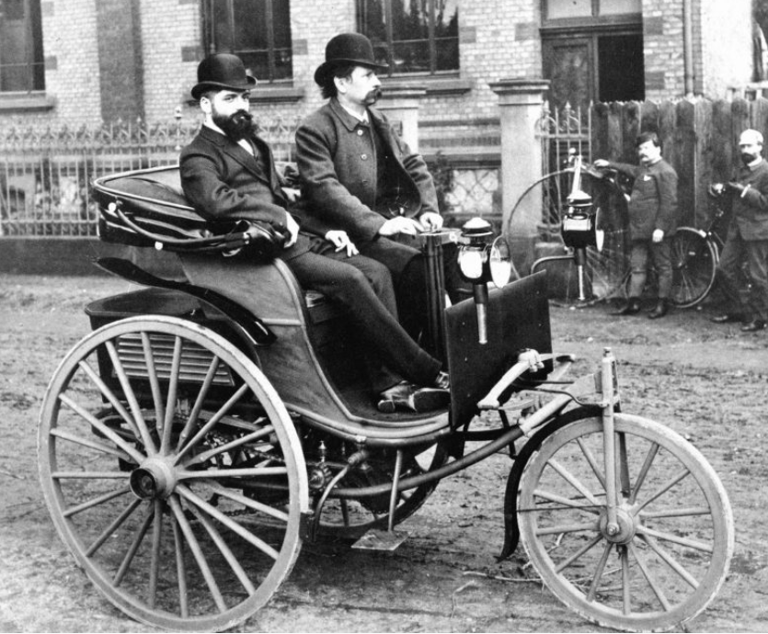
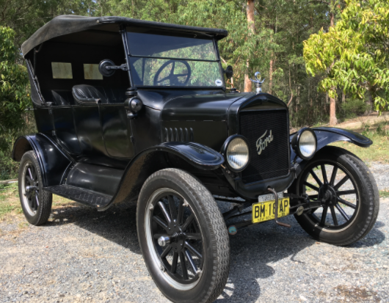
Evolution of automotive:
Steam Machine Of Verbiest, In 1678. (Ferdinand Verbiest)
Cugnot's 1771 fardier à vapeur, as preserved at the Musée des Arts et Métiers, Paris, France
Gustave Trouvé's tricycle, the first ever electric automobile to be shown in public
The original Benz Patent-Motorwagen, first built in 1885 and awarded the patent for the concept
In 1885, Karl Benz invented a car that is credited as the first car in the world to be powered by fuel. The complete structure of the car was created in accordance with the dimensions of the internal machinery. Benz’s car became the model for the cars made after it.
Cars became widely available in the early
20th century. One of the first cars accessible
to the masses was the 1908 Model T,
an American car manufactured by the
Ford Motor Company.
1908 Model T

Slide 8
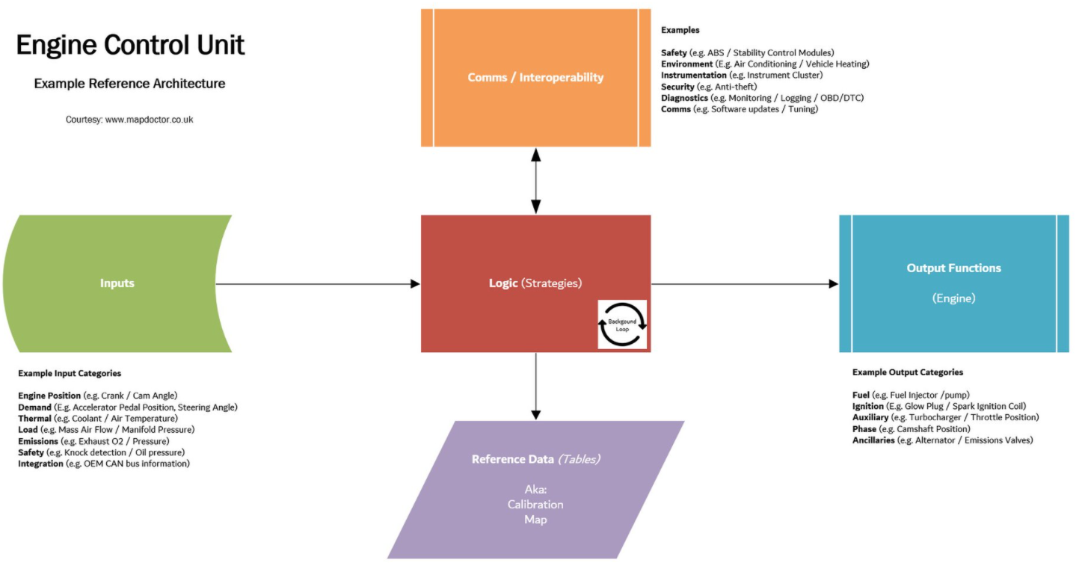

Electronic Control Unit (Embedded system) in Car ?
An Example System
General Motors' (GM) first ECUs had a small application of hybrid digital ECUs as a pilot program in 1979, but by 1980, all active programs were using microprocessor-based systems.
Modern ECUs use a microprocessor which can process the inputs from the engine sensors in real-time. An electronic control unit contains the hardware and software (firmware). The hardware consists of electronic components on a printed circuit board (PCB), ceramic substrate or a thin laminate substrate. The main component on this circuit board is a microcontroller chip (MCU). The software is stored in the microcontroller or other chips on the PCB., typically in EPROMs or flash memory so the CPU can be re-programmed by uploading updated code or replacing chips. This is also referred to as an (electronic) Engine Management System (EMS).

Slide 9

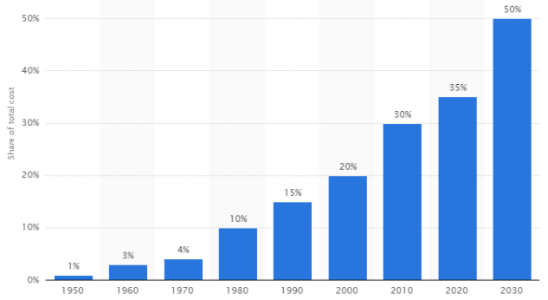
Growth of Electronic system in Automobile
Electronic systems have become an increasingly large component of the cost of an automobile, from only around 1% of its value in 1950 to around 30% in 2010.Modern electric cars rely on power electronics for the main propulsion motor control, as well as managing the battery system.
Future autonomous cars will rely on powerful computer systems, an array of sensors, networking, and satellite navigation, all of which will require electronics
* Reference data at 2022

Slide 10
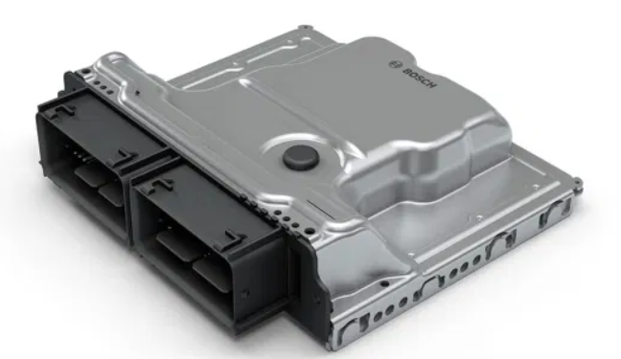
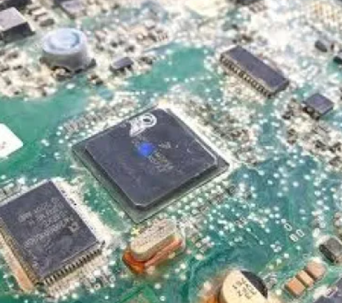
why electronics in Automotive is so important ?
It is an electronic device which has base numbers and parameters filled in its memory. With multiple sensors around a vehicle feeding the ECU data it can manage and control the electronic systems efficiently by giving orders to improve their output.
Let’s take an example of how ECU controls something by looking at how airbags are deployed during an accident.
The car has sensors located around itself called the crash sensors which inform the ECU when a crash has occurred. The ECU then measures the speed of the vehicle when it undergoes accident and then using its onboard memory compares the data of whether it should launch the airbags or not. If the data provides enough reason the ECU deploys the airbags. Note that all this happens in mere milliseconds.
That covers how an ECU works let us take a look at what happens if it is faulty and even worse when it breaks down.
A faulty ECU is probably the worst thing for a car. It’ll work but its performance will be heavily affected. You’ll notice sudden drops in fuel economy and jerky gear shifts. The check engine light staying on might mean a lot of possible errors but an ECU fault is one of the major ones.
What Happens If An ECU Is Dead?
The car won’t start at all. The ECU controls the engine ignition so a dead one will not start the car at all. Other features will not work as well but frankly if the engine is dead other features don’t really matter that much.
That covers the brief explanation of the Electronic Control Unit.
An ECU
Inside ECU

