Slide 1
Scala School – Filters & Action Composition
02.02.2016 Matthew Lloyd, Alexey Gravanov

Slide 2
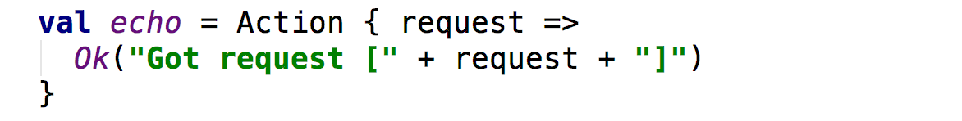
What are Actions?
The standard way of handling requests in Play
They accept a Request[A]
They return a Result
Asynchronous by default (they return in a Future[Result])
Utilise BodyParsers to parse request bodies.
Seite <number>
Filters & Action Composition

Slide 3
Custom Actions
Timing Action
Seite <number>
Filters & Action Composition

Slide 4
A Basic Timing Action
We can do more with Actions by creating custom actions
Let's make a simple action that will calculate how long
our service takes to respond.
We need to be able to wrap an existing Action.
Calculate the time it's taken.
And modify it's response by adding a Response-Time Header
Seite <number>
Filters & Action Composition

Slide 5
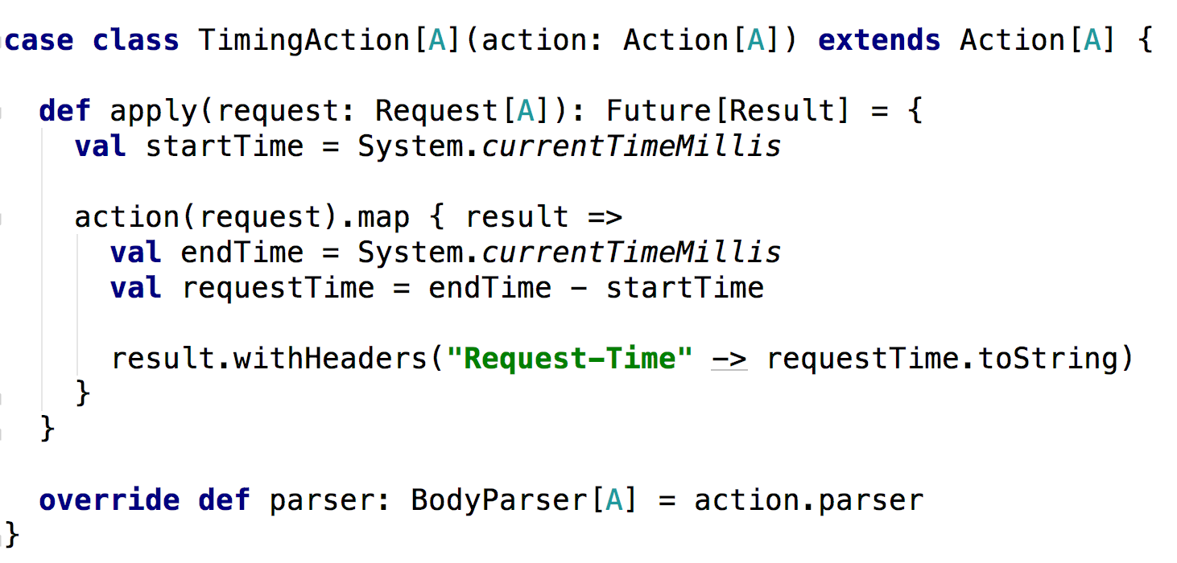
A Basic Timing Action - Implementation
Seite <number>
Filters & Action Composition

Slide 6
A Basic Timing Action
What's this doing?
Wrap the existing action in the constructor.
Implement the apply method.
Call the wrapped action.
Map the Future[Result] and add the Header.
Ensure we carry across any existing BodyParsers.
Seite <number>
Filters & Action Composition

Slide 7
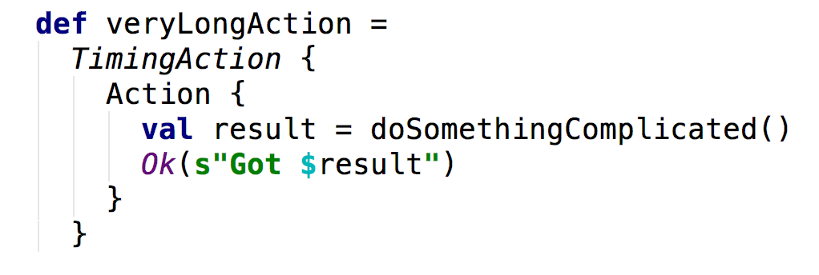
A Basic Timing Action – Usage
Seite <number>
Filters & Action Composition

Slide 8
Custom Actions
Login Action
Seite <number>
Filters & Action Composition

Slide 9
A Login Action
Let's make a simple action that will accept a UserID and Pass.
Lookup the User from the ID.
Compare the password.
And either allow access to the resource or return Forbidden.
Seite <number>
Filters & Action Composition

Slide 10
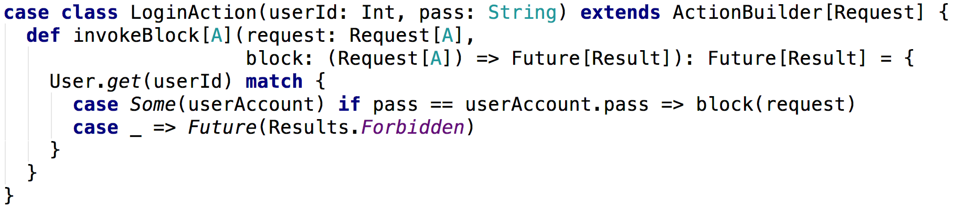
A Login Action – Implementation
Seite <number>
Filters & Action Composition

Slide 11
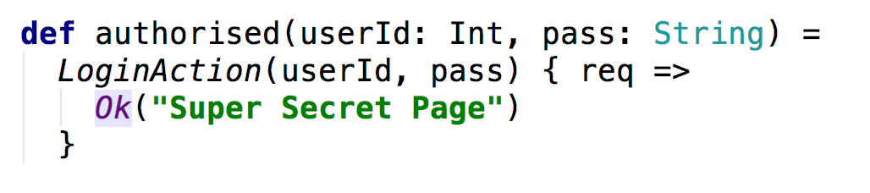
A Login Action - Usage
Seite <number>
Filters & Action Composition

Slide 12
Custom Actions
Advanced Login Action
Seite <number>
Filters & Action Composition

Slide 13
An Advanced Login Action
We want to be able to access our User Data once logged in.
We need to pass the User data through the Request.
Let's use a WrappedRequest to include User Data.
Seite <number>
Filters & Action Composition

Slide 14
An Advanced Login Action – Custom Request
Seite <number>
Filters & Action Composition

Slide 15
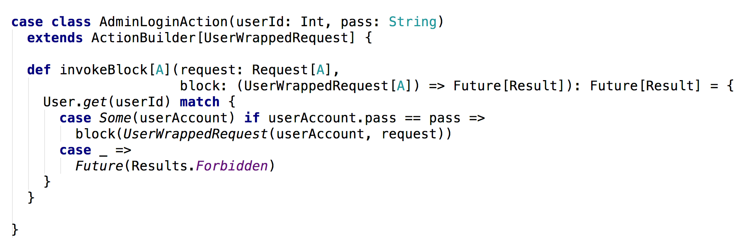
An Advanced Login Action - Implementation
Seite <number>
Filters & Action Composition

Slide 16
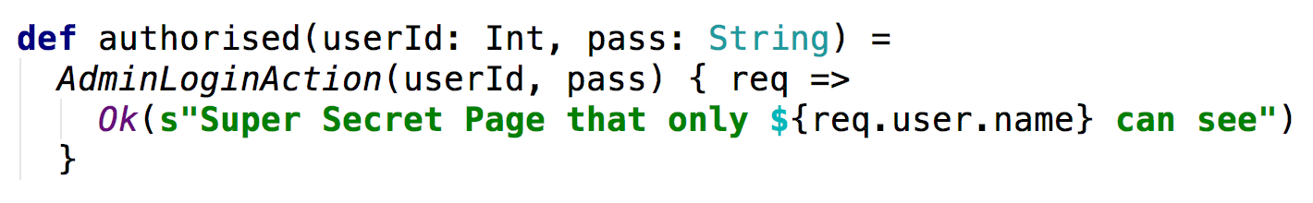
An Advanced Login Action - Usage
Seite <number>
Filters & Action Composition

Slide 17
Custom Actions
Putting it all together
Seite <number>
Filters & Action Composition

Slide 18
Putting it all together
ActionBuilder allows us to easily compose multiple Actions.
You can build up Actions to perform specific tasks.
Then compose them together when using them.
Seite <number>
Filters & Action Composition

Slide 19
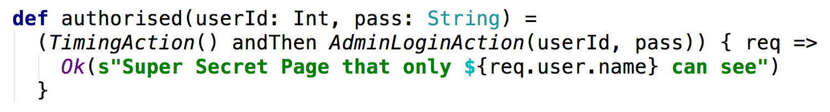
Putting it all together – Action Composition
Seite <number>
Filters & Action Composition

Slide 20
Filters & Actions
Filters
Seite <number>
Filters & Action Composition

Slide 21
What are Filters?
A way of applying logic to all requests.
Filters will apply to all requests.
They can be used similarly to Action Composition.
Good for Timing, Logging, Gzip etc...
Seite <number>
Filters & Action Composition

Slide 22
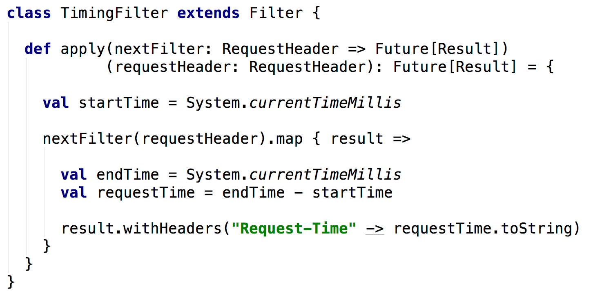
A Timing Filter – Implementation
Seite <number>
Filters & Action Composition

Slide 23
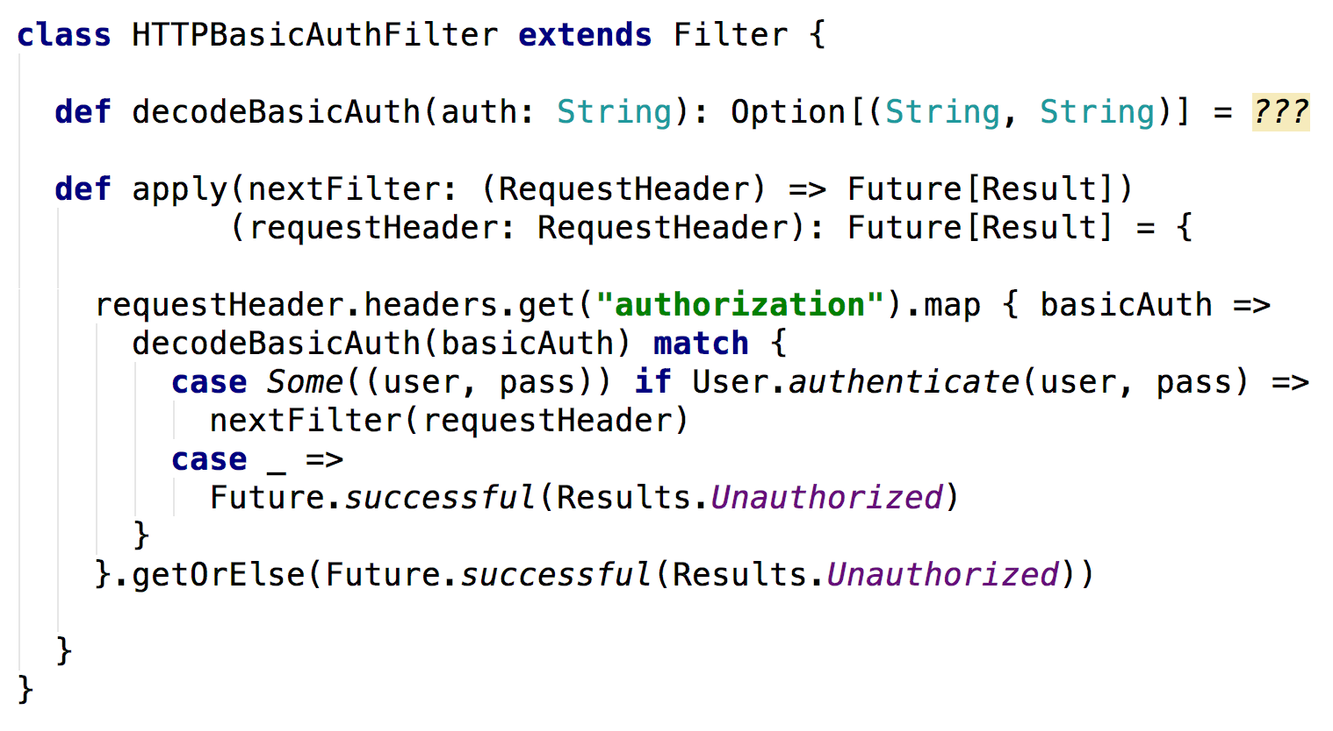
A Basic HTTP Auth Filter – Implementation
Seite <number>
Filters & Action Composition

Slide 24
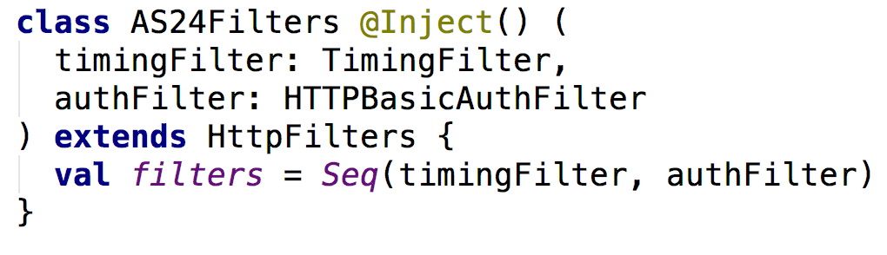
Filters - Usage
Seite <number>
Filters & Action Composition

Slide 25
Anything else to know?
Filters are executed in a chain one by one.
Filters can modify both requests and results.
Filters are executed AFTER routing but BEFORE actions.
This means they have access to the routing info from the
Request header.
Seite <number>
Filters & Action Composition

Slide 26
When to use Filters vs Action Composition?
Filters
Only to be used for global cross cutting concerns.
When you need to affect ALL routes at once.
Action Composition
For specific concerns for certain endpoints.
When you need access to Route Parameters.
Should only really be used for sub set of endpoints.
Seite <number>
Filters & Action Composition

