Slide 1

CMPE – 273 Enterprise Distributed Systems
Semester Project Presentation
Event Driven Failure Recovery for
Distributed Container Clusters
Team Autobots:
Mayuri Sapre
Nagesh Kathare
Sagar Bhoite
Saurabh Phaltane
May 11
Department of Computer Engineering

Slide 2
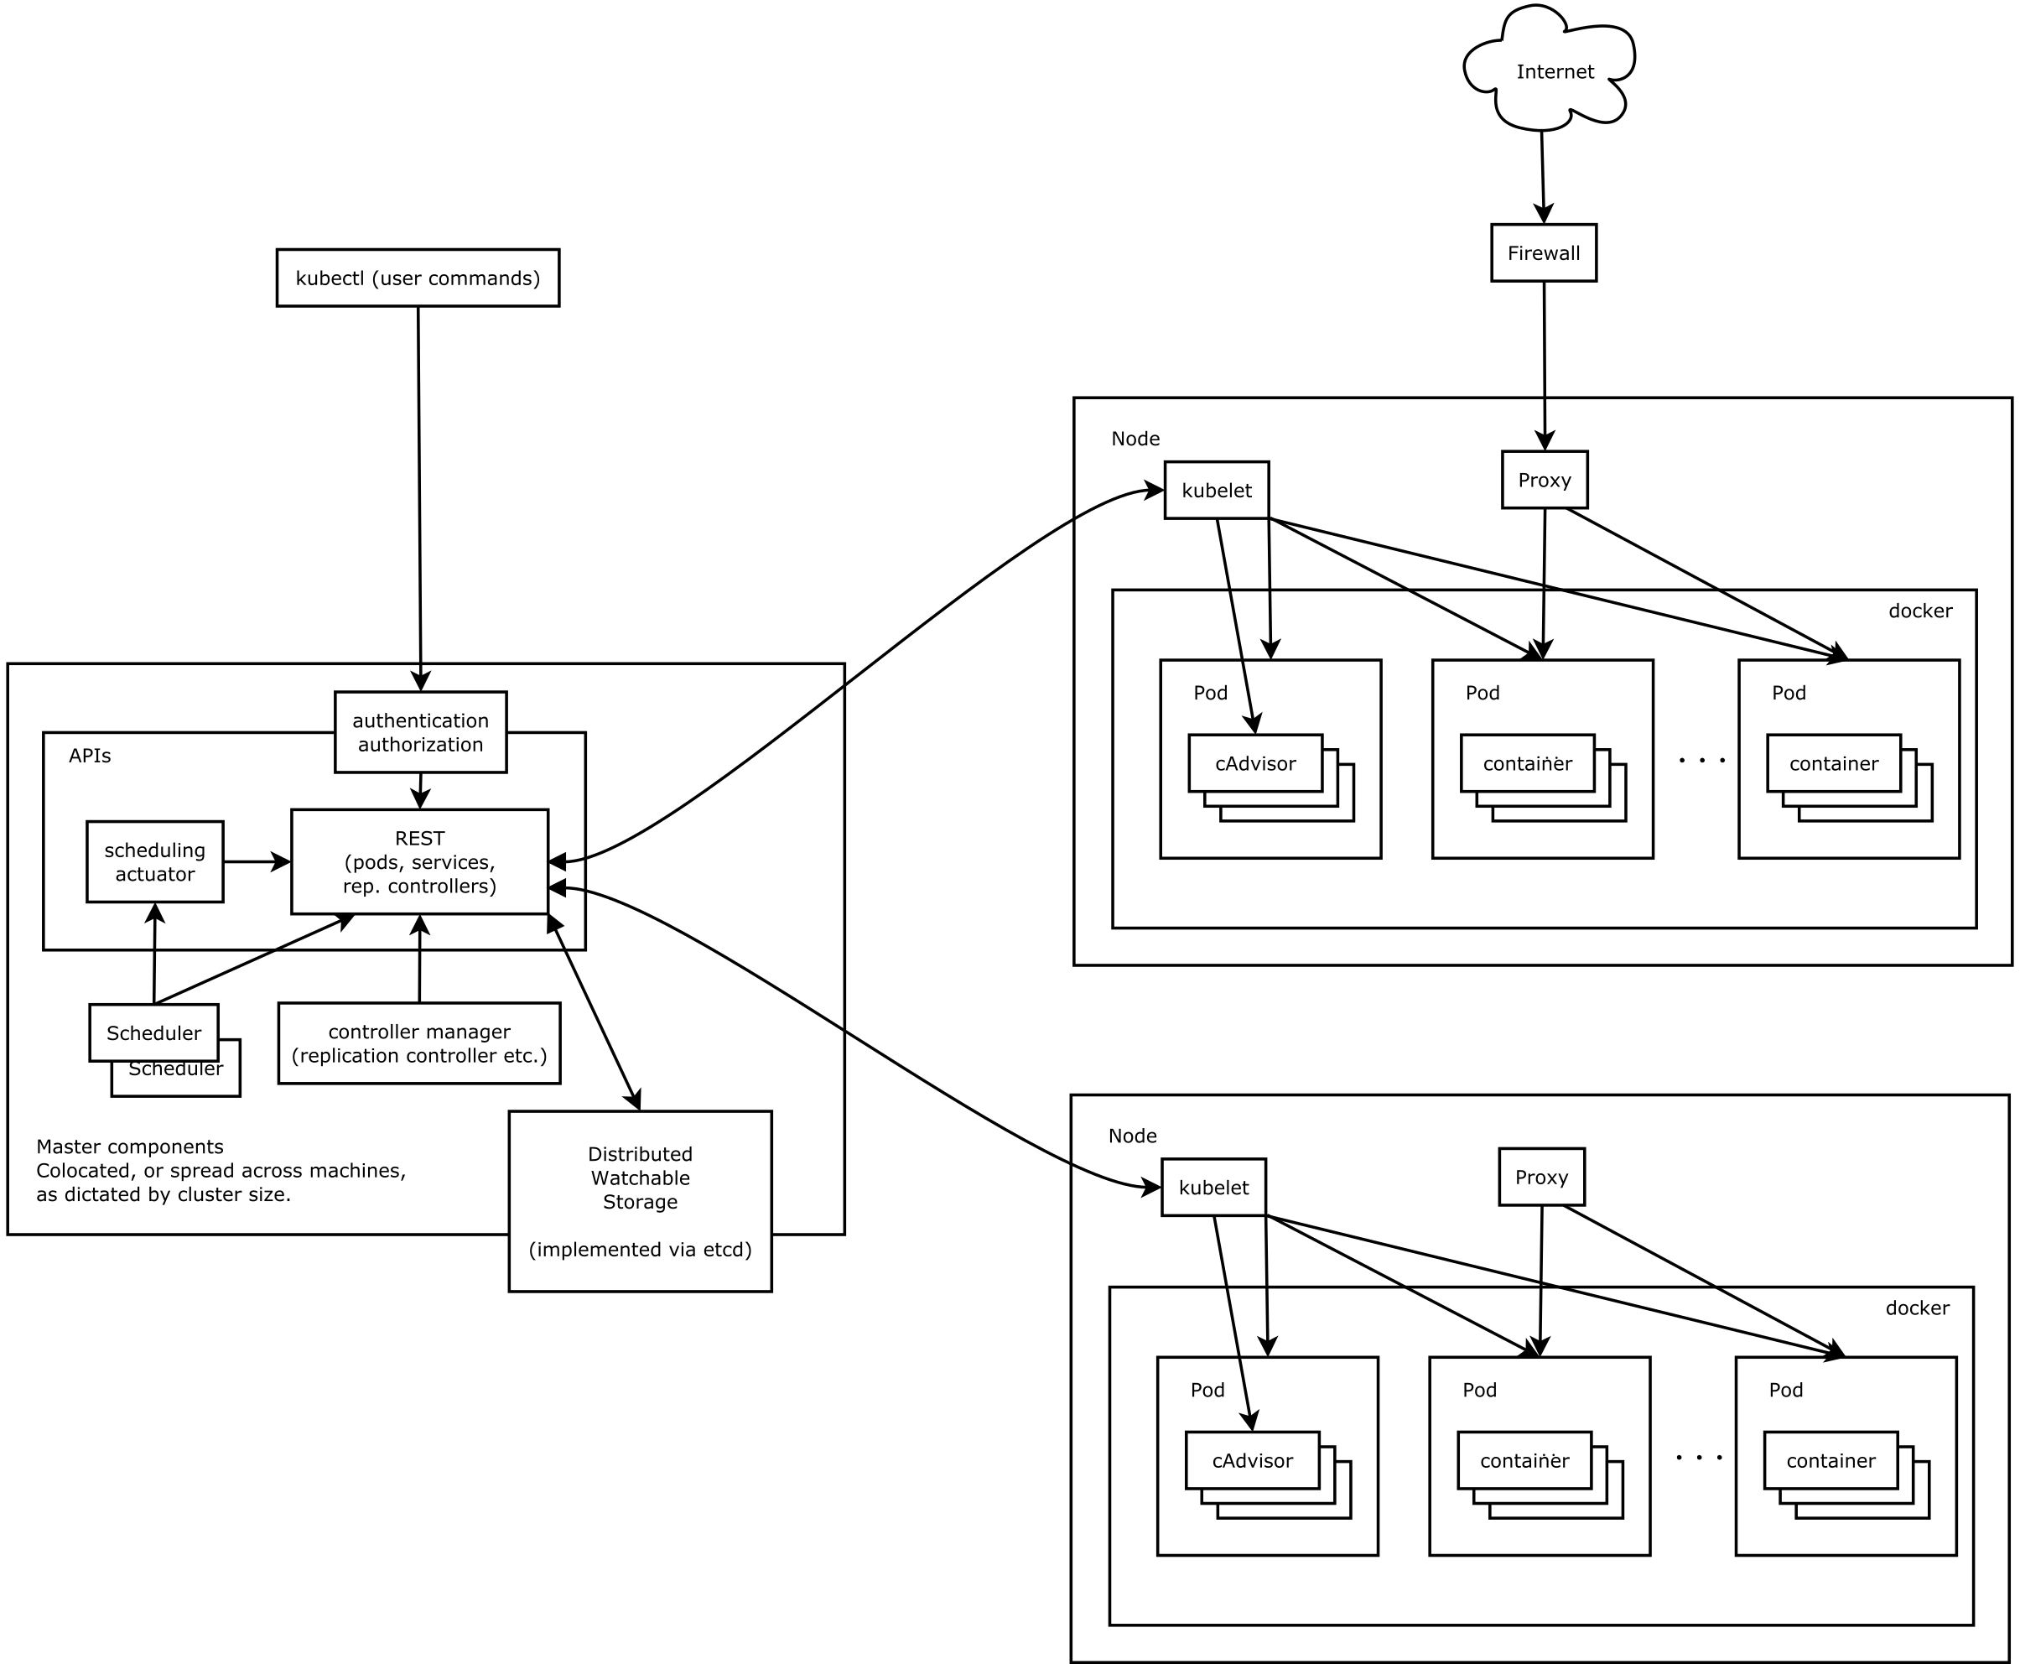




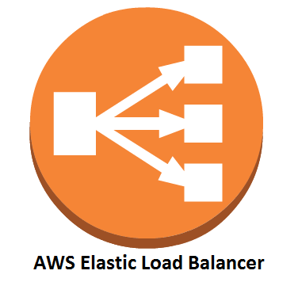


SysAdmin
service
service
user
StackStorm WebHook
action
Get node status
action

