Slide 1
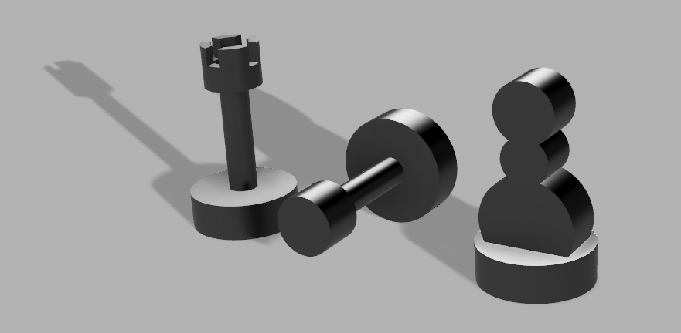
Expected style match
Closer style match due to rotation

Slide 2
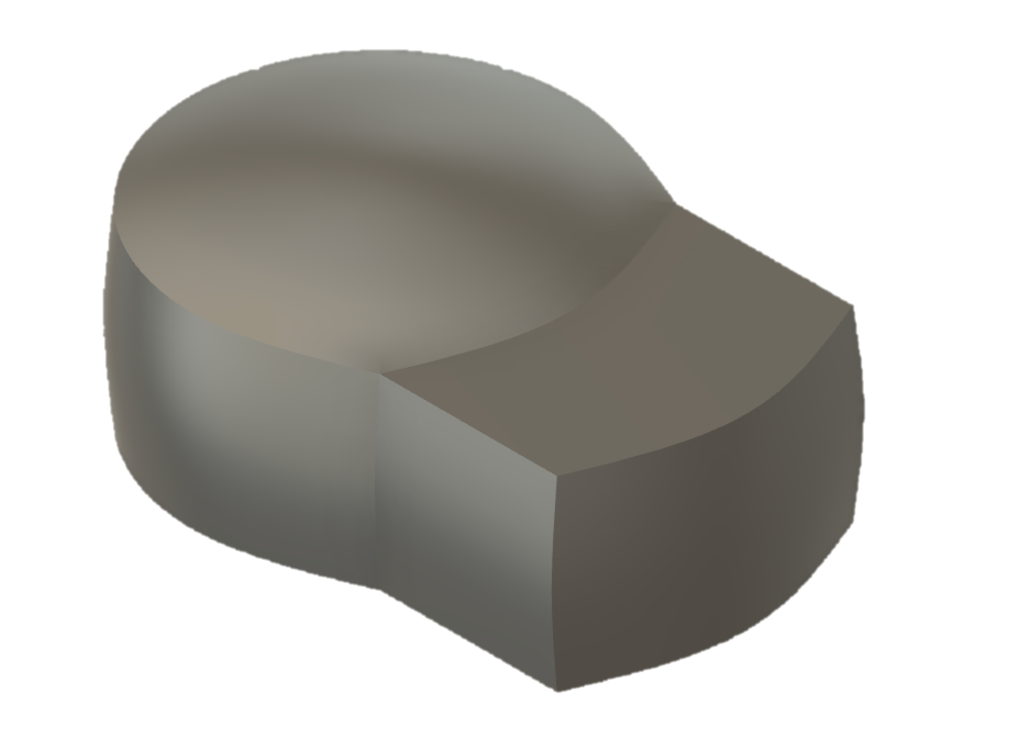
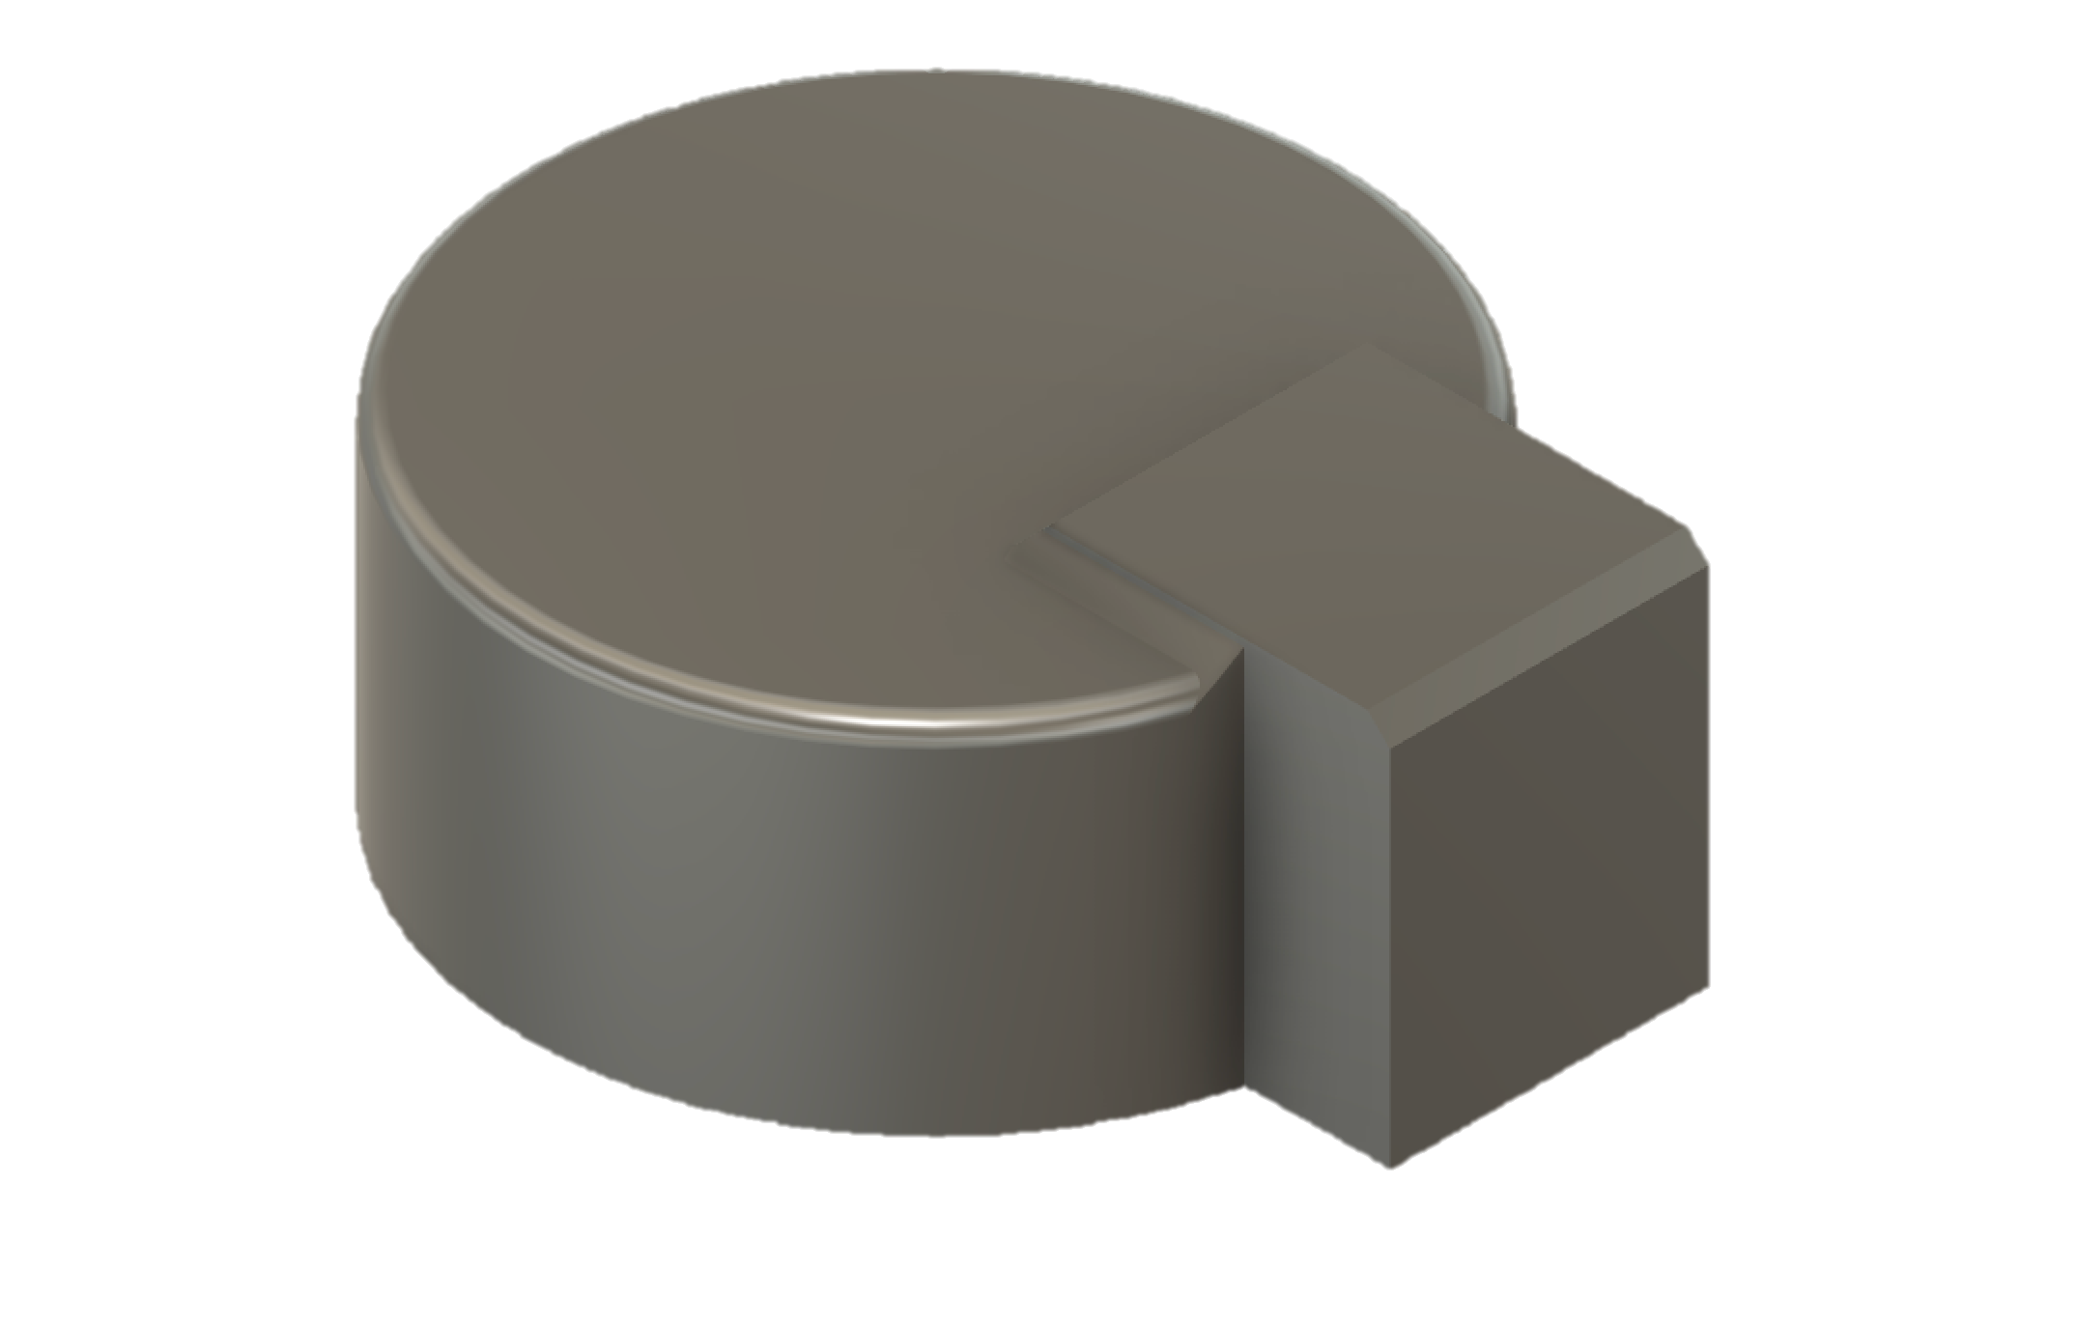
Notes:
Currently we are focused on these specific characteristics…
Explain the hierarchy of style better
solid math definition? Convince it is possible to to use modern data-driven methods to grab this ill-defined and why
Explain geometric feature etc.
We looked at … and showed us this is possible (one or two tech details to win them)
Punch line: maybe end on the most tantalizing next step challenge

Slide 3
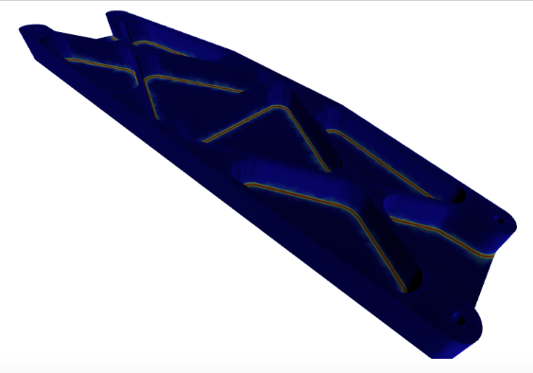

Slide 4
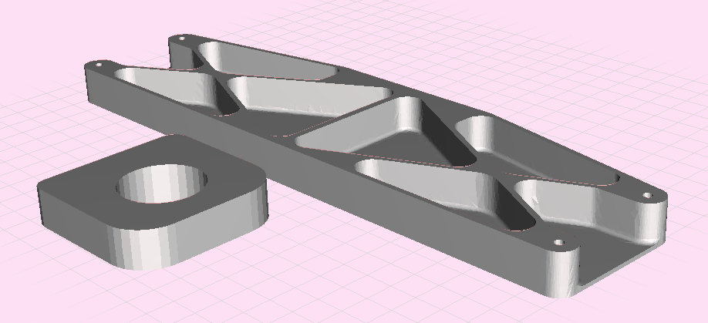
A Fillet in the internal edge
of the pocket
A Pocket

