Slide 1
1010

Slide 2
题目大意
背景
The new function F(x) is defined as follows: F(x) = max(Si(x)), i = 1...n. The domain of x is [0, 1000]. Si(x) is a quadric function. Josephina wonders the minimum of F(x). Unfortunately, it's too hard for her to solve this problem. As a super programmer, can you help her?

Slide 3
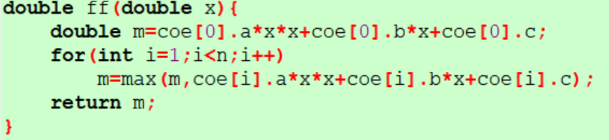
F(X)
The new function F(x) is defined as follows: F(x) = max(Si(x)), i = 1...n.
The domain of x is [0, 1000].
Si(x) is a quadric function.

Slide 4
最大值极小化
Josephina wonders the minimum of F(x). Unfortunately, it's too hard for her to solve this problem. As a super programmer, can you help her?

Slide 5
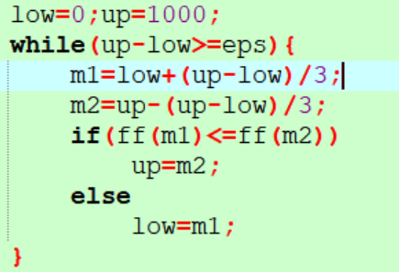
三分法

Slide 6
Josephina wonders the minimum of F(x).

