Slide 1




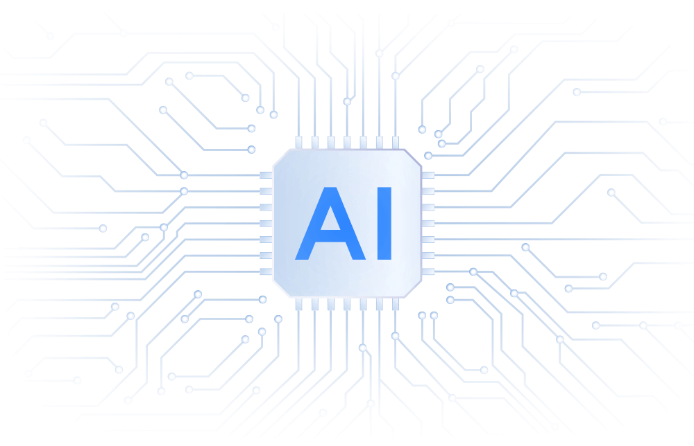


Adan Playil
Data Analyst
Turning Data into Insights

Slide 2



Background
M.Sc. Cloud Computing – Newcastle University
  (Thesis: Quantum-Enhanced Secure Communication via One-Time Pad & Key Distribution – Distinction)
B.Tech Cloud Technology & Information Security – Ajeenkya D.Y. Patil University
  GPA: 8.7/10

Slide 3

Professional Journey
Data Bootcamp – Just IT Ltd, London
Intensive training in data analysis, SQL, Power BI, and real-world projects
Built a strong foundation for transitioning into data-focused roles
2025 | Education Support & Media
Teaching Assistant – Collingwood Media & Arts, Newcastle, UK
Supported learners in creative and technical subjects
Strengthened communication, organisation, and problem-solving skills
2024 | Academic Support Role
Teaching Assistant – Teaching Personnel, Newcastle, UK
Assisted educators and students in structured learning environments
Developed adaptability, teamwork, and stakeholder communication
2023 | Cloud & Infrastructure Exposure
Cloud Engineer (Option 2) – Emanate Agency, Pune, India
Gained hands-on exposure to cloud concepts and infrastructure
Built technical foundations in cloud environments and system operations

Slide 4

What I Can Offer
Analytical problem-solving & insight generation
Data storytelling for stakeholders
Effective communication & collaboration
Adaptability to new technologies and tools
AWS Cloud Practitioner Certificate

Slide 5
Technical skills
Data Analysis & Visualization
SQL
Power BI
Tableau
Excel
R Studio
Programming & Scripting
Python
R
Java
JavaScript
Data Governance & Architecture
Data cleaning
Data transformation
Data summarization
Storytelling
Automation Tools
N8N
Relevance AI
Zapier
VoiceFlow
Cloud & DevOps
AWS
Azure
GCP
Kubernetes
CI/CD pipelines

Slide 6

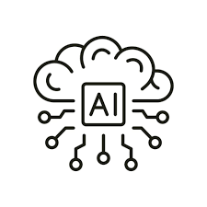


Fun Fact
I’m a jack of all trades—I love trying new experiences, exploring technologies, and learning continuously.
Outside of work, football keeps me disciplined, music sparks my creativity 🎧, and AI fuels my curiosity 🧠

Slide 7

Projects
Quantum Random Key Generator & Distributor
Developed a quantum-secure communication system using AWS Braket and ANUQRNG. Implemented One-Time Pad (OTP) encryption and BB84 quantum key distribution to achieve quantum-resistant security. Demonstrated true random key generation, secure encryption/decryption, and eavesdrop detection.
Key Skills: Quantum Computing, AWS Braket, Cryptography, BB84 Protocol, Secure Communication

Slide 8

G1OS – Cloud-Based Operating System
Built a cloud-based operating system with a monolithic kernel and multiprocessing support to improve performance, scalability, and security. Enabled remote access to desktop environments and files, supporting collaboration and productivity. Deployed and tested the system in a cloud environment.
Key Skills: Operating System Development, Kernel Programming, Cloud Computing (AWS), Linux Administration, Performance Optimization
Blockchain Application for GDPR Compliance
Designed a public blockchain network using the Ethereum Virtual Machine (EVM). Developed smart contracts to manage data usage consent, agreement processing, and activity logging, with a focus on GDPR compliance. This project strengthened understanding of blockchain architecture and decentralized applications.
Key Skills: Blockchain Development, Smart Contracts, Ethereum VM, Data Governance, Security & Compliance

Slide 9


Custromer_Shopping_Behavior_Analysis
Github: https://github.com/Automate0/Customer_shopping_behavior_Analysis
Conducted data analysis to understand customer purchasing patterns and trends. Explored transactional data to identify insights that support business decision-making and customer behavior understanding.
Key Skills: Data Analysis, SQL, Data Visualization, Analytical Thinking, Business Insights

Slide 10
Way of Execution
Layer | Tool | Purpose
Processing | Google Colab | Clean & transform data
Storage | AWS Aurora PostgreSQL | Persist curated data
Analysis | SQL/ pgadmin4 | Business logic & Querying
Visualization | Power BI Desktop | Insight Delivery
Documentation | GitHub | Creating a repository

Slide 11
Data tells a story
and I am passionate about being the translator turning numbers into insights, and insights into decisions. With a foundation in cloud, automation, and analytics, I am ready to help businesses scale smarter and faster. Let’s connect and explore how we can turn complex data into real-world impact together.
linkedIn: https://www.linkedin.com/in/adan-playil08112001/
Github: https://github.com/Automate0
Email: adanplayil7@gmail.com

Slide 12


