Slide 1
Kubernetes with Minikube and Helm Charts

Slide 2
Introductions
Donald Simpson - John Pikoulas
www.automateditsolutions.com Peoples Postcode Lottery Hays
Notes:
Kubernetes is a portable, extensible open-source platform for managing containerized workloads and services, that facilitates both declarative configuration and automation. It was developed by Google, and announced in mid-2014
You don’t have to worry about every instance you own. Nor, do you need to worry about whether the containers are running. If an instance fails, Kubernetes will re-create the containers of the failed instance on one that’s running.
Minikube is a tool that makes it easy to run Kubernetes locally. Minikube runs a single-node Kubernetes cluster inside a Virtual Machine (VM) on your laptop for users looking to try out Kubernetes or develop with it day-to-day.

Slide 3
Agenda
Recap of previous sessions
Kubernetes: options, concepts and components
Minikube setup – kubectl and VirtualBox
My First Cluster and Hello k8s World
Helm and Tiller, Helm Charts
Some basic examples
Next steps…
Notes:
Kubernetes is a portable, extensible open-source platform for managing containerized workloads and services, that facilitates both declarative configuration and automation. It was developed by Google, and announced in mid-2014
You don’t have to worry about every instance you own. Nor, do you need to worry about whether the containers are running. If an instance fails, Kubernetes will re-create the containers of the failed instance on one that’s running.
Minikube is a tool that makes it easy to run Kubernetes locally. Minikube runs a single-node Kubernetes cluster inside a Virtual Machine (VM) on your laptop for users looking to try out Kubernetes or develop with it day-to-day.
https://www.bmc.com/blogs/what-is-kubernetes/

Slide 4
Previously….

Slide 5
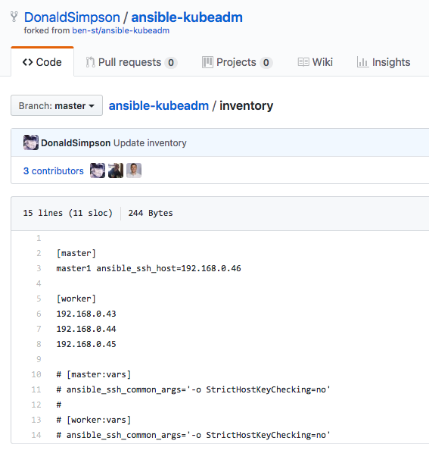
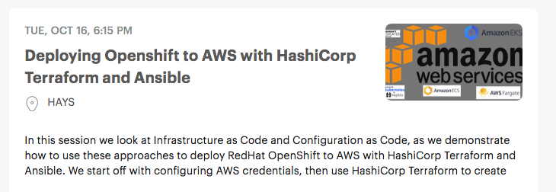
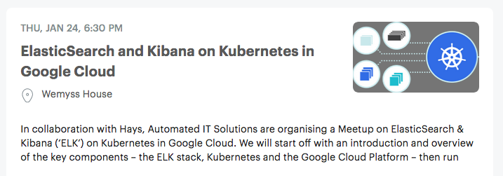
Kubernetes – options, options…
GCP or AWS managed? DIY? Cloud? On Prem?
Hybrid?
Notes:
In our previous presentations we demonstrated running kubernetes in Google cloud platform.
AWS Managed Services unburdens you from infrastructure operations so you can direct resources toward differentiating your business
HL k8s and our previous presentations, example of what/how you can do staff.
To begin to understand Kubernetes usefulness, we have to first understand two other concepts. Immutable Infrastructure and Containers. Well what are those? Immutable infrastructure is the concept where servers are never modified after deployment. The idea is that if something needs to be changed, it’s never modified directly on the server, instead a new server is built from a base image with all changes needed baked in with it so that we can just replace new server with the old one without any further modification. Containers are a way to package your code, runtime, system tools, system libraries and configs so that it can be shipped as a lightweight, standalone executable. The idea is that your application will behave the same every time no matter where (e.g Ubuntu or Windows) it is running. It is worth mentioning that containerization is not a new concept, it was just made popular with the rise of microservices and Docker.
Now that we understand those two concepts we can answer our question, which is what is Kubernetes? I will define it as a container or microservice platform that orchestrates computing, networking, and storage infrastructure workloads for us. As you can see from the definition, Kubernetes extends how we scale containerized application so that we can enjoy all the benefits of a true immutable infrastructure.
If you are like me and wondering where the name “Kubernetes” -κυβερνήτης- came from, it is a Greek word, meaning helmsman or pilot and K8s is an abbreviation derived by replacing the 8 letters “ubernete” with “8”.

Slide 6
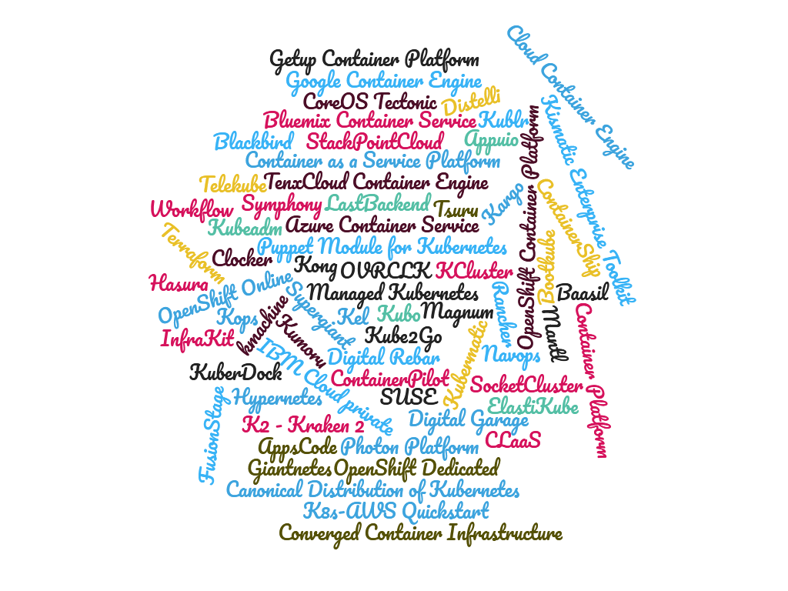
Kubernetes – more options…
Kubernetes deployment options
What’s that all about?
There are many ways to run K8s, depending on your needs.
But today we are doing minikube. And will touch on some of the others
Notes:
Kubernetes is a portable, extensible open-source platform for managing containerized workloads and services, that facilitates both declarative configuration and automation. It was developed by Google, and announced in mid-2014
You don’t have to worry about every instance you own. Nor, do you need to worry about whether the containers are running. If an instance fails, Kubernetes will re-create the containers of the failed instance on one that’s running.
Minikube is a tool that makes it easy to run Kubernetes locally. Minikube runs a single-node Kubernetes cluster inside a Virtual Machine (VM) on your laptop for users looking to try out Kubernetes or develop with it day-to-day.

Slide 7
Kubernetes but first this… key concepts and components

Slide 8
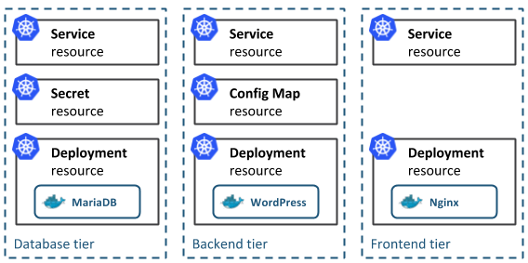
Concepts
Kubernetes Native App architecture
The architecture of a typical Cloud-Native application consists of 3-tiers: a persistence or database tier, backend tier and frontend tier for your application. In Kubernetes, you define and create multiple resources for each of these tiers:
Notes:
Pod — a group of one or more containers (such as Docker containers), with shared storage/network, and a specification for how to run the containers. Even if the pod has several containers, they will all be reachable in the network through a single IP address.
Service — an abstraction which defines a logical set of Pods and a policy by which to access them. Pods have a life cycle. They get created and die. We need a way to make them accessible on a regular basis, even if they are re-created. By giving Pods a certain label we use a Service to route traffic to all Pods with that particular label. Voila! Reliable access to Pods even if they are re-created.
ReplicaSet — give Pods a label and control their replication. Nowadays they are only used through Deployments.
Deployment — describes the desired state and makes sure to change the actual state to the desired state if needed. A deployment manages Pods and ReplicaSets so you don’t have to.
Horizontal scaling – Scale your application up and down from command line or UI.
Automated rollouts and rollbacks – Rolls outs changes will monitor the health of your application to ensure all instances does not go down at the same time. If something goes wrong, k8s will rollback the change automatically.
Service discovery and load balancing – Containers will get their own IP and you can put a set of containers behinds a single DNS name to be load-balanced.
Storage orchestration – Auto mount local, public cloud or a network storage.
Secret and configuration management – Create and Update secrets and configs without rebuilding your image.
Self-healing – Restarts failed containers, replaces and reschedules containers when nodes die, kills containers that don’t respond to your user-defined health check, and doesn’t advertise them to clients until they are ready to serve.
Batch execution – Manage your batch and Continuous Integration workloads. It also makes sure it replaces failed containers.
Automatic binpacking – k8s is smart enough to schedule containers based on resource requirements and other constraints.

Slide 9
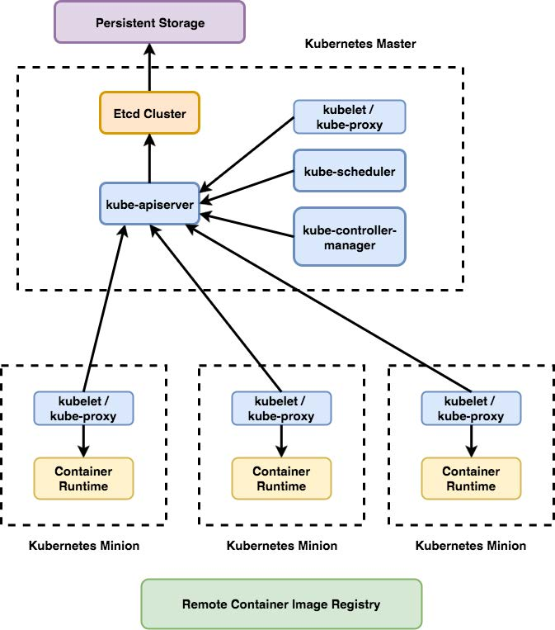
Components
Core components, control plane components, components we need to manage our cluster:
kube-apiserver
kube-controller-manager
kube-scheduler
etcd
Runtime components — components that basically run our containers and make them available via network:
kubelet
kube-proxy
container runtime
Notes:
kube-apiserver
Component on the master that exposes the Kubernetes API. It is the front-end for the Kubernetes control plane. It is designed to scale horizontally – that is, it scales by deploying more instances. See Building High-Availability Clusters.
etcd
Consistent and highly-available key value store used as Kubernetes’ backing store for all cluster data.If your Kubernetes cluster uses etcd as its backing store, make sure you have a back up plan for those data.
kube-scheduler
Component on the master that watches newly created pods that have no node assigned, and selects a node for them to run on. Factors taken into account for scheduling decisions include individual and collective resource requirements, hardware/software/policy constraints, affinity and anti-affinity specifications, data locality, inter-workload interference and deadlines.
kube-controller-manager
Component on the master that runs controllers . Logically, each controller is a separate process, but to reduce complexity, they are all compiled into a single binary and run in a single process.
These controllers include:
Node Controller: Responsible for noticing and responding when nodes go down.
Replication Controller: Responsible for maintaining the correct number of pods for every replication controller object in the system.
Endpoints Controller: Populates the Endpoints object (that is, joins Services & Pods).
Service Account & Token Controllers: Create default accounts and API access tokens for new namespaces.
———————————
kubelet
An agent that runs on each node in the cluster. It makes sure that containers are running in a pod. The kubelet takes a set of PodSpecs that are provided through various mechanisms and ensures that the containers described in those PodSpecs are running and healthy. The kubelet doesn’t manage containers which were not created by Kubernetes.
kube-proxy
kube-proxy enables the Kubernetes service abstraction by maintaining network rules on the host and performing connection forwarding.
Container Runtime
The container runtime is the software that is responsible for running containers. Kubernetes supports several runtimes: Docker, containerd, cri-o, rktlet and any implementation of the Kubernetes CRI (Container Runtime Interface).

Slide 10
Sailing on… with Helm and Tiller

Slide 11
Adding Helm and Tiller
Helm: Helm is a tool that streamlines installing and managing Kubernetes applications. Helm runs on your laptop, CI/CD, or wherever you want it to run
Tiller: Tiller runs inside of your Kubernetes cluster, and manages releases (installations) of your charts
A Gentle Farewell to Tiller, from Helm 3.
Notes:
Helm: the package manager for k8s
Helm helps you manage Kubernetes applications — Helm Charts help you define, install, and upgrade even the most complex Kubernetes application.
Charts are easy to create, version, share, and publish — so start using Helm and stop the copy-and-paste. The latest version of Helm is maintained by the CNCF - in collaboration with Microsoft, Google, Bitnami and the Helm contributor community.
Tiller: is the in-cluster component of Helm. It interacts directly with the Kubernetes API server to install, upgrade, query, and remove Kubernetes resources. It also stores the objects that represent releases.
During the Helm 2 development cycle, we introduced Tiller as part of our integration with Google’s Deployment Manager. Tiller played an important role for teams working on a shared cluster - it made it possible for multiple different operators to interact with the same set of releases.
With Tiller gone, the security model for Helm is radically simplified. Helm 3 now supports all the modern security, identity, and authorization features of modern Kubernetes. Helm’s permissions are evaluated using your kubeconfig file. Cluster administrators can restrict user permissions at whatever granularity they see fit. Releases are still recorded in-cluster, and the rest of Helm’s functionality remains.
With role-based access controls (RBAC) enabled by default in Kubernetes 1.6, locking down Tiller for use in a production scenario became more difficult to manage. Due to the vast number of possible security policies, our stance was to provide a permissive default configuration. This allowed first-time users to start experimenting with Helm and Kubernetes without having to dive headfirst into the security controls. Unfortunately, this permissive configuration could grant a user a broad range of permissions they weren’t intended to have.

Slide 12
Helm Charts
Chart: Chart is a Helm package that contains information sufficient for installing a set of Kubernetes resources into a Kubernetes cluster
Charts contain a Chart.yaml file as well as templates, default values (values.yaml), and dependencies.
Charts are developed in a well-defined directory structure, and then packaged into an archive format called a chart archive
Notes:
Charts: Helm uses a packaging format called charts. A chart is a collection of files that describe a related set of Kubernetes resources. A single chart might be used to deploy something simple, like a memcached pod, or something complex, like a full web app stack with HTTP servers, databases, caches, and so on.
Charts are created as files laid out in a particular directory tree, then they can be packaged into versioned archives to be deployed

Slide 13
Minikube

Slide 14
Minikube, VirtualBox and kubectl
Minikube is an open source tool that enables you to run Kubernetes on your laptop or other local machine. It runs a single-node cluster inside a virtual machine on your local machine
Kubeadm provides support for most clouds and bare metal with Ansible employed to treat provisioning and orchestration matters
Notes:
Minikube is the name of a go program that builds a Kubernetes cluster in a single host with a set of small resources to run a small kubernetes deployment. It is meant for testing scenarios of kubernetes (creating pods, services, managing storage, network ingress rules, etc) but in the local environment for the developer or administrator to test.
Kubectl is the command line interface for Kubernetes. From kubectl you can manage a big majority of the kubernetes resources. Kubectl exposes sub commands for each part of the cluster. The CLI calls Kubernetes API server to modify the desired state or query the current state of the cluster.
Kubelet is an internal node agent running on all the nodes of the cluster. It's job is to assure that a podspec provided by the api server is healthy. In simpler words, it is a container that is constantly checking the statuses of the pods in the node it is running to verify the desired pod specification is met.

Slide 15
My First Cluster
We’re first going to setup our components
Setup VirtualBox, kubectl, minikube
Start our cluster
ssh in our cluster
Examine our docker running containers
Examine our cluster
Examine some minikube add ons
Examine minikube dashboard
Take a look at kubectl command line
Notes:
Minikube has a set of built in addons that can be used enabled, disabled, and opened inside of the local k8s environment.
Run Heapster in a Kubernetes cluster with an InfluxDB backend and a Grafana UI - different example use case of our previous demo
kubectl get deployment -n kube-system to get the yaml code
minikube config view vm configuration details

Slide 16
Hello (k8s) World
Example app – deploy "Hello World" nginx docker image
Run hello-nginx
Get pods
Expose deployment
Get the service url
Get pods
Scale cluster pods

Slide 17
Bonus demo
Use Helm to deploy Wordpress with MariaDB and Jenkins on our k8s cluster
Deploy Jenkins
Deploy Wordpress w/MariaDB
Helm ls
Helm install
Help service

Slide 18
Summary of all the things

Slide 19
What did we do?
Introduction to K8s
k8s components
k8s on your dev laptop
Start our first cluster
Deploy nginx
Increase pod count
Deploy Jenkins

Slide 20
Next steps

