Slide 1
Kubernetes with Minikube and Helm Charts

Slide 2
Introductions
Donald Simpson
(John Pikoulas) www.automateditsolutions.com Peoples Postcode Lottery Hays

Slide 3
Agenda
Recap of previous sessions
Kubernetes: options, concepts and components
Minikube setup – kubectl and VirtualBox
My First Cluster and Hello k8s World
Helm and Tiller, Helm Charts
Next steps…

Slide 4
Previously….

Slide 5
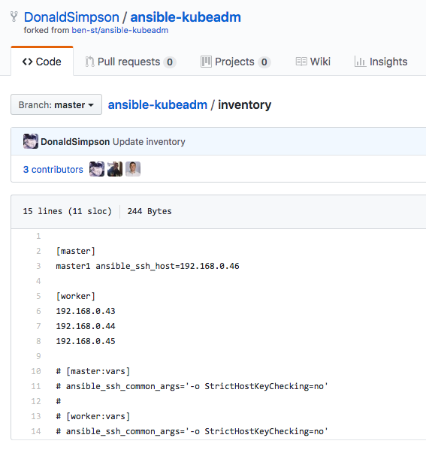
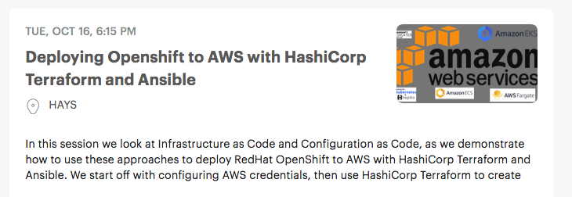
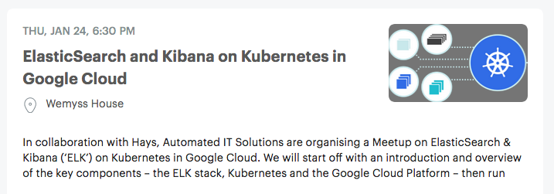
Kubernetes – options, options…
Review this: https://kubernetes.io/docs/setup/
GCP or AWS managed? DIY? Cloud? On Prem?
Hybrid?

Slide 6
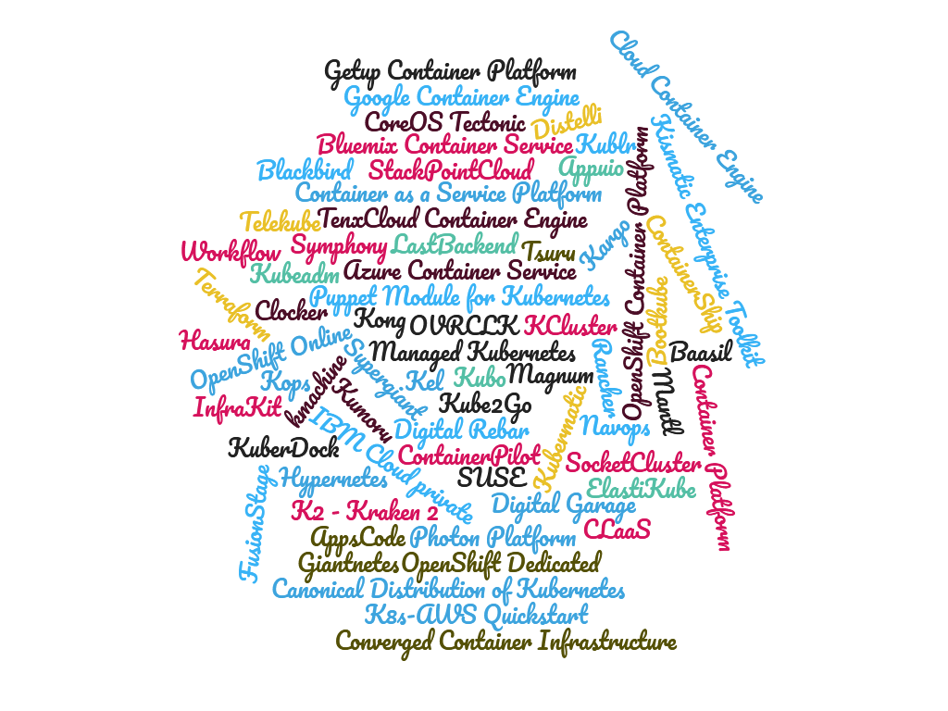
Kubernetes – more options…
Kubernetes deployment options
There are many ways to run K8s, depending on your needs.
But today we are doing minikube. Minikube is a tool that makes it easy to run Kubernetes locally. Minikube runs a single-node Kubernetes cluster inside a Virtual Machine (VM) on your laptop for users looking to try out Kubernetes or develop with it day-to-day.
And will touch on some of the others
Along the way

Slide 7
Kubernetes but first this… key concepts and components

Slide 8
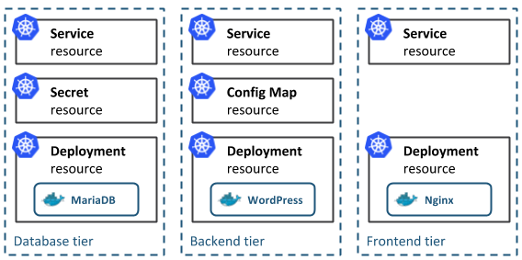
Concepts
Kubernetes Native App architecture [from https://docs.bitnami.com/kubernetes/get-started-kubernetes/ ]
The architecture of a typical Cloud-Native application consists of 3-tiers: a persistence or database tier, backend tier and frontend tier for your application. In Kubernetes, you define and create multiple resources for each of these tiers:

Slide 9
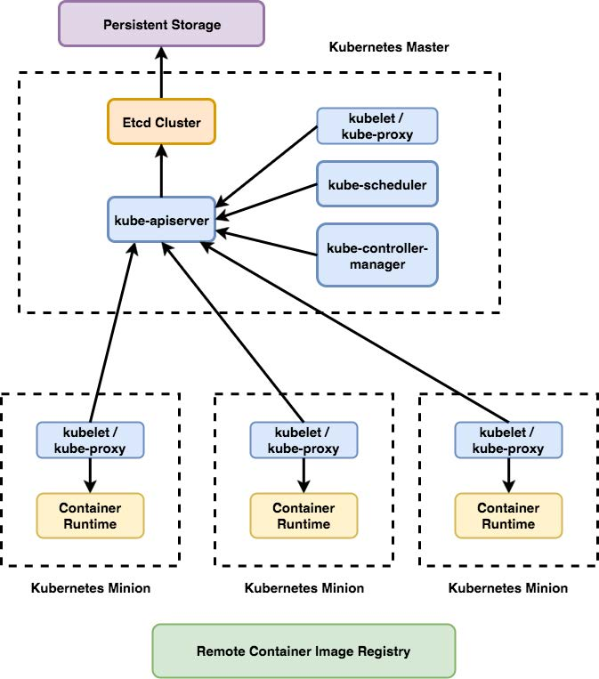
Components
Core components, control plane components, components we need to manage our cluster:
kube-apiserver
kube-controller-manager
kube-scheduler
etcd
Runtime components — components that basically run our containers and make them available via network:
kubelet
kube-proxy
container runtime

Slide 10
Minikube

Slide 11
Minikube, VirtualBox and kubectl
Minikube is an open source tool that enables you to run Kubernetes on your laptop or other local machine. It runs a single-node cluster inside a virtual machine on your local machine
Kubespray vs. Kubeadm
Kubeadm provides support for most clouds and bare metal with Ansible employed to treat provisioning and orchestration matters
Kubespray is a nice choice when you either are familiar with Ansible or seek a possibility to switch between multiple platforms

Slide 12
My First Cluster
We’re first going to setup our components
Setup VirtualBox, Kubctl, minikube
Start our cluster
Ssh in our cluster
Examine our docker running containers
Examine our cluster
Examine some minikube add ons
Examine minikube dashboard
Take a look at kubectl command line

Slide 13
Hello (k8s) World
Example app – deploy "Hello World" nginx docker image
Run hello-nginx
Get pods
Expose deployment
Get the service url
Get pods
Scale cluster pods

Slide 14
Sailing on… with Helm and Tiller

Slide 15
Adding Helm and Tiller
Helm: Helm is a tool that streamlines installing and managing Kubernetes applications. Helm runs on your laptop, CI/CD, or wherever you want it to run
Tiller: Tiller runs inside of your Kubernetes cluster, and manages releases (installations) of your charts
Chart: Chart is a Helm package that contains information sufficient for installing a set of Kubernetes resources into a Kubernetes cluster

Slide 16
Helm Charts
Charts contain a Chart.yaml file as well as templates, default values (values.yaml), and dependencies.
Charts are developed in a well-defined directory structure, and then packaged into an archive format called a chart archive
Lint: To lint a chart is to validate that it follows the conventions and requirements of the Helm chart standard. Helm provides tools to do this, notably the helm lint command

Slide 17
Bonus demo
Use Helm to deploy Wordpress with MariaDB and Jenkins on our k8s cluster
Deploy Wordpress w/MariaDB
Deploy Jenkins
Helm ls
Helm install
Help service

Slide 18
Summary of all the things

Slide 19
What did we do?
Summarise all the things – add diagrams if needed?
Explain things, mention website and meetup and github etc

Slide 20
Next steps

