Slide 1
An Introduction to Kubernetes
AutomatedITSolutions.com

Slide 2
Introductions
John Pikoulas
www.automateditsolutions.com
AutomatedITSolutions.com
Notes:
Kubernetes is a portable, extensible open-source platform for managing containerized workloads and services, that facilitates both declarative configuration and automation. It was developed by Google, and announced in mid-2014
You don’t have to worry about every instance you own. Nor, do you need to worry about whether the containers are running. If an instance fails, Kubernetes will re-create the containers of the failed instance on one that’s running.
Minikube is a tool that makes it easy to run Kubernetes locally. Minikube runs a single-node Kubernetes cluster inside a Virtual Machine (VM) on your laptop for users looking to try out Kubernetes or develop with it day-to-day.

Slide 3
Agenda
WHAT IS K8S
SUMMARY OF K8S COMPONENTS-WHY USE
WHERE/HOW TO RUN K8S
K8S ON AWS
K8S ON GOOGLE CLOUD
K8S OPENSHIFT
K8S ON YOUR LAPTOP
APPENDIX
AutomatedITSolutions.com
Notes:
Kubernetes is a portable, extensible open-source platform for managing containerized workloads and services, that facilitates both declarative configuration and automation. It was developed by Google, and announced in mid-2014
You don’t have to worry about every instance you own. Nor, do you need to worry about whether the containers are running. If an instance fails, Kubernetes will re-create the containers of the failed instance on one that’s running.
Minikube is a tool that makes it easy to run Kubernetes locally. Minikube runs a single-node Kubernetes cluster inside a Virtual Machine (VM) on your laptop for users looking to try out Kubernetes or develop with it day-to-day.
https://www.bmc.com/blogs/what-is-kubernetes/

Slide 4
SUMMARY OF K8S COMPONENTS-WHY USE
“Kubernetes is a portable, extensible, open-source platform for managing containerized workloads and services, that facilitates both declarative configuration and automation.”
“The name Kubernetes originates from Greek word(κυβερνήτης), meaning helmsman or pilot. Google open-sourced the Kubernetes project in 2014.”
https://kubernetes.io
AutomatedITSolutions.com
Notes:
https://kubernetes.io/docs/concepts/
https://kubernetes.io/docs/concepts/overview/what-is-kubernetes/
Kubernetes is a portable, extensible open-source platform for managing containerized workloads and services, that facilitates both declarative configuration and automation. It was developed by Google, and announced in mid-2014
You don’t have to worry about every instance you own. Nor, do you need to worry about whether the containers are running. If an instance fails, Kubernetes will re-create the containers of the failed instance on one that’s running.
Minikube is a tool that makes it easy to run Kubernetes locally. Minikube runs a single-node Kubernetes cluster inside a Virtual Machine (VM) on your laptop for users looking to try out Kubernetes or develop with it day-to-day.

Slide 5
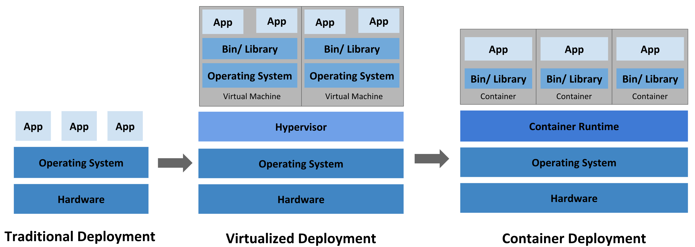
GOING BACK IN TIME
AutomatedITSolutions.com
Notes:
Kubernetes is a portable, extensible open-source platform for managing containerized workloads and services, that facilitates both declarative configuration and automation. It was developed by Google, and announced in mid-2014
You don’t have to worry about every instance you own. Nor, do you need to worry about whether the containers are running. If an instance fails, Kubernetes will re-create the containers of the failed instance on one that’s running.
Minikube is a tool that makes it easy to run Kubernetes locally. Minikube runs a single-node Kubernetes cluster inside a Virtual Machine (VM) on your laptop for users looking to try out Kubernetes or develop with it day-to-day.

Slide 6
WHAT CAN IT DO
Service discovery and load balancing: Kubernetes can expose a container using the DNS name or using their own IP address. If traffic to a container is high, Kubernetes is able to load balance and distribute the network traffic so that the deployment is stable.
Storage orchestration: Kubernetes allows you to automatically mount a storage system of your choice, such as local storages, public cloud providers, and more.
Automated rollouts and rollbacks: You can automate Kubernetes to create new containers for your deployment, remove existing containers and adopt all their resources to the new container.
Automatic bin packing: Kubernetes allows you to specify how much CPU and memory (RAM) each container needs.
Self-healing: Kubernetes restarts containers that fail, replaces containers, kills containers that don’t respond to your user-defined health check, and doesn’t advertise them to clients until they are ready to serve.
Secret and configuration management: Kubernetes lets you store and manage sensitive information, such as passwords, OAuth tokens, and ssh keys. You can deploy and update secrets and application configuration without rebuilding your container images, and without exposing secrets in your stack configuration.
AutomatedITSolutions.com

Slide 7
Kubernetes but first this… key concepts and components
AutomatedITSolutions.com

Slide 8
Kubernetes Native App Architecture
The architecture of a typical Cloud-Native application consists of 3-tiers: a persistence or database tier, backend tier and frontend tier for your application. In Kubernetes, you define and create multiple resources for each of these tiers:
AutomatedITSolutions.com
Notes:
Pod — a group of one or more containers (such as Docker containers), with shared storage/network, and a specification for how to run the containers. Even if the pod has several containers, they will all be reachable in the network through a single IP address.
Service — an abstraction which defines a logical set of Pods and a policy by which to access them. Pods have a life cycle. They get created and die. We need a way to make them accessible on a regular basis, even if they are re-created. By giving Pods a certain label we use a Service to route traffic to all Pods with that particular label. Voila! Reliable access to Pods even if they are re-created.
ReplicaSet — give Pods a label and control their replication. Nowadays they are only used through Deployments.
Deployment — describes the desired state and makes sure to change the actual state to the desired state if needed. A deployment manages Pods and ReplicaSets so you don’t have to.
Horizontal scaling – Scale your application up and down from command line or UI.
Automated rollouts and rollbacks – Rolls outs changes will monitor the health of your application to ensure all instances does not go down at the same time. If something goes wrong, k8s will rollback the change automatically.
Service discovery and load balancing – Containers will get their own IP and you can put a set of containers behinds a single DNS name to be load-balanced.
Storage orchestration – Auto mount local, public cloud or a network storage.
Secret and configuration management – Create and Update secrets and configs without rebuilding your image.
Self-healing – Restarts failed containers, replaces and reschedules containers when nodes die, kills containers that don’t respond to your user-defined health check, and doesn’t advertise them to clients until they are ready to serve.
Batch execution – Manage your batch and Continuous Integration workloads. It also makes sure it replaces failed containers.
Automatic binpacking – k8s is smart enough to schedule containers based on resource requirements and other constraints.

Slide 9
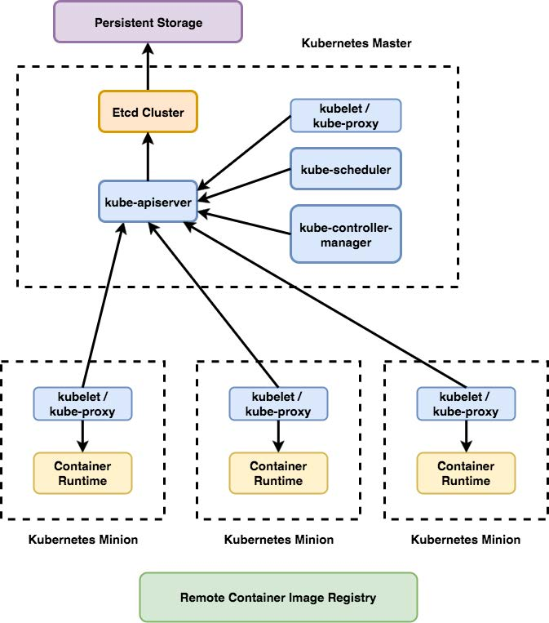
Components
Core components, control plane components, components we need to manage our cluster:
kube-apiserver
kube-controller-manager
kube-scheduler
etcd
Runtime components — components that basically run our containers and make them available via network:
kubelet
kube-proxy
container runtime
AutomatedITSolutions.com
Notes:
kube-apiserver
Component on the master that exposes the Kubernetes API. It is the front-end for the Kubernetes control plane. It is designed to scale horizontally – that is, it scales by deploying more instances. See Building High-Availability Clusters.
etcd
Consistent and highly-available key value store used as Kubernetes’ backing store for all cluster data.If your Kubernetes cluster uses etcd as its backing store, make sure you have a back up plan for those data.
kube-scheduler
Component on the master that watches newly created pods that have no node assigned, and selects a node for them to run on. Factors taken into account for scheduling decisions include individual and collective resource requirements, hardware/software/policy constraints, affinity and anti-affinity specifications, data locality, inter-workload interference and deadlines.
kube-controller-manager
Component on the master that runs controllers . Logically, each controller is a separate process, but to reduce complexity, they are all compiled into a single binary and run in a single process.
These controllers include:
Node Controller: Responsible for noticing and responding when nodes go down.
Replication Controller: Responsible for maintaining the correct number of pods for every replication controller object in the system.
Endpoints Controller: Populates the Endpoints object (that is, joins Services & Pods).
Service Account & Token Controllers: Create default accounts and API access tokens for new namespaces.
———————————
kubelet
An agent that runs on each node in the cluster. It makes sure that containers are running in a pod. The kubelet takes a set of PodSpecs that are provided through various mechanisms and ensures that the containers described in those PodSpecs are running and healthy. The kubelet doesn’t manage containers which were not created by Kubernetes.
kube-proxy
kube-proxy enables the Kubernetes service abstraction by maintaining network rules on the host and performing connection forwarding.
Container Runtime
The container runtime is the software that is responsible for running containers. Kubernetes supports several runtimes: Docker, containerd, cri-o, rktlet and any implementation of the Kubernetes CRI (Container Runtime Interface).

Slide 10
K8S ON AWS
Amazon Elastic Kubernetes Service (Amazon EKS)
https://aws.amazon.com/eks/
AutomatedITSolutions.com
Notes:
Amazon Elastic Kubernetes Service (Amazon EKS) makes it easy to deploy, manage, and scale containerized applications using Kubernetes on AWS.
Amazon EKS runs the Kubernetes management infrastructure for you across multiple AWS availability zones to eliminate a single point of failure. Amazon EKS is certified Kubernetes conformant so you can use existing tooling and plugins from partners and the Kubernetes community. Applications running on any standard Kubernetes environment are fully compatible and can be easily migrated to Amazon EKS.

Slide 11
K8S ON GOOGLE CLOUD
Kubernetes Engine is a managed, production-ready environment for deploying containerized applications.
gcloud container clusters create hello-cluster --num-nodes=2
AutomatedITSolutions.com
Notes:
Kubernetes Engine is a managed, production-ready environment for deploying containerized applications.

Slide 12
K8S ON AZURE
Azure Kubernetes Service (AKS)
AutomatedITSolutions.com
Notes:
The fully managed Azure Kubernetes Service (AKS) makes deploying and managing containerized applications easy. It offers serverless Kubernetes, an integrated continuous integration and continuous delivery (CI/CD), and enterprise-grade security and governance. Unite your development and operations teams on a single platform to rapidly build, deliver, and scale applications with confidence.
Elastic provisioning of additional capacity without the need to manage the infrastructure.
Faster end-to-end development experience and integration with Visual Studio Code Kubernetes tools, Azure DevOps, and Azure Monitor
Advanced identity and access management using Azure Active Directory, and dynamic rules enforcement across multiple clusters with Azure Policy
Orchestration of containers across 28 regions and growing, in the public cloud, in Azure Stack, or on IoT edge devices

Slide 13
K8S OPENSHIFT
Red Hat OpenShift is a hybrid cloud, enterprise Kubernetes platform
AutomatedITSolutions.com
Notes:
We package Kubernetes and include additional tooling as features that we find important and our users demand. Much as CoreOS and CentOS contain different sets of tooling, catering to different users, so it is the same with Kubernetes distributions. At Red Hat we have focused on making available the tools that help make developers and operations teams successful. This is why, for example, we are including Istio as a technology preview in OpenShift now. We feel it is a tool many users may come to depend on, and thus should be included as table stakes in the base distribution.
OpenShift product vs. Kubernetes project: OpenShift Container Platform is a product that you can install on your infrastructure that has a paid support included that comes with a subscription
OpenShift limited installation vs. install Kubernetes (almost) anywhere: You cannot install it on other linux distributions. Kubernetes, on the other hand, can be installed almost on any linux distribution such as Debian, Ubuntu (most popular ones) and many others.
OpenShift has more strict security policies than default Kubernetes: For example, most of container images available on Docker Hub won’t run on OpenShift, as it forbids to run a container as root and even many of official images don’t meet this requirement.
OpenShift templates are less flexible than Kubernetes Helm charts: Helm is so much better, but its current architecture (Tiller component installed as Pod with huge permissions) isn’t compatible with more strict security polices in OpenShift. Tiller is deprecated on recent K8s release
Routers on OpenShift vs. Ingress on Kubernetes
Integrated CI/CD with Jenkins

Slide 14
K8S ON YOUR LAPTOP
AutomatedITSolutions.com

Slide 15
Minikube, VirtualBox and kubectl
Minikube is an open source tool that enables you to run Kubernetes on your laptop or other local machine. It runs a single-node cluster inside a virtual machine on your local machine
Kubeadm provides support for most clouds and bare metal with Ansible employed to treat provisioning and orchestration matters
AutomatedITSolutions.com
Notes:
Minikube is the name of a go program that builds a Kubernetes cluster in a single host with a set of small resources to run a small kubernetes deployment. It is meant for testing scenarios of kubernetes (creating pods, services, managing storage, network ingress rules, etc) but in the local environment for the developer or administrator to test.
Kubectl is the command line interface for Kubernetes. From kubectl you can manage a big majority of the kubernetes resources. Kubectl exposes sub commands for each part of the cluster. The CLI calls Kubernetes API server to modify the desired state or query the current state of the cluster.
Kubelet is an internal node agent running on all the nodes of the cluster. It's job is to assure that a podspec provided by the api server is healthy. In simpler words, it is a container that is constantly checking the statuses of the pods in the node it is running to verify the desired pod specification is met.

Slide 16
Adding Helm and Tiller
Helm: Helm is a tool that streamlines installing and managing Kubernetes applications. Helm runs on your laptop, CI/CD, or wherever you want it to run
Tiller: Tiller runs inside of your Kubernetes cluster, and manages releases (installations) of your charts
A Gentle Farewell to Tiller, from Helm 3.
AutomatedITSolutions.com
Notes:
Helm: the package manager for k8s
Helm helps you manage Kubernetes applications — Helm Charts help you define, install, and upgrade even the most complex Kubernetes application.
Charts are easy to create, version, share, and publish — so start using Helm and stop the copy-and-paste. The latest version of Helm is maintained by the CNCF - in collaboration with Microsoft, Google, Bitnami and the Helm contributor community.
Tiller: is the in-cluster component of Helm. It interacts directly with the Kubernetes API server to install, upgrade, query, and remove Kubernetes resources. It also stores the objects that represent releases.
During the Helm 2 development cycle, we introduced Tiller as part of our integration with Google’s Deployment Manager. Tiller played an important role for teams working on a shared cluster - it made it possible for multiple different operators to interact with the same set of releases.
With Tiller gone, the security model for Helm is radically simplified. Helm 3 now supports all the modern security, identity, and authorization features of modern Kubernetes. Helm’s permissions are evaluated using your kubeconfig file. Cluster administrators can restrict user permissions at whatever granularity they see fit. Releases are still recorded in-cluster, and the rest of Helm’s functionality remains.
With role-based access controls (RBAC) enabled by default in Kubernetes 1.6, locking down Tiller for use in a production scenario became more difficult to manage. Due to the vast number of possible security policies, our stance was to provide a permissive default configuration. This allowed first-time users to start experimenting with Helm and Kubernetes without having to dive headfirst into the security controls. Unfortunately, this permissive configuration could grant a user a broad range of permissions they weren’t intended to have.

Slide 17
Helm Charts
Chart: Chart is a Helm package that contains information sufficient for installing a set of Kubernetes resources into a Kubernetes cluster
Charts contain a Chart.yaml file as well as templates, default values (values.yaml), and dependencies.
Charts are developed in a well-defined directory structure, and then packaged into an archive format called a chart archive
AutomatedITSolutions.com
Notes:
Charts: Helm uses a packaging format called charts. A chart is a collection of files that describe a related set of Kubernetes resources. A single chart might be used to deploy something simple, like a memcached pod, or something complex, like a full web app stack with HTTP servers, databases, caches, and so on.
Charts are created as files laid out in a particular directory tree, then they can be packaged into versioned archives to be deployed

Slide 18
Appendix
https://sweetcode.io/deploying-databases-kubernetes-statefulsets/
https://kubedb.com/
https://www.donaldsimpson.co.uk/2019/06/12/kubernetes-with-minikube-and-helm-part-1/
https://aws.amazon.com/kubernetes/
https://aws.amazon.com/eks/
https://cloud.google.com/kubernetes-engine/
https://zero-to-jupyterhub.readthedocs.io/en/latest/google/step-zero-gcp.html
https://kubernetes.io/docs/setup/production-environment/turnkey/azure/
https://docs.microsoft.com/en-us/azure/aks/intro-kubernetes
https://www.openshift.com/learn/topics/kubernetes/
https://blog.openshift.com/whats-the-difference-between-openshift-and-kubernetes/
https://kubernetes.io/docs/concepts/overview/what-is-kubernetes/
AutomatedITSolutions.com

Slide 19
Next steps

