Slide 1
Kubernetes with Minikube and Helm Charts

Slide 2
Introductions
John Pikoulas, Donald Simpson
https://www.automateditsolutions.com/

Slide 3
Agenda
Recap of previous sessions
Kubernetes concepts and components
Minikube setup – kubectl and VirtualBox
My First Cluster and Hello k8s World
Helm and Tiller, Helm Charts
Next steps…

Slide 4
Previously….

Slide 5
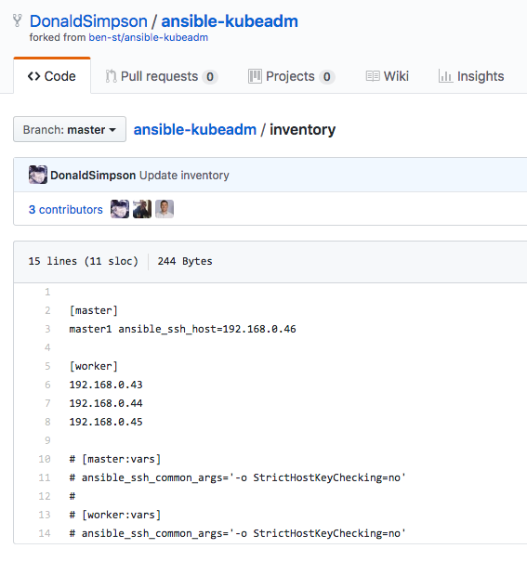
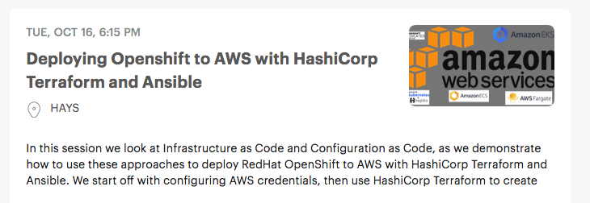
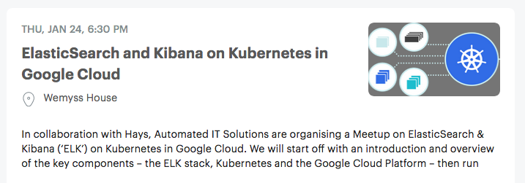
Kubernetes – options, options…
Review this: https://kubernetes.io/docs/setup/
GCP or AWS managed? DIY? Cloud? On Prem?
Hybrid?

Slide 6
Kubernetes but first this… key concepts and components

Slide 7
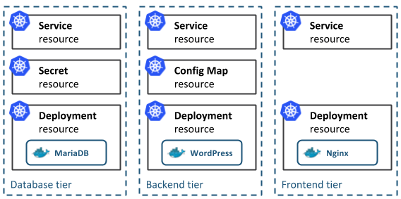
Concepts
Kubernetes Native App architecture [from https://docs.bitnami.com/kubernetes/get-started-kubernetes/ ]
The architecture of a typical Cloud-Native application consists of 3-tiers: a persistence or database tier, backend tier and frontend tier for your application. In Kubernetes, you define and create multiple resources for each of these tiers:

Slide 8
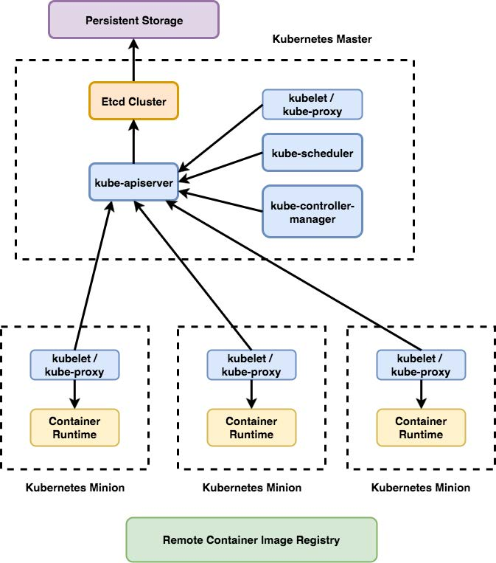
Components
Take this all from https://kubernetes.io/docs/concepts/overview/components/
Master Components
Node Components
Think you had a slide for this previously we could reuse here?
https://applatix.com/making-kubernetes-production-ready-part-2/

Slide 9
Minikube

Slide 10
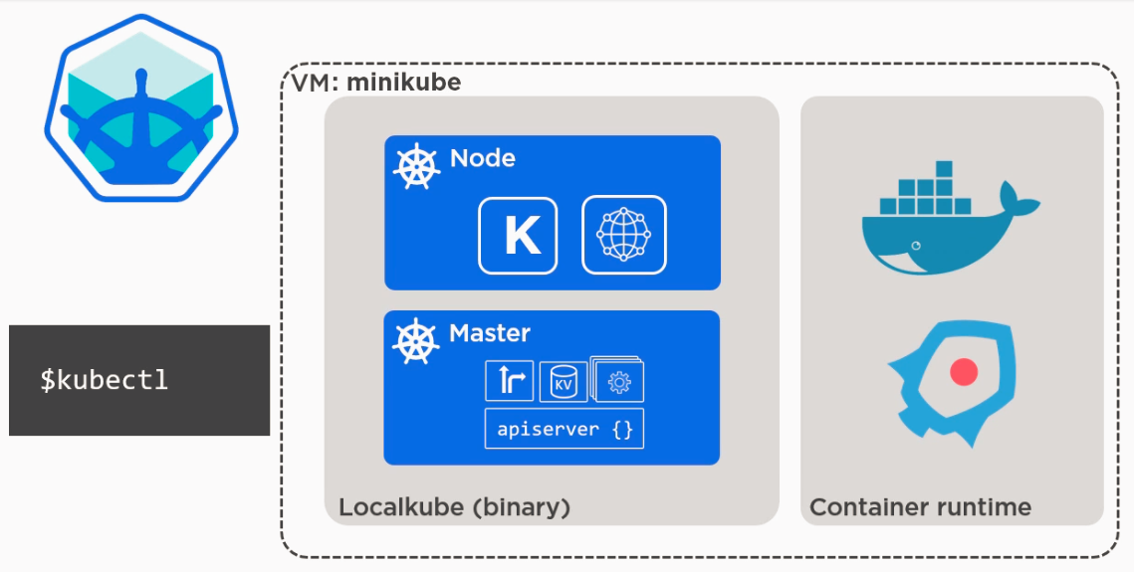
Minikube, VirtualBox and kubectl
Explain “why minikube?” and what the options are – kubespray/kubeadm etc
Get and configure minikube
Setup kubectl
Install VirtualBox
(TODO add pics and links)

Slide 11
My First Cluster
Don do demo steps here – JP to know what to say for the next while…

Slide 12
Hello (k8s) World
Don do demo steps here – JP to know what to say for the next while…

Slide 13
Sailing on… with Helm and Tiller

Slide 14
Adding Helm and Tiller
Explain what and why and outline how
then
Don do demo steps here – JP to know what to say for the next while…

Slide 15
Helm Charts
Explore the charts – know what to say about them…
Don demo installing a couple

Slide 16
Summary of all the things

Slide 17
What did we do?
Summarise all the things
Explain things, mention website and meetup and github etc

Slide 18
Next steps

