Slide 1
Kubernetes with Minikube and Helm Charts

Slide 2
Introductions
Donald Simpson
(John Pikoulas) www.automateditsolutions.com Peoples Postcode Lottery Hays

Slide 3
Agenda
Recap of previous sessions
Kubernetes: options, concepts and components
Minikube setup – kubectl and VirtualBox
My First Cluster and Hello k8s World
Helm and Tiller, Helm Charts
Next steps…

Slide 4
Previously….

Slide 5
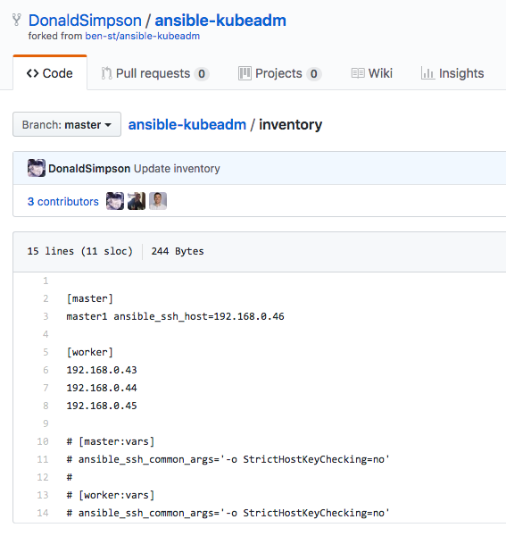
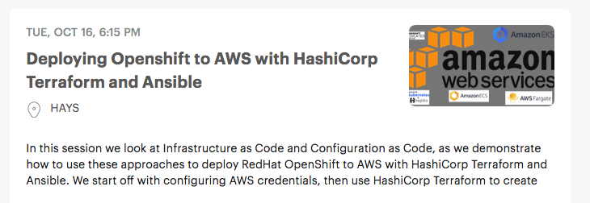
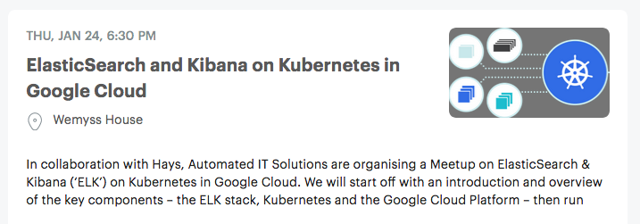
Kubernetes – options, options…
Review this: https://kubernetes.io/docs/setup/
GCP or AWS managed? DIY? Cloud? On Prem?
Hybrid?

Slide 6
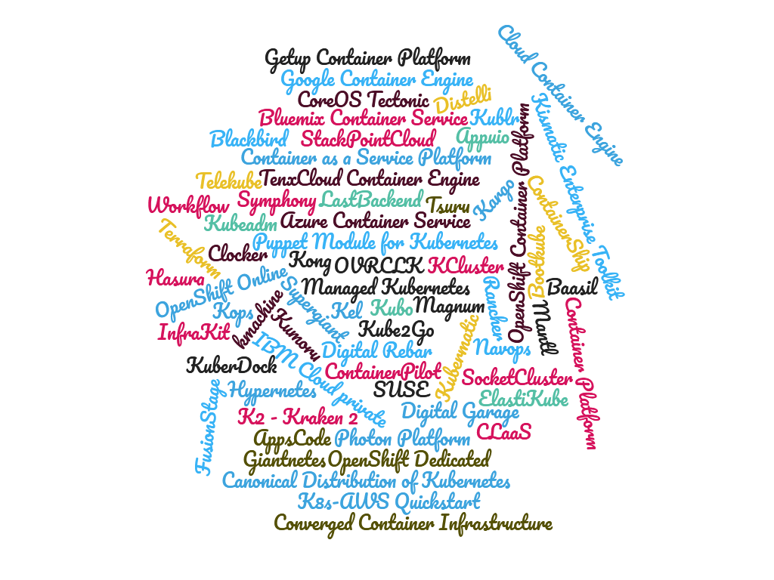
Kubernetes – more options…
Kubernetes deployment options
Explain there are many ways
But today we are doing minikube
And will touch on some of the others
Along the way

Slide 7
Kubernetes but first this… key concepts and components

Slide 8
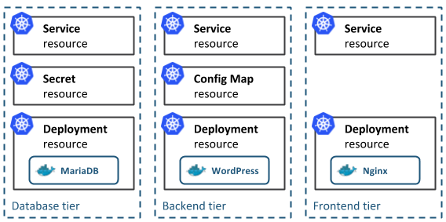
Concepts
Kubernetes Native App architecture [from https://docs.bitnami.com/kubernetes/get-started-kubernetes/ ]
The architecture of a typical Cloud-Native application consists of 3-tiers: a persistence or database tier, backend tier and frontend tier for your application. In Kubernetes, you define and create multiple resources for each of these tiers:

Slide 9
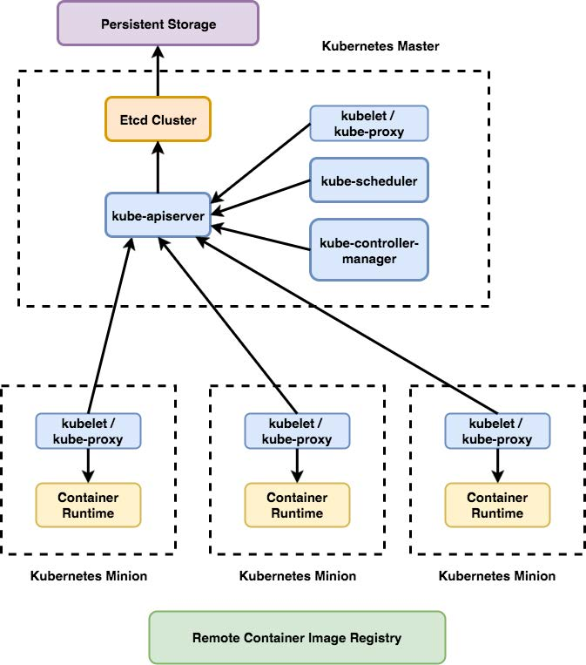
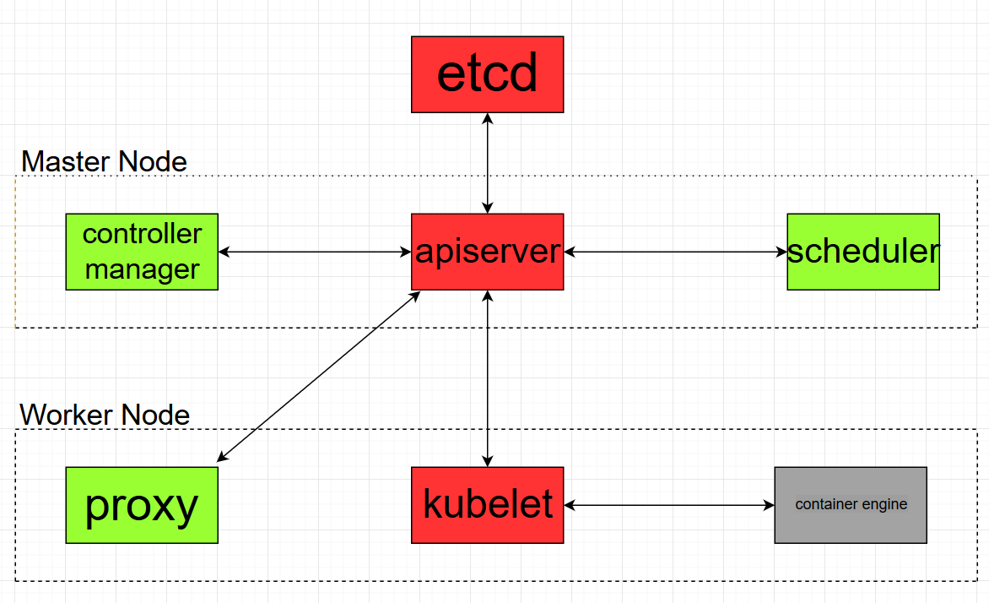
Components
Take this all from https://kubernetes.io/docs/concepts/overview/components/
Master Components
Node Components
Think you had a slide for this previously we could reuse here?
https://applatix.com/making-kubernetes-production-ready-part-2/

Slide 10
Minikube

Slide 11
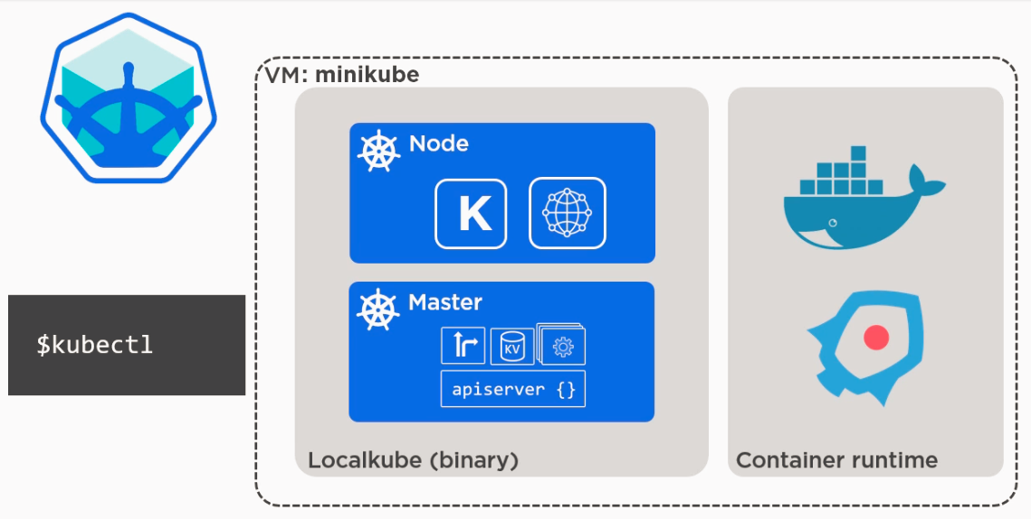
Minikube, VirtualBox and kubectl
Explain “why minikube?” and what the options are – kubespray/kubeadm etc
Say what we’re going to do: setup
Virtual Box
kubectl
Minikube

Slide 12
My First Cluster
JP to explain what we are about to do
Then Don start demo and JP talk through it
(switch to other slideshow just for us)

Slide 13
Hello (k8s) World
JP to explain what we are about to do
Then Don start demo and JP talk through it
(switch to other slideshow just for us)

Slide 14
Sailing on… with Helm and Tiller

Slide 15
Adding Helm and Tiller
JP to explain what we are about to do
Then Don start demo and JP talk through it
(switch to other slideshow just for us)

Slide 16
Helm Charts
JP to explain what we are about to do
Then Don start demo and JP talk through it
(switch to other slideshow just for us)

Slide 17
Summary of all the things

Slide 18
What did we do?
Summarise all the things – add diagrams if needed?
Explain things, mention website and meetup and github etc

Slide 19
Next steps

