Slide 1
Deploying Openshift to AWS with Terraform and Ansible
http://www.AutomatedITSolutions.com
John Pikoulas | john@automateditsolutions.com
Donald Simpson | don@automateditsolutions.com
Raju Uppalapati | raju@automateditsolutions.com
Liam Lavelle | liam@automateditsolutions.com

Slide 2
Up and running with Openshift on AWS
Welcome, from Automated IT Solutions!
Up and running with Openshift on AWS using Ansible and Terraform.
WIFI:
Git repo: https://github.com/AutomatedIT/terraform-aws-openshift
Create an AWS account if you want to follow along: https://aws.amazon.com/free

Slide 3
Up and running with Openshift on AWS
What we’ll cover...
Provisioning of Openshift infrastructure on AWS using Hashicorp Terraform.
Deploying Openshift to the infrastructure using Ansible.
Production ready Openshift cluster it isn’t.
There is a lot to get through.
Credits, further reading and resources.

Slide 4
Up and running with Openshift on AWS
Terraform in a nutshell...
A tool for building, changing and versioning infrastructure.
Provision using service providers like AWS, Azure…
‘Infrastructure as code’ so it can be versioned, shared and reused.
Provides execution plan.
Builds a resource graph.
Makes change automation simpler.

Slide 5
Up and running with Openshift on AWS
Ansible in a nutshell...
Push based configuration management tool
Similar to Puppet, Chef etc
Declarative
No plugins or agents installed on the hosts
Ansible playbooks are the main scripts (written in YAML)
Based on the playbooks Ansible generates python scripts

Slide 6
Up and running with Openshift on AWS
AWS in a nutshell...
Comprehensive, evolving cloud computing platform from AWS
Mix of IaaS, PaaS and SaaS
Compute, storage, databases, networking, dev tools and app services.
Elastic/scalable
Pay-as-you go pricing model.

Slide 7
Up and running with Openshift on AWS
Openshift in a nutshell...
PaaS
IDE integration/build and deploy containers
Runs the Kubernetes orchestration platform
Auto-scaling

Slide 8
Up and running with Openshift on AWS
What you’ll need if you want to follow along...
Tested on Ubuntu
Laptop
AWS account
Access to the internet
Some £££/$$$
Notes:
You'll be paying for:
1 x m4.xlarge instance
2 x t2.large instances

Slide 9
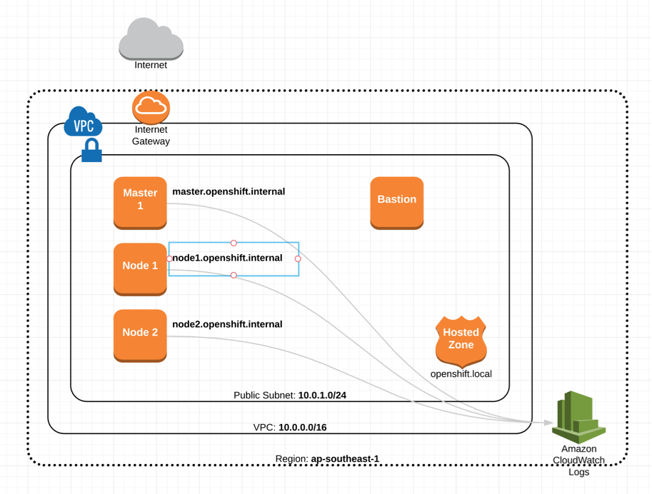
Up and running with Openshift on AWS
Terraform/AWS infrastructure for Openshift...

Slide 10
Up and running with Openshift on AWS
Terraform/AWS infrastructure for Openshift...cont
1. A network.
2. A public subnet, with internet access via a gateway.
3. A master host, which will run the Openshift master.
4. A node host, which will run Openshift nodes.
5. A hosted zone, which allows us to configure DNS.
6. A bastion to access the hosts without directly exposing them.
7. Basic log aggregation with Cloudwatch.

Slide 11
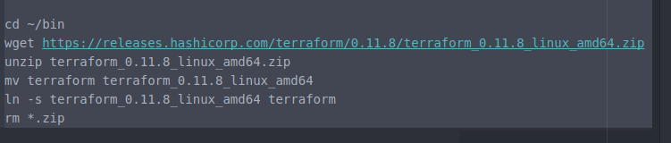
Up and running with Openshift on AWS
Installing Terraform…
https://github.com/AutomatedIT/terraform-aws-openshift/blob/master/TERRAFORM_INSTALL.MD

Slide 12

Up and running with Openshift on AWS
Installing Terraform…cont
Check its working

Slide 13
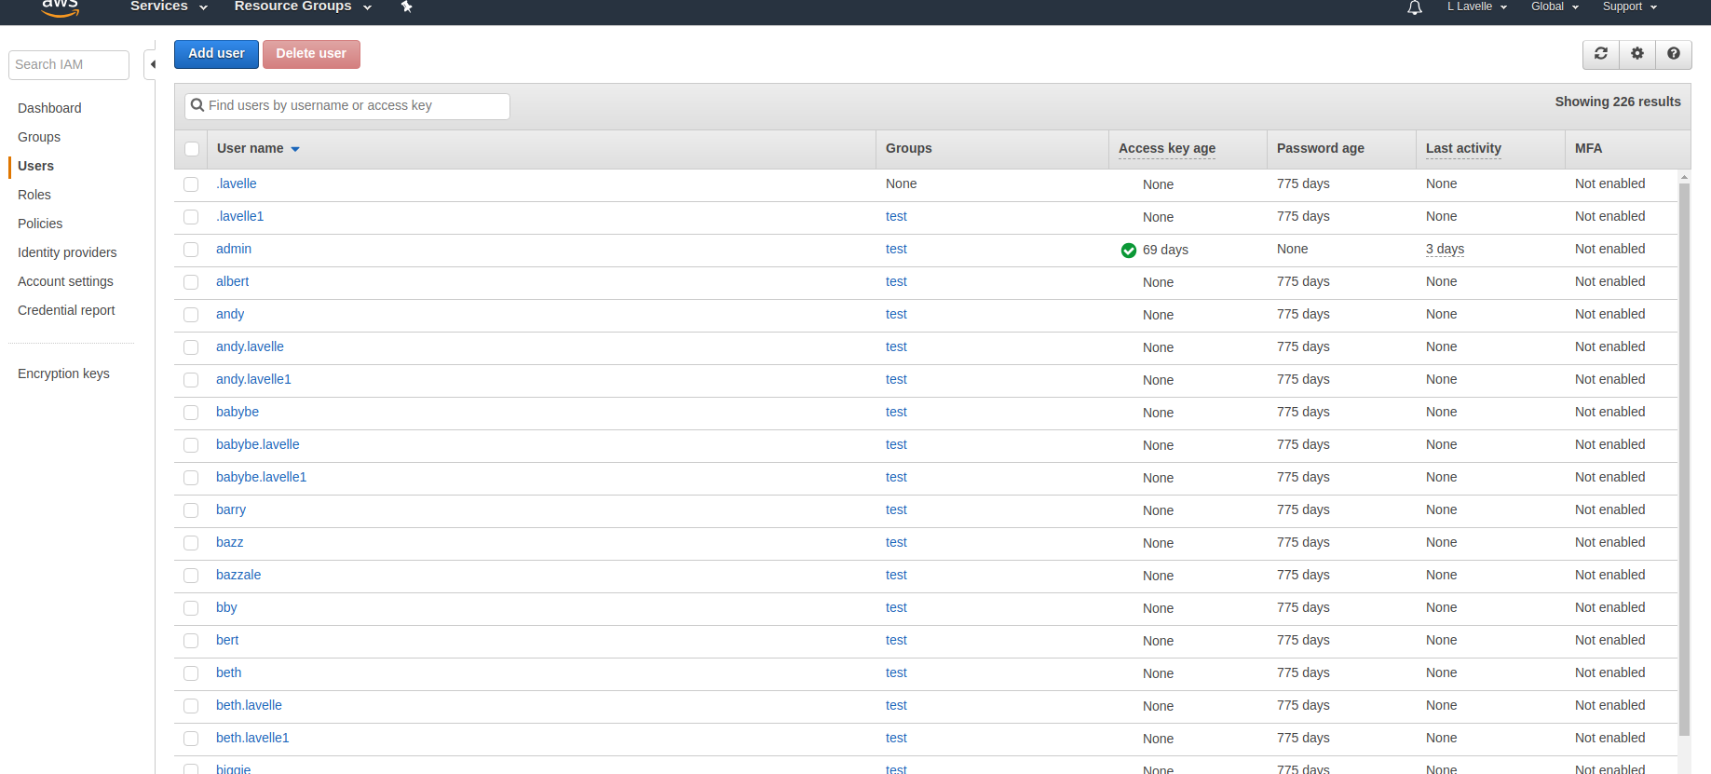
Up and running with Openshift on AWS
Configuring AWS credentials…

Slide 14
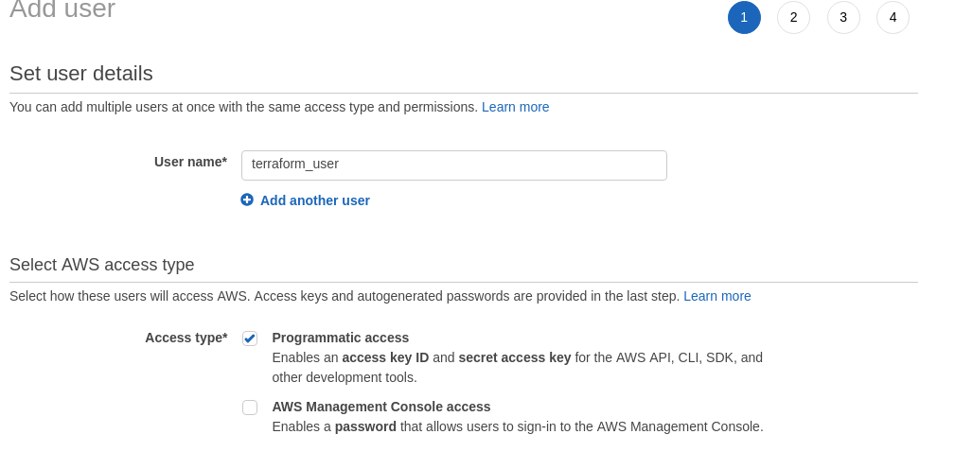
Up and running with Openshift on AWS
Configuring AWS credentials…cont.

Slide 15
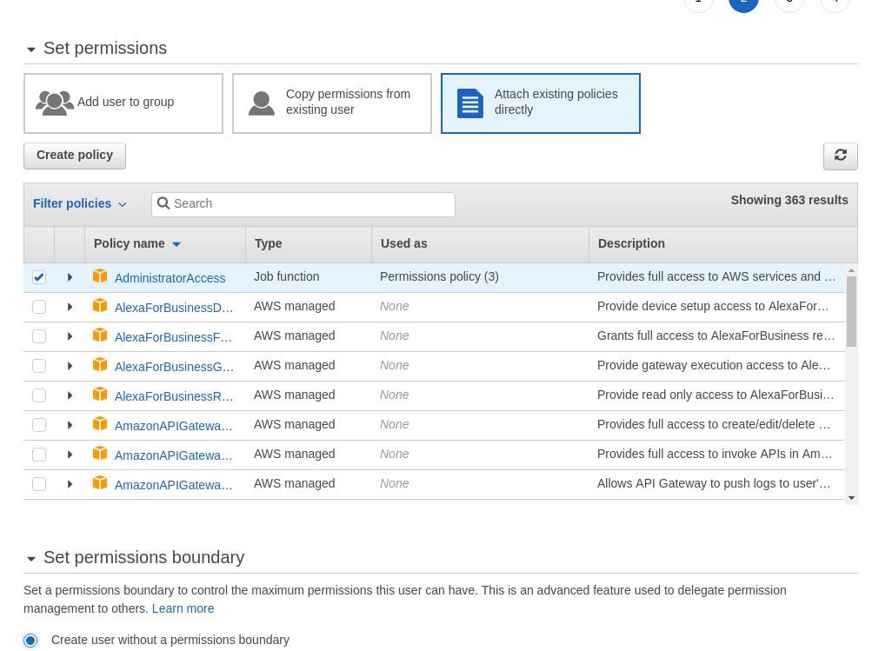
Up and running with Openshift on AWS
Configuring AWS credentials…cont

Slide 16
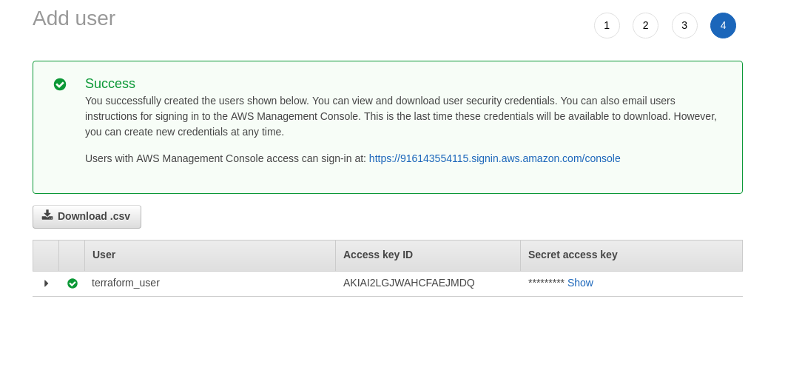
Up and running with Openshift on AWS
Configuring AWS credentials…cont.

Slide 17
Up and running with Openshift on AWS
Configuring AWS credentials…cont
Install AWS CLI tool
Provides commands for interacting with AWS services
Gives direct access to the AWS services public APIs

Slide 18

Up and running with Openshift on AWS
Configuring AWS credentials…cont.
Notes:
There are other ways to configure credentails:
https://www.terraform.io/docs/providers/aws/
Check the main.tf

Slide 19
Up and running with Openshift on AWS
Run Terraform
https://github.com/AutomatedIT/terraform-aws-openshift/
cd to that repo
Run the makefile command:

Slide 20

Up and running with Openshift on AWS

Slide 21
Up and running with Openshift on AWS
Deploy Openshift using Ansible
It takes ~=20min
Run the makefile command
Notes:
.

Slide 22
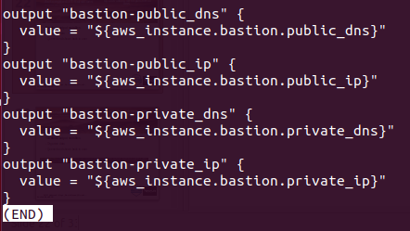
Up and running with Openshift on AWS
Terraform output variables
Organise data
Queried and shown back to user
modules/openshift/99-outputs.tf
Notes:
AWS resources have attributes
Declare variables based on AWS resource attributes.

Slide 23
Up and running with Openshift on AWS
Terraform output variables...cont
Can be used in scripts etc.
Notes:
Show example in script / and or command line

Slide 24
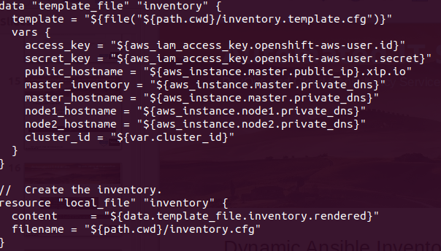
Up and running with Openshift on AWS
Dynamic Ansible Inventory file…modules/openshift/09-inventory.tf

Slide 25
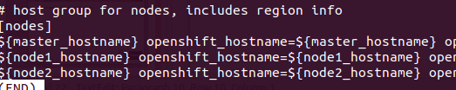
Up and running with Openshift on AWS
Dynamic Ansible Inventory file…inventory.template.cfg

Slide 26
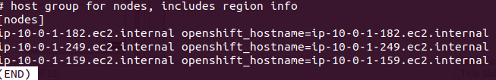
Up and running with Openshift on AWS
Dynamic Ansible Inventory file...inventory.cfg

Slide 27
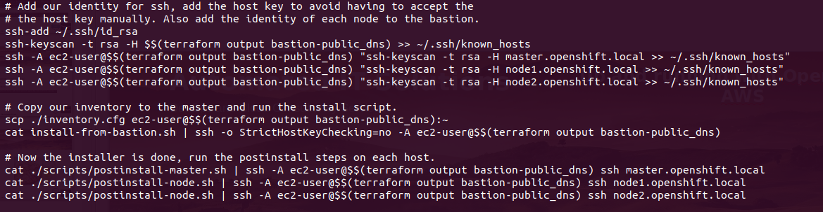
Up and running with Openshift on AWS
Installing Openshift…makefile

Slide 28
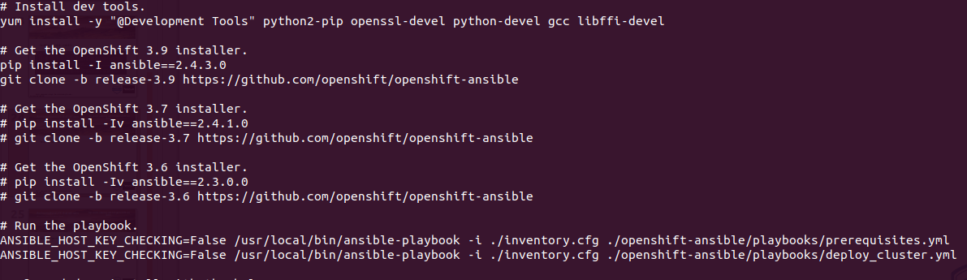
Up and running with Openshift on AWS
Installing Openshift…install-from-bastion.sh

Slide 29
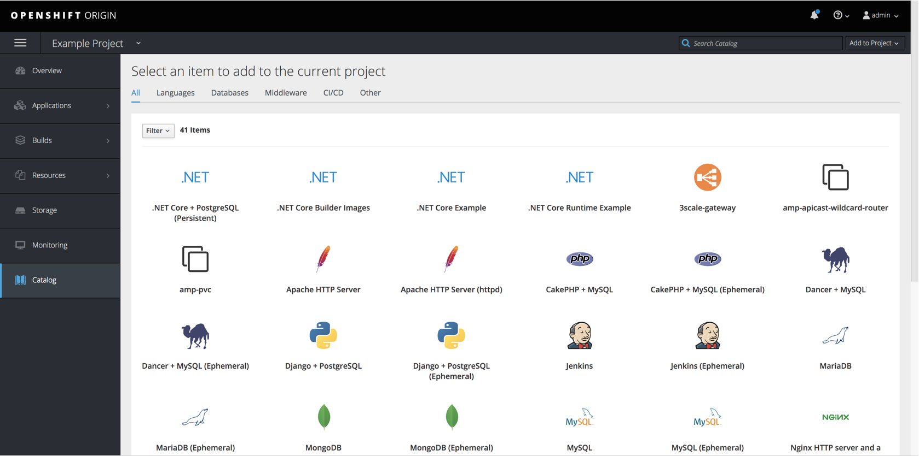
Up and running with Openshift on AWS
Installing Openshift...cont.
Notes:
Perhaps login to master and run some commands
Add admin to admin group
oadm policy add-cluster-role-to-user cluster-admin

Slide 30
Up and running with Openshift on AWS
Credits
David Kerr
https://github.com/dwmkerr/terraform-aws-openshift

Slide 31
Up and running with Openshift on AWS
References
Ansible: https://docs.ansible.com/
AWS: https://docs.aws.amazon.com/index.html#lang/en_us
Openshift: https://docs.openshift.com/
Terraform: https://www.terraform.io/docs/index.html

Slide 32
Up and running with Openshift on AWS
Thanks and good night!
Feedback is appreciated.
https://www.meetup.com/Automated-IT-Solutions/events/255291757/
Slides will be available on the website.
http://www.automateditsolutions.com
Thanks to Hays, Sponsors and Automated IT Solutions.

