Slide 1
Introduction to Vagrant
Agenda:
  Part I: Introduction to Vagrant
    What is Vagrant?
    Create an Ubuntu server in 3 easy steps
    Interacting with Vagrant - the CLI
    A look at the Vagrantfile
    Vagrant provisioners
    Vagrant providers
  Part II: Installing Vagrant
  Part III: Creating a repeatable LAMP stack from scratch

Slide 2

Who we are
Hays IT
  Lee Varga - lee.varga@hays.com
Automated IT Solutions
http://www.automateditsolutions.com
  Adam Cheney - adam@automateditsolutions.com
  John Pikoulas - john@automateditsolutions.com
  Raju Uppalapati - raju@automateditsolutions.com
  Donald Simpson - don@automateditsolutions.com

Slide 3

What is Vagrant?
Build environments consistently
Share environments easily
Version-control environments
Notes:
- Vagrant is
- automation tool with domain-specific language
- automates creation of VMs and environments
- large number of providers
- modular framework for working with virtual machines
- build and manage VMs in single workflow
- build environments with tools and dependencies consistently and quickly
- environments become disposable
- can be reproduced on any host machine supporting virtualisation
- version-control machine specifications
- cross-OS platform tool
- handles networking automatically
- dispels “it works on my machine…”
- development and test environments can be consistent
- match production environments
- can easily share
- Vagrantfile describes machines
- includes configuration and provisioning
- named ‘Vagrantfiles’ because literal filename
- complete description
- developers can:
- check out Vagrantfile
- ‘vagrant up’
- environment ready in seconds

Slide 4

Vagrant & Docker
Notes:
- not really fair comparison
- some overlap
- play well together
- Vagrant launches things to run apps and services for development
- can be on:
- VirtualBox
- VMWare
- remote services like AWS
- could easily run containers
- Vagrant really doesn't care
- it embraces that
- can use Vagrant and Docker together
- Docker one of possible providers for Vagrant
- also provisioner for Vagrant
- Vagrant can:
- launch Docker from images or Dockerfiles
- automatically install Docker
- configure containers to run on VM boot

Slide 5
Create an Ubuntu server
Notes:
- download base box:
`vagrant box add ubuntu/xenial64`
- not strictly required
- will be executed automatically if not already pulled
- create the Vagrantfile:
`vagrant init ubuntu/xenial64`
- most trivial Vagrantfile possible:
- ruby headers
- top level configuration
- box definition
- nothing else (other than comments)
- start VM:
`vagrant up`
- new VM up and running
- to jump on:
`vagrant ssh`

Slide 6
Vagrant CLI
Notes:
- almost all interaction through CLI
- no GUI
- three most important :
- `vagrant box add`
- `vagrant init`
- `vagrant up`
- documentation available at vagrantup.com.

Slide 7
Vagrant commands
vagrant box
add
list
remove
repackage
update
Notes:
- manage boxes
- functionality exposed through subcommands
- `vagrant box add`
- makes box at given address available locally
- looks on Vagrant Cloud by default
- `vagrant box list`
- shows local boxes
- `vagrant box remove`
- removes local box
- `vagrant box repackage`
- opposite of `vagrant box add`
- takes local box and packages
- `vagrant box update`
- brings to latest version.

Slide 8
Vagrant commands
vagrant up
vagrant halt
vagrant suspend
vagrant reload
vagrant destroy
vagrant ssh
Notes:
-allow you to control state of VM
- `vagrant up`
- starts VM from Vagrantfile
- `vagrant halt`
- stops VM
- tries to bring down gracefully
- ACPI shutdown
- if it can't or `--force` flag will just power off
- `vagrant suspend`
- halt VM without shutting it down
- `vagrant reload`
- used for changes to Vagrantfile
- effectively `vagrant halt` followed by `vagrant up`
- `vagrant destroy`
- stop running machine and delete all resources
- `vagrant ssh`
- ssh to running machine as 'vagrant'

Slide 9
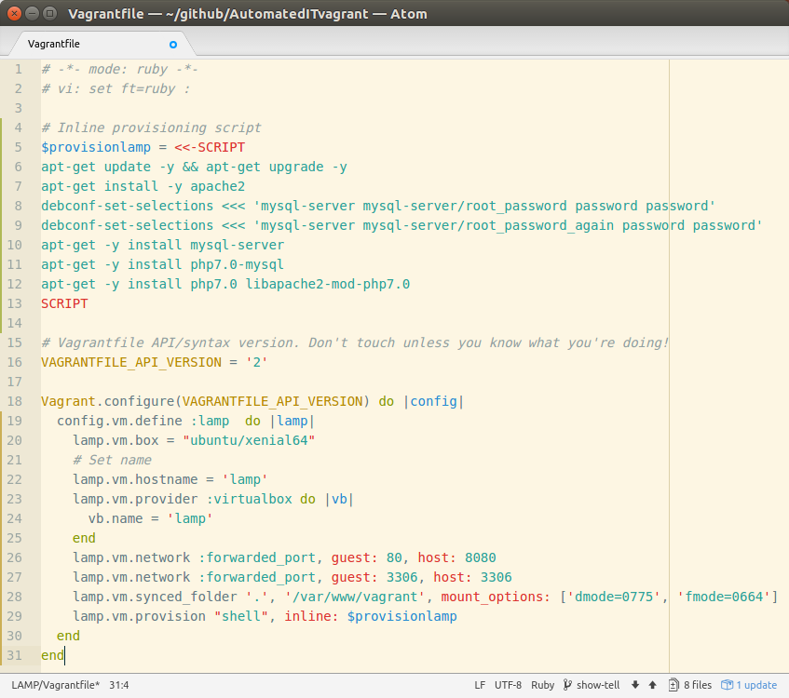
Vagrantfile
Main Vagrant configuration block
Notes:
- Vagrantfiles written in Ruby
- full power of that language
- one-to-one relationship with project
- committed to source-control
- developers can pick up and run `vagrant up` to start identical VM
- can define whole cluster in a single Vagrantfile
- each box individual configurations
- even base them on completely different base boxes
- only 2 supported versions for configuration block:
- "1" for Vagrant 1.0.x;
- "2" for Vagrant 1.1 up to 2.0.x
- can mix and match in single Vagrantfile only in separate `Vagrant.configure` blocks

Slide 10
Vagrantfile
Machine settings
Notes:
- `config.vm` settings define configuration of the virtual machine
- lots of settings that are useful
- a few of the more important ones:
- `config.vm.box`:
- specifies starting vagrant box
- `config.vm.hostname`:
- sets guest hostname
- `config.vm.define`:
- multiple machine environments
- defines namespace per machine

Slide 11
Vagrantfile
Network settings
Notes:
- `config.vm.network`
- forwarded ports
- TCP traffic by default
- can allow UDP
- can specify address for host side
- private networks
- only talk to host and other machine in same networks
- static IP or DHCP
- private networks never allow public access to machine
- public
- less private than private networks
- definition is fuzzy because different providers treat them slightly differently
- one area where there is inconsistency across providers
- publics networks might allow public access to machine so should be careful
- Vagrant boxes insecure by default and design
- use insecure keypairs for ssh access
- public passwords
- often allow root access over ssh
- box is potentially wide open
- bear in mind before using a public network

Slide 12
Vagrantfile
Synchronized folder
Notes:
- `config.vm.synced_folder`
- allows share of filesystem location between host and guest
- simple way of sharing resources between host and guest
- support for symbolic links across implementations and host/guest combinations not consistent
- test if important to workflow

Slide 13
Vagrantfile
Provider-specific settings
Notes:
- `config.vm.provider`
- allows modification of settings specific to provider
- well-behaved providers generally work with any Vagrantfile with sensible defaults
- individual providers often expose specific configurations
- portable as ignored if provider doesn't match

Slide 14
Vagrantfile
Host provisioning
Notes:
- `config.vm.provision`
- allow installtion of software
- altered configurations
- part of the `vagrant up` process
- can use `vagrant ssh` to install but not repeatable
- using provisioning allows `vagrant destroy` and `vagrant up` to reset machine
- sharing much easier

Slide 15
Vagrantfile
Ruby variable with inline shell script
Notes:
- provisioner here can use inline shell script
- ability to use Ruby functionality to extend Vagrantfile
- define inline provisioning shell script as variable
- pass variable straight to provisioning

Slide 16





Vagrant provisioners
Notes:
- inline shell script
- shell script file
- Ansible
- Docker
- Puppet
- Chef

Slide 17
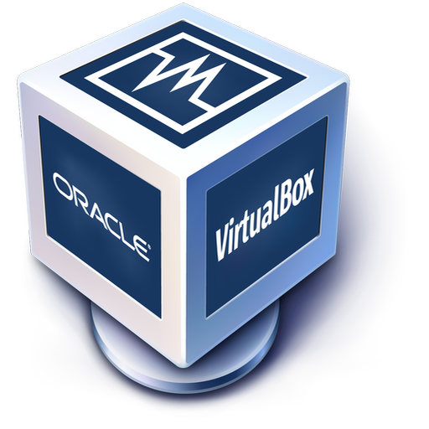






Vagrant providers
Notes:
- VirtualBox (the default)
- VMWare
- Kernel Virtual Machine (KVM)
- OpenStack
- Docker
- Amazon Web services
- Azure
- Google Cloud

