Slide 1

Stock Price Predictions from Earnings Calls
Artificially Intelligent Group:
Radhika Balasubramaniam, Chad Dubiel, Katy Fuentes, Pankaj Tahiliani
January 26, 2021

Slide 2
Overview of Models
TF-IDF and count vectorization
Classification
Logistic Regression
Latent Dirichlet Allocation (LDA)
VADER Sentiment Intensity Analyzer (SIA) polarity scoring
Hu Liu (HL) and Loughran McDonald (LM) word dictionaries
Linear Discriminant Analysis on sentiment scores and price
LSTM
GRU

Slide 3
Key Considerations
Is there a change in stock price after an earnings call?
Does an earnings call influence the stock price?
What is the call’s sentiment? What are common words/topics used across company earnings calls?
What is the price change for the stock before and after the call? Is there a trend or can you predict the change in price?

Slide 4
Data Sources
S&P 100/500 List-https://en.wikipedia.org/wiki/List_of_stock_exchanges
Earnings Calls Transcripts*-https://seekingalpha.com/earnings/earnings-call-transcripts
*The transcripts from Seeking Alpha are protected by copyright and cannot be used for commercial purposes. This is an educational project for the Data Visualization Program at Rice University and the use of the information should be permitted on the Copyright Fair Use principal.
Yahoo Finance Historical stock price- https://sg.finance.yahoo.com/

Slide 5
Process
Download S&P100 and then S&P500 list from Wikipedia
Scrape Seeking Alpha webpages for each company transcript with date, title, URL
Narrow list to only earning call transcript URLs
Scrape each Seeking Alpha webpage for the earnings call transcript and save to text file
Scrape Yahoo finance webpage by Stock symbol and download 2015 through 2020 stock price history
Read text files and preprocess text

Slide 6
TF-IDF and Count Vectorization
Extract the text in the prepared remarks section.
Question and answer section was excluded.
Preprocess the text.
Remove stop words and other noise.
Lemmatization.
Tokenize the text.
Sampled the dataset into train and test subsets.
Both a simple count vectorizer and TF-IDF vectorizer were fit to the training subset and then both the training and test texts were transformed into matrices.

Slide 7
Classification
Returns were calculated for difference in closing price 1 day, 7 days and 28 days later.
A rating of ‘buy’, ‘hold’, or ‘sell’ was then assigned for each of these returns.

Slide 8
Classification
Buy
Return > 3%
Hold
Return < 3% and > -3%
Sell
Return < -3%

Slide 9
Logistic Regression Model
Vectorized text from the training data set was fed as features to a logistic regression classification machine learning model with the ‘buy’, ‘hold’ and ‘sell’ labels.
The model was most accurate when using TF-IDF vectorization and considered returns the day following the earnings report.
Model was further optimized using grid search hyperparameter tuning with 5 fold cross-validation.
Accuracy Scores:
Vectorization | t+1 | t+7 | t+28
CountVectorizer() | 0.687737 | 0.467762 | 0.429836
TfidfVectorizer() | 0.768647 | 0.536030 | 0.426043

Slide 10
Sentiment Analysis
The 2020 S&P100 earnings calls transcripts were modified by the following processing steps:
• Removed numbers and punctuation
•Preprocessed text by cleaning up contractions, removing html, tokenizing words, lemmatized words, removed stop words, and minimum character words
• Removed infrequent words
Text was processed for the full transcript and prepared remarks to compare influence of question and answer sessions.

Slide 11
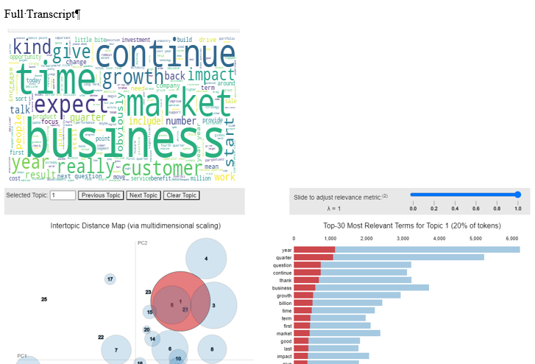
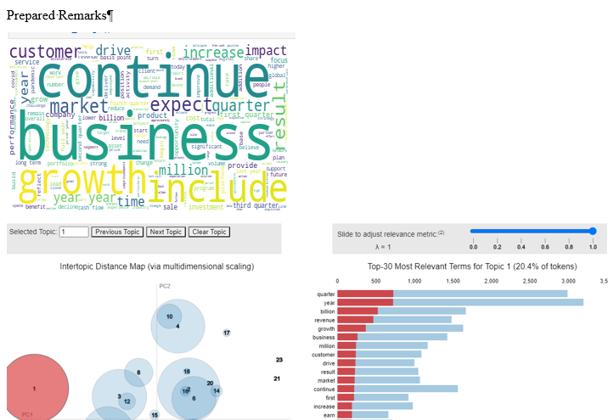
Latent Dirichlet Allocation (LDA)
Text/Words overlapped in the full transcript and prepared remarks, but the topic distribution varied significantly between the two.

Slide 12
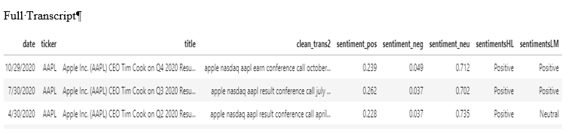
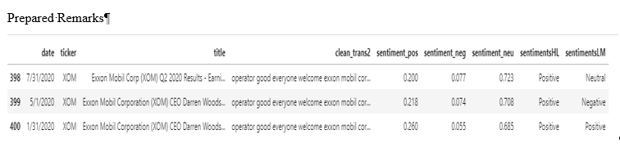
VADER Sentiment Intensity Analyzer (SIA) Polarity Scoring Hu Liu (HL) and Loughran McDonald (LM) word lists
Sentiment Totals | Using HL Dictionary | Using LM Dictionary
Positive | 255 | 374
Negative | 88 | 16
Neutral | 58 | 11

Slide 13
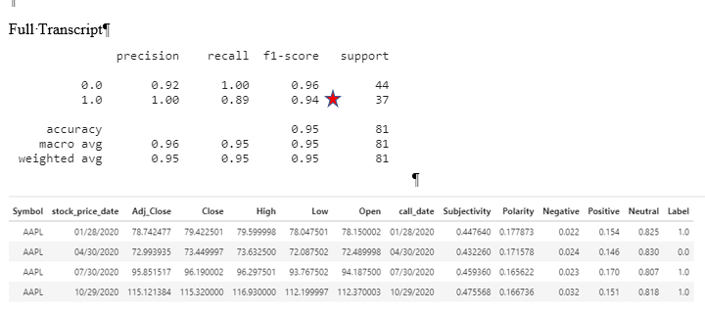
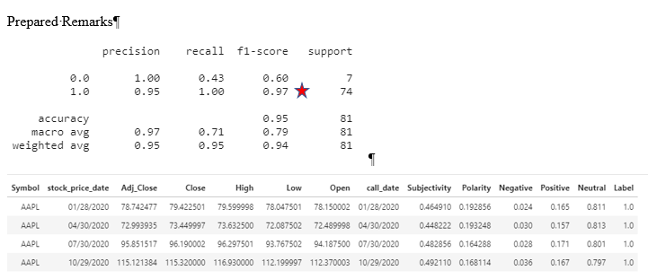
Linear Discriminant Analysis

Slide 14
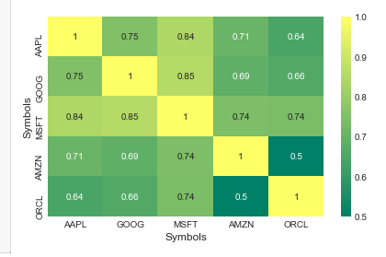
Price Forecast
Get the stock prices of the stocks for past 15 years
Identify the stocks to be included in the model.
Calculate SMA and EMA for the stocks
Calculate Percentage return for the stocks
Calculate risk matrix and remove the stocks that are outliers
Plot the stock expected returns and stock prices against each other
with pair grid and look for overlapping.
Calculate heat map with expected returns

Slide 15
LSTM Process
Prepare the date for the GRU
Shifted the data by lag of one day, 24 hours
Performed rolling with 60 rolling windows
Built the neural network for price forecasting
Four layers with 128 units, 1 dense layer.
Noise dropout – 0.5
Optimizer - rmsprop and loss is calculated as MSE
Fit the model with 10 epochs and 20 batch size

Slide 16
GRU Process
Prepare the date for the LSTM
Shifted the data by lag of one day, 24 hours
Performed rolling with 60 rolling windows
Built the neural network for price forecasting
Four layers with 128 units, 1 dense layer.
Noise dropout - 0.2
Optimizer - SGD and loss is calculated as MSE
Fit the model with 50 epochs and 150 batch size

Slide 17
Challenges
Large text files
Model run times

Slide 18
Next steps/uses…
Backtrack results
Predict trends
Predict price
Embed sentiment in model

Slide 19
Webpage Demo

Slide 20
Questions

