Slide 1
PANet (train+val): 0.708
YOLOv3: 0.6616
YOLOv3 (larger anchor size): 0.645

Slide 2
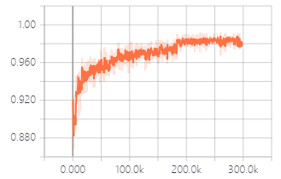
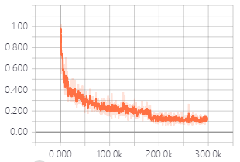
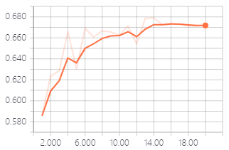
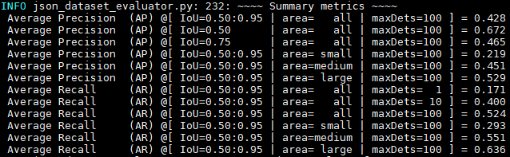
cls accuracy
loss
AP50 on val set
Evaluation result at epoch 20

Slide 3
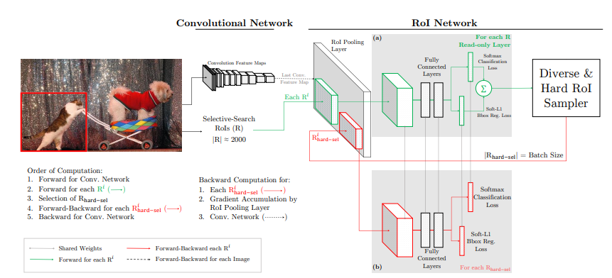
OHEM and Focal loss
Focal loss: 针对 one-stage detection algorithm，GitHub上的几个repo在测试时报错；并且有 issue 反应 focal loss 结果不稳定[1]，使用 focal loss 训练的模型结果 更差[2]
（Focal loss 对 YOLOv3不起作用，论文 “YOLOv3: An Incremental Improvement” 的第四节 “Things we tried that didn’t work” ）
[1] https://github.com/mkocabas/focal-loss-keras/issues/5
[2] https://forums.fast.ai/t/yolov3-dropped-map-points-with-focal-loss/14046/2
OHEM: 没有找到包含 OHEM 的 Mask R-CNN/PANet 实现，自己尝试实现有困难

Slide 4
To-dos:
继续尝试实现 OHEM
训练 RetinaNet (with focal loss)

