Slide 1
Part 1. Data prepossessing
Original dataset
Train + val: 1870 images
Augmented dataset (split, rotation, translation, flip, affine)
Train + val: 35678 images

Slide 2
Part 2. Results
修改网络参数（anchor size）
数据增强手段是否可以改进
考虑其他网络结构（Mask R-CNN，PANet）

Slide 3
Part 3. Paper: PANet
Liu, S. , Qi, L. , Qin, H. , Shi, J. , & Jia, J. . (2018). Path aggregation network for instance segmentation. Proceedings of IEEE Conference on Computer Vision and Pattern Recognition (CVPR)
1st place of COCO Instance Segmentation Challenge 2017 ,
2nd place of COCO Detection Challenge 2017,
1st place of 2018 Scene Understanding Challenge for Autonomous Navigation in Unstructured Environments

Slide 4
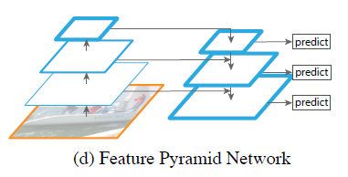
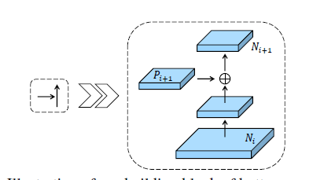
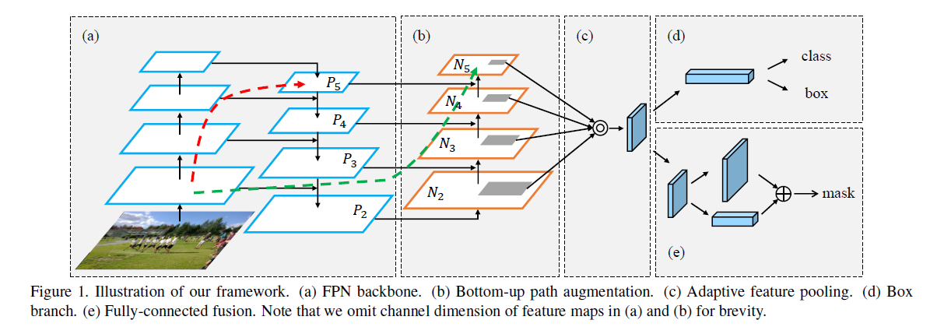
Part 3. Paper: PANet
Liu, S. , Qi, L. , Qin, H. , Shi, J. , & Jia, J. . (2018). Path aggregation network for instance segmentation. Proceedings of IEEE Conference on Computer Vision and Pattern Recognition (CVPR)

Slide 5
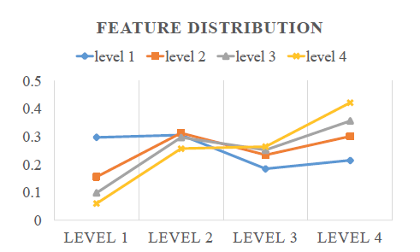
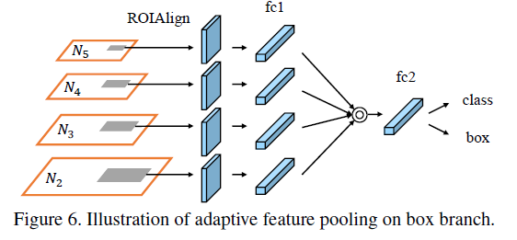
Part 3. Paper: PANet
Main contributions: bottom-up path augmentation, adaptive feature pooling

Slide 6
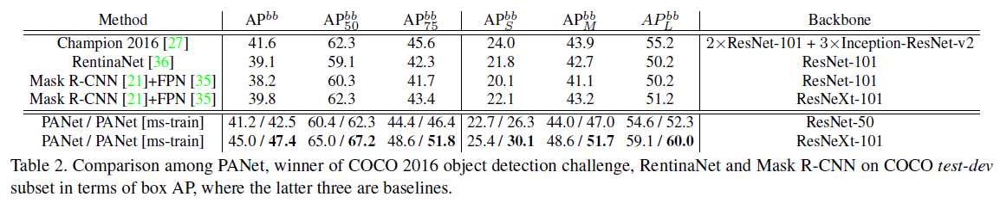
Part 3. Paper: PANet
Result on detection task

