Slide 1
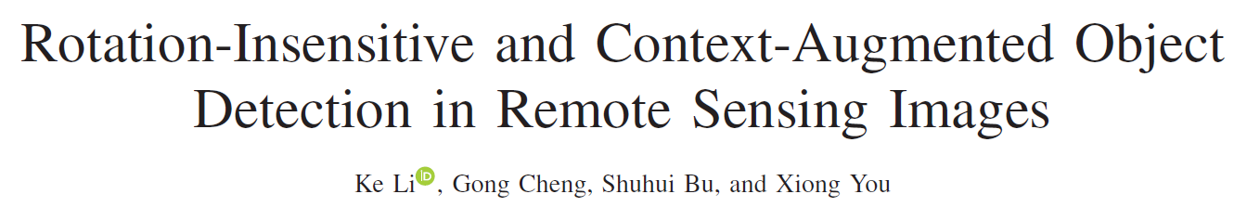
Region proposal network
Feature fusion network
Classification and object localization
Li, Ke, et al. "Rotation-Insensitive and Context-Augmented Object Detection in Remote Sensing Images." IEEE Transactions on Geoscience & Remote Sensing PP.99(2017):1-12.

Slide 2
Experiments (YOLO)
Baseline (YOLO v2):
Batches: 450k
YOLO v2:
Batches: 200k, dataset: 1024x1024 split (1x)
YOLO v3:
Batches: 10k, dataset: 1024x1024 split (1x)
YOLO v3:
Batches: 3k, dataset: 1024x1024 split (1x, 2x), neg: mostly dropped
Total 47746 split images (1024x1024), neg 6713

Slide 3
 | baseline | v2_20k | v3_10k | v3_3k
Plane | 78.72 | 47.76 | 43.2 | 75.25
BD | 39.11 | 0 | 12.14 | 13.4
Bridge | 22.64 | 0 | 5.74 | 17.46
GTF | 34.71 | 0 | 9.57 | 14.91
SV | 32.26 | 14.63 | 52.98 | 64.08
LV | 23.12 | 15.87 | 35.19 | 55.05
Ship | 49.53 | 13.81 | 52.11 | 69.29
TC | 76.15 | 0.04 | 63.69 | 83.04
BC | 43.53 | 0 | 10.63 | 46.16
ST | 36.6 | 12.11 | 24.42 | 49.67
SBF | 23.93 | 0 | 9.31 | 12.93
RA | 43.88 | 0 | 17.94 | 18.73
Harbor | 40.99 | 6.88 | 18.39 | 35.94
SP | 40.53 | 12.64 | 33.22 | 33.49
HC | 4.69 | 0.02 | 0 | 0.98
mAP | 39.36 | 8.25 | 25.9 | 39.36

Slide 4
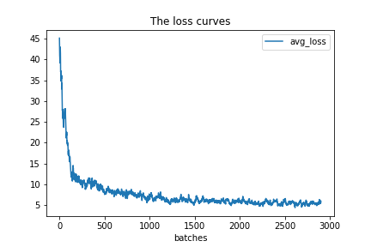
Loss (v3_3k)

Slide 5
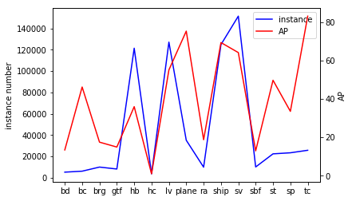
Problem
Cat. | bd | bc | brg | gtf | hb | hc | lv | plane | ra | ship | sv | sbf | st | sp | tc
num. | 5k | 6k | 10k | 8k | 121k | 4k | 127k | 35k | 10k | 125k | 152k | 10k | 22k | 23k | 26k
Problem: imbalance of the number of instance among different categories
To-do: augmentation for specific categories.

Slide 6
To-do
YOLO v3 算法中默认anchors设置为9个，
(10, 13) (16, 30) (33, 23)
(30, 61) (62, 45) (59, 119)
(116, 90) (156, 198) (373, 326)
尺寸小的anchors检测较小的物体，尺寸较大的anchors检测较大的物体
数据集中的物体都相对较小，考虑增加小尺寸的anchors（对数据集的label聚类分析），可能会对检测结果又帮助
YOLO v3 与 v2相比检测精度更高，对小目标识别更加准确，但边界框预测存在误差，可能对小目标的检测影响较大
可以尝试不同的算法：
Faster R-CNN w/ ResNet or FPN
Mask R-CNN
He, K., et al. "Mask R-CNN. " IEEE Transactions on Pattern Analysis & Machine Intelligence PP.99(2017):1-1.

