Slide 1
论文：Fully Convolutional Networks for Semantic Segmentation U-Net: Convolutional Networks for Biomedical Image Segmentation
李自强 2018/11/1

Slide 2
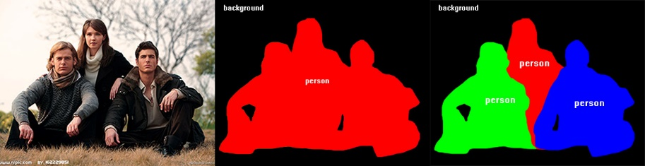
FCN(Fully Convolutional Networks)
Task
pixelwise classification
Original image
semantic segmentation
instance segmentation

Slide 3
FCN(Fully Convolutional Networks)
传统方法
机器学习方法：像素级的决策树分类
TextonForest、Random Forest based classifiers
深度学习方法：patchwise、pixelwise

Slide 4
FCN(Fully Convolutional Networks)
patchwise
逐像素地抽取周围像素对中心像素进行分类
问题:（1）存储开销大
（2）计算效率低下
（3）patch大小的选择
慢，重复计算，定位精度和上下文信息不可兼顾

Slide 5
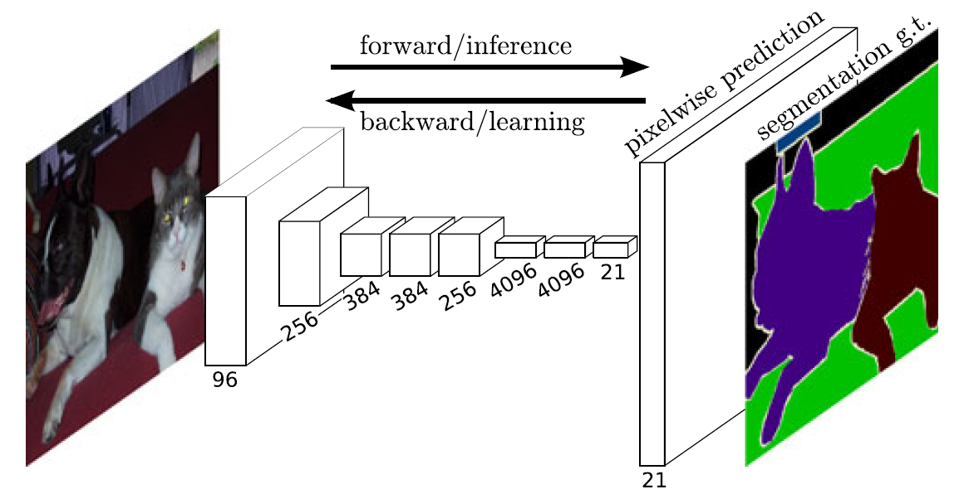
FCN(Fully Convolutional Networks)
pixelwise

Slide 6
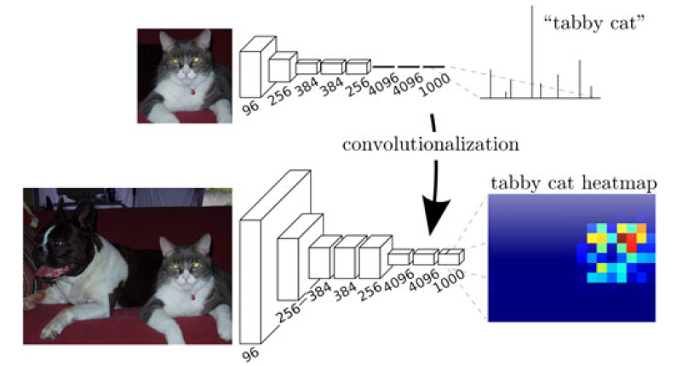
FCN(Fully Convolutional Networks)
Fully Convolution
主干网络：AlexNet、VGG16、GoogLeNet

Slide 7
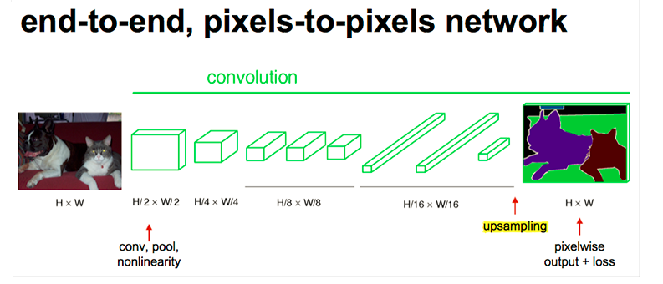
FCN(Fully Convolutional Networks)
Fully connected layer → convolutional layer
全连接层：输入维度固定，丢失像素空间信息
7*7*512 input → 4096
Filter: F=7, P=0, S=1, K=4096（卷积层实现全连接层）
7*7*512 input → 1*1*4096

Slide 8
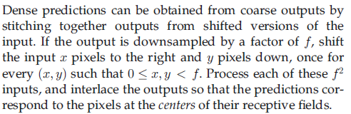
FCN(Fully Convolutional Networks)
Dense predications
1) Shift-and-Stitch
设降采样因子是f , 通过 shift pixels（平移像素）的方式，产生 f^2个version 的 input ，输入网络后相应地产生 f^2个output，然后 stitch(拼接)所有 output 就实现了 dense prediciton。

Slide 9
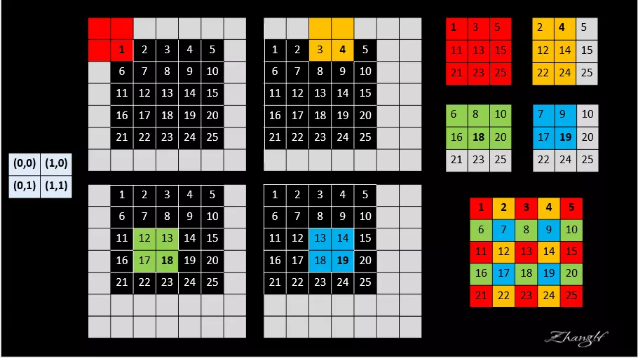
Shift-and-Stitch
网络：一层 maxpooling 2*2，f=2

Slide 10
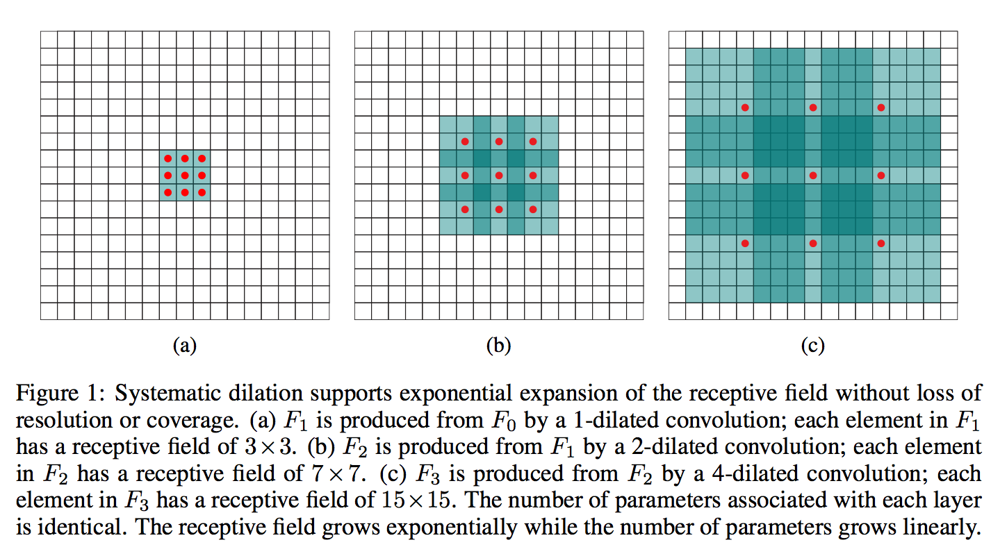

FCN(Fully Convolutional Networks)
Dense predications
2) Dilation Convolution
扩大卷积核，扩大感受野，避免下采样减少feature map大小
（即不使用pooling也可以保证感受野够大）

Slide 11
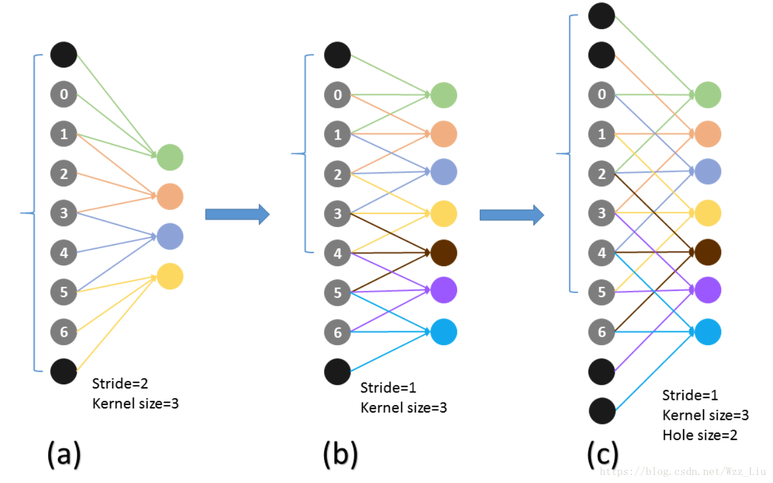
Dilation Convolution

Slide 12
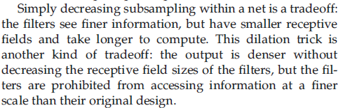
FCN(Fully Convolutional Networks)
Dense predications
存在问题

Slide 13
FCN(Fully Convolutional Networks)
Dense predications
3) deconvolution(Fractionally Strided)
反卷积得到相应大小feature map而不是转置的值

Slide 14
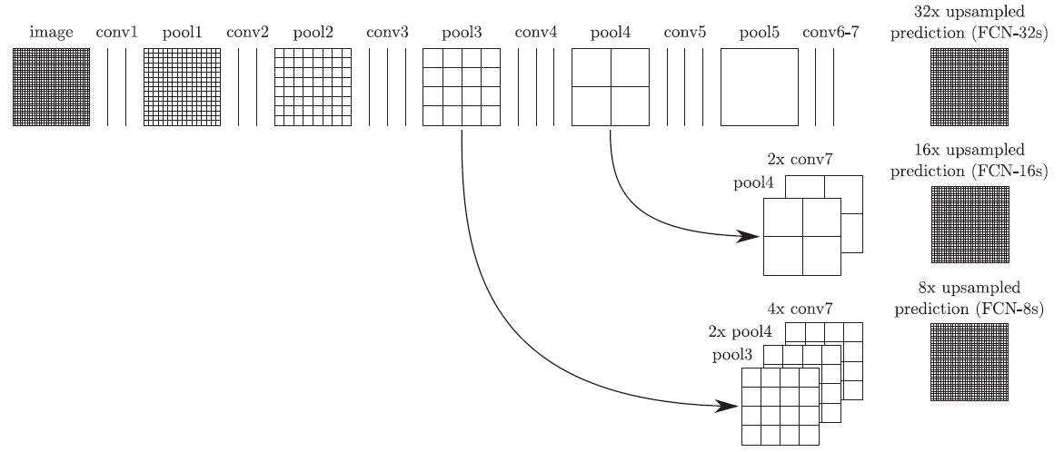
FCN(Fully Convolutional Networks)
Skip Architecture
Feature hierarchies:
shallower layers: localize、high resolution → where
deeper layers: global、semantic → what

Slide 15
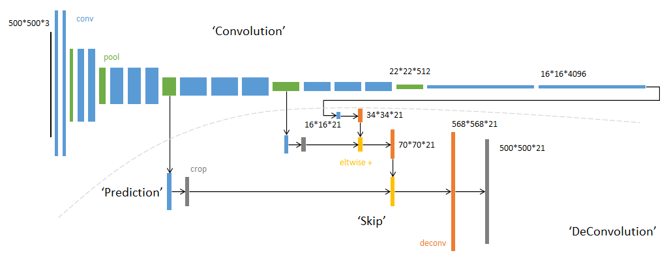
FCN(Fully Convolutional Networks)
Skip Architecture
Feature hierarchies:
shallower layers: localize、high resolution → where
deeper layers: global、semantic → what

Slide 16
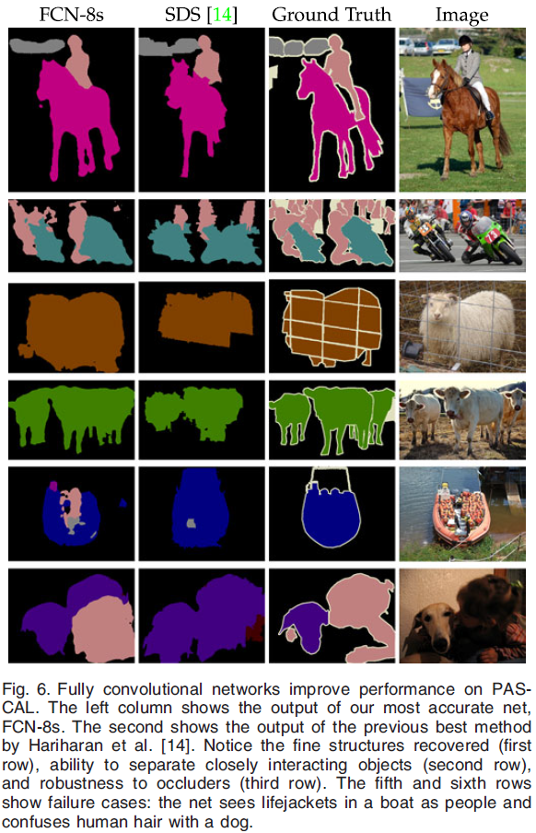

Slide 17
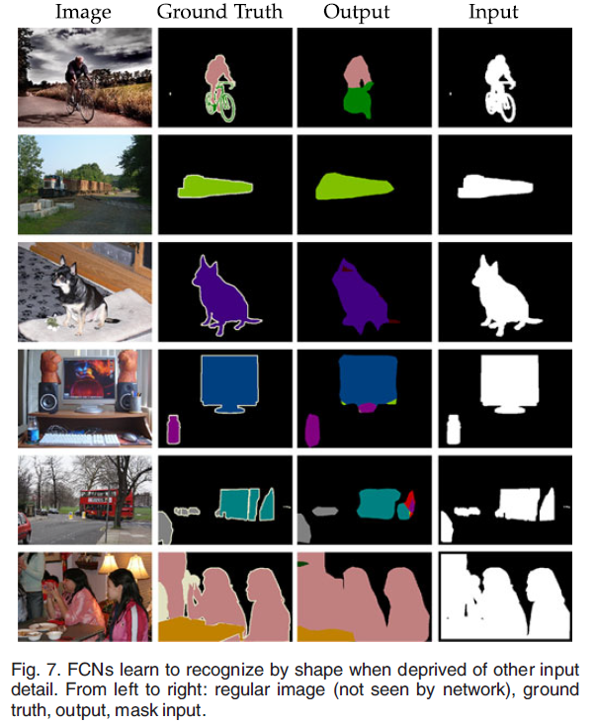
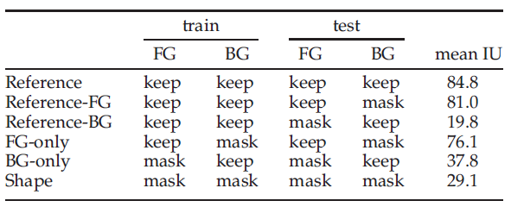

Slide 18
U-Net
Biomedical Image Segmentation
data augmentation
feature fusion
seamless segmentation
weight map

Slide 19
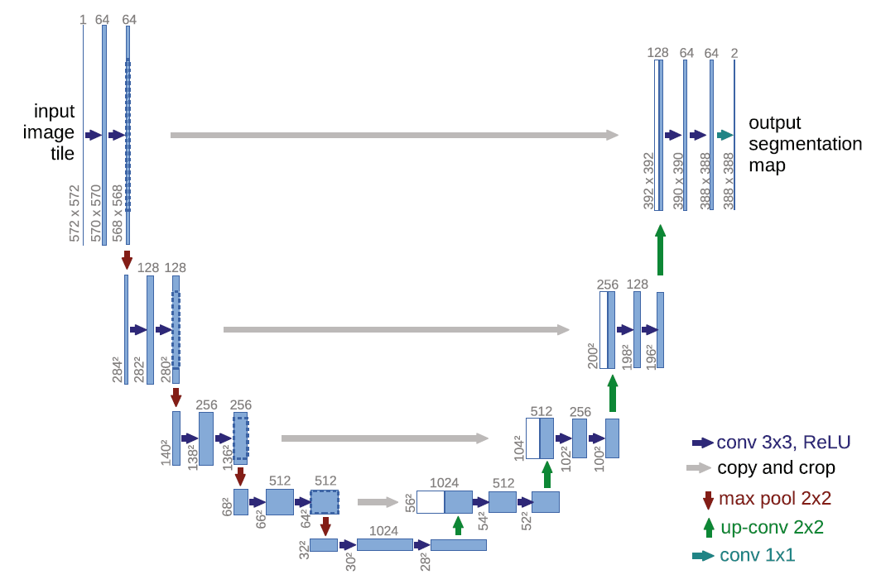
U-Net

Slide 20
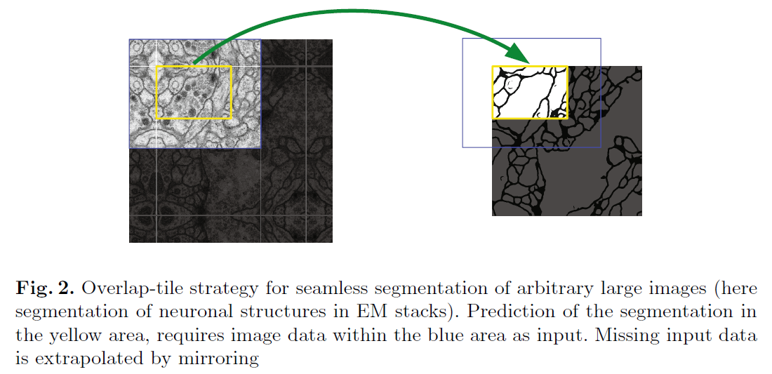
U-Net
seamless segmentation

Slide 21
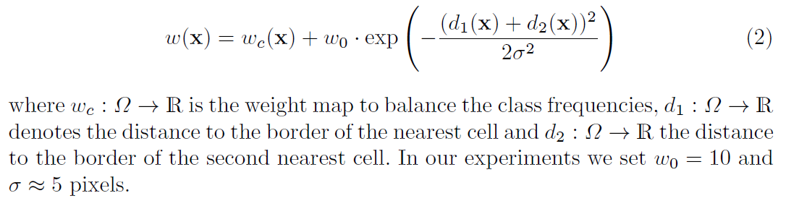
U-Net
weight map
作用：① 补偿训练数据集中不同类别的像素频率差别
② 强迫学习小的分离边界

Slide 22
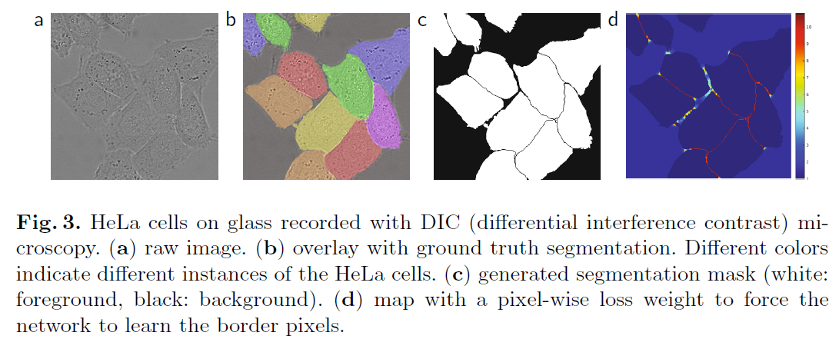
U-Net
weight map

Slide 23
U-Net
Data augmentation
shift
rotation
elastic deformation
drop out

