Slide 1
Density Map Generation
Most methods use a fixed gaussian kernel size in spite of the existence of adaptive generation methods

Slide 2
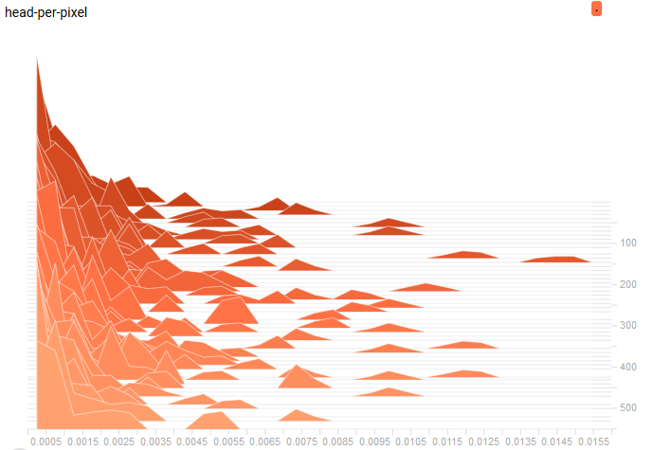
Sampling and Augmentation
Different image sizes
Set batch size to 1
Resize the images to a fixed size
Low dataset volume
Non-uniform density distribution
Random clip
Random horizontal flip

Slide 3
Sampling and Augmentation
Cross-dataset sampling
Random rotation (padding with 0)
Random horizontal flip
Random clip (by the minimum image size of one batch)
Random color (hue, saturation, contrast, brightness)
↓
Images batch with uniform size but varied perspectives and color

Slide 4
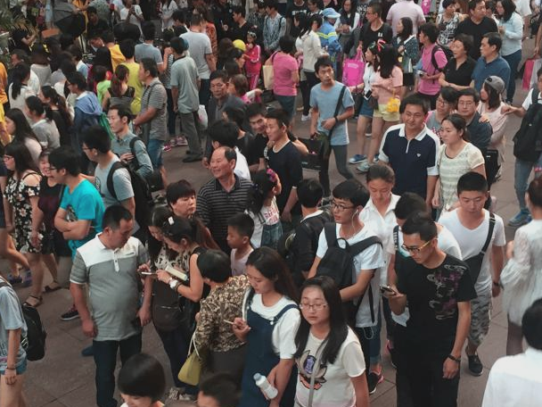
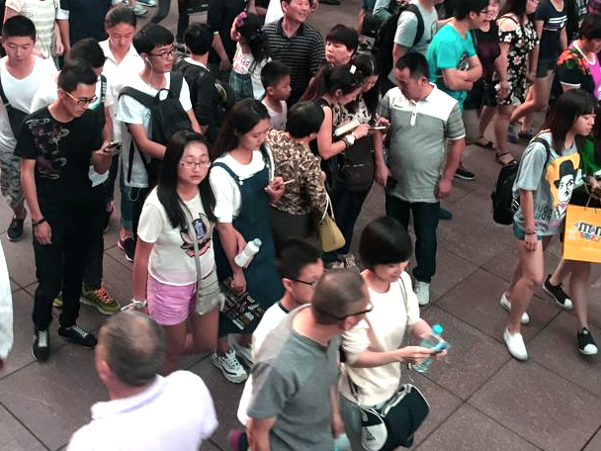
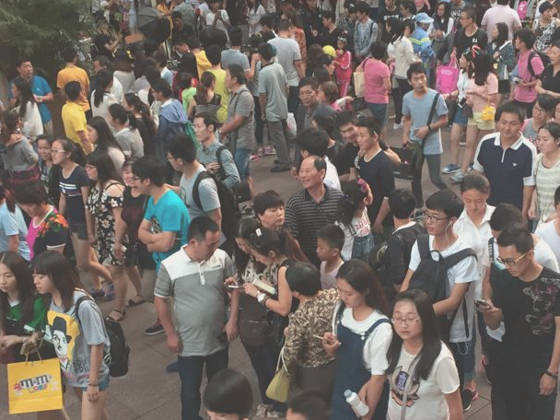
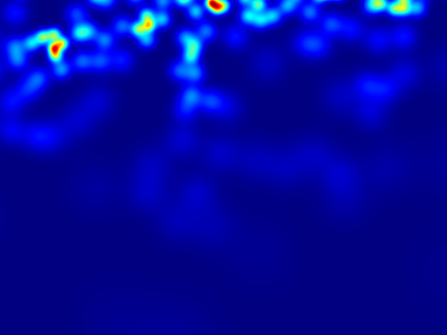
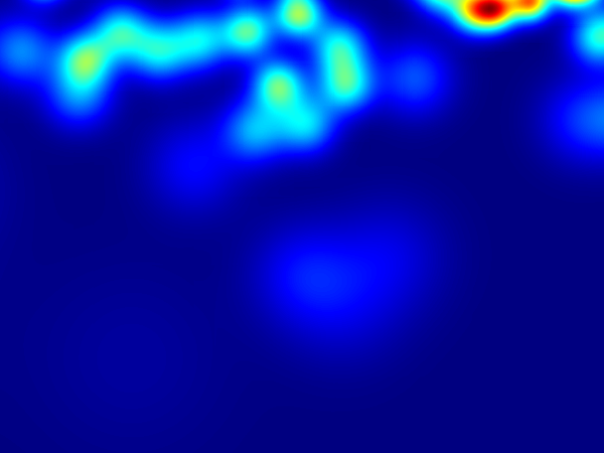
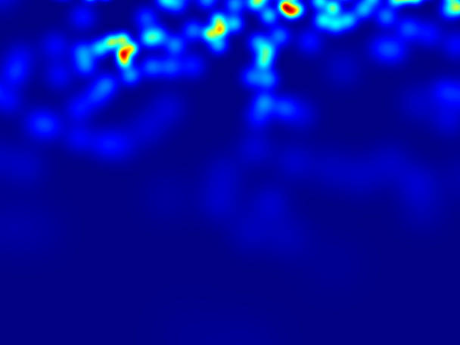
Sampling and Augmentation

Slide 5
Which Tensorflow Library to use?
tf.layers
tf.contrib
Wraps tf.layers
arg_scope dramatically boosts coding efficiency
Some methods may be unstable
tf.slim
Wraps part of tf.contrib
Has not been updated for years
Keras
The most convenient one
Lack of up-to-date methods

Slide 6
Re-implementing Methods
[MCNN] Multi-Column CNN
[SANet] Scale Aggregation Network
[DRSAN] Deep Recurrent Spatial-Aware Network
[CSRNet] Dilated Convolutional Neural Networks

Slide 7
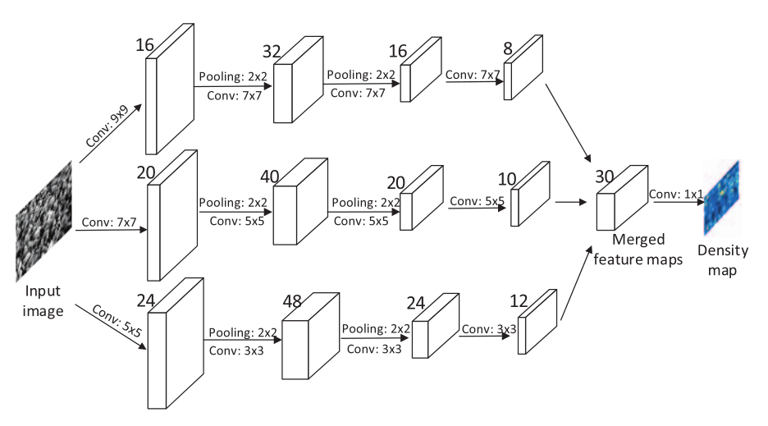
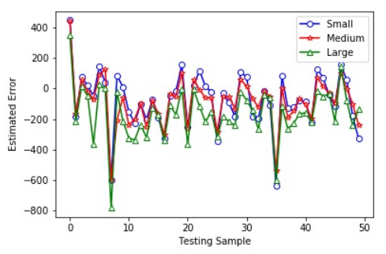
Multi-Column CNN
Different columns extract features from different scales
DOES NOT actually perform as the intuition suggests (Yuhong Li et al.)

Slide 8
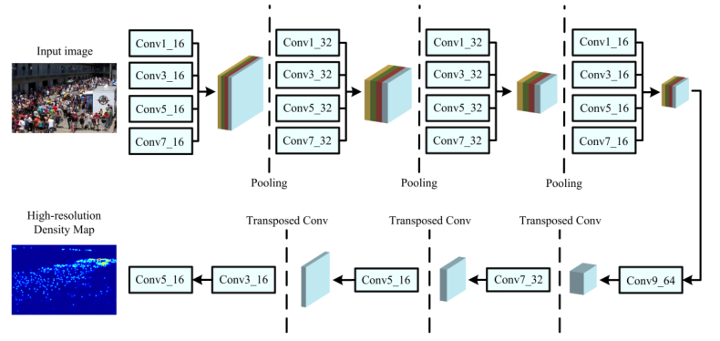
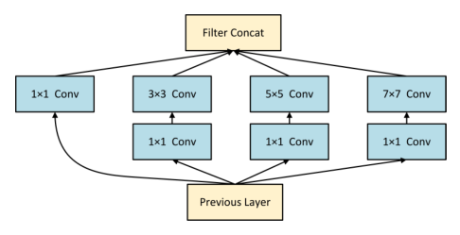
Scale Aggregation Network
Improves the multi-scale representation and generates high-resolution density maps
IN (Instance Normalization) instead of BN (Batch Normalization)
Local Pattern Consistency Loss: SSIM Loss

Slide 9

Scale Aggregation Network
BN:
IN: Normalize each image or feature map Independent of the others in the batch, said to perform better in generating tasks

Slide 10
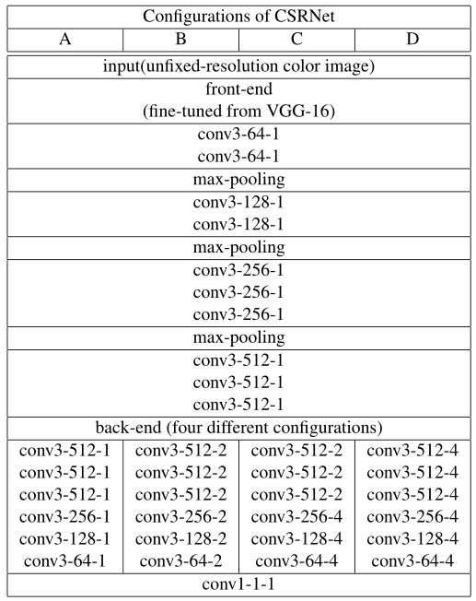
Dilated Convolutional Neural Networks
VGG Front-end:
strong transfer learning ability and its flexible architecture for easily concatenating
Dilated CNN Back-end :
Dilated convolutional layers have been demonstrated in segmentation tasks with significant improvement of accuracy and it is a good alternative of pooling layer.
Notes:
空洞卷积

Slide 11
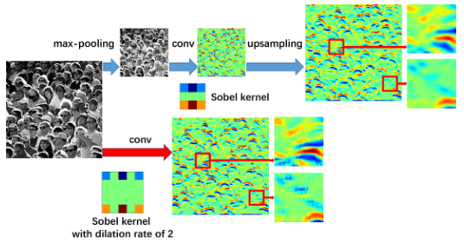
Dilated Convolutional Neural Networks
Comparison between Conv + Pool and Dilated Conv: Dilated Conv preserves more detailed information

Slide 12
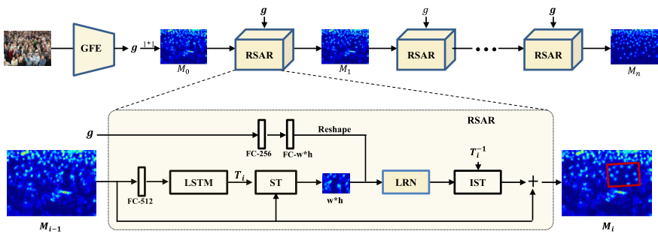
Deep Recurrent Spatial-Aware Network
Global Feature Embedding (GFE)
for global feature extraction
Recurrent Spatial-Aware Refinement (RSAR)
iteratively locates image regions with a spatial transformer-based attention mechanism and refine the attended density map region with residual learning

Slide 13
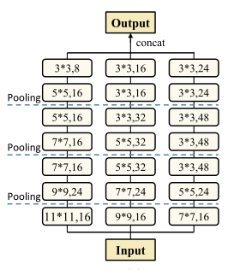
Global Feature Embedding (GFE)
Multi-column model generates the initial crowd density map M0

Slide 14
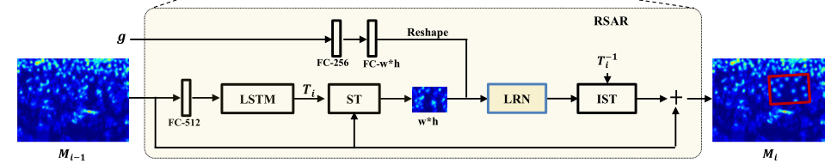
Recurrent Spatial-Aware Refinement (RSAR)
Attentional Region Localization
a Spatial Transformer Network dynamically locates an attentional region from the crowd density map
Region Density Map Refinement
a Local Refinement Network refines the density map of the selected region with residual learning

Slide 15

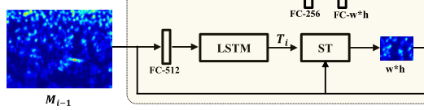
Attentional Region Localization
Ri
determine which image region to be refined with a spatial transformer network: an LSTM with fully-connected layers which yields a transformation matrix Ti of the spatial transformer
Ri = spatial_transform(Mi-1, Ti)

Slide 16
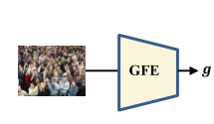

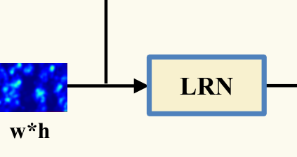
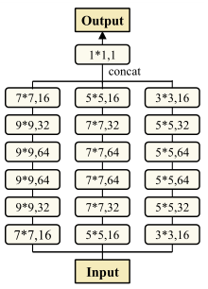
Region Density Map Refinement
cg
Ri
Residual Map
Encode the global feature g with two stacked fully-connected layers and construct the global context map cg by reshaping the output of the last FC layer to a new tensor with a size of w ∗ h
LRN performs crowd map refinement on the attentional region with a Local Refinement Network, which learns the residual between the region map ri and the ground truth of its corresponding region

Slide 17

Region Density Map Refinement
Get the new crowd density map Mi by adding the invers transformed residual map to the Mi−1
A high-quality crowd density map with accurately estimated crowd number would be acquired after a refinement of n iterations

