Slide 1



Learning summary report
Reporter：Yuan Wu

Slide 2
Content
01
Machine Learning
02
Pattern recognition

Slide 3
Machine Learning
01

Slide 4
01 Machine Learning
AdaBoost元算法
Application
Adaboost classifier integrated with multiple single-layer decision trees。
Advantages and disadvantages
Application
Data type
Principle of building

Slide 5
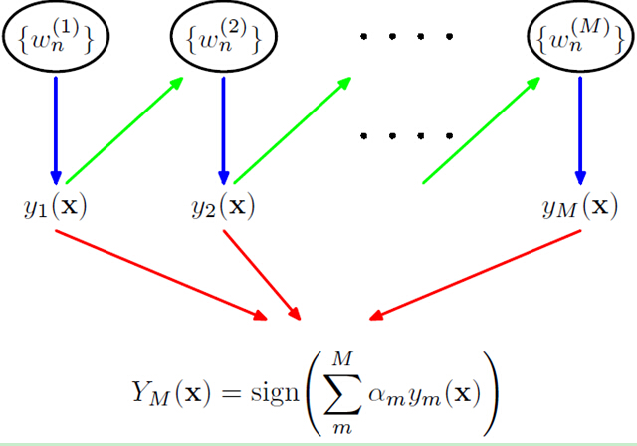
01 Machine Learning
The flow chart

Slide 6


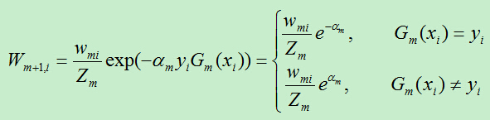

01 Machine Learning
1
Initialize the weights
2
Weight of the base classifier
3
Update weights of data
4
Final classifier

Slide 7
02
Pattern Recognition

Slide 8
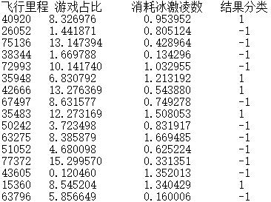
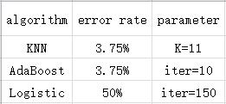
02 Pattern recognition
Training & Test Data Set
Training algorithm & Test Result

Slide 9
02 Pattern recognition
Q:
The third algorithm doesn't do very well. What might be the reason?
A:
The selected data set is non-linear, leading to poor generalization

Slide 10
THANK YOU！

