Slide 1
Meme Sentiment Classification
Using Deep Learning (MobileNetV2 Transfer Learning)
Media & Entertainment — Mini Project
Presented by: GURRALA ROHITH KUMAR 013
Veda Charan Sanapathi 031
Notes:
Good morning sir. My project is Meme Sentiment Classification using Deep Learning.

Slide 2
What is the Problem?
Memes are shared in very large numbers every day on social media.
A meme can be Positive (funny, happy), Neutral, or Negative (insulting, sad).
Companies and brands want to know how people feel — but reading every meme by hand is not possible.
So we need a computer program that looks at a meme and tells its sentiment automatically.
Our Goal
Give a meme image → the model says
Positive
Neutral
Negative
Meme Sentiment Classification · 2

Slide 3
Literature Survey
Very little research work is done on meme sentiment. Text sentiment and normal image classification are common, but memes mix picture + text + humour, so it is a new and hard area.
In 2020 the Memotion task (SemEval-2020) gave the first proper dataset of ~7,000 memes. Even the best teams got low scores — this shows the problem is difficult. [1]
MobileNetV2 (2018) is a light and fast CNN that gives good accuracy. [2]
Transfer learning: reuse a model trained on a big dataset (ImageNet) for our small dataset. [3][4]
Adam optimizer is the standard method used to train the network. [5]
Meme Sentiment Classification · 3

Slide 4
Dataset — Memotion 7k
Around 7,000 real meme images with sentiment labels given by humans.
Original 5 labels merged into 3 classes.
Corrupt images removed; images kept in class folders.
80% for training (5,592 images), 20% for validation (1,398 images).
Note: dataset has many more positive memes than negative — this affects results.
Meme Sentiment Classification · 4

Slide 5
How the System Works (Pipeline)
Meme Image
›
Resize 224×224
& Normalize
›
Data
Augmentation
›
MobileNetV2
(CNN Backbone)
›
Global Avg
Pooling
›
Dense Layers
+ Softmax
›
Sentiment
Image is resized to 224×224 and pixel values scaled to 0–1.
Augmentation (flip, small rotate, zoom) makes the model learn better and not just memorize.
MobileNetV2 already knows how to see shapes, faces and objects (trained on 1.4 million ImageNet photos).
Our new Dense layers learn to map these features to Positive / Neutral / Negative.
Meme Sentiment Classification · 5

Slide 6
Model Architecture
1
MobileNetV2 (154 layers)
Pre-trained feature extractor — transfer learning
2
Global Average Pooling
7×7×1280 features → one 1280-length vector
3
Batch Normalization
Keeps values stable, faster training
4
Dense (256, ReLU)
Hidden layer — learns meme-sentiment patterns
5
Dropout (0.4)
Turns off 40% neurons in training — stops overfitting
6
Dense (3, Softmax)
Output: probability of each of the 3 classes
Meme Sentiment Classification · 6

Slide 7
Activation Functions Used
ReLU (hidden layer)
Softmax (output layer)
f(x) = max(0, x)
e^zi / Σ e^zj
Negative input becomes 0, positive stays same.
Very simple and fast.
Solves the vanishing gradient problem.
Used inside MobileNetV2 also (ReLU6).
Converts 3 raw scores into 3 probabilities that add up to 100%.
Example: Positive 85%, Neutral 10%, Negative 5% → answer is Positive.
Best choice when exactly one class must be selected.
Meme Sentiment Classification · 7

Slide 8
Training the Model
Phase 1 — Feature Extraction
Phase 2 — Fine-Tuning
MobileNetV2 frozen (weights not changed)
Only new Dense layers are trained
Learning rate 1e-4, up to 10 epochs
Last 30 layers of MobileNetV2 unfrozen
Whole network trained slowly
Learning rate 1e-5, up to 10 epochs
Loss: Categorical Cross-Entropy · Optimizer: Adam · Batch size: 32
ModelCheckpoint — saves the BEST weights (highest validation accuracy) to models/meme_sentiment.keras.
EarlyStopping — if validation loss does not improve for 5 epochs, training stops and best weights are restored.
ReduceLROnPlateau — learning rate is reduced when improvement stops.
Meme Sentiment Classification · 8

Slide 9
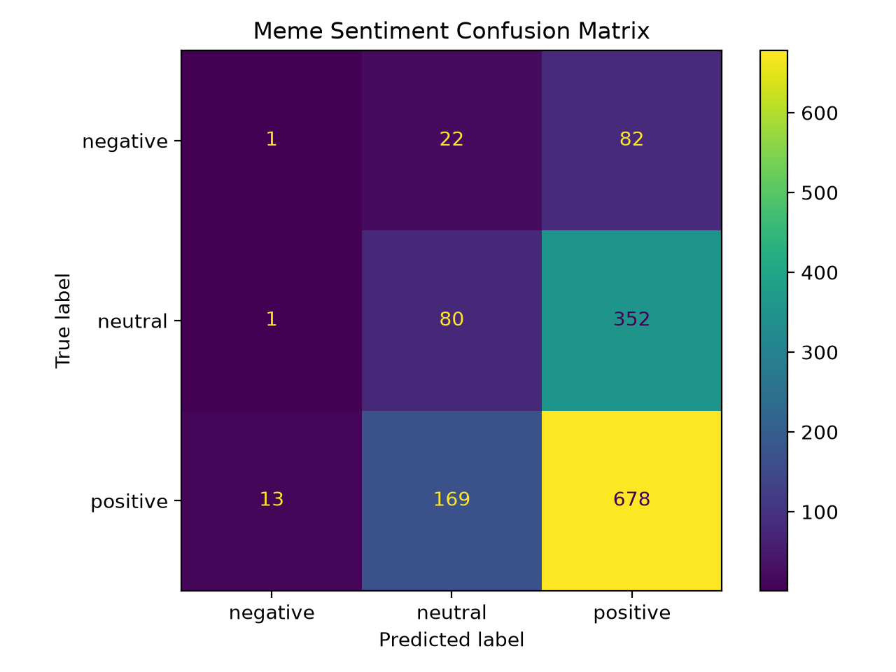
Results
54–57%
Positive class is detected well (F1 ≈ 0.69).
Neutral and Negative are often confused with Positive.
Reason 1: dataset imbalance (6 positive for every 1 negative).
Reason 2: the joke is often in the caption text, not the picture.
Published image-only results on Memotion are also in the same range [1].
Validation accuracy
33%
Random guess baseline (3 classes)
Meme Sentiment Classification · 9

Slide 10
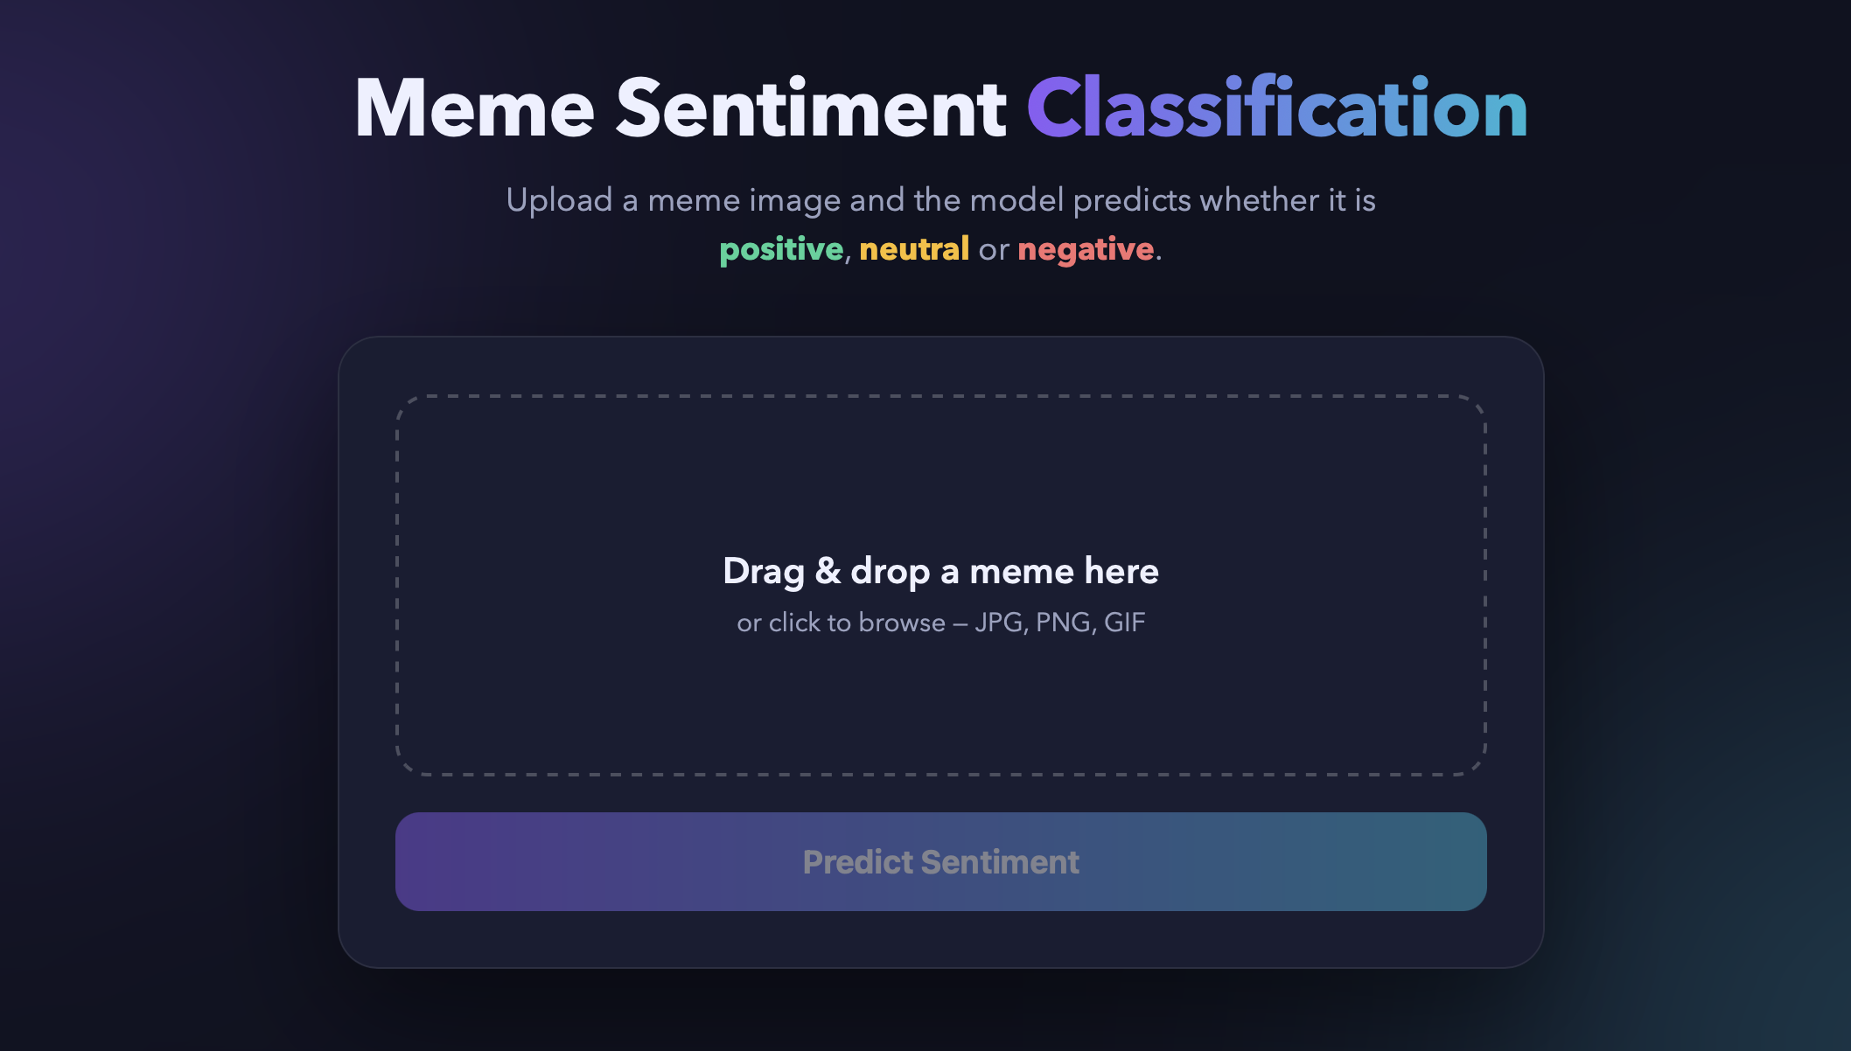
Web Application
Built with Flask (Python) — runs on http://127.0.0.1:5001
User drags & drops a meme image.
Model predicts and shows sentiment with confidence %.
Probability bars for all three classes.
Simple enough for any non-technical user.
Meme Sentiment Classification · 10

Slide 11
Conclusion & Future Work
Conclusion
Future Work
Built a complete deep learning pipeline: data → training → evaluation → web app.
Transfer learning with MobileNetV2 works on a small dataset.
Best weights are selected and saved automatically.
Result is much better than random and matches published image-only work.
Class weights to handle dataset imbalance.
Add OCR + text model (LSTM / BERT) and combine with CNN — the way to reach ~70%.
Fine-tune more backbone layers or try a stronger CNN (EfficientNet).
Meme Sentiment Classification · 11

Slide 12
References (IEEE)
[1] C. Sharma et al., “SemEval-2020 Task 8: Memotion Analysis — The Visuo-Lingual Metaphor!,” in Proc. SemEval-2020, Barcelona, Spain, 2020, pp. 759–773.
[2] M. Sandler, A. Howard, M. Zhu, A. Zhmoginov, and L.-C. Chen, “MobileNetV2: Inverted Residuals and Linear Bottlenecks,” in Proc. IEEE/CVF CVPR, Salt Lake City, UT, USA, 2018, pp. 4510–4520.
[3] J. Deng, W. Dong, R. Socher, L.-J. Li, K. Li, and L. Fei-Fei, “ImageNet: A Large-Scale Hierarchical Image Database,” in Proc. IEEE CVPR, Miami, FL, USA, 2009, pp. 248–255.
[4] S. J. Pan and Q. Yang, “A Survey on Transfer Learning,” IEEE Trans. Knowledge and Data Engineering, vol. 22, no. 10, pp. 1345–1359, Oct. 2010.
[5] D. P. Kingma and J. Ba, “Adam: A Method for Stochastic Optimization,” in Proc. ICLR, San Diego, CA, USA, 2015.
Meme Sentiment Classification · 12

Slide 13
Thank You
Questions are welcome

