Slide 1
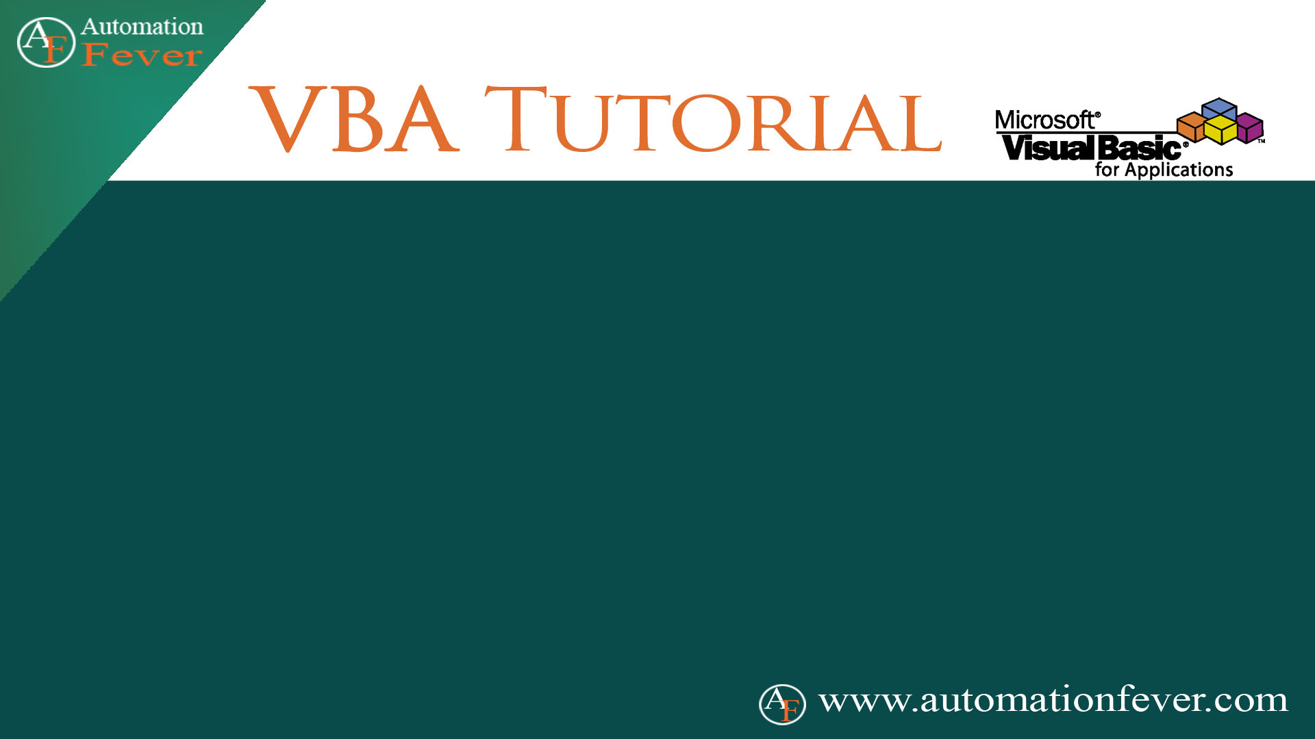
Error Handling

Slide 2
Types of Errors
Syntax Errors
Compile Errors
Run Time Error

