Slide 1
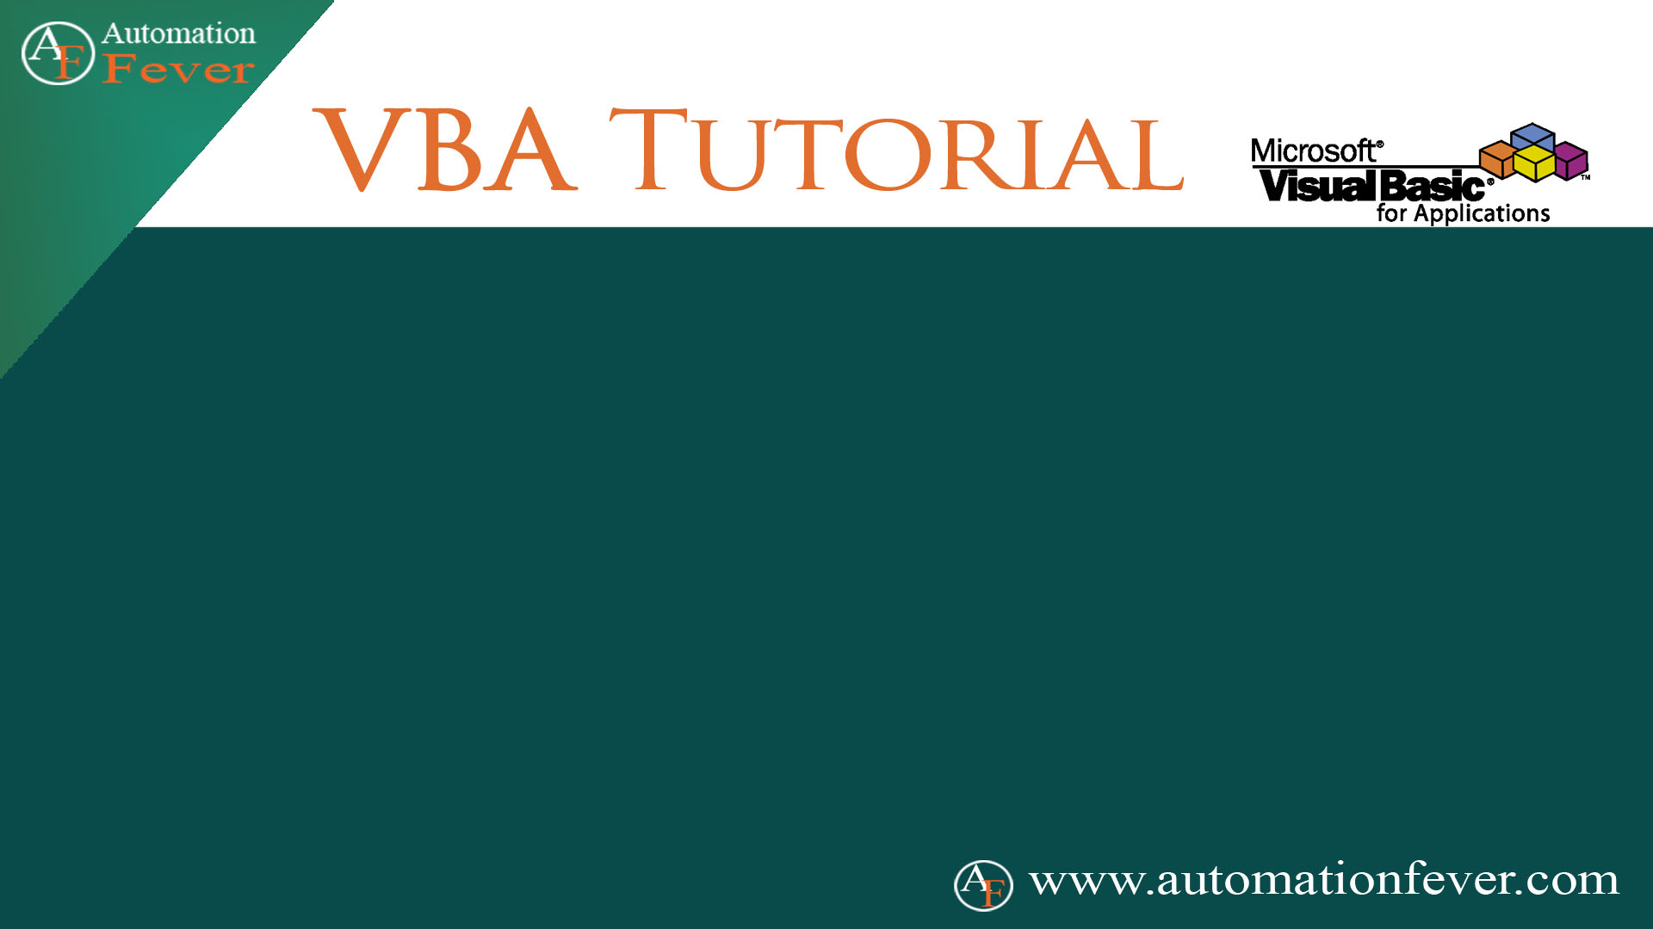
File Dialog

Slide 2

msoFileDialogOpen
Display File Open Dialog
Open Single Excel File Using File Open Dialogs
Open Multiple Excel File Using Open Dialogs
Change File Dialog Title And Button Name
Setting File Filters
Setting Default Path In File Dialog

Slide 3
MsoFileDialogType
Value | Description
msoFileDialogOpen | Open dialog box
msoFileDialogSaveAs | Save As dialog box
msoFileDialogFilePicker | File picker dialog box
msoFileDialogFolderPicker | Folder picker dialog box

