Slide 1
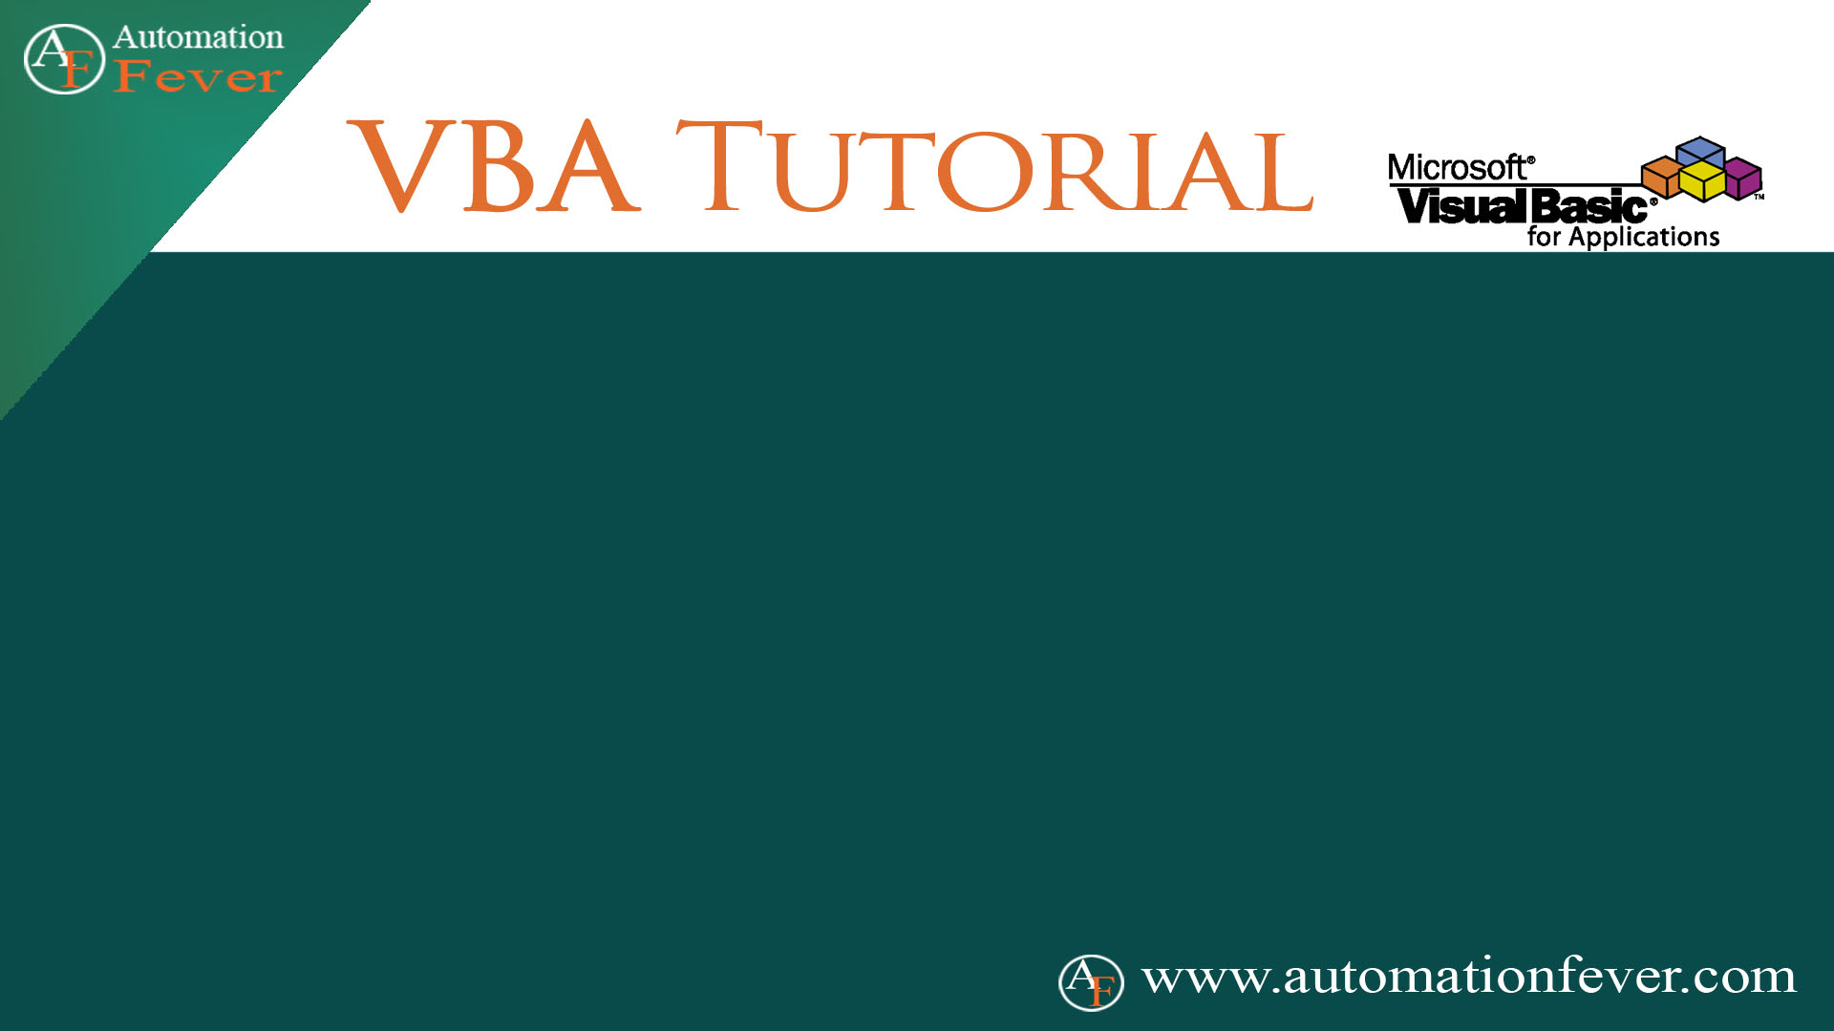
Find Method
Important Notes About Find Parameters

