Slide 1
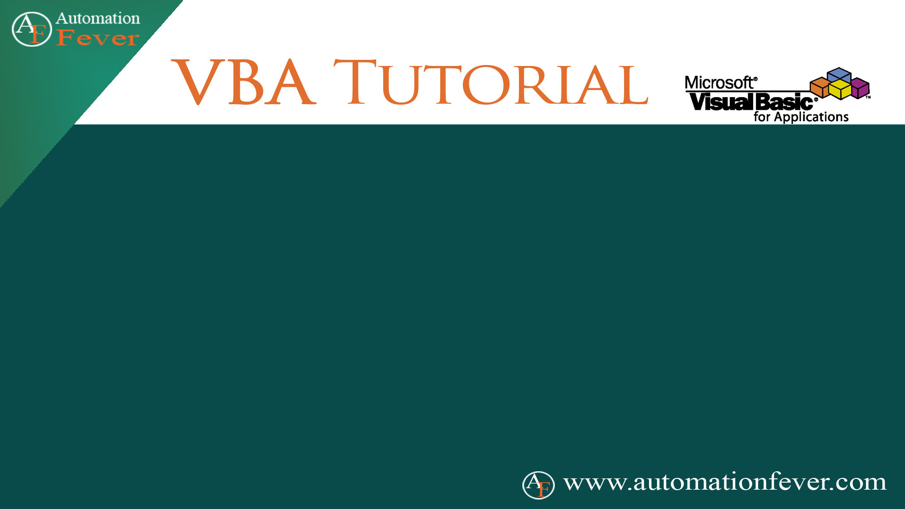
Repeat Last User Action

