Slide 1
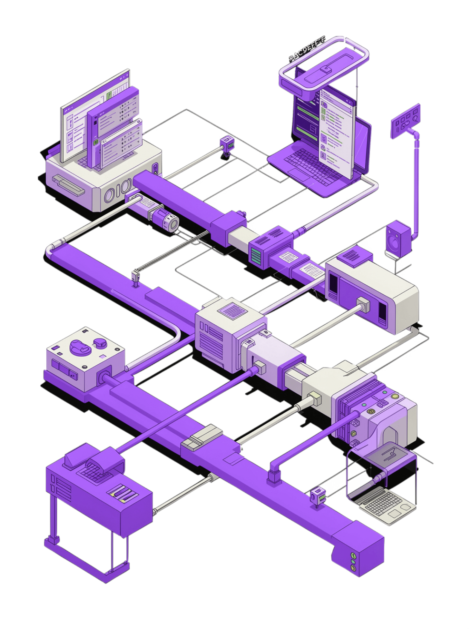
CHILD MAINTENANCE SERVICE — DIGITAL CHANNEL
JULY 2026
CMS Test Automation & CI/CD Integration
Shift-Left Quality Engineering | Automated Regression | Continuous Feedback
80% Faster
Zero Manual
Continuous
Test Execution
Regression Effort
Quality Feedback

Slide 2







CMS DIGITAL CHANNEL · JULY 2026
Executive Summary
A shift-left quality engineering programme delivering automated CI/CD test pipelines across all 6 CMS Digital Channel projects — eliminating manual regression and enabling continuous delivery confidence.
80%+
6
Manual Testing Reduction
CMS Projects Covered
4
0
Test Types Automated
Manual Bug Reports
What We Delivered
Projects & Coverage
Automated CI/CD pipelines across all 6 CMS projects via GitHub Actions
Regression, security (OWASP ZAP), performance (k6) & cross-browser testing
Enforcement & Finance
Get Help Apply
Real-time Slack notifications with pass/fail summaries & pipeline links
VPF UI + ENF API
End-to-end journeys
Shift-left quality gates preventing defective code reaching production
Respond
Online Revive
Citizen response flows
Account reactivation
Maternity Allowance
SED
Benefit claim journeys
Employer Deductions
Test Coverage by Type
Regression
Security
Full suites run on every PR and merge, catching issues before staging.
OWASP ZAP automatically scans for vulnerabilities on every build cycle.
Performance
Compatibility
k6 load tests validate service performance with automated thresholds.
Playwright cross-browser runs across Chrome, Firefox, Safari & Edge.
All 6 projects now ship with automated quality gates — reducing manual testing by 80%+ and enabling continuous delivery confidence across the CMS Digital Channel.

Slide 3


The Problem (Before Automation)
PAIN POINTS
BUSINESS IMPACT
Manual Testing Challenges
The Cost of Manual Testing
2–3 Days — Full Regression
5+
Days of manual effort blocked every deployment window.
Days Lost Per Release
1–2 Days — Cross-Browser Checks
Regression & browser testing per cycle
Manual compatibility checks with no automated coverage.
10×
Zero — Security Scanning
Late Bug Fix Cost
No security scanning — vulnerabilities found too late.
Production defects cost 10× more to fix
Late Stage — Performance Feedback
🚨 Delayed Releases
🐛 Production Defects
Performance issues surfaced after costly rework was needed.
Testing bottlenecks every release
Bugs slipping through coverage gaps
Email & Meetings — Communication
📉 Inconsistent Coverage
😤 Developer Frustration
No real-time feedback — results via email and meetings only.
No standard process across projects
No timely feedback for engineers
5+ days per sprint consumed by manual testing — with no guarantee of consistent quality across all 6 projects.

Slide 4





The Solution — Integrated CI/CD Pipeline
A fully automated pipeline triggered on every code push, progressing through five quality gates before delivering results to the team.
Functional Tests
Security Scan
Performance
Cross‑Browser
Playwright E2E & API
OWASP ZAP DAST
k6 load & stress
BrowserStack runs
Reporting
Allure & Slack alerts
Push → Branch & commit extracted → Test pipeline triggered → Results delivered in real time.

Slide 5



Technology Stack
An integrated ecosystem — from code push to insight delivery.
Playwright + TypeScript
GitLab CI
Allure Reports
E2E UI & API tests
Pipeline orchestration
Visual test reporting
OWASP ZAP
k6
📢 Slack
📊 Allure Portal
Security gate
Performance gate
Real-time pass/fail alerts
Trends, screenshots & traces
BrowserStack
📧 Email
Compatibility gate
Failure summaries to inbox

Slide 6






Story-Based Test Execution
Developers stay in their natural workflow — smart tag extraction handles the rest automatically.
1. Name Branch
2. Push Code
3. Tag Extracted
feature/AFCM-1234-fix-payment
GitLab CI triggers automatically
AFCM-1234 parsed from branch name
4. Tests Run
5. Check Slack
Only @AFCM-1234 tagged tests execute
Pass/fail result in < 5 min
Falls back to full regression automatically if no story tag is found in the branch name or commit message.
⚙️ Manual Trigger Options
📊 Smart Tag Extraction
Environment
Test Tags
Branch Name
Commit Message
Select dev, test, or staging
Run @smoke, @regression, or a specific story ID
feature/AFCM-1234-… → AFCM-1234
[AFCM-1234] fix… → AFCM-1234
Quality Gates
No Match
Toggle OWASP ZAP, k6 load tests, and BrowserStack on/off
Full regression suite runs as fallback
90%
<5m
Faster Feedback
Targeted Result
vs full regression run
per story-tagged execution
0
Extra Steps
just name the branch correctly

Slide 7







SECURITY SHIFT-LEFT
ZAP Integration — Security at Every Commit
Scanning Flow
Vulnerabilities Detected
01
02
💉 SQL Injection
⚡ XSS
Browser Proxy
Active Scan
Playwright routes traffic through ZAP proxy
ZAP crawls URLs and detects vulnerabilities
⚙️ Misconfigurations
🔒 Missing Headers
03
04
Risk Triage
Instant Alert
🎯 Security issues caught at dev time — not in production.
Findings ranked: High / Medium / Low
Slack notification + HTML report artifact
0
100%
Prod Escapes
CI Coverage
🚦 Mandatory Quality Gates
✅ Functional Tests
🔐 Security Gate
Story-tagged tests must pass before merge
Zero high-severity findings — any High blocks merge
Merge Blocked
Slack Alert
PR held until all gates pass
Gate name, severity, and branch sent
⚡ Performance
🌐 Cross-Browser
Response times within defined SLA bounds
Chrome, Firefox, and Safari verified
Allure Report
Full evidence as pipeline artifact
🔐 High-severity = automatic merge block.

Slide 8
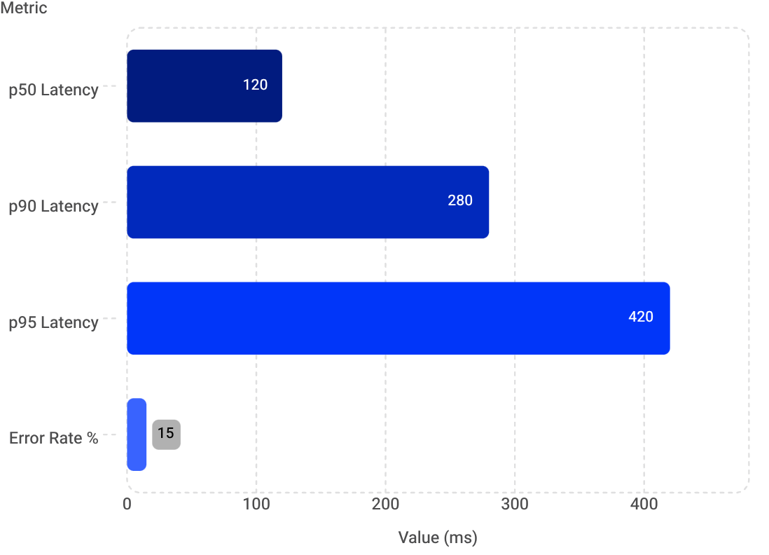
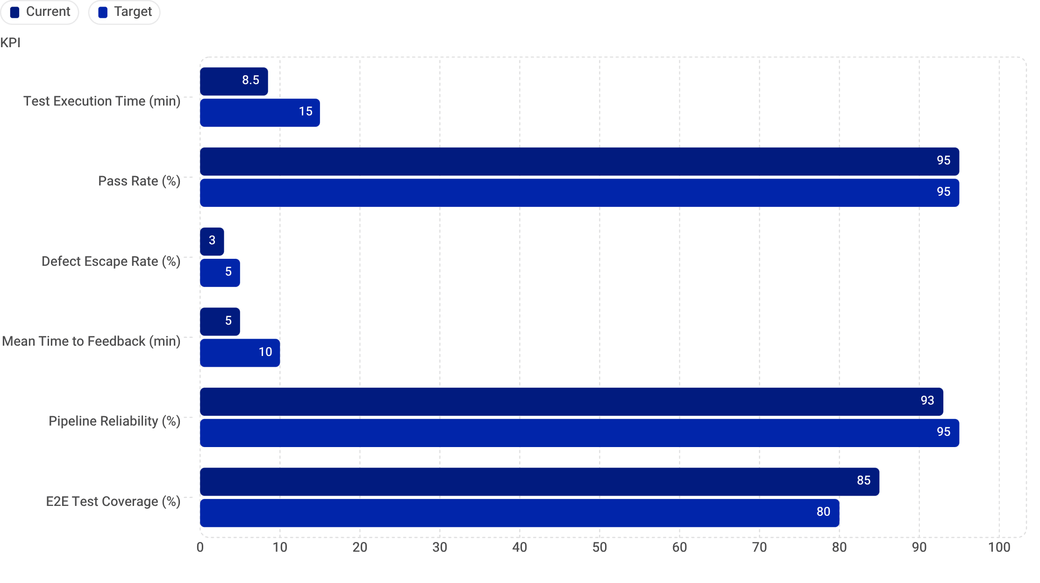
PERFORMANCE DASHBOARD
Performance Testing with k6
2500ms
1800ms
0.1
p95
LCP
FCP
CLS
API Latency
Largest Contentful Paint
First Contentful Paint
Cumulative Layout Shift
Response percentile
Web Vitals Targets
API Load Test Metrics
75%
85%
LCP < 2500ms
FCP < 1800ms
90%
80%
CLS < 0.1
TTFB < 800ms
Pipeline Gate: Builds fail automatically if any Web Vital or API threshold is breached.
Key Metrics & KPIs
⏱ Exec Time
✅ Pass Rate
🐛 Defect Escape
⚡ MTTF
8.5 min vs 15 min ✅
95% on target ✅
3% vs 5% ✅
5 min vs 10 min ✅
🧪 E2E Coverage
85% vs 80% ✅

Slide 9




Cross-Browser Compatibility & Real-Time Notifications
GDS-compliant rendering validated across all major browsers via BrowserStack cloud — with instant Slack alerts on every test run.
🔔 Real-Time Slack Alerts
Chrome
✅ Test Results
Win 11
Pass/Fail counts, pass rate & failed test names
🔗 Report Links
Allure report & pipeline links with duration
Edge
🛡 Security Alerts
Win 11
ZAP vulnerability counts & k6 Web Vitals summary
Coverage — 200+ Automated Scenarios
Project
Firefox
E2E
API
ZAP
k6
Browser
Slack
Enforcement
Win 11
✅
✅
✅
✅
✅
✅
Get Help Apply
✅
✅
—
✅
✅
✅
Respond
✅
—
✅
✅
✅
✅
Online Revive
Safari
✅
✅
—
✅
✅
✅
Maternity
macOS
✅
—
✅
✅
✅
✅
SED
✅
—
✅
✅
✅
—
BrowserStack Integration
CDP WebSocket
Live cloud cross-browser rendering checks
Trigger
On-demand or per release pipeline
Coverage
4 browsers × 2 OS = full GDS matrix

Slide 10







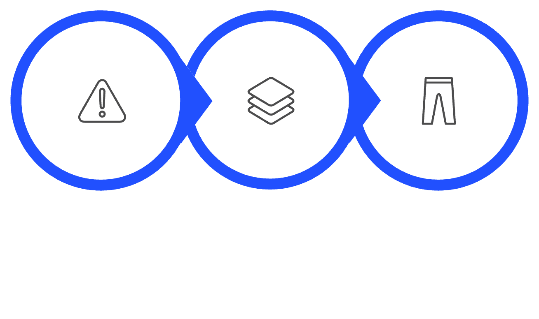



ZERO MANUAL LOGGING
Automated Failure Reporting & Migration from Legacy
When tests fail, the system instantly captures and broadcasts everything your team needs — no human intervention required. Built on a modernised stack migrated from legacy tooling.
🔍 Triggers Automatically When
📋 Every Failure Report Includes
Functional Test Fails
Any failing Cypress or integration test triggers the pipeline
Pipeline Link
Branch & Env
Tags Used
Allure Report Shows Failures
Direct URL to the CI run
Exact context of failure
Test scope of the run
Report generation detects and flags failed scenarios
✅ Zero manual logging — failures reported instantly to Slack.
Failure Count
Allure Report
Slack Alert
Total failed tests
Full visual test report
Instant team notification
Test Fails
Capture Context
Slack Alert
🔄 Migration from Legacy Stack
⚡ Why Playwright?
3× Faster Execution
Built-in Auto-Waiting
Legacy
Migrated To
Parallel headless runs cut suite runtime dramatically
Fewer flaky tests — waits for elements automatically
Selenium / Java / Cucumber
Manual Postman tests
No CI/CD pipeline
Playwright / TypeScript
Automated API tests
Full GitLab CI/CD
Native API Testing
Single Framework
REST assertions alongside UI tests in one codebase
UI + API + Performance unified under one tool

Slide 11
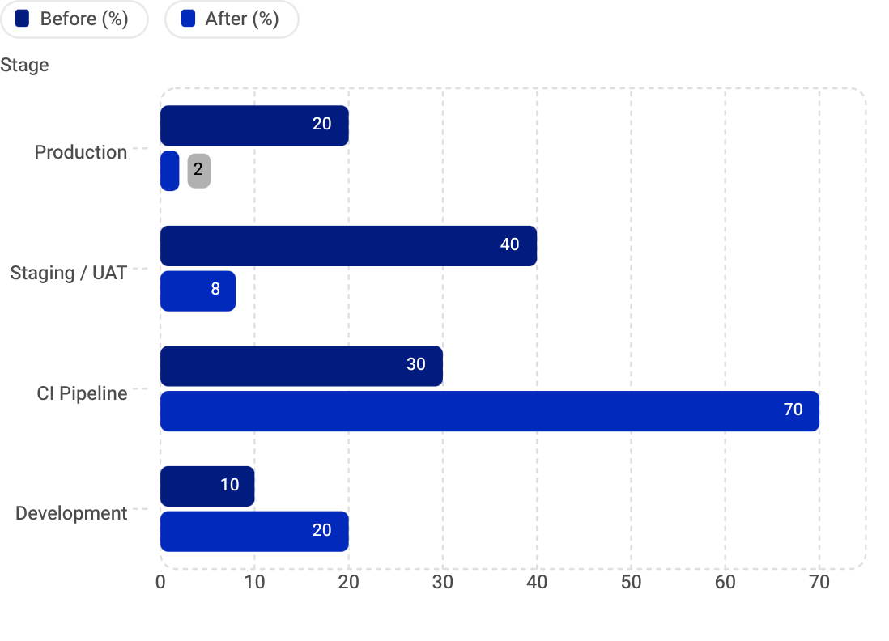
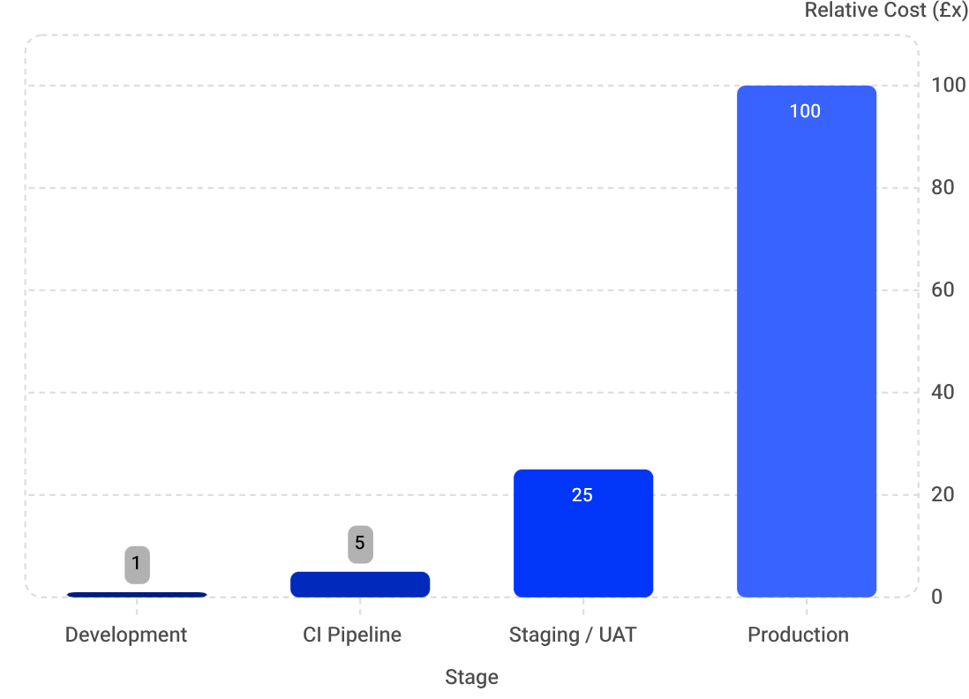
Impact & Key Outcomes
Delivering measurable ROI across all 6 CMS projects through shift-left quality engineering
80%+
90%
Less Manual Testing
Faster Feedback
Reduction in regression effort across all 6 projects
Story-based execution vs full regression
6
5
CMS Projects
Quality Gates
Fully covered by automated CI/CD pipelines
Functional · Security · Performance · Compatibility · Reporting
🎯 Shift-Left: Defect Detection
💰 Cost of Defect by Stage
Defects caught in production dropped from 20% → 2% — the most expensive place to fix bugs
Fixing a bug in production costs £100x more than catching it at development time
Business Value: Shift-left testing + automated pipelines means fewer production incidents, faster releases, and dramatically lower cost-of-quality — delivering continuous GDS-compliant coverage.
FUTURE ROADMAP
Planned Enhancements
Next-phase capabilities to further strengthen quality coverage and automation maturity
Accessibility Testing
axe-core integration for automated WCAG compliance checks on every build
Visual Regression Testing
Screenshot comparison to catch unintended UI changes across releases
AI-Powered Test Generation
Intelligent test synthesis from user stories and acceptance criteria
SUMMARY
What We've Built & Why It Matters
🏗️ What's In Place
🚀 Business Outcomes
6 Fully Automated Test Pipelines
Comprehensive Quality Gates
Faster Releases with Higher Confidence
Security & Performance Regressions Prevented
Every CMS project covered from commit to deploy
Functional, Security, Performance & Compatibility on every run
Continuous automated validation removes bottlenecks from release cycles
OWASP ZAP and Lighthouse thresholds block degraded builds automatically
Real-Time Slack Feedback
Significant Cost Savings
Instant failure notifications with full context — zero manual logging
Production defect rate dropped from 20% → 2%, eliminating costly hotfixes
Strategic Value: This framework is a living quality platform that scales with the programme, enforces GDS standards automatically, and gives every team real-time confidence in every deployment.

