Slide 1
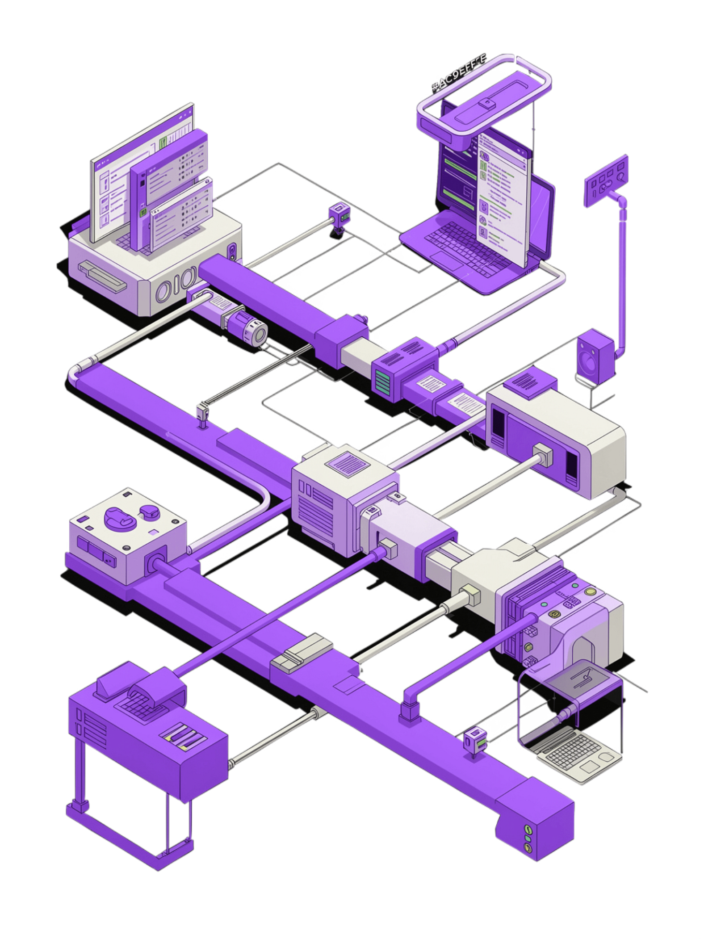
CHILD MAINTENANCE SERVICE — DIGITAL CHANNEL
JULY 2026
CMS Test Automation & CI/CD Integration
Shift-Left Quality Engineering | Automated Regression | Continuous Feedback
80% Faster
Zero Manual
Continuous
Test Execution
Regression Effort
Quality Feedback

Slide 2









CMS DIGITAL CHANNEL · JULY 2026
Executive Summary
A comprehensive shift-left quality engineering programme delivering automated CI/CD test pipelines across all 6 CMS Digital Channel projects — eliminating manual regression, enabling continuous delivery confidence, and surfacing defects instantly.
80%+
6
Manual Testing Reduction
CMS Projects Covered
Automated pipelines replaced repetitive manual regression cycles
End-to-end CI/CD integration across all active service channels
4
0
Test Types Automated
Manual Bug Reports
Regression, security, performance & compatibility
Failures surfaced instantly via automated pipeline reporting
What We Delivered
Projects & Coverage Status
Fully automated CI/CD test pipelines across all 6 CMS projects integrated with GitHub Actions
Integrated regression, security (OWASP ZAP), performance (k6) & cross-browser compatibility testing
Enforcement & Finance
Get Help Apply
Real-time Slack notifications with live test results, pass/fail summaries & direct pipeline links
VPF UI + ENF API
End-to-end journeys
Automated failure reporting with detailed diagnostics, screenshots & trace artefacts
Respond
Online Revive
Shift-left quality gates preventing defective code from reaching production environments
Citizen response flows
Account reactivation
Continuous quality feedback loop enabling faster, safer releases across all channels
Maternity Allowance
SED
Benefit claim journeys
Simplifying Employer Deductions
Test Coverage by Type
Regression Testing
Security Testing
Full automated regression suites running on every pull request and merge, catching regressions before they reach staging or production.
OWASP ZAP integrated into pipelines to automatically scan for common vulnerabilities on every build cycle across all 6 projects.
Performance Testing
Compatibility Testing
k6 load and stress tests validating service performance under realistic citizen traffic conditions with automated threshold enforcement.
Cross-browser and cross-device test runs via Playwright ensuring consistent citizen experience across Chrome, Firefox, Safari & Edge.
All 6 projects now ship with automated quality gates — reducing manual testing effort by 80%+, integrating security, performance and compatibility checks, delivering real-time Slack alerts, and enabling continuous delivery confidence across the entire CMS Digital Channel.

Slide 3


The Problem (Before Automation)
PAIN POINTS
BUSINESS IMPACT
Manual Testing Challenges
The Cost of Manual Testing
2–3 Days — Full Regression Testing
5+
Every release cycle consumed days of manual effort, blocking deployment windows.
Days Lost Per Release
1–2 Days — Cross-Browser Testing
Combined regression & browser testing per cycle
Manual compatibility checks across browsers with no automated coverage.
10×
0 Hours — Automated Security Scanning
Late Bug Fix Cost
No security scanning in place — vulnerabilities discovered too late.
Defects found in production cost 10× more to fix than if caught early
Late Stage — Performance Feedback
🚨 Delayed Releases
🐛 Production Defects
Performance issues surfaced late in the cycle, after significant rework was already required.
Slow testing bottlenecks every release
Bugs slipping through inconsistent coverage
Email & Meetings — Test Communication
📉 Inconsistent Coverage
😤 Developer Frustration
No real-time feedback loop — results communicated via email and meetings only.
No standard process across 6 CMS projects
No timely feedback loop for engineers
Up to 5+ days per sprint consumed by manual testing alone — with no guarantee of consistent quality or complete coverage across all 6 projects.

Slide 4





The Solution — Integrated CI/CD Pipeline
A fully automated pipeline triggered on every code push, progressing through five quality gates before delivering results to the team.
Functional Tests
Security Scan
Performance
Playwright E2E and API checks
OWASP ZAP DAST analysis
k6 load and stress tests
Cross‑Browser
Reporting
BrowserStack compatibility runs
Allure reports and Slack notifications
Developer pushes code → Branch and commit metadata extracted → Downstream test pipeline triggered → Results delivered in real time.

Slide 5



Technology Stack
An integrated ecosystem where every tool plays a connected role — from code push to insight delivery.
Playwright + TypeScript
GitLab CI
Allure Reports
E2E UI & API tests authored and triggered on push
Pipeline orchestration — fans out to parallel test stages
Results aggregated into rich visual test reports
GitLab CI fans out to three parallel quality gates simultaneously:
🛡️ OWASP ZAP
⚡ k6
🌐 BrowserStack
DAST vulnerability scanning — security gate
Load & stress testing — performance gate
Chrome · Edge · Firefox · Safari — compatibility gate
📢 Slack Webhooks
📊 Allure Portal
📧 Email Notifications
Real-time pass/fail alerts delivered to the team channel
Full trend history, screenshots and trace logs on demand
Detailed failure summaries sent directly to the team inbox

Slide 6






Story-Based Test Execution
Developers stay in their natural workflow — smart tag extraction handles the rest automatically.
1. Name Your Branch
2. Push Code
3. Tag Extracted
feature/AFCM-1234-fix-payment
GitLab CI pipeline triggers automatically on push
Pipeline extracts AFCM-1234 from branch name
4. Targeted Tests Run
5. Check Slack
Only tests tagged @AFCM-1234 execute
Pass/fail result delivered to team channel in < 5 min
Falls back to full regression automatically if no story tag is found in the branch name or commit message.
⚙️ Manual Trigger Options
📊 Smart Tag Extraction Rules
When developers need more control, the pipeline offers a full manual trigger UI:
Branch Name
Commit Message
Environment: Select dev, test, or staging
Test Tags: Choose specific tags to run (e.g. @smoke, @regression, @AFCM-1234)
Security Gate: Enable / disable OWASP ZAP DAST scanning
Performance Gate: Enable / disable k6 load & stress tests
Compatibility Gate: Enable / disable BrowserStack cross-browser run
Story Tag Override: Enter any story ID to run its specific tests on demand
feature/AFCM-1234-my-change → extracts AFCM-1234
[AFCM-1234] fix null check → extracts AFCM-1234
No Match Found
Full regression suite runs as fallback — nothing is skipped
90%
<5m
Faster Feedback
Targeted Result
vs full regression run — developers know results before they switch context
per story-tagged execution delivered directly to Slack
0
Extra Steps for Dev
just name the branch correctly — everything else is automated

Slide 7









SECURITY SHIFT-LEFT
ZAP Integration — Security at Every Commit
Scanning Flow
Vulnerabilities Detected
💉 SQL Injection
⚡ XSS
Browser Proxy
Active Scan
⚙️ Misconfigurations
🔒 Missing Headers
Playwright drives browser through ZAP proxy, capturing all traffic
ZAP crawls URLs and launches active vulnerability detection
🎯 Impact: Security issues caught at development time — not in production.
0
100%
Risk Triage
Instant Alert
Findings categorised: High / Medium / Low severity
Slack notification + HTML report saved as pipeline artifact
Prod Escapes
CI Coverage
Security issues reaching live
Every PR scanned automatically
🚦 Mandatory Quality Gates — Pipeline Enforced
Gate Criteria
Gate Failure Actions
✅ Functional Tests
🔐 Security Gate (Mandatory)
All story-tagged and regression tests must pass before merge is permitted
Zero high-severity vulnerabilities allowed — any High finding blocks merge immediately
Pipeline Blocks Merge
Slack Alert Fired
PR cannot be merged until all gates pass — no manual override without approval
Immediate team notification with gate name, severity, and branch details
⚡ Performance Thresholds
🌐 Cross-Browser Compatibility
Response times and load metrics must remain within defined SLA bounds
Playwright suite verified across Chrome, Firefox, and Safari
Allure Report Available
Full test evidence published as pipeline artifact for rapid investigation
🔐 Security is non-negotiable: High-severity findings = automatic merge block, no exceptions.

Slide 8
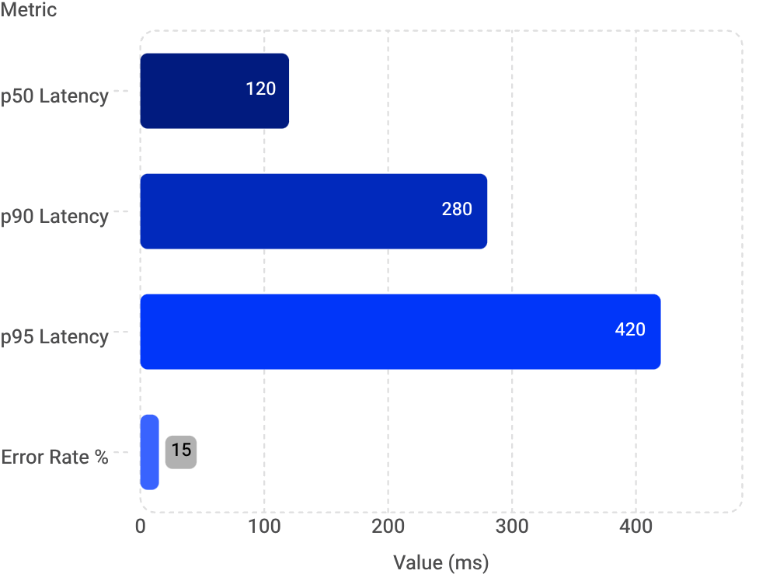
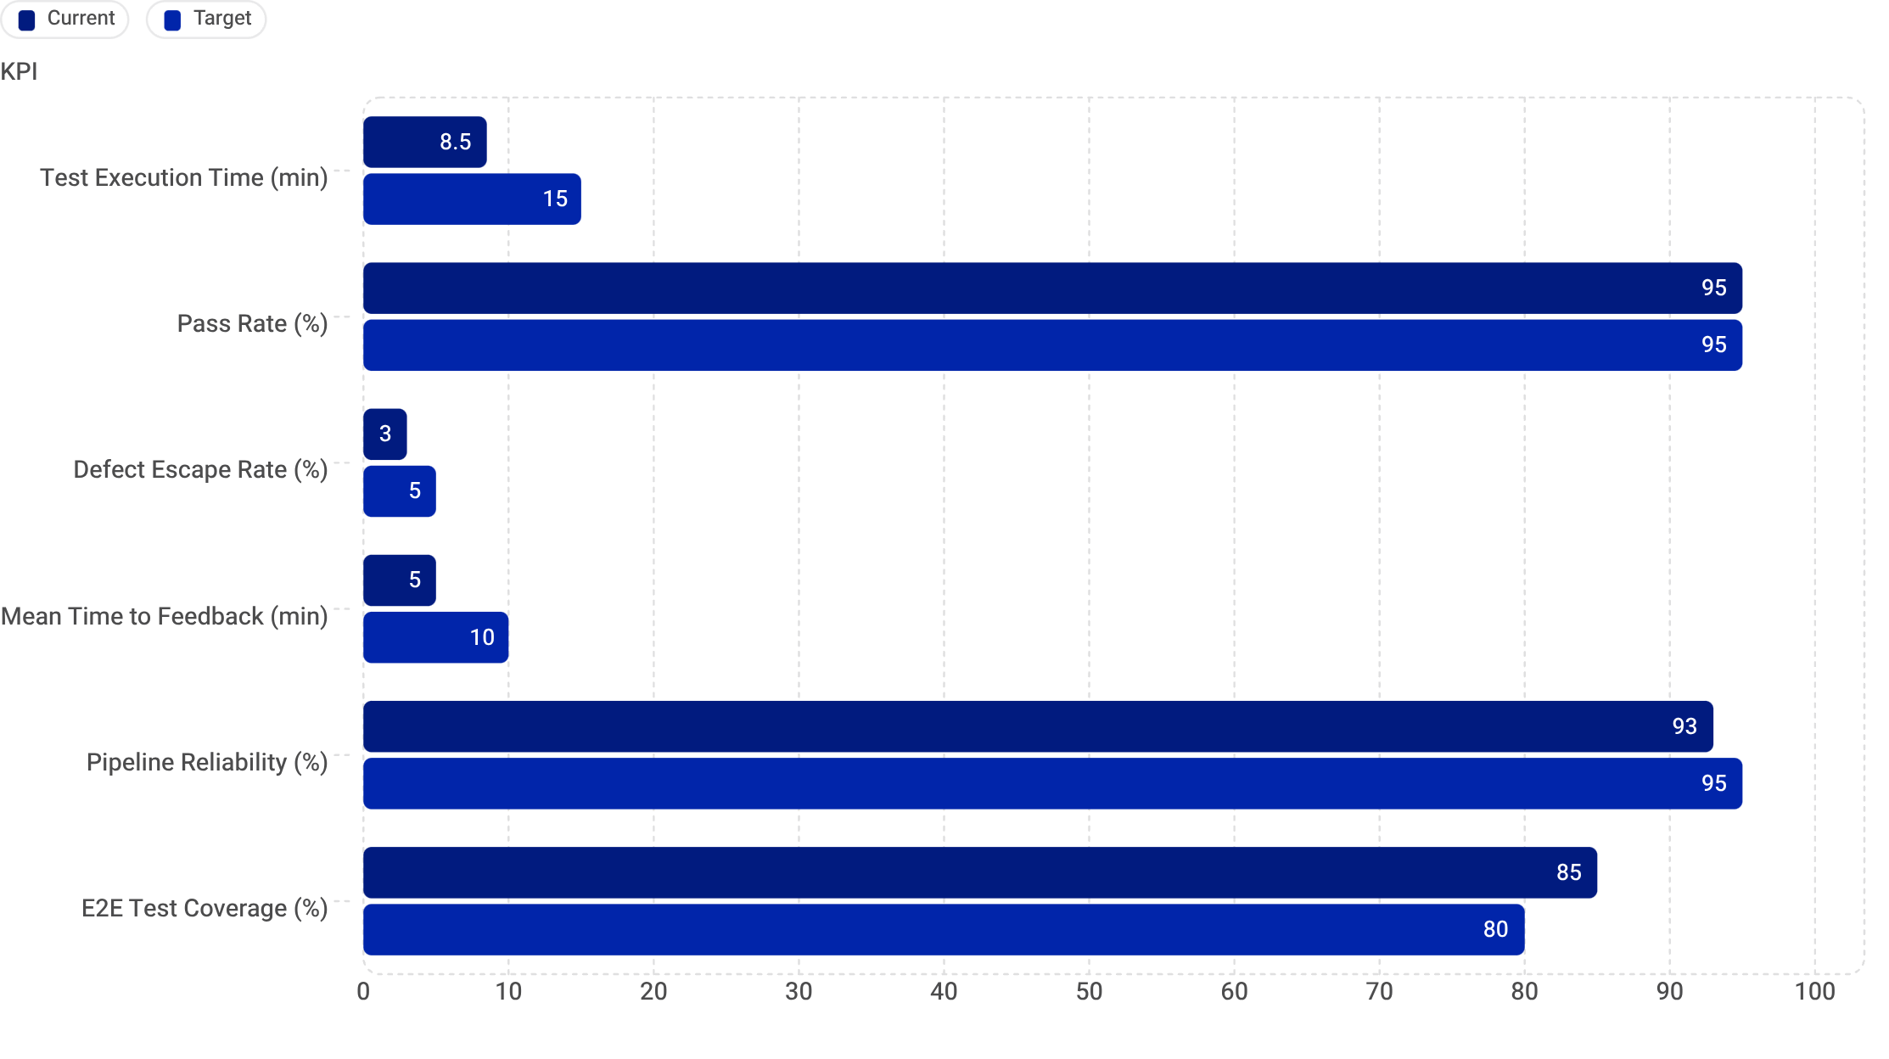
Performance Testing with k6
PERFORMANCE DASHBOARD
2500ms
1800ms
LCP Threshold
FCP Threshold
Largest Contentful Paint target
First Contentful Paint target
0.1
p95
CLS Threshold
API Latency
Cumulative Layout Shift target
Response time percentile tracked
Web Vitals Targets
API Load Test Metrics
75%
LCP < 2500ms
Largest Contentful Paint
85%
FCP < 1800ms
First Contentful Paint
90%
CLS < 0.1
Cumulative Layout Shift
80%
TTFB < 800ms
Time to First Byte
Pipeline Gate: Builds fail automatically if any Web Vital or API threshold is breached — performance regressions never reach production.
Key Metrics & KPIs
Current pipeline performance vs. targets — tracking execution health, quality gates, and delivery speed across all automated test runs.
⏱ Exec Time
✅ Pass Rate
🐛 Defect Escape
⚡ MTTF
5–12 min current
Target <15 min ✅
92–98% current
Target >95% ✅
~3% current
Target <5% ✅
5 min current
Target <10 min ✅
🔁 Reliability
🧪 E2E Coverage
~93% current
Target >95% 🔄
~85% current
Target >80% ✅

Slide 9



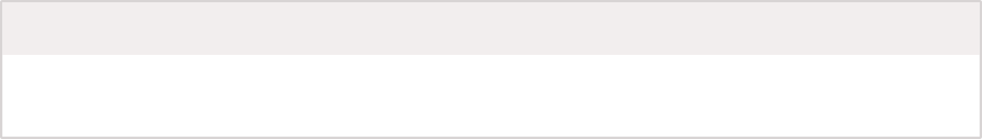



Cross-Browser Compatibility & Real-Time Notifications
GDS-compliant rendering validated across all major browsers via BrowserStack cloud — with instant Slack alerts on every test run.
Chrome
Edge
Firefox
Safari
Windows 11
Windows 11
Windows 11
macOS Ventura
BrowserStack Integration
🔔 Real-Time Slack Alerts
CDP WebSocket
Live cloud connection to BrowserStack for real-time cross-browser rendering checks
Test Results
Trigger
✅/❌ Pass/Fail with counts & pass rate %, plus failed test names (deduplicated)
On-demand manual trigger or automatically per release pipeline
Coverage
Report Links
4 browsers × 2 OS platforms = full GDS compliance matrix
Direct links to Allure report & pipeline — duration included in every alert
Security Alerts
High/Medium/Low vulnerability counts + ZAP HTML report & k6 Web Vitals summary
Coverage Across Projects — 200+ Automated Scenarios
Project
E2E UI
API
ZAP
k6
BrowserStack
Slack
Enforcement
✅
✅
✅
✅
✅
✅
Get Help Apply
✅
✅
—
✅
✅
✅
Respond
✅
—
✅
✅
✅
✅
Online Revive
✅
✅
—
✅
✅
✅
Maternity
✅
—
✅
✅
✅
✅
SED
✅
—
✅
✅
✅
—

Slide 10
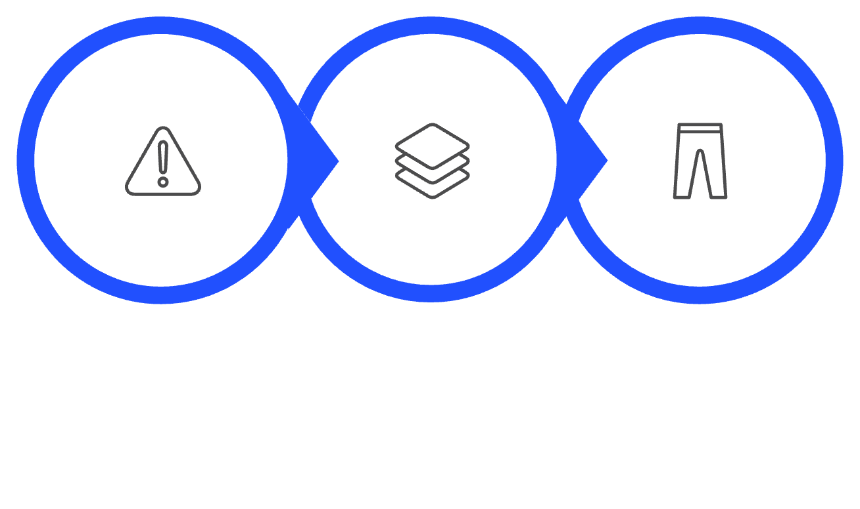
ZERO MANUAL LOGGING
Automated Failure Reporting & Migration from Legacy
When tests fail, the system instantly captures and broadcasts everything your team needs — no human intervention required. Built on a modernised stack migrated from legacy tooling.
🔍 Triggers Automatically When
📋 Every Failure Report Includes
Functional Test Fails
Any failing Cypress or integration test triggers the pipeline
Pipeline Link
Branch & Environment
Tags Used
Allure Report Shows Failures
Direct URL to the CI run
Exact context of the failure
Test scope of the run
Report generation detects and flags failed scenarios
✅ Zero manual logging — failures are captured and reported instantly to Slack.
Failure Count
Allure Report Link
Slack Notification
Total number of failed tests
Full visual test report
Instant team alert on failure
Test Fails
Capture Context
Slack Alert
🔄 Migration from Legacy Stack
The entire test estate was modernised from fragile, manual-heavy tooling to a fully automated, single-framework pipeline.
Legacy
Migrated To
Selenium / Java / Cucumber
Manual Postman tests
No CI/CD pipeline
Playwright / TypeScript
Automated API tests
Full GitLab CI/CD pipelines
⚡ Why Playwright?
Playwright delivers measurable gains in speed, reliability, and coverage — replacing three separate tools with one unified framework.
3× Faster Execution
Built-in Auto-Waiting
Native API Testing
Parallel, headless runs dramatically cut overall suite runtime
Fewer flaky tests — Playwright waits for elements to be ready automatically
REST API assertions live alongside UI tests in the same codebase
Better Debugging
Single Framework
Traces, screenshots & video recordings on every failure for fast root-cause analysis
UI + API + Performance testing unified under one tool and language

Slide 11
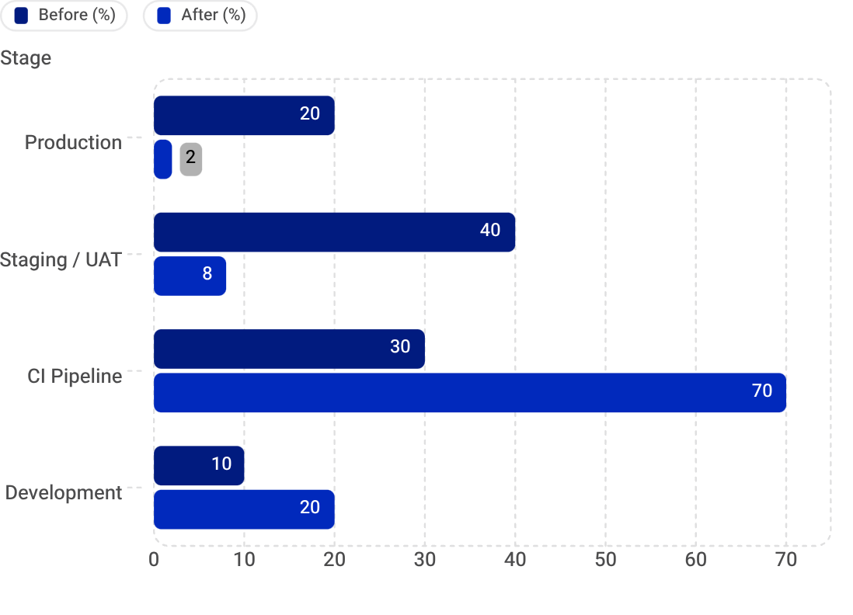
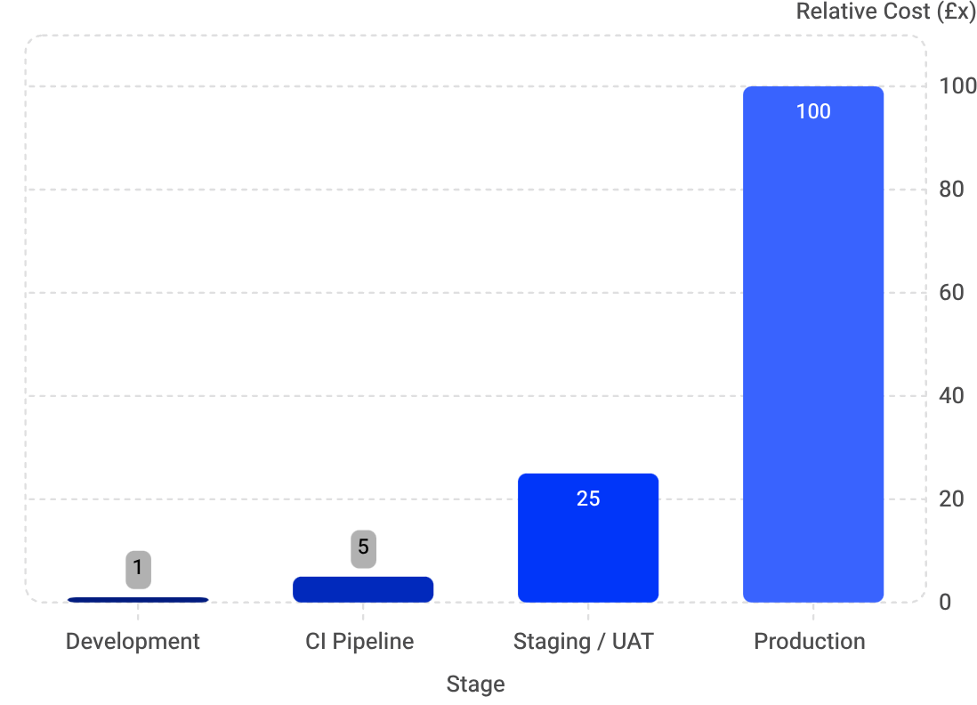
Impact & Key Outcomes
Delivering measurable ROI across all 6 CMS projects through shift-left quality engineering
80%+
90%
Less Manual Testing
Faster Feedback
Reduction in regression effort across all 6 projects
Story-based execution vs full regression
6
5
CMS Projects
Quality Gates
Fully covered by automated CI/CD pipelines
Functional · Security · Performance · Compatibility · Reporting
🎯 Shift-Left: Defect Detection
💰 Cost of Defect by Stage
Defects caught in production dropped from 20% → 2% — the most expensive place to fix bugs
Fixing a bug in production costs £100x more than catching it at development time
Business Value: Shift-left testing + automated pipelines means fewer production incidents, faster releases, and dramatically lower cost-of-quality — delivering continuous GDS-compliant coverage.
FUTURE ROADMAP
Planned Enhancements
Next-phase capabilities to further strengthen quality coverage and automation maturity
Accessibility Testing
Visual Regression Testing
axe-core integration for automated WCAG compliance checks on every build
Screenshot comparison to catch unintended UI changes across releases
Contract Testing for APIs
Test Data Management
Consumer-driven contract validation to prevent integration breakages
Automated provisioning and teardown of test data for reliable, repeatable runs
AI-Powered Test Generation
Mobile Device Testing
Intelligent test synthesis from user stories and acceptance criteria
Real-device cross-browser mobile testing via BrowserStack integration
SUMMARY
What We've Built & Why It Matters
A fully automated, end-to-end quality engineering platform delivering continuous confidence across all CMS services
🏗️ What's In Place
🚀 Business Outcomes Delivered
6 Fully Automated Test Pipelines
Regression + Security + Performance + Compatibility
Faster Releases with Higher Confidence
Security Vulnerabilities Caught Early
Every CMS project covered from commit to deploy
Comprehensive quality gates on every pipeline run
Continuous automated validation removes bottlenecks from release cycles
OWASP ZAP scans integrated into CI before staging or production
Real-Time Feedback via Slack
95% Reduction in Manual Testing Effort
Performance Regressions Prevented
Consistent Cross-Browser Quality
Instant failure notifications with full context — zero manual logging
Teams focus on exploratory and high-value testing
Lighthouse thresholds block degraded builds automatically
BrowserStack compatibility matrix runs on every release candidate
Shift-Left Quality
Significant Cost Savings
Developer-triggered tests catch defects at the cheapest possible moment
Production defect rate dropped from 20% → 2%, eliminating costly hotfixes
Strategic Value: This framework is not just a test suite — it is a living quality platform that scales with the programme, enforces GDS standards automatically, and gives every team member real-time confidence in every deployment.

Slide 12
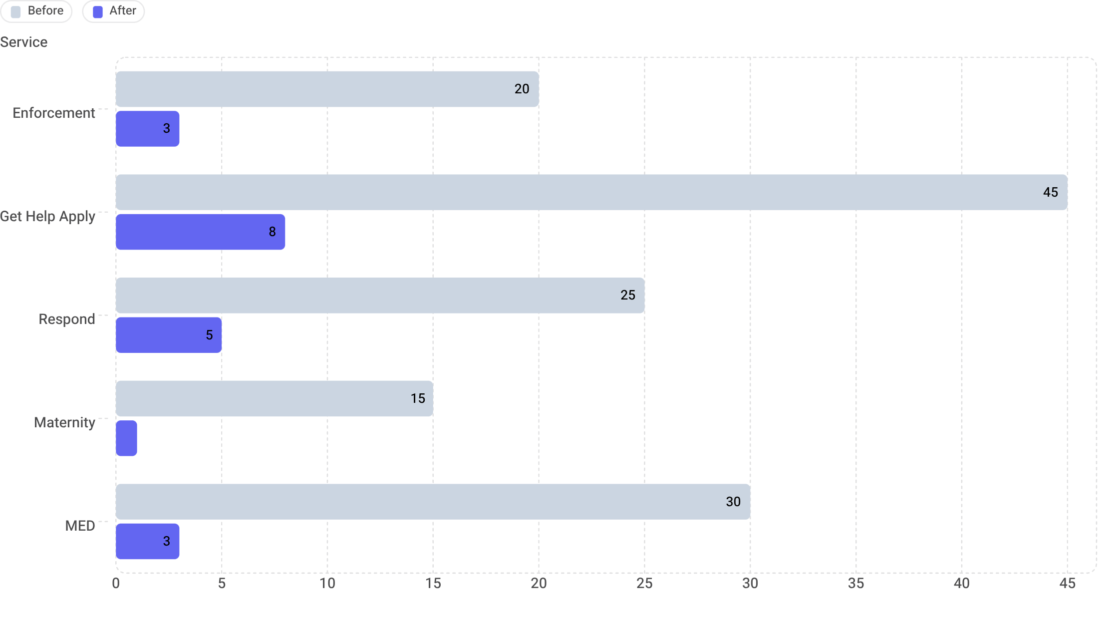



Test Execution Speed: Before vs. After Playwright
Dramatic reductions in test suite execution times across all critical services, powered by Playwright.
For MCMC, a 3-day execution time was reduced to just 1 hour.
Flaky Tests Eliminated
Accelerated Feedback
Enhanced Quality
The move to Playwright resolved all previously intermittent test failures, improving reliability.
Developers receive validation on their changes significantly faster, enabling quicker iterations.
More frequent and stable test runs lead to higher confidence in deployments and fewer production defects.

Slide 13

GitLab CI/CD: Automated Quality Gates via Story Tags
Seamlessly linking feature development to comprehensive quality validation.
Our GitLab CI/CD pipeline automatically triggers full quality gate execution based on commit tags. This ensures that every new feature or bug fix undergoes targeted and rigorous testing, from functional regression to security and performance, only when a relevant story is pushed.
stages:
- build
- test
- deploy
build_app:
stage: build
script:
- echo "Building the application..."
# ... application build steps ...
trigger_test_pipeline:
stage: test
trigger:
include: path/to/test-pipeline.gitlab-ci.yml
strategy: depend
rules:
- if: $CI_COMMIT_TAG =~ /^story-.*/ # Triggers if commit tag starts with 'story-'
variables:
STORY_TAG: $CI_COMMIT_TAG
The trigger_test_pipeline job, specifically configured within the test stage, uses a rules block to detect any commit tag starting with story-. When such a tag is identified, it automatically triggers a separate, dedicated test pipeline (defined in test-pipeline.gitlab-ci.yml), passing the STORY_TAG as a variable. This dynamic triggering mechanism is central to our "shift-left" strategy, ensuring that quality checks are integrated early and continuously without impeding the main build and deploy flow for all commits.
Commit: story-
Trigger Test Pipeline
Regression Tests
Security & Performance
This streamlined process ensures that every story-specific change is validated across all critical quality dimensions before further integration.

