Slide 1
Flight Finder
A GUI to inquire about real-time flight costs
Joshua Fishman

Slide 2
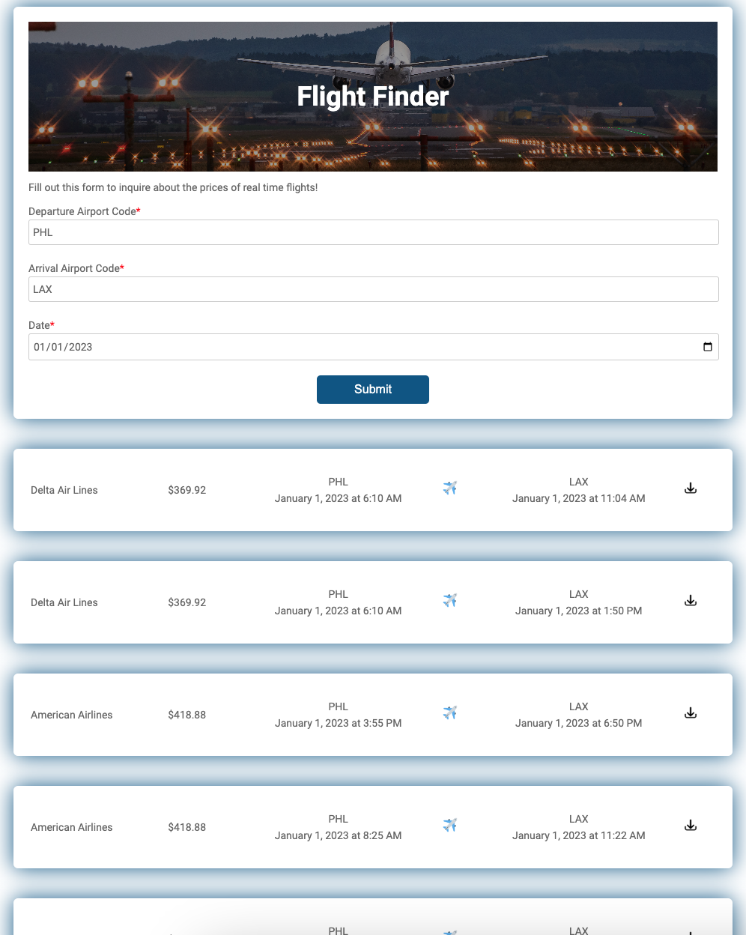
GUI Example
Inputs
Outputs

Slide 3
Tech Stack
Languages:
Server: Node.js
Client: HTML, CSS, and JavaScript (no framework used)
Frameworks and Libraries
No JavaScript frameworks were used for developing the client
Based on W3 Schools "Gym Membership Form" HTML and CSS template:
https://www.w3docs.com/learn-html/html-form-templates.html
The Node.js server utilizes Express to host a web server
Development tools
Nodemon – hot reloading the server on changes
Using dotenv library to remove secret credentials from source code
API:
Only one API used: RapidAPI Flight Fare Search

Slide 4
Architecture
Time
Request HTML/CSS/JS
Browser
Server
(uses Nodejs and Express)
External API / Mock API
Webpage Loaded
Request airports.json to validate input
"Submit" button pressed
Input Validated
Get-flights request
Repeat for each inquiry
API Request
Results Displayed

Slide 5
How to Run
Install node and npm if not already installed on your computer
this application is known to work with npm 8.1.2 and node v16.13.2, but other versions will likely work too
Run npm install to download all node modules
Run npm start to start the server
Go to the URL localhost:3000 to view the application

Slide 6
Extras
View this project in GitHub: https://github.com/AutomationMusician/flight-finder
Download the JSON file containing all available information about the flight by clicking on the download button:

