Slide 1

Git Basics

Slide 2
Agenda
Git basics
Git – Installation and Setup
Git - Creating and Managing REPO
Using Git with VS Code and Github

Slide 3
Installation and Setup
Download and Install Git from https://git-scm.com/downloads
Install the Posh-Git module from the PowerShell Gallery
Go to Code.VisualStudio.com and download and Install Visual Studio Code
Install PowerShell extension
Install Git extension if not already installed
Install VS code as a replacement for PowerShell ISE (Optional but recommended)
http://mikefrobbins.com/2017/08/24/how-to-install-visual-studio-code-and-configure-it-as-a-replacement-for-the-powershell-ise/

Slide 4
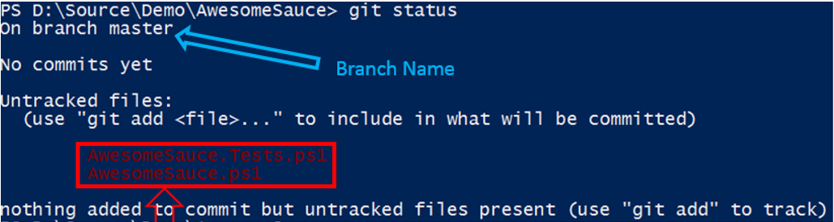
Crating and Managing REPO
git Init
Create an empty Git repository or reinitialize an existing one
After running the above command, a new .git folder will be created in the directory. You will need to run dir -attributes h to see this directory as it's hidden
If you have Posh-Git installed, your PowerShell prompt will reflect the current status of your GIT repository. If you do not have Posh-Git install, type the following command:
git clone
Copy remote repository into your local folder
git status
Both the Posh-Git prompt and Git Status will tell you similar information such as:
Current Branch
Number of files that have been modified, added, deleted

Slide 5
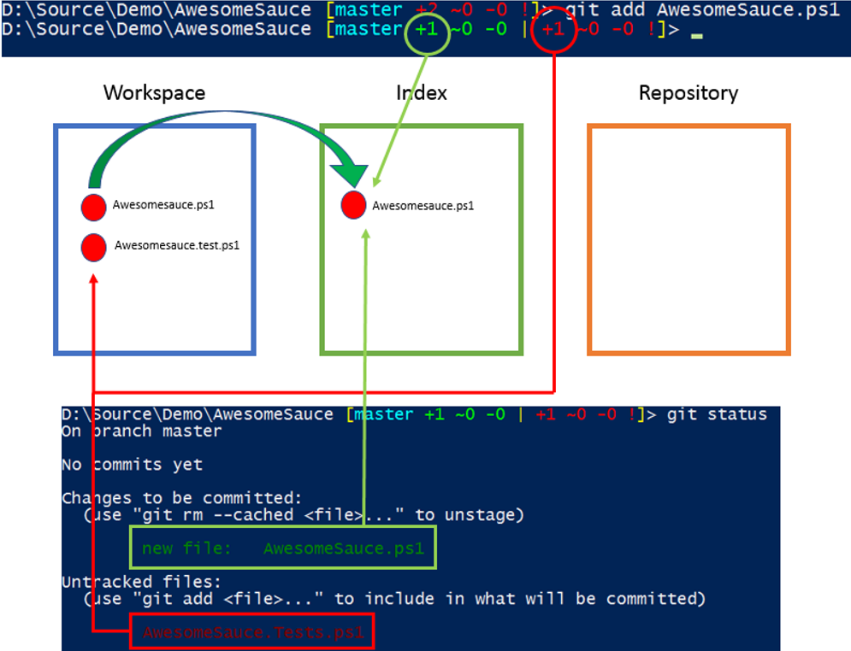
Crating and Managing REPO
Git Add <fileName>
Or for multiple files
Git Add .
Add file contents to the index
Notice that our Git prompt now shows a bit more information. The prompt now displays two distinct pieces of information separated by the pipe symbol ('|'). On the left we see a +1 in green text and on the right a +1 in red. The left side represents the awesomesauce.ps1 file we just staged, the red right side is that status of the awesomesauce.test.ps1 that still has not been staged.
Note: If you have an Issue with Posh-Git prompt not showing up + and - changes, then run Add-PoshGitToProfile

Slide 6
Crating and Managing REPO
Git config –-global
Before we proceed with the next step, we need to tell Git who we are. It will use this information in the next step to identify us as the individual who initiated the step. We do this by editing the Git Config file (supply your own info)
Lastly, we need to commit our staged work to the local repository. We will do this with the Git Commit command.
This command takes a single parameter (in this example) for the commit message. It's important to provide a short,
clear message summarizing the reason for the commit.
Git Commit -m 'commit message'

Slide 7

Crating and Managing REPO
git push -u origin -–all
Last thing we need to run is git push command to push the changes to the repo
git pull
Pulls Latest From Remote Repository
git clone
Will copy the remote repository into your folder

Slide 8
Thank You!

