Slide 1
WebdriverIO Test Automation Framework
Presented By:
Nikhil Jain

Slide 2
Contents
Introduction
WebdriverIO Overview & Key Features
WebdriverIO Frameworks
Core Concepts
Node.js & Packages
Sync Mode Vs Async Mode
Page Object Model
Behavioural Data Driven
WebdriverIO Framework Setup
Installation & Configuration
WebdriverIO Setup
Cucumber Integration
Typescript

Slide 3
Contents Continued..
Develop Automated Scripts
Create Test Scripts
Hands On
Integration
Reports
Jenkins
Migration
Protractor To WebdriverIO

Slide 4
Introduction
WebdriverIO Overview
Key Features Of WebdriverIO
Frameworks Supported By WebdriverIO

Slide 5
WebdriverIO Overview
WebdriverIO is a progressive automation framework built to automate modern web and mobile applications
WebdriverIO is one of the open source projects that is run by an open governance and owned by a non-profit entity called OpenJS Foundation
WebdriverIO can be run on the WebDriver Protocol for true cross-browser testing as well as Chrome DevTools Protocol for Chromium based automation using Puppeteer
4. WebdriverIO can be used to automate:
🌐 modern web applications written in React, Vue, Angular, Svelte or other frontend frameworks
📱 hybrid or native mobile applications running in an emulator/simulator or on a real device
💻 native desktop applications (e.g. written with Electron.js)

Slide 6
Key Features WebdriverIO
Run automation tests both for web applications as well as native mobile apps
Simple and Easy Syntax
Integrating tests to third-party tools such as Appium.
‘Wdio setup wizard’ to make the setup simple and easy.
Integrated test runner
Frameworks Supported By WebdriverIO
Mocha
Jasmine
Cucumber

Slide 7
Core Concepts
Node.js
Node.js Packages
Sync Mode Vs Async Mode
Page Object Model
Behavioural Data Driven

Slide 8
Node.js & Packages
Node.js is an open source, cross-platform runtime environment for developing server-side and networking applications.
Node.js applications are written in JavaScript, and can be run within the Node.js runtime on OS X, Microsoft Windows, and Linux.
Node.js also provides a rich library of various JavaScript modules which simplifies the development of web applications using Node.js to a great extent.
npm is a package manager for the JavaScript programming language maintained by npm, Inc.
npm is the default package manager for the JavaScript runtime environment Node.js.
npm is an online database of public and paid-for private packages, called the npm registry

Slide 9
Sync Mode Vs Async Mode
WebdriverIO runs a set of asynchronous commands to interact with the browser or mobile device.
In JavaScript asynchronous operations are handled via async/await. This however can be a confusing concept for people unfamiliar with the language.
In addition to that it can make tests very verbose as almost every operation is asynchronous.
Every browser/element function call returns a Promise and needs to be awaited to get result
describe('suite async', () => {
it('test', async () => { // pay attention to `async` keyword
const el = await $('body') // note `await` keyword
await el.click()
await browser.pause(500)
console.log(browser.capabilities) // static properties should not be awaited
await $('body').click() // WON'T WORK! You can't chain functions like this.
})
})
Note : if await is missing here, you'll get `Unhandled promise rejection`

Slide 10
Sync Mode Vs Async Mode. Continued..
How to enable/disable sync mode#
To simplify its usage WebdriverIO provides the ability to run commands synchronous through node-fibers.
To enable sync mode you only need to add the @wdio/sync package to your dev dependencies:
describe('suite async', () => {
it('test’, () => {
const el = $('body’)
el.click()
browser.pause(500)
console.log(browser.capabilities)
$('body').click()
})
})

Slide 11
Page Object Model
Page Object Model (POM) is a design pattern, popularly used in test automation that creates Object Repository for web UI elements.
The advantage of the model is that it reduces code duplication and improves test maintenance.
Under this model, for each web page in the application, there should be a corresponding Page Class.
This Page class will identify the WebElements of that web page and also contains Page methods which perform operations on those WebElements.
Name of these methods should be given as per the task they are performing, i.e., if a loader is waiting for the payment gateway to appear, POM method name can be waitForPaymentScreenDisplay().

Slide 12
BDD (Behaviour Driven Development)
BDD is a way for software teams to work that closes the gap between business people and technical people
Scenarios are written in plain English language which can be written by any non technical person as well
Encouraging collaboration across roles to build shared understanding of the problem to be solved
Working in rapid, small iterations to increase feedback and the flow of value
Producing system documentation that is automatically checked against the system’s behaviour

Slide 13
WebdriverIO Setup
Installation
IDE configuration
TypeScript
Browser Configuration
Cucumber Integration
Features
Step Definitions

Slide 14
Installation & Configuration
1. Download and install Node.js from https://nodejs.org/en/download/
2. Download and install VSCode (Visual Studio Code) from https://code.visualstudio.com/.
3. VS Code Extensions:
Launch VSCode IDE.
Go to Extension tab
Install Cucumber (Gherkin) Full Support extension (To enable syntax auto-completion in feature file and step definition, formatting, code snippets, syntax highlight, and easy maintenance of cucumber files)
Install JavaScript and TypeScript Nightly extension (For TypeScript support)

Slide 15
WebdriverIO Setup
Create new project folder with the name: WebDriverIO_Cucumber_Project at any desired location in the machine (Ex. C:\MyProjects).
Open the project folder in IDE.
Open a new terminal and execute the command “npm init –y” to create a basic structure of the package.json file. (Note : -y option is to affirm the options automatically)
Observe the package.json created inside the project folder
Execute the command:
npm i --save-dev @wdio/cli to install WebDriverIO command-line client.
Observe the node_modules folder created inside the project folder. This folder contains all the necessary libraries.

Slide 16
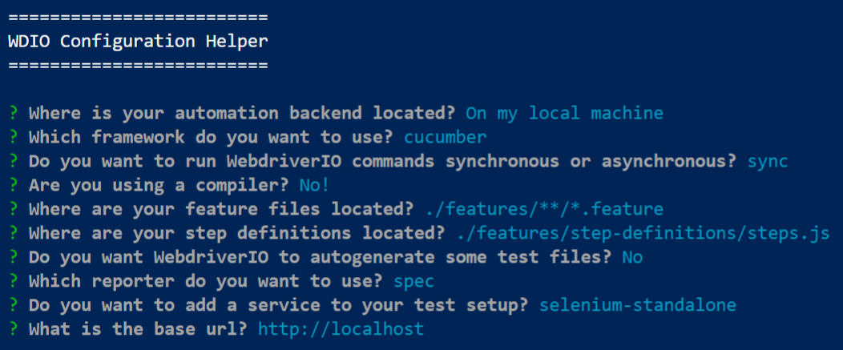
WebdriverIO Setup Continued
Execute the command npx wdio config to create and customize the wdio.conf.js file in the project and answer the prompted questions as stated below:
Observe the package.json inside the project folder:
Observe the wdio.conf.js created inside the project folder. Cucumber options can be modified by changing the settings in the 'CucumberOpts.'

Slide 17
Cucumber Integration – Feature Files
In the project folder, create a new folder with the name: features.
Inside the features folder, create a new file with the name: login.feature.
Below is the code for the sample feature file:
Feature: To test the login functionality in "The Internet Herokuapp"
Background:
Given the user is on login page
Scenario: The one where user logs in using valid credentials
When the user enters username as "tomsmith" and password as "SuperSecretPassword!"
And clicks on login button
Then the user must navigate to secure area page displaying a message "You logged into a secure area!"
The above code in the feature file represents the valid login scenarios with validation of success and error messages.

Slide 18
Cucumber Integration – Step Definitions
Execute the command './node_modules/.bin/cucumber-js.cmd' to run the cucumber feature file scenarios and generate the step definition methods
Inside the features folder create a new folder with the name: step-definitions.
Inside the step-definitions folder, create a new file with the name: steps.js.
Add the below line of code in the steps.js file:
const { Given, When, Then } = require('@cucumber/cucumber’);
Copy the generated step definition methods and paste them into the steps.js file. Make sure not to copy the duplicate step definition methods
Rename the variables appropriately to make the code more understandable

Slide 19
Step Definitions – Continued..
7. Below is the code for the step definition file:
const { Given, When, Then } = require('@cucumber/cucumber');
Given('the user is on login page', function () {
});
When('the user enters username as {string} and password as {string}', function (username, password) {
});
When('clicks on login button', function () {
});
Then('the user must navigate to secure area page displaying a message {string}', function (successMessage) {
);
Then('the user must remain on login page displaying a message {string}', function (errorMessage) {
});
The above code in the step definition file represents the methods generated for each scenario step in the feature file. Cucumber Expressions are used to handle similar steps smartly.

Slide 20
Cucumber Integration – Page Objects
Inside the features folder create a new folder with the name: pages.
Inside the pages folder, create three new files with names: base.page.js, login.page.js, secure.page.js.
Below is the code for the BasePage class:
Create and export a module with class "BasePage". This class contains a function.
This class behaves as a Parent class, which contains the common functionalities, that can be inherited by child classes.
This module can be imported and called from the child classes.
module.exports = class BasePage {
open (path) {
browser.url(path);
}
}

Slide 21
Page Objects – Continued..
4. Below is the code for the LoginPage class:
Create and export a module with class "LoginPage".
This class behaves as a Child class, which contains the selectors of Login page UI elements required for the test automation scenarios.
This module can be imported and called from Step Definitions to access the UI elements.
const BasePage = require('./base.page')
class LoginPage extends BasePage {
get userNameTextBox () { return $('#username') }
get passwordTextBox () { return $('#password') }
get loginButton () { return $('button[type="submit"]') }
get loginPageElement () { return $('div[class="example"] h2') }
get messageElement () { return $('#flash') }
open() {
super.open('https://the-internet.herokuapp.com/login')
}
}
module.exports = new LoginPage();

Slide 22
Page Objects – Continued..
5. Below is the code for the SecurePage class:
Create and export a module with class "SecurePage".
This class behaves as a Child class, which contains the selectors of Secure page UI elements required for the test automation scenarios.
This module can be imported and called from Step Definitions to access the UI elements.
const BasePage = require('./base.page')
class SecurePage extends BasePage {
get secureAreaElement () { return $('div[class="example"] h2') }
get messageElement () { return $('#flash') }
}
module.exports = new SecurePage();

Slide 23
Step Definitions
Import classes from newly created page object files. Import the required keywords from Cucumber. Use Page Object classes and methods to interact with the UI elements. Use WebDriverIO commands to perform action the UI elements. Use expect() to perform the necessary validations.
const { Given, When, Then } = require('@cucumber/cucumber');
const LoginPage = require('../pages/login.page');
const SecurePage = require('../pages/secure.page');
Given('the user is on login page', function () {
LoginPage.open();
expect(browser).toHaveTitle('The Internet');
});
When('the user enters username as {string} and password as {string}', function (username, password) {
LoginPage.userNameTextBox.setValue(username);
LoginPage.passwordTextBox.setValue(password);
});

Slide 24
Step Definitions. Continued..
When('clicks on login button', function () {
LoginPage.loginButton.click();
});
Then('the user must navigate to secure area page displaying a message {string}', function (successMessage) {
expect(SecurePage.secureAreaElement).toExist();
expect(SecurePage.secureAreaElement).toHaveTextContaining('Secure Area');
expect(SecurePage.messageElement).toExist();
expect(SecurePage.messageElement).toHaveTextContaining(successMessage);
});
Then('the user must remain on login page displaying a message {string}', function (errorMessage) {
expect(LoginPage.loginPageElement).toExist();
expect(LoginPage.loginPageElement).toHaveTextContaining('Login Page');
expect(LoginPage.messageElement).toExist();
expect(LoginPage.messageElement).toHaveTextContaining(errorMessage);
);

Slide 25
Browser Configuration
Open the wdio.conf.js file and search for 'capabilities.'
By default, notice the Chrome browser is configured in the capabilities, allowing the test to run only on the Chrome browser.
Update the capabilities in the wdio.conf.js file as below:
capabilities: [{
maxInstances: 5,
browserName: 'chrome',
acceptInsecureCerts: true
},
{
maxInstances: 5,
browserName: ‘chrome',
acceptInsecureCerts: true
}],

Slide 26
Failure Screenshot
In the project folder, create a new folder with the name: reports.
Inside the reports folder create a new folder with the name: screenshots.
Open the wdio.conf.js file and search for 'afterStep: function' under the Hooks section.
afterStep: function (step, context, { error, result, duration, passed, retries }) {
if(error) {
browser.saveScreenshot('./reports/screenshots/Fail.png')
}},
The above code in the afterStep function will take a screenshot after every cucumber step, in event of step failure.
4. Add the below line of code in the wdio.conf.js file as a first-line to import the 'moment' library if the file name needs to be appended by timestamp
const moment= require('moment');

Slide 27
Integrations
Reports
Jenkins

Slide 28
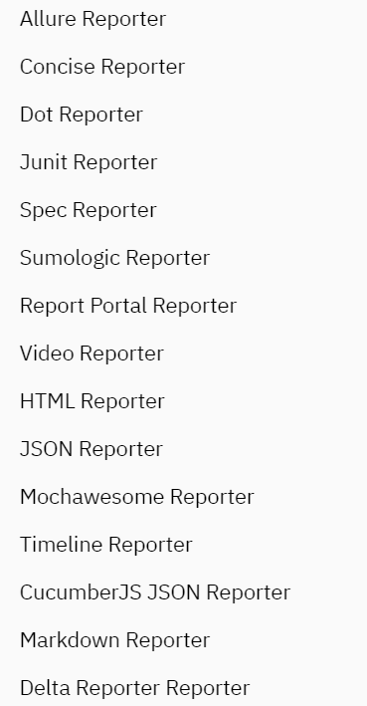
Reporting

Slide 29
Reporting Continued..
Execute the command: npm install @wdio/allure-reporter --save-dev to install the allure-reporter.
Execute the command: npm install -g allure-commandline --save-dev to install Allure Commandline, which is used to generate allure reports from the test results.
Open the wdio.conf.js file and search for 'reporters.’
Update the reporters to 'allure' and specify the output directory for storing the allure results.
reporters: [['allure', {
outputDir: './reports/allure-results'
}]],
The above code will use an allure reporter to generate and save the allure results in the specified path.

Slide 30
Jenkins
WebdriverIO supports integration with Jenkins. Depending on the framework being used, install a Jenkins plugin. E.g. Install cucumber plugin if cucumber framework is being used. Here, Junit is being used for demo purpose npm install @wdio/junit-reporter --save-dev
Update your config to save your XUnit results where Jenkins can find them, (and specify the junit reporter):
// wdio.conf.js
module.exports = {
reporters: ['dot',['junit', {
outputDir: './'
}]
],}
Add a post-build action called "Publish JUnit test result report“ to track your Junit report

Slide 31
Execute Your First Program
Execute the command: npx wdio run ./wdio.conf.js to run the project.
Observe the test automation in real-time across Chrome or Firefox browsers and view the test results in the terminal window.
Observe the 'allure-results' folder created inside reports. This folder contains all the files associated with the test results.
Observe the 'screenshots' folder with the page screenshots for the failure scenario steps.
To generate the allure report, execute the command: allure generate reports/allure-results/.
Observe the 'allure-report' folder created inside the project. This folder contains the allure report and associated files.
Execute the command: allure open to view the allure report in a browser.

Slide 32
Migration
Protractor Framework Setup
Protractor to WebdriverIO

Slide 33
Protractor Framework Setup
Download the sample Protractor project from below link if required
https://github.com/AutomationTestFramework/Protractor
2. Execute npm install to install all the packages from package.json
3. Execute below commands
webdriver-manager update
OR
node node_modules/protractor/bin/webdriver-manager update
4. Execute npm test to execute all the test cases from the project just downloaded
At this point, sample Protractor framework is set up on your machine to migrate to WebdriverIO framework.

Slide 34
Protractor To WebdriverIO
Angular team has announced that Protractor will not longer be supported. Protractor will continued to be maintained until Angular version 15 (end of 2022). Blow is the process to migrate existing Protractor framework to WebdriverIO however this might need some customization as everyone has a different setup and uses Protractor in different ways
The Protractor and WebdriverIO API is actually very similar, to a point where the majority of commands can be rewritten in an automated way through a codemod.
To install the codemod, run:
npm install jscodeshift @wdio/codemod
3. First migrate only conf.js file by executing below command
npx jscodeshift -t ./node_modules/@wdio/codemod/protractor ./conf.ts
4. Next step is to configure a minimal WebdriverIO setup that we start building up as we migrate from one framework to another. Install the WebdriverIO CLI via:
npm install --save-dev @wdio/cli

Slide 35
Protractor To WebdriverIO. Continued..
Run the configuration wizard as done while setting up WebdriverIO framework npx wdio config
After we have a transformed conf.ts and a new wdio.conf.ts, it is now time to migrate the configuration from one config to another. Make sure to only port code that is essential for all tests to be able to run. In ours we port the hook function and framework timeout.
Migrate the test files
npx jscodeshift -t ./node_modules/@wdio/codemod/protractor ./test/specs/first-test.spec.ts
For some Protractor commands there is just no replacement for it in WebdriverIO. In this case the codemod will give you some advice how to refactor it.

Slide 36
Thank You

