Slide 1
Hardware
Arduino
Steering and throttle
RaspberryPi4
Speed
throttle
steering
Control loop
Speed
Image
ESC Motor
Speed
Sensor
USB Camera
ServoMotor

Slide 2
Control loop
Camera
Memory
Steering / throttle
DeepLearning Model
Image
Image
Steering / throttle
Actuators
Serial port

Slide 3
Control loop
Camera
Memory
Steering / throttle
DeepLearning Model
Image
Image / speed
Steering / throttle
Speed / telemetry
Simulator
Actuators
Serial port

Slide 4
Logging + Telemetry
Object avoidance Model
Camera
Memory
Steering / throttle
DeepLearning Model
Image
Image / speed
Steering / throttle
Speed / telemetry
Emergency braking
Actuators
Serial port
Speed + telemetry
Speed sensor + IMU

Slide 5
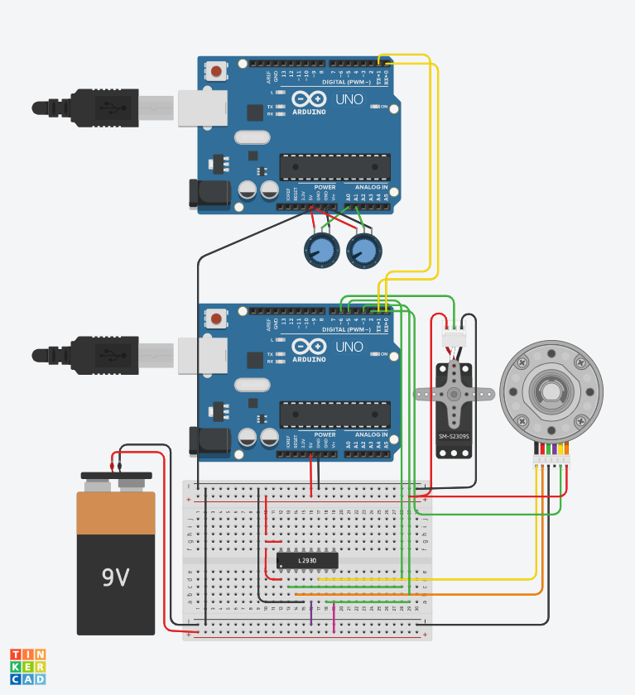
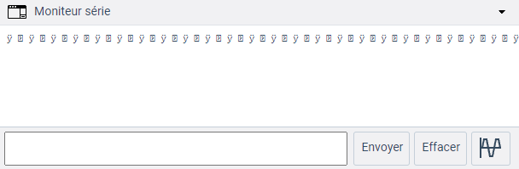
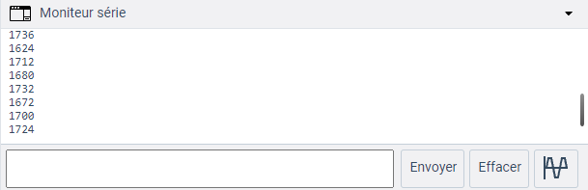
TinkerCad
simulation of the low level Arduino code
Arduino(1)
Arduino to send steering and throttle
(simulating raspberryPi)
Serial communication
Serial Output of Arduino(1) (steering /throttle output)
Arduino(2)
Arduino to receive steering and throttle
and send back speed
Serial Output of Arduino(2) (speed sensor signal)

Slide 6




Flatten

Slide 7




Slide 8











Slide 9
















Database

Slide 10
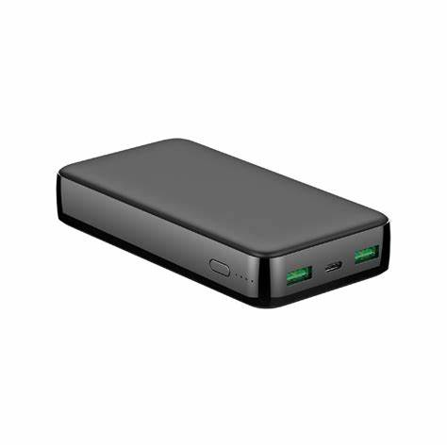
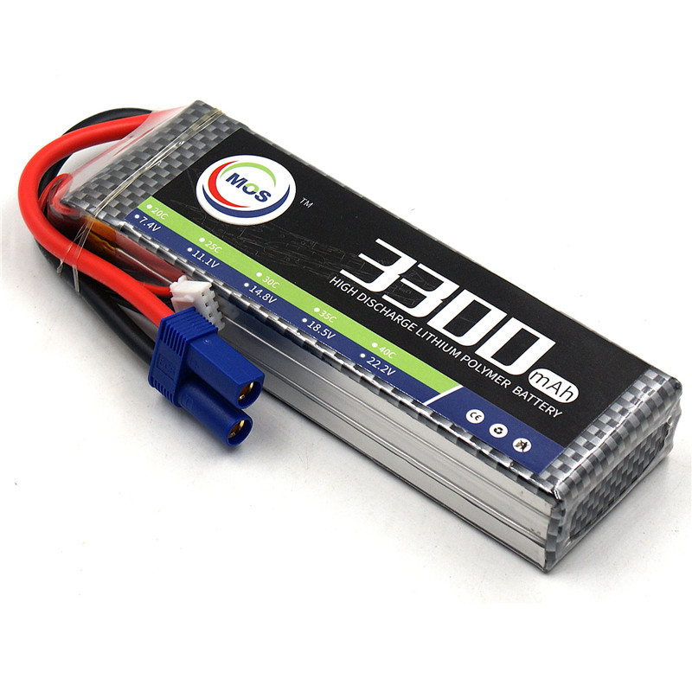
Camera
Motor
Main board
Servo Motor
Arduino or similar
ESC
5V
7.4V
5-6V
Gnd

Slide 11
HIGH
Falling edge
Rising edge
LOW
LOW

